Slide 1

Focus on
innovation.
We take care of the rest.
proto, our AI engineer, plans every step.
baker makes the board. mixer tests it.
protopus-kappa.vercel.app

Slide 2
01 · PROBLEM
A prototype is a loop,
and every lap costs weeks
design
2
weeks waiting for a board to come back from a fab
order
bug found
5
AND AGAIN
instruments to buy before you can measure it
×3, ×4, ×5
wait 2 weeks
5
test
vendor apps and driver stacks to keep alive
solder by hand
Nobody is short of ideas. They are short of tries.

Slide 3
02 · WHY NOW
AI already builds software.
In hardware, it stops at the file.
SOFTWARE
HARDWARE FILES
THE BENCH
$100M ARR
~$100M
0
Lovable, 8 months after launch, selling to people who can't code.
raised by AI that draws boards: Flux, Quilter, Diode. Claude now drives Fusion and Blender.
AI tools that can make the board, power it and see if it works.
idea
files
board
test
verdict
Smart machines give the AI access to the real world.
AI today
protopus: the AI's hands and eyes
TechCrunch 23 Jul 2025 · SiliconANGLE 27 Feb 2026 · BusinessWire 7 Oct 2025 · Fenwick · claude.com/connectors · digitalproduction.com 30 Apr 2026

Slide 4

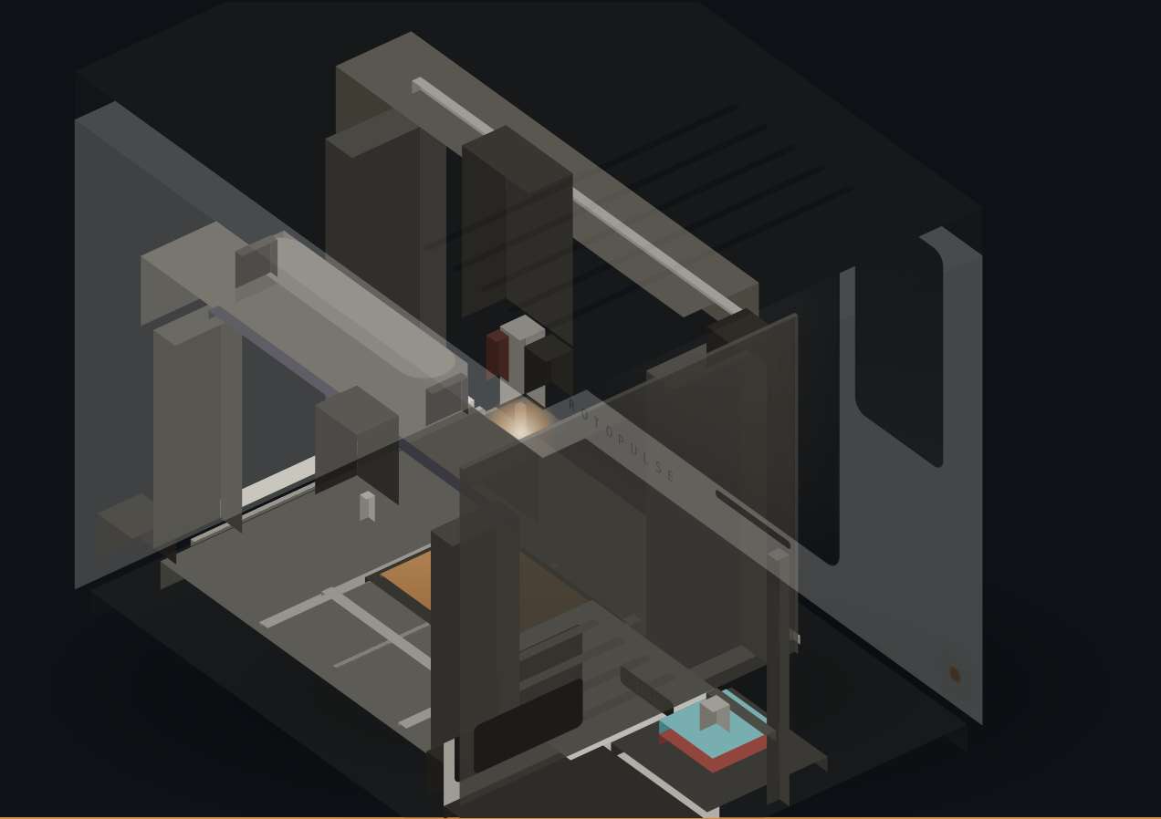
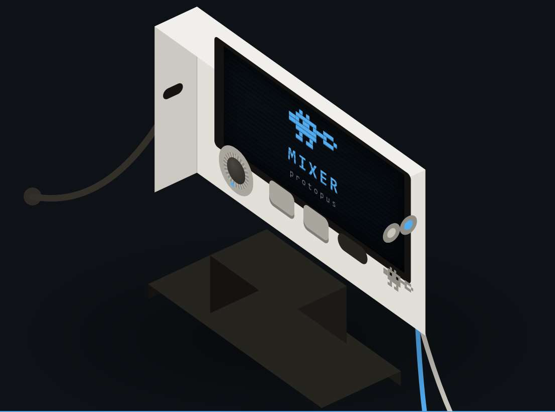
03 · SOLUTION
One AI engineer, and the two smart machines it runs
proto
baker
mixer
Plans the build, runs the machines, explains the results.
Makes the board: mill, mask, stencil, paste, reflow.
Tests it: eight instruments on one cable.
FOR PROTOTYPES · the first 1–10 boards of a design. Volume goes to a fab.
Website · protopus-kappa.vercel.app
Video · Baker prototype running
DEMO 1
DEMO 2

Slide 5
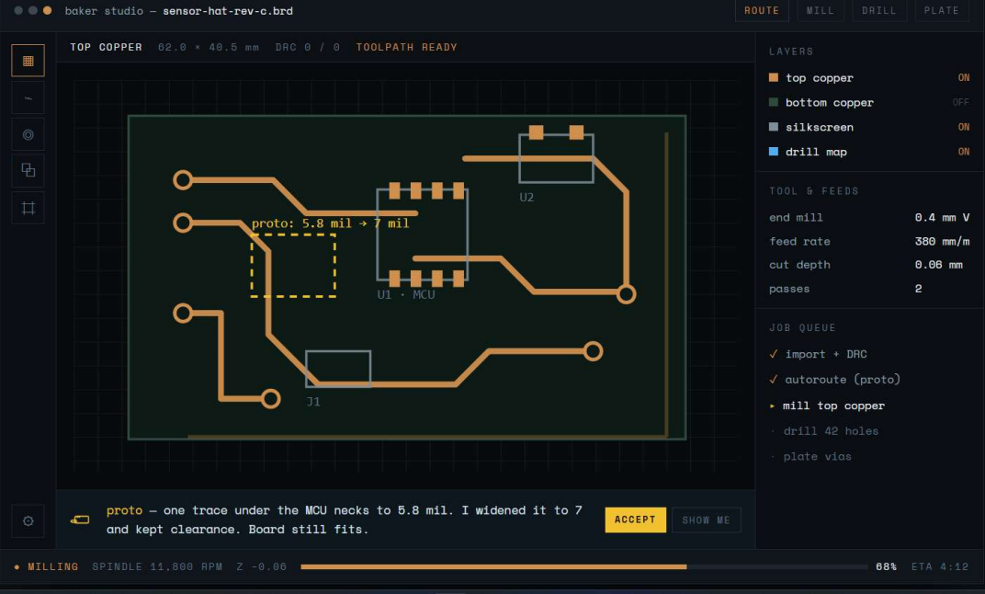
04 · PROTO · WHAT MAKES IT OURS
An AI engineer that understands your board
01
READS
schematics and layouts, via the Flux.ai API
02
MAKES
the Baker job: mill, drill, mask, stencil, jig
03
DIAGNOSES
through Mixer, in plain words
04
HAS A CHARACTER
a platypus engineer, built on Gemini
Baker Studio today: Proto found the thin trace, fixed it and planned the mill. You press Accept.
Probe matrix: probes under the board reach every net.
NEXT
Simple enough that a high-school student can print a board.

Slide 6
05 · PROTO · HOW THE AI WORKS
A loop, not a chatbot
UNDERSTAND
PLAN
CHECK
MAKE
design → board model
LLM breaks the goal into steps
DRC + Baker rules
toolpaths, mask, stencil, jig
next attempt
YOU GET
EXPLAIN
MEASURE
APPROVE
a tested board + a sentence
measured vs expected → fix
Mixer runs the test plan
you press Accept
MEMORY every run logs design → settings → measurements → outcome. No files-only AI has this data: it's the moat.
The model proposes · tested engines compute · you approve · the machine executes.

Slide 7
06 · PROTO · ONE RUN
From “import” to “PASS” in one sitting
baker studio — sensor-hat-rev-c.brd
10:02
you
import sensor-hat-rev-c from Flux
10:03
proto
one trace under the MCU necks to 5.8 mil. Widened to 7 mil. [Accept]
10:04
baker
mill · drill 42 holes · mask · stencil · jig prints in parallel
11:40
you
drop parts into the jig
11:52
baker
low-temperature reflow
12:05
mixer
power up ✓ 3V3 rail ✓ I²C sensor: no reply ✗
12:08
proto
“SDA has no pull-up: R4 is lifted on one pad. Reheat R4.”
12:15
mixer
retest: sensor replies ✓ PASS
Illustrative run on the Baker Studio board. Times are engineering targets; the proof of concept measures them.

Slide 8
07 · BAKER · UNDER THE HOOD
Fifteen steps on one shuttle, in one box
FR4
YOU · STEPS 13–14
drop parts into a printed jig
hotplate reflow, 138 °C
ZONE A
500 W spindle · touch probe
mill · drill
10 W laser cuts the stencil
ZONE B
liquid mask
10.1" LCD, 405 nm UV
wipe · dry · cure · paste
MIXER · STEP 15
one cable
eight instruments
Proto reads the result
⟷ SHUTTLE · one fixture, one coordinate frame, steps 01–12
stencil cut from the same Gerber, in the same frame: no alignment step
≈2 h
15–20 min
3–5
₹1.45L
per board
of it hands-on
boards per shift
production cost
Times are engineering targets. Prototype ₹3,73,418 → production ₹1,44,842 (China parts, Delhi build, 100 units).

Slide 9
08 · MIXER · UNDER THE HOOD
Eight instruments, one cable, one brain
scope · 2 ch · 12-bit
FPGA
capture, trigger,
waveforms, logic
HOW A TEST RUNS
wavegen · 2 ch · 14-bit
T1
connect
T2
power up, current watched
logic · 16 ch
PROTO
expected vs measured → verdict
T3
check the rails
pattern generator
T4
drive the inputs
protocol decoder
T5
capture outputs
T6
decode the buses
2 programmable supplies
T7
verdict in plain words
24-bit multimeter
T8
fix → next board same evening
₹13,740
8 in 1
Our tester
production cost
scope to 24-bit meter, AD3 class
on the China line too
Prototype ₹74,847 keeps 12/14-bit converters; production drops to 8-bit, one USB cable, no screen. Status: designed, first build in the proof of concept.

Slide 10
09 · COMPETITION
Others solve one step.
Nobody closes the whole loop.
PRODUCT
PRICE · ₹
MAKE
ASSEMBLE
TEST
GUIDE
Voltera V-One
~3.1 lakh
LPKF ProtoMat
8.6–24.5 lakh
Makera Carvera
~5.1 lakh
Bantam Tools · discontinued
~3.1 lakh
Digilent Analog Discovery 3
~33,000
JLCPCB, PCBWay
per order, weeks
Flux (AI design)
1.3–4.3k / month
protopus
3.34 lakh
List prices at ₹88 per US$, before import duty · voltera.io · Design World · Makera · ToolGuyd · Digilent · flux.ai

Slide 11
10 · ECONOMICS · PROJECTED
We earn on every machine.
The customer earns it back in months.
PER UNIT · ₹
BAKER
MIXER
FOR THE CUSTOMER
Total cost (all-in)
2,00,000
22,500
₹334
₹6,721
Selling price
2,99,000
34,999
per board on Baker
same board from JLCPCB, landed
Margin
~33%
~36%
53 boards
₹9,999 / year · one Proto plan per workspace
to pay back Baker + Mixer: about 6.6 months for a startup iterating twice a week
+ consumables, reordered as labs build
Projections at 100-unit batches; costed model Baker ₹1,44,842, Mixer ₹13,740. JLCPCB: PCB + PCBA + DHL + 10% BCD + 18% IGST. Waiting time not counted.

Slide 12
11 · MARKET PLAN / GROWTH STRATEGY
Start in the maker studios, then
follow the people who watch them
₹6.4L cr
₹3.1L cr
₹55K cr
₹8.3K cr
global PCB market
global test and measurement
India PCB, ~15% a year
India test and measurement
33M+
2.3M+
10,000
~2,500
active Arduino users
Hackster hardware community
Atal Tinkering Labs, +50,000 planned
Fab Labs in 125 countries
NOW
NEXT
ALONGSIDE
Maker studios
Hobbyists and startups
Prototyping labs
Free units for featured videos. The Bambu Lab playbook.
Everyone who watches and loses weeks per board.
Tinkering, Fab and college labs that already buy tools.
IMARC · Grand View · Arduino · Hackster · Atal Innovation Mission · Forbes · at ₹88 per US$

Slide 13
12 · WHERE WE ARE, AND WHAT THE MONEY PROVES
Told honestly, one milestone at a time
Baker
Software
Mixer
prototype running on the bench
Baker Studio + Proto; website live
designed, not yet built
M2
M3
M4
M5
M6
M7–9
Baker runs all 15 steps
process tests pass
Mixer measures
Rev B + 5 Mixers
proof of concept: 20 boards
seed round
Samuel Beek, Founder & CEO of Schematik, is interested in funding us at proof of concept.
SIGNAL
Built in the university lab, tested with students and makers. A demo video every month.

Slide 14
13 · GRANT / FUNDING REQUIRED
₹16,00,000
nine months to a proof of concept, and time to raise.
₹4.48L
₹2.20L
₹4.50L
₹1.35L
₹1.50L
₹1.97L
Baker + Mixer builds
Rev B + 5 Mixers
one engineer, 9 months
Proto software + compute
testing, tooling, safety
IP, outreach, reserve
Enough to survive one failed iteration and raise from strength. Builds line by line from the cost report.

Slide 15
14 · WHAT'S NEXT
After proof of concept: raise,
build in China, run lean from Delhi
THE ROUND
THE CHINA PLAN
OPERATIONS
~₹1.5 Cr seed
Design in Delhi, build in Shenzhen
Delhi finalises, doesn't build
China pilots ₹70L · set-up + IP ₹25L · team of 5 ₹25L · Delhi centre ₹20L · buffer ₹10L
Mixer: turnkey from batch one. Baker: modules first; turnkey once ≤ $1,305 ex-works
Scan, test, activate Proto, ship. Mixer is our production tester: our rig, our data
MONTH 0–2
MONTH 3–5
MONTH 6–9
MONTH 10–12
design freeze, 12 RFQs
EVT + DVT pilots
PVT: 100 Mixers, 20 Bakers
first container
From the China assembly line master plan. Pilot batches are sellable (≈₹95L at list). Months counted from the round.

Slide 16

MANAGEMENT TEAM & CORE SKILLS
Who is building this
Soham
Founder
Third year ECE, Faculty of Technology, University of Delhi
Industrial design
Mechanical architecture
Thank you.
Embedded electronics
Machine software
Come and try the loop.
protopus-kappa.vercel.app
HIRING NEXT · a software engineer who also writes firmware.
soham9763015@ece.du.ac.in

