Slide 1


CIC-TBI · QUARTERLY PROGRESS REVIEW
Quarterly progress,
July to September.
Research → design → build → integration, and what comes next.
website · ​Baker · ​Mixer · ​Probe Matrix
Soham, Founder · Protopus
Notes:
0:00 – 0:20 · Cover
Good afternoon, sir. I am Soham, founder of Protopus. Thank you for your patience today. In the next ten minutes I will take you through what we did from July to September, month by month, and what we plan to do next.

Slide 2
01 · WHAT WE ARE BUILDING
Smart prototyping machines, guided by AI
TODAY fab order → 7–20 days + customs → hand soldering → a borrowed bench
PROTO
STEP 1 · NOW
STEP 2
CONCEPT
Proto
​Baker
​Mixer
​Probe Matrix
the AI engineer: plans the build, checks the design, explains results
makes a finished board on the desk: mill, mask, stencil, paste, reflow
tests the board: eight instruments on one cable
spring probes under the board, so Proto reaches every net
FOR PROTOTYPING the first 1–10 boards of a design. Volume stays with the fabs.
Notes:
0:20 – 1:20 · What we are building
First, a quick reminder of what Protopus is. Today, a first circuit board in India means a fab order, seven to twenty days of shipping and customs, hand soldering, and a borrowed test bench. AI has made software easy to build, but not hardware, because AI has no hands in the real world. We build those hands. Proto is our AI engineer: it plans the build. Baker, our first machine, makes a finished board on the desk. Mixer, the second, will test it. The Probe Matrix is a new accessory that lets Proto reach every point on the board. And we are clear about one thing: this is for prototyping, the first one to ten boards of a design. Volume stays with the fabs.

Slide 3
02 · THE QUARTER AT A GLANCE
Research → design → build → integration
MILESTONE | MONTH | STATUS
Market, user and competition research | Jul | DONE
Brand identity and website live | Jul | DONE
Samuel Beek (Schematik): funding offered after the proof of concept | Jul | DONE
Prototype design finalised | Aug | DONE
Build of the first Baker prototype | Aug– | IN PROGRESS
Software–hardware integration | Sep– | IN PROGRESS
Proof-of-concept funding from STMicroelectronics | Sep– | IN DISCUSSION
​Probe Matrix accessory | Sep | CONCEPT
Cost report, workflow, China plan, pitch | Sep | DONE
JULY
AUGUST
SEPTEMBER
research
website
S. Beek
design
build
integration
STMicro
Probe Matrix
Notes:
1:20 – 2:20 · The quarter at a glance
Here is the quarter on one page. In July we finished our research, launched the website and had our first investor conversation. In August we finalised the prototype design and started building it. In September we worked on connecting the software to the hardware, opened funding talks for the proof of concept, and conceived the Probe Matrix. The colours show where each item stands: green is done, yellow is in progress, blue is in discussion. I have only marked something done when it is actually done.

Slide 4
03 · JULY 2026
Research, brand and website, first investor
1.1
Problem study
DONE
a first board: fab order, 7–20 days, ~₹6,700 per assembled try landed in India
1.2
User study
DONE
eight rungs from idea to iteration; rungs 5–8 are physical, where we work
1.3
Competition study
DONE
mills, ink printers, pick-and-place, USB instruments, fabs, AI tools: each solves one step
1.4
Market study
DONE
5,868 AICTE colleges, ~2,250 hardware startups, 10,000 Atal Tinkering Labs
1.5
Product concept
DONE
Proto plans, Baker makes, Mixer tests; for the first 1–10 boards of a design
1.6
Brand and website
DONE
name, logo, mascot, design language; site live with Baker and Mixer pages
1.7
Meeting with Samuel Beek, Schematik
DONE
verbal commitment to fund Protopus after the proof of concept
Notes:
2:20 – 3:50 · July
July was research and our first step outside. We mapped how a first board is made today: one assembled try from JLCPCB, landed in India, costs about six thousand seven hundred rupees and takes up to twenty days. We studied where people get stuck, in eight rungs from idea to iteration, and saw that the first four are being solved by AI software, while the last four are physical. That is where we chose to work. We studied every competitor and their prices; each one solves only one step. We sized our first market in India: about fifty-nine hundred engineering colleges, the hardware startups, and ten thousand Atal Tinkering Labs. Then we defined the product, built the Protopus brand, and launched the website with pages for Baker and Mixer. At the end of July we met Samuel Beek, founder and CEO of Schematik. He gave us a verbal commitment to fund Protopus once the proof of concept is achieved.

Slide 5
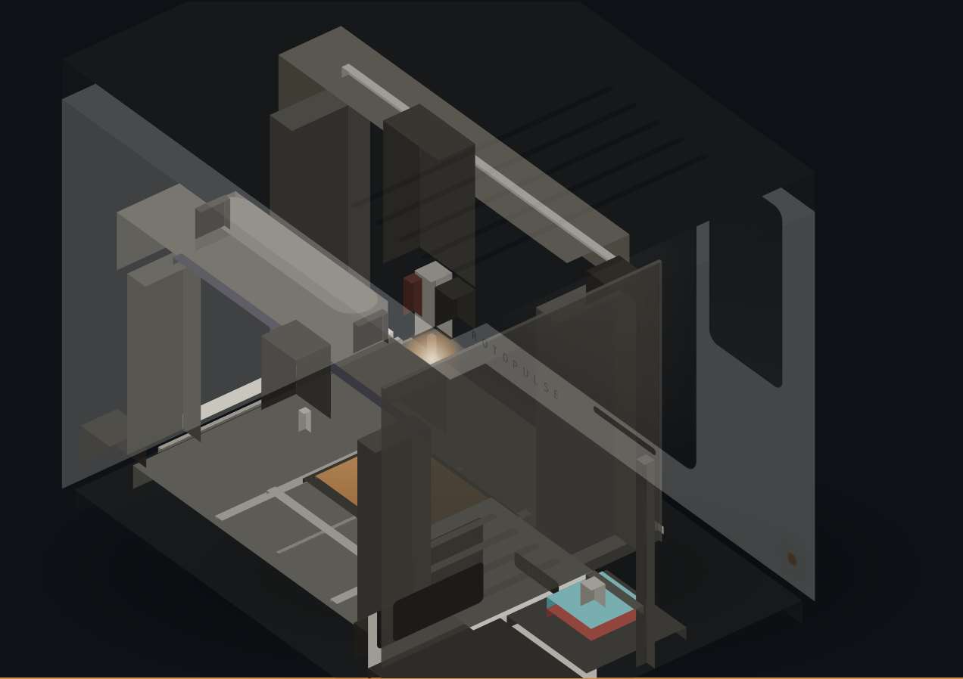
04 · AUGUST 2026
Prototype design finalised; build started
2.1
​Baker 15-step process
DONE
feed, probe, mill, drill, mask, stencil, paste, jig, reflow, test
2.2
Machine architecture
DONE
one shuttle, two zones, one coordinate frame; refill magazine
2.3
Subsystem specification
DONE
500 W spindle, 10 W laser, 405 nm LCD, 138 °C reflow; Pi 5 + Klipper
2.4
​Mixer architecture
DONE
eight instruments on one FPGA; for after the Baker proof of concept
​Baker, render of the design
2.5
Parts and bill of materials
DONE
every subsystem selected, so procurement could start
2.6
Build of the real prototype
IN PROGRESS
procurement and assembly of the first Baker
Notes:
3:50 – 5:20 · August
In August we turned the idea into an engineering design. We fixed Baker's fifteen-step process: feed and probe the board, mill and drill it, apply and cure the solder mask, cut the stencil and paste, place the parts using a printed jig, reflow, and hand it over for test. We chose one moving shuttle that carries the board through two zones in a single coordinate frame, with a refill magazine so a board does not need loading each time. We specified every subsystem: the spindle, the laser, the UV screen for the mask, the low-temperature reflow, and the control electronics running Klipper. We also defined Mixer's architecture for a later stage. Then we selected the parts, built the bill of materials, and in late August we started building the first Baker. The build is in progress.

Slide 6
05 · SEPTEMBER 2026 · PART 1
Software meets hardware; the business on paper
3.1
​Baker Studio and Proto
IN PROGRESS
₹3,73,418
reads designs (Flux.ai API), flags problems, plans the job
​Baker prototype build
3.2
Software–hardware integration
IN PROGRESS
​Baker Studio to the control electronics through Klipper
₹1,44,842
3.3
Costed BOM and cost report
DONE
​Baker production (projected)
70 lines, costed with duty and a 15% contingency
₹74,847
3.4
Workflow document
DONE
“the story of a PCB”: one board through all 15 steps
​Mixer prototype build
3.5
China manufacturing plan
DONE
₹13,740
turnkey in China; testing, minimal assembly and shipping from India
​Mixer production, projected
Notes:
5:20 – 6:50 · September: integration and the business
September had two halves. The first was software and documentation. We worked on Baker Studio, where Proto reads a design through the Flux AI interface, flags problems like a trace that is too thin, proposes the fix, and plans the machine job. We are connecting it to the machine through the Klipper firmware; that integration is in progress. We costed the full bill of materials, line by line. The first Baker prototype comes to about three lakh seventy-three thousand rupees, including duty and a fifteen percent contingency. At a hundred units, with parts from China, production is projected at about one lakh forty-five thousand. We also wrote the workflow document, which follows one board through all fifteen steps, and a manufacturing plan: turnkey production in China, with final testing, minimal assembly and shipping from India.

Slide 7
06 · SEPTEMBER 2026 · PART 2
Funding talks, a new accessory, a sharper plan
3.6 · IN DISCUSSION
3.7 · CONCEPT
3.8 · DONE
STMicroelectronics
​Probe Matrix
Pitch and round-1 review
We approached STMicroelectronics to fund the prototype and the proof of concept. Discussions are ongoing; nothing is committed yet.
Conceived after that meeting: spring probes under the board, so Proto can reach every net to test and program it. Concept page live.
Pitch prepared; round-1 questions answered in writing. The plan is now Baker first, with funding in milestone-based instalments.
Probe Matrix concept: probe-matrix.vercel.app
Notes:
6:50 – 7:50 · September: funding, Probe Matrix, plan
The second half was about the road ahead. We approached STMicroelectronics to fund the prototype and the proof of concept. Those discussions are ongoing; nothing is committed yet. After that meeting we conceived the Probe Matrix: spring probes under the board, so Proto can reach every point to test and program it without a person moving probes. The concept page is live. Finally, we prepared our pitch and received round-one review questions. As a result we are going Baker first, one product at a time, with funding released in milestone-based instalments.

Slide 8
07 · THE QUARTER IN NUMBERS
What the three months produced
15
70
2 + 1
​Baker process steps designed
line items in the costed bill of materials
machines designed, plus one accessory conceived
₹3,73,418
₹1,44,842
7
costed first Baker prototype
projected Baker production cost
deliverables: website, BOM, cost report, workflow, China plan, pitch, concept page
Notes:
7:50 – 8:30 · The quarter in numbers
In numbers: a fifteen-step process designed, a seventy-line costed bill of materials, two machines designed and one accessory conceived, a costed prototype of about three point seven three lakh, a projected production cost of about one point four five lakh, and seven deliverables completed, from the website to the concept page.

Slide 9
08 · NEXT QUARTER · OCT–DEC 2026
Finish Baker, prove it, fund it
PLANNED STEP | TARGET
Complete the first Baker prototype build | Oct–Nov
Run all 15 Baker steps end to end on one board | Nov–Dec
Proto: plain-English brief → Gerbers → Baker job | Nov–Dec
Close proof-of-concept funding | Oct–Dec
₹15 LAKH, NINE MONTHS, RELEASED IN INSTALMENTS · NO FOUNDER SALARY
₹6L
₹5L
₹4L
at signing
after milestone 1: Baker runs all 15 steps
after milestone 2: process tests pass; Proto makes a Baker job
Milestone 3, the proof of concept: 20 boards made with Proto + Baker.
Notes:
8:30 – 9:40 · Next quarter
For October to December, our focus is the Baker prototype. We will complete the build, run all fifteen steps end to end on one board, take Proto from a plain-English brief to a Baker job, and close the proof-of-concept funding. We are seeking fifteen lakh rupees for a nine-month proof of concept, released in three instalments: six lakh at signing, five lakh once Baker runs all fifteen steps, and four lakh once the process tests pass and Proto produces a Baker job. The proof of concept is twenty boards made with Proto and Baker. No founder salary is drawn.

Slide 10
Thank you, sir.
Questions and guidance welcome.
WEBSITE
https://protopus-kappa.vercel.app/
BAKER
https://protopus-kappa.vercel.app/#/baker
MIXER
https://protopus-kappa.vercel.app/#/mixer
PROBE MATRIX
https://probe-matrix.vercel.app/
Soham · Founder, Protopus · soham9763015@ece.du.ac.in
Notes:
9:40 – 10:00 · Thank you
That is our quarter, sir. The report has the full details, and the links are on the screen. Thank you. I would be glad to take your questions and your guidance for the next quarter.

