Slide 1

Focus on
innovation.
We take care of the rest.
Smart machines and accessories for prototyping, run by an AI engineer.
proto plans every step. baker makes the board. mixer will test it.
protopus-kappa.vercel.app

Slide 2
01 · PROBLEM
A prototype is a loop,
and every lap costs weeks
design
7–20
days for an assembled prototype from JLCPCB to reach India, per try
order
bug found
5
AND AGAIN
instruments to buy before you can measure it
×3, ×4, ×5
wait 1–3 weeks
5
test
vendor apps and driver stacks to keep alive
solder by hand
Nobody is short of ideas. They are short of tries.

Slide 3
02 · WHY NOW
AI already builds software.
In hardware, it stops at the file.
SOFTWARE
HARDWARE FILES
THE BENCH
$100M ARR
~$100M
none yet
Lovable, 8 months after launch, selling to people who can't code.
raised by AI that draws boards: Flux $49M, Quilter $40M, Diode $11.4M. Claude drives Fusion and Blender (Apr 2026).
an AI that can make the board, power it and tell you if it works.
idea
files
board
test
verdict
Smart machines give the AI access to the real world.
AI today
protopus: the AI's hands and eyes
TechCrunch 23 Jul 2025 (Lovable) · SiliconANGLE 27 Feb 2026 (Flux) · BusinessWire 7 Oct 2025 (Quilter) · Fenwick (Diode) · Anthropic, Claude for Creative Work, 28 Apr 2026

Slide 4
03 · THE EXPERTISE CURVE
Every rung of hardware knowledge
loses people. Proto removes rungs.
RUNG
YOU USED TO NEED
WHO CARRIES IT NOW
01
idea → spec
What exactly should it do?
Proto asks, then writes it
HOW PEOPLE LEARN
By doing: try, look, adjust (Kolb's cycle). The speed of feedback sets the speed of learning.
02
parts
Datasheets, stock, footprints
Proto picks in-stock parts
03
schematic
Circuit theory, references
Proto + Flux check it
04
layout
An EDA tool, DRC
Proto fixes it (Baker Studio)
7–20 days
05
fabrication
Vendors, customs, 7–20 days
Baker, in hours
per try today: beginners quit, experts batch changes
06
assembly
SMD soldering, stencil, reflow
Baker + printed jig
≈2 hours
07
bring-up
Scope, logic analyser, firmware
Mixer measures (step 2)
per try on Baker (target): many more attempts in one semester
08
debug
Root cause, next revision
Proto explains the fix
rungs 01–04: software can carry them · rungs 05–08: they need machines

Slide 5
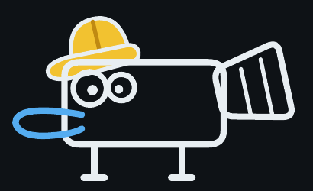
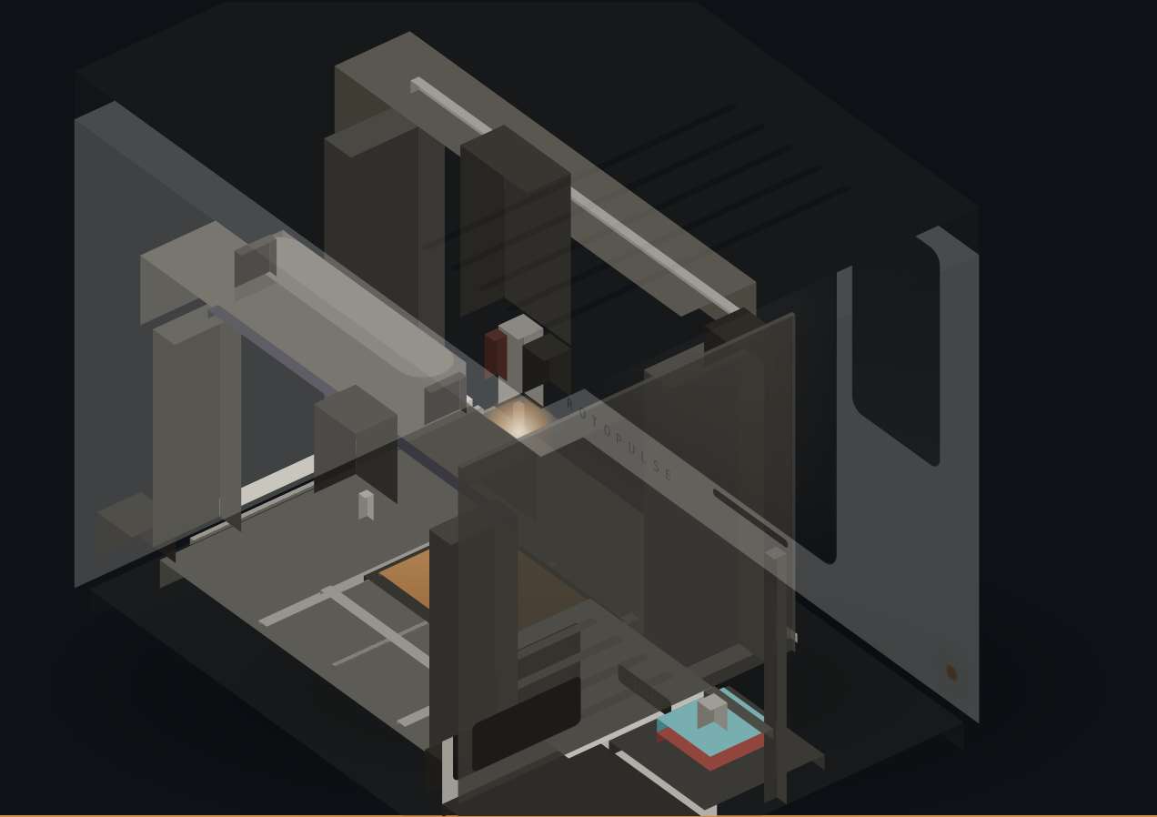
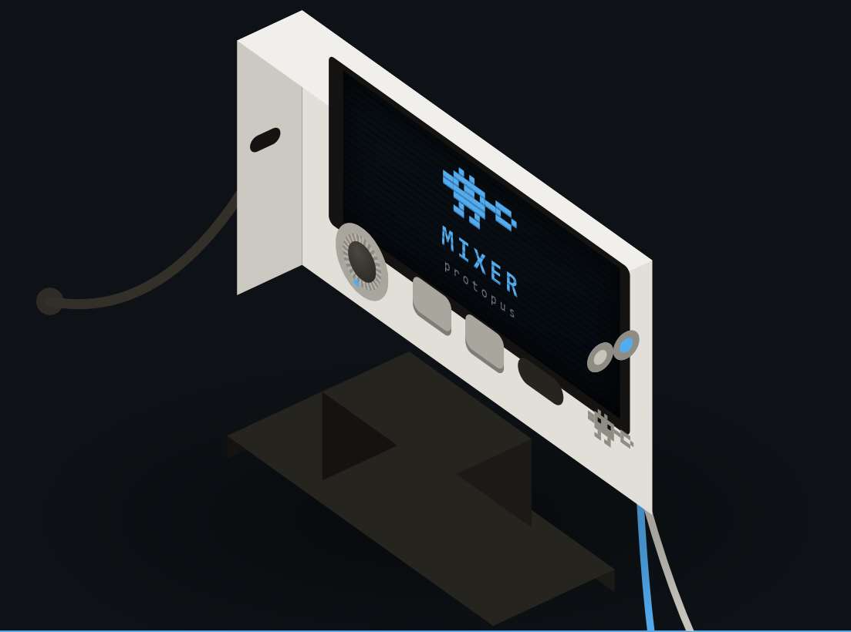
04 · SOLUTION
One AI engineer, and the smart machines it runs
STEP 1 · NOW
STEP 1 · NOW
STEP 2 · AFTER POC
proto
baker
mixer
Plans the build, drives the machines, explains the results.
Makes the board: mill, mask, stencil, paste, reflow.
Tests it: eight instruments on one cable.
STEP 3
Probe Matrix: probes under the board, so Proto can reach, test and program every net. Then any 3D printer for the enclosure.
FOR PROTOTYPES · the first 1–10 boards of a design. Volume goes to a fab. DEMOS · website · Baker prototype video

Slide 6
05 · BUILT FOR PROTOTYPING, NOT PRODUCTION
A 3D printer doesn't replace the mould.
Baker doesn't replace the fab.
THE PATH FROM IDEA TO 1,000s
BOARDS A YEAR → RIGHT TOOL
EXISTS
PROTOTYPE desktop 3D print: shape, feel, fit
VOLUME injection mould
10
baker
a plastic bottle
same-day loops beat fab minimums
100
baker
TODAY
one machine covers a busy lab
PROTOTYPE fab order + hand assembly + borrowed bench
VOLUME fab / EMS
a circuit board
1,000
baker + a fab
any batch of 10+ identical boards → fab
PROTOPUS
10,000
fab / EMS
PROTOTYPE Proto + Baker: finished board on the desk
VOLUME fab / EMS, with checked files
production; Proto exports checked files
a circuit board
1,00,000
fab / EMS
not what Baker is for
Plastic has had a desktop prototyping path for years. Electronics hasn't had one that ends in a finished, soldered board.
Not a desktop mill: a mill automates one step for experts (Bantam Tools stopped selling its PCB mill in 2025). Baker runs 15 steps, with Proto guiding.
Baker throughput target: 3–5 boards per 8-hour shift (750–1,250 a year), to be measured in the proof of concept · ToolGuyd, 11 Nov 2025.

Slide 7
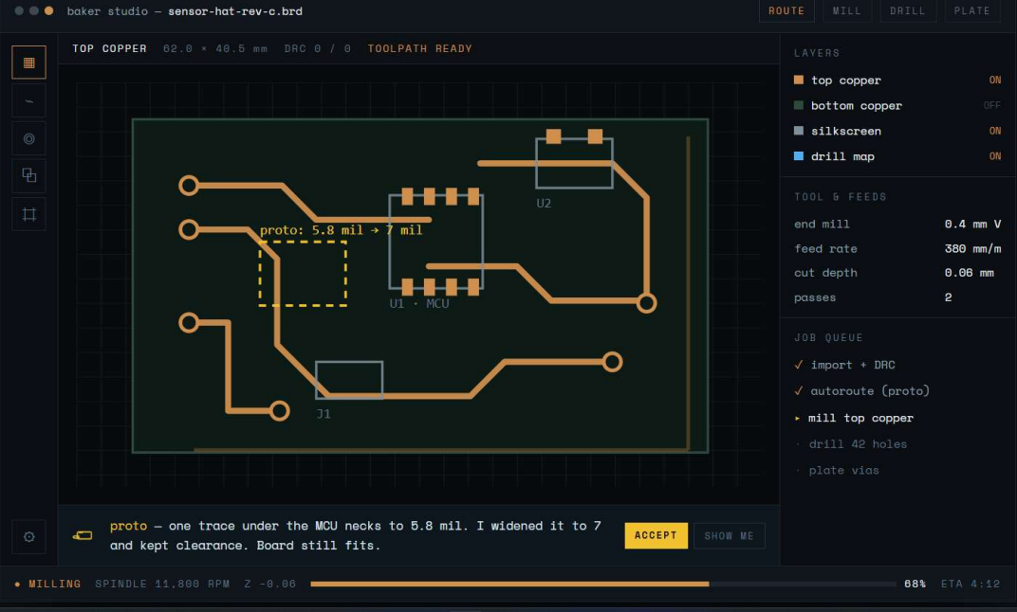
06 · PROTO · WHAT MAKES IT OURS
An AI engineer that understands your board
01
READS
schematics and layouts, via the Flux.ai API
02
MAKES
the Gerbers and the Baker job: mill, drill, mask, stencil, jig
03
DIAGNOSES
through Mixer (step 2): waveforms, in plain words
04
HAS A CHARACTER
a platypus engineer, built on Gemini
Baker Studio today: Proto found the thin trace, fixed it and planned the mill. You press Accept.
Probe Matrix: probes under the board reach every net.
NEXT
Designed so a first-timer can go from idea to board, with Proto at each step.

Slide 8
07 · PROTO · HOW THE AI WORKS
A loop, not a chatbot
UNDERSTAND
PLAN
CHECK
MAKE
brief or design → board model
a large model breaks the goal into steps
DRC + Baker process rules
Gerbers, toolpaths, mask, stencil, jig
next attempt
YOU GET
EXPLAIN
MEASURE
APPROVE
a board + a plain-English report
measured vs expected → fix
bench now; Mixer in step 2
you press Accept
MEMORY every run logs design → settings → measurements → outcome. File-only AI tools never see the real board, so they can't collect this data.
The model proposes · tested engines compute · you approve · the machine executes.

Slide 9
08 · PROTO · ONE RUN
From “import” to “PASS” in one sitting
baker studio — sensor-hat-rev-c.brd
10:02
you
import sensor-hat-rev-c from Flux
10:03
proto
one trace under the MCU necks to 5.8 mil. Widened to 7 mil. [Accept]
10:04
baker
mill · drill 42 holes · mask · stencil · jig prints in parallel
11:40
you
drop parts into the jig
11:52
baker
low-temperature reflow
12:05
mixer
power up ✓ 3V3 rail ✓ I²C sensor: no reply ✗
12:08
proto
“SDA has no pull-up: R4 is lifted on one pad. Reheat R4.”
12:15
mixer
retest: sensor replies ✓ PASS
Illustrative run of the full system (Mixer is step 2). Times are engineering targets; the proof of concept measures them.

Slide 10
09 · BAKER · UNDER THE HOOD
Fifteen steps on one shuttle, in one box
FR4
refill
YOU · STEPS 13–14 (MANUAL)
jig auto-generated from the Gerber
you drop parts into it
hotplate reflow, 138 °C
ZONE A
500 W spindle · touch probe
mill · drill
10 W laser cuts the stencil
ZONE B
liquid mask
10.1" LCD, 405 nm UV
wipe · dry · cure · paste
TEST · STEP 15
bench instruments in step 1
Mixer in step 2: one cable,
eight instruments
⟷ SHUTTLE · one fixture, one coordinate frame, steps 01–12 automated
refill magazine loads the next blank · stencil cut from the same Gerber, in the same frame
≈2 h
15–20 min
3–5
₹1.45L
per board (target)
of it hands-on (target)
boards per shift (target)
production cost (projected)
Prototype ₹3,73,418 → production ₹1,44,842 (China parts, Delhi build, 100 units) · protopus-kappa.vercel.app/#/baker

Slide 11
10 · BAKER · TECH STACK, PROTOTYPE → PRODUCTION
Same 15 steps, cheaper parts: ₹3,73,418 → ₹1,44,842
FUNCTION | PROTOTYPE (INDIA, 1 UNIT) | PRODUCTION (CHINA PARTS, 100) | WHY
Axes | Finished ball-screw linear stages | SFU1605 ball screws + HGR15 rails | ≈₹5,500 per axis vs ₹16,500
Z axes | 100 mm SFU1605 stage + NEMA17 ×2 | T8 screw + linear guide | Spindle/laser Z and dispense Z
Control | Raspberry Pi 5 + BTT Octopus Pro + DM556 | BTT Manta M8P V2 + CB1 (8 × TMC2209) | One board, 8 drivers, ≈₹10,800
Power | 24 V + 48 V + 12 V supplies | One LRS-350-24 rail (spindle keeps its own) | Fewer supplies, simpler wiring
Spindle + laser | 500 W ER11 kit · 10 W 445 nm diode (retail) | Volume-sourced; quotes at 100 units | Biggest cost-down lever
Mask + UV | Syringe LPSM · 10.1" 12K LCD · ChiTu L K1 · 405 nm | Same engine | The LCD also prints jigs in production
Placement jig | Separate Saturn 3 Ultra + wash/cure (TR300, 160 °C) | Resin vat + lift under Baker's own UV screen | Removes the printer (to test)
Reflow | 300 W silicone hotplate · SSR · MAX31855 · Sn42Bi58 (138 °C) | Same | Stays under the jig resin's 160 °C
Firmware | Klipper + Moonraker + Proto job runner | Locked factory image; activation stays with us | IP by architecture
Unit cost | ₹3,73,418 (incl. 35% duty/courier, 15% contingency) | ₹1,44,842 (incl. duty, freight, Delhi assembly) | Hardware target ₹1,50,000
Open points tested in the proof of concept: 0.5 mm-pitch mask clean-out · film registration ±50 µm · jig accuracy after resin shrink · laser offset drift · baker →

Slide 12
11 · MIXER · STEP 2 · TECH STACK
Eight instruments, one cable, one brain
scope · 2 ch · 12-bit 65 MS/s
FPGA
Tang Primer 20K
capture, trigger,
waveforms, logic
HOW A TEST RUNS
wavegen · 2 ch · 14-bit
T1
connect
T2
power up, current watched
logic · 16 ch
PROTO
expected vs measured → verdict
T3
check the rails
pattern generator
T4
drive the inputs
protocol decoder
T5
capture outputs
T6
decode the buses
2 programmable supplies
T7
verdict in plain words
24-bit multimeter
T8
fix → next board
AD9226 ×2 · AN9767 · AD8066 · ADS1256 + REF5025 · MCP4728 → XL6009 · INA226 · 74LVC245
₹13,740
8 in 1
Probe Matrix
production cost (projected)
Analog Discovery 3 class
next: full access to every net
Prototype ₹74,847 keeps 12/14-bit converters; production: Tang Nano 9K, AD9288 8-bit 80 MS/s, DAC908, FT232HL, one USB cable, no screen. Built in step 2, after the PoC.

Slide 13
12 · COMPETITION
Others solve one step.
We're building the whole loop.
PRODUCT
PRICE · ₹
MAKE
ASSEMBLE
TEST
GUIDE
Voltera V-One (ink printer)
~3.1 lakh
LPKF ProtoMat
8.6–24.5 lakh
Makera Carvera (desktop CNC)
~4.8 lakh
Bantam Tools PCB mill
discontinued 2025
Digilent Analog Discovery 3
~34,000
JLCPCB, PCBWay → India
per order, 7–20 days
Flux (AI design)
1.3–4.3k / month
protopus · proto + baker
2.99 lakh (+34,999 mixer)
List prices at ₹88 per US$, before import duty: Voltera $3,499.99 · Makera $5,499 · Digilent $389 · Flux $15–49/editor/month · LPKF via Design World · ToolGuyd · JLCPCB + zbotic.in. Protopus prices projected.

Slide 14
13 · ECONOMICS · PROJECTED
We earn on every machine.
The customer earns it back in months.
PER UNIT · ₹
BAKER
MIXER
FOR THE CUSTOMER
Total cost (all-in)
2,00,000
22,500
₹334
₹6,721
Selling price
2,99,000
34,999
consumables per board on Baker
same board from JLCPCB, landed in India
Margin after all costs
~33%
~36%
47 boards
₹9,999 / year · one Proto plan per workspace
to pay back Baker: about 5.9 months for a startup iterating twice a week (11.8 months at once a week). 53 boards once Mixer is added.
+ consumables, reordered as labs build · gross margin on build cost: Baker 51.6%
Projections at 100-unit batches; production cost Baker ₹1,44,842, Mixer ₹13,740. JLCPCB: 5 PCBs + PCBA ($8 setup, $1.50 stencil) + DHL + 10% BCD + 18% IGST. Waiting time not counted.

Slide 15
14 · MARKET PLAN / GROWTH STRATEGY
Start in the maker studios, then
follow the people who watch them
₹6.4L cr
₹3.1L cr
₹55K cr
₹8.3K cr
global PCB market
global test and measurement
India PCB, ~15% a year
India test and measurement
33M+
2.3M+
10,000
~2,500
active Arduino users
Hackster hardware community
Atal Tinkering Labs, +50,000 planned
Fab Labs in 125 countries
NOW
NEXT
ALONGSIDE
Maker studios
Hobbyists and startups
Prototyping labs
Baker units for featured videos. The Bambu Lab playbook.
Everyone who watches and loses weeks per board.
Tinkering, Fab and college labs that already buy tools.
IMARC · Grand View · Arduino · Hackster · Atal Innovation Mission · Forbes · at ₹88 per US$

Slide 16
15 · WHERE WE ARE, AND WHAT THE MONEY PROVES
Told honestly, one milestone at a time
Baker
Software
Mixer
prototype running on the bench
Baker Studio + Proto; website live
step 2: designed, built after the PoC
M2
M3
M4
M5
M6
M7–9
Baker runs all 15 steps
process tests pass
Proto: brief → Gerbers → Baker job
Baker Rev B
proof of concept: 20 boards
seed round
Samuel Beek, Founder & CEO of Schematik, is interested in funding us at proof of concept.
SIGNAL
Baker first, one product at a time. Built in the university lab, tested with students and makers. A demo video every month.

Slide 17
16 · GRANT / FUNDING REQUIRED
₹15,00,000
Baker first: nine months to a proof of concept, and time to raise.
₹3.73L
₹1.60L
₹4.50L
₹1.35L
₹1.50L
₹2.32L
Baker build, costed line by line
Rev B + test-board consumables
one software + firmware engineer, 9 months
Proto software + compute
testing, tooling, lab safety
IP, outreach, reserve
One product at a time: Mixer and Probe Matrix are step 2, funded after the proof of concept. No founder salary. Builds line by line from the cost report.

Slide 18
17 · WHAT'S NEXT
Step by step: prove Baker, then
add the instruments, then the ecosystem
STEP 1 · NOW · ₹15L
STEP 2 · SEED · ~₹1.5 CR
STEP 3 · ECOSYSTEM
Proto + Baker
Mixer + Probe Matrix
Proto runs it all
Proof of concept: 20 boards, measured cycle time, Proto from brief to Baker job.
Test and program every board. Baker pilots through China: 20 Bakers, 100 Mixers.
Any 3D printer joins for enclosures and jigs. India first, then global.
HOW WE RUN THE COMPANY
Software team
Hardware team
China, turnkey
India
improves Proto
machines + accessories
parts, assembly, factory test
test, minimal assembly, ship
Seed use (indicative): China pilots + first batches ₹70L · set-up + IP ₹25L · team of 5 ₹25L · Delhi centre ₹20L · buffer ₹10L. Pilot batches are sellable (≈₹95L at list).

Slide 19
18 · VISION
One plain-English brief in.
A tested prototype out.
Baker
makes the board
Mixer + Probe Matrix
tests and programs
EXAMPLE · A SMARTWATCH WITH 10 BUTTONS
01
you describe it in plain English
PROTO
backed by large models; plans in a project repository
02
Proto checks feasibility and limits
03
plans electronics, sensors, PCB; BOM with buy links
any 3D printer
enclosure + jigs
connectors
Flux · Fusion · parts APIs
04
Baker makes the board; the printer prints a case sized from the measured PCB
05
Mixer + Probe Matrix program and test; failing parts are flagged
We never sell a 3D printer: Proto drives the one you have.
The one-stop solution for prototyping: idea to innovation, without the friction.
06
you say what felt off; Proto plans the next revision

Slide 20
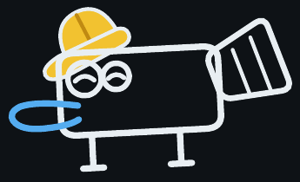
MANAGEMENT TEAM & CORE SKILLS
Who is building this
Soham
Founder
Third year ECE, Faculty of Technology, University of Delhi
Industrial design
Mechanical architecture
Thank you.
Embedded electronics
Machine software
Come and try the loop.
protopus-kappa.vercel.app
HIRING NEXT · a software engineer who also writes firmware.
soham9763015@ece.du.ac.in

