Slide 1
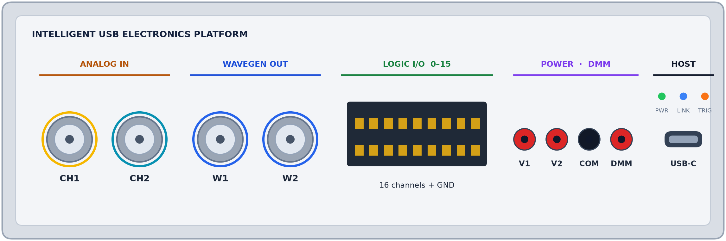
SKILL ENHANCEMENT COURSE (SEC) PROJECT
Design and Development of an Intelligent USB-Based Electronics Platform
Eight bench instruments on one USB cable, with Proto, an AI engineer that plans every test and explains every measurement.
ONE DEVICE, EIGHT INSTRUMENTS
Oscilloscope
Waveform generator
Logic analyser
Pattern generator
PROJECT TEAM
SUPERVISOR
Protocol decoder
Power supply 1
Avi Prakash Jaiswal
24294917
Prof. G.S. Chilana
Power supply 2
Multimeter
Soham Pandit Nalawade
24294917002
Harshit Saini
24294917086
+ Proto
an AI engineer that runs the tests and gives a verdict in plain words
Anshul
24294917037
Notes:
Speaker: Avi · about 0:45
Good morning. We are presenting our SEC project, Design and Development of an Intelligent USB-Based Electronics Platform, under the supervision of Prof. G.S. Chilana. I am Avi, with Harshit and Anshul; our team member Soham Pandit Nalawade could not be present today. In one line, our project is one small device that does the work of eight lab instruments, connects to a laptop with one USB cable, and has an AI engineer, called Proto, that runs tests and explains the results in plain language.

Slide 2
MOTIVATION AND OBJECTIVES
Why one intelligent platform instead of a bench of instruments
THE PROBLEM
OBJECTIVES
Costly and bulky
1
Integrate eight instruments into one compact, USB-connected unit
A complete electronics bench needs five to eight separate instruments.
2
Design an FPGA-based acquisition and signal-generation core
Disconnected
Each instrument has its own interface; results are hard to combine and record.
3
Develop a single software workbench for every instrument
Hard to interpret
Students can read a number but often not what it means, or what to fix.
4
Embed Proto an AI engineer that plans tests and explains results in plain language
Scope
Wavegen
Logic
Pattern
1 USB
device
Decoder
PSU 1
PSU 2
DMM
5
Keep it affordable for student labs, with a low-cost production design
Intelligent USB-Based Electronics Platform · SEC Project
2 / 7
Notes:
Speaker: Avi · about 1:00
Why did we build this? A normal electronics bench needs five to eight separate instruments: an oscilloscope, a function generator, a logic analyser, a multimeter and power supplies. They are costly and bulky, each has its own controls, and students often see a number without knowing what it means or what to fix. So our objectives are: put all eight instruments in one USB unit; build the core on an FPGA; give everything one software screen; add Proto, an AI engineer that plans tests and explains results; and keep it affordable for student labs.

Slide 3
HARDWARE DESIGN
System architecture: one FPGA core, one USB link
CH1 · CH2 in
Analog front end
2× ADC
FPGA core
Host computer
AD8066 buffers, relay range switching
AD9226 · 12-bit · 65 MS/s
Tang Primer 20K (Gowin)
Device driver + API
Trigger engine
W1 · W2 out
Output stage
Dual DAC
buffer and level shift
AN9767 · 14-bit · 125 MS/s
Capture buffers
Workbench software
USB 2.0
High-Speed
Logic 0–15
Level shifting
Direct I/O
DDS signal synthesis
Data logging
74LVC245 · 16 channels
logic analyser + pattern generator
Pattern sequencer
DMM in
Precision input
24-bit ADC
Proto
AI engineer: plans tests, reads results, explains
REF5025 reference
ADS1256 multimeter
Protocol decode (I²C · SPI · UART)
V1 · V2 out
Programmable supplies
Setpoint + sense
USB packetiser
XL6009 regulators
MCP4728 DAC · INA226 monitor
Intelligent USB-Based Electronics Platform · SEC Project
3 / 7
Notes:
Speaker: Harshit · about 1:15
This is how the hardware is organised. Read it from left to right. Each port on the left goes through a front end that protects and scales the signal, then through a converter. The two oscilloscope inputs use AD9226 chips, 12-bit converters that take 65 million readings per second. The waveform outputs use a 14-bit dual DAC. The 16 logic lines pass through a 74LVC245 buffer, the multimeter uses a precise 24-bit ADC, and the two power supplies are set by a small DAC and measured by an INA226 current monitor. Everything meets in the FPGA, the brain of the device. It handles triggering, captures data, generates waveforms and decodes buses, then sends everything over USB 2.0 to the computer, where our software and Proto run.

Slide 4
HARDWARE DESIGN
Instrument interface: the front panel and what each port does
Instrument | Port | Key specification | Hardware
Oscilloscope | CH1, CH2 | 2 channels · 12-bit · 65 MS/s | AD8066 front end + 2× AD9226
Waveform generator | W1, W2 | 2 channels · 14-bit · up to 125 MS/s | AN9767 dual DAC, FPGA DDS
Logic analyser | Logic 0–15 | 16 channels | 74LVC245 + FPGA capture
Pattern generator | Logic 0–15 | 16 channels, programmable sequences | FPGA sequencer
Protocol decoder | Logic 0–15 | I²C · SPI · UART | FPGA + host software
Programmable supplies | V1, V2, COM | 2 outputs, voltage and current monitored | MCP4728 + XL6009 + INA226
Multimeter | DMM, COM | 24-bit resolution | ADS1256 + REF5025
Intelligent USB-Based Electronics Platform · SEC Project
4 / 7
Notes:
Speaker: Harshit · about 1:00
This is the front panel the user actually touches. CH1 and CH2 are the oscilloscope inputs. W1 and W2 are the signal generator outputs. The 16-pin header is for logic signals: the logic analyser, the pattern generator and the protocol decoder all use it. V1, V2 and COM are the two programmable power supplies, DMM is the multimeter input, and USB-C connects to the laptop. The table shows each instrument, its port, its key specification and the chip that does the job.

Slide 5
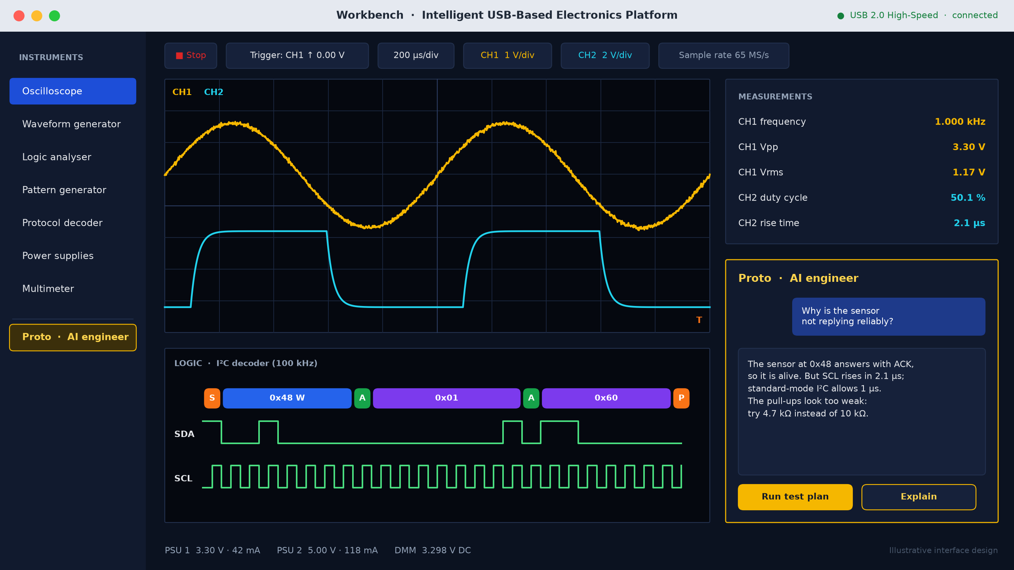
SOFTWARE DESIGN
Software interface: every instrument and Proto in one workbench
SOFTWARE STACK
Proto, AI engineer
plans tests, explains results
Workbench UI
scope, logic, decoder, supplies, DMM views
Device API
commands, streaming, logging
USB transport
USB 2.0 high-speed data link
FPGA gateware
trigger, capture, DDS, decode
Top: what the user sees. Bottom: what runs on the hardware.
Intelligent USB-Based Electronics Platform · SEC Project
5 / 7
Notes:
Speaker: Anshul · about 1:00
This is our software design. On the left you choose an instrument. In the middle is the oscilloscope screen with two waveforms, and below it the logic view decoding an I2C message into readable bytes. On the right are automatic measurements like frequency, voltage and rise time, and the Proto panel, where you can ask a question in plain English. On the right side of the slide is the software stack, from bottom to top: the FPGA logic, the USB link, the device interface, the workbench screen, and Proto at the top.

Slide 6
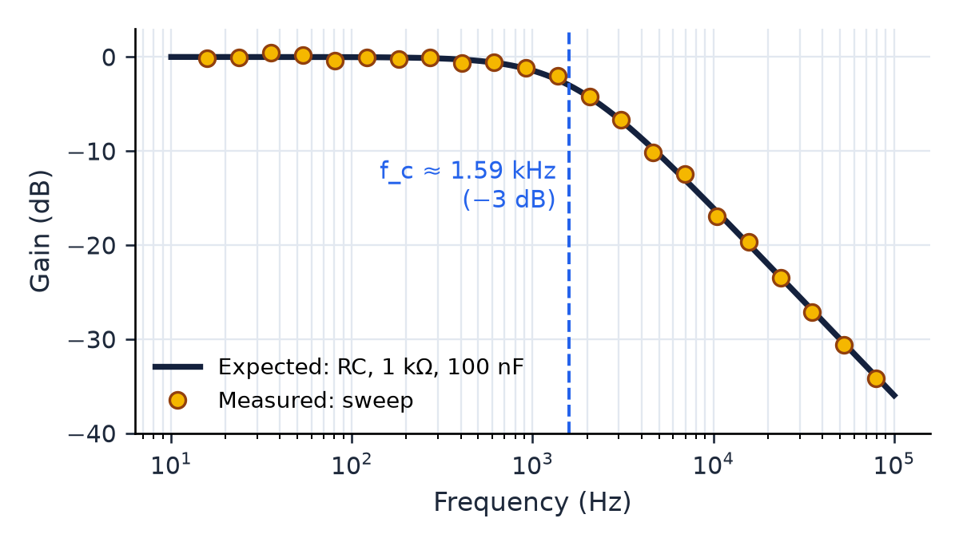
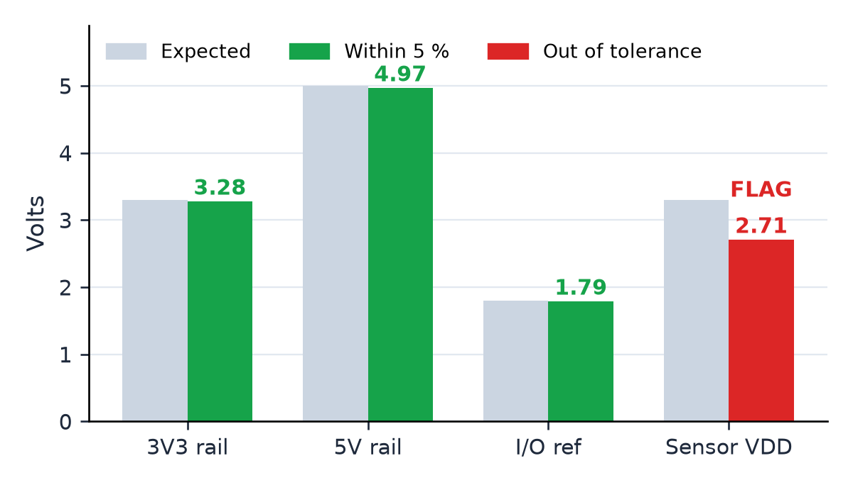
INTELLIGENCE AND RESULTS
Proto, the AI engineer: from a measurement to a verdict
HOW PROTO RUNS A TEST
Frequency response of an RC filter
Supply-rail check with tolerance
1
Connect the board
2
Power up, watch the current
3
Check every supply rail
4
Drive the inputs
5
Capture the outputs
Wavegen sweeps, scope measures, Proto compares with theory: f_c = 1/(2πRC) ≈ 1.59 kHz.
DMM and supply monitors read each rail; anything outside ±5 % is flagged.
6
Decode the buses
PROTO'S VERDICT
7
Verdict in plain words
“The 3V3 and 5V rails are fine, but the sensor supply is 2.71 V, 18 % low. Check the regulator enable pin and the 10 µF output capacitor, then run the test again.”
8
Suggest the fix
Graphs show illustrative data for the test method.
Intelligent USB-Based Electronics Platform · SEC Project
6 / 7
Notes:
Speaker: Anshul · about 1:15
Proto is what makes the platform intelligent. It follows a fixed test flow: connect the board, power it up while watching the current, check every supply rail, drive the inputs, capture the outputs, decode the buses, give a verdict and suggest the fix. The first graph shows a frequency-response test of an RC filter. The generator sweeps the frequency, the scope measures the output, and Proto compares it with theory: the cutoff is one over two pi R C, about 1.59 kilohertz. The second graph checks each supply rail against a five percent tolerance. Here the sensor supply is 2.71 volts instead of 3.3, so Proto flags it and suggests what to check. These graphs show the test method with example data.

Slide 7
PLAN AND CONCLUSION
Thank you
Methodology, outcomes and future scope
DEVELOPMENT METHODOLOGY
1
2
3
4
5
6
7
Requirements and architecture
Component selection and BOM
Schematic and PCB design
FPGA gateware
Workbench software
Proto integration
Testing and validation
EXPECTED OUTCOMES
FUTURE SCOPE
One USB unit replaces eight bench instruments
Tests run as plans, not as manual steps
Measurements explained in plain language by Proto
Affordable enough for every student lab bench
A probe fixture that reaches every net of a board automatically
More protocol decoders (CAN, I²S, 1-Wire)
Remote lab access over the network
Proto-generated lab reports from recorded measurements
Intelligent USB-Based Electronics Platform · SEC Project
7 / 7
Notes:
Speaker: Avi · about 1:00
Our method has seven phases: requirements and architecture, component selection, schematic and PCB design, FPGA logic, the workbench software, Proto integration, and finally testing and validation. The expected outcome is one USB unit that replaces eight bench instruments, runs tests as plans, and explains results in simple language at a cost student labs can afford. In future we want to add a probe fixture that reaches every point on a board automatically, more protocol decoders, remote lab access and automatic lab reports. Thank you. We are happy to take your questions.

