Slide 1

Team Name: Redstone Coders
Team Leader: Soham Prasant Kumbhar
Problem Statement no : 16 (Open Innovation)
Problem statement: AI-DRIVEN ERROR-FREE FORM AUTOMATION PLATFORM.
University/College name: DYP College Kolhapur

Slide 2
Problem Statment
Government service portals are often complex, jargon-heavy, and primarily English-based, making it difficult for many citizens—especially regional language users—to correctly understand instructions and fill forms. Small mistakes like typos, incorrect file formats, or missing details frequently lead to application rejections, forcing citizens to spend extra time and money on agents or repeated visits to fix avoidable errors.
Proposed solution
Develop an AI-powered assistant that simplifies government portal instructions into easy, step-by-step guidance.
Automatically extract key information from uploaded documents and auto-fill government form fields to reduce manual data entry.
Implement smart document checker that verifies file size, format, and clarity before upload.
Provide real-time form validation to detect errors like typos, missing fields, or incorrect formats before submission.
Integrate multilingual support (Marathi + other regional languages) to help users understand instructions clearly.
Use voice guidance and text-to-speech so low-literacy users can navigate forms easily.

Slide 3
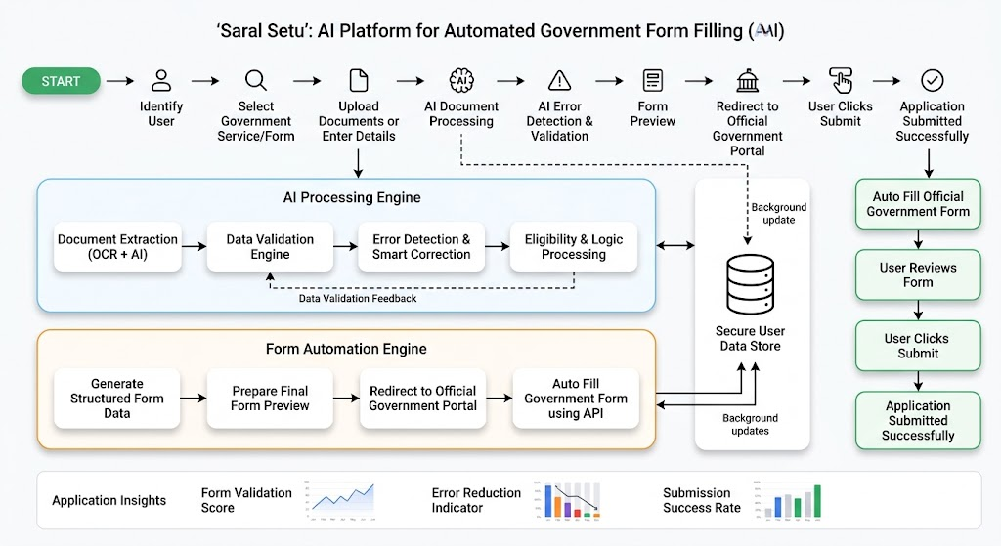
Implementation Plan
AI extracts data, auto-fills forms, and ensures error-free government applications.
Detects typos, missing fields, and wrong data.
Validates form data using government rules.
Reuses previously verified user information automatically.
Users enter details or upload documents easily.
System securely processes user data and requests.
Important information extracted automatically from documents.
Final application securely stored and ready submission

Slide 4
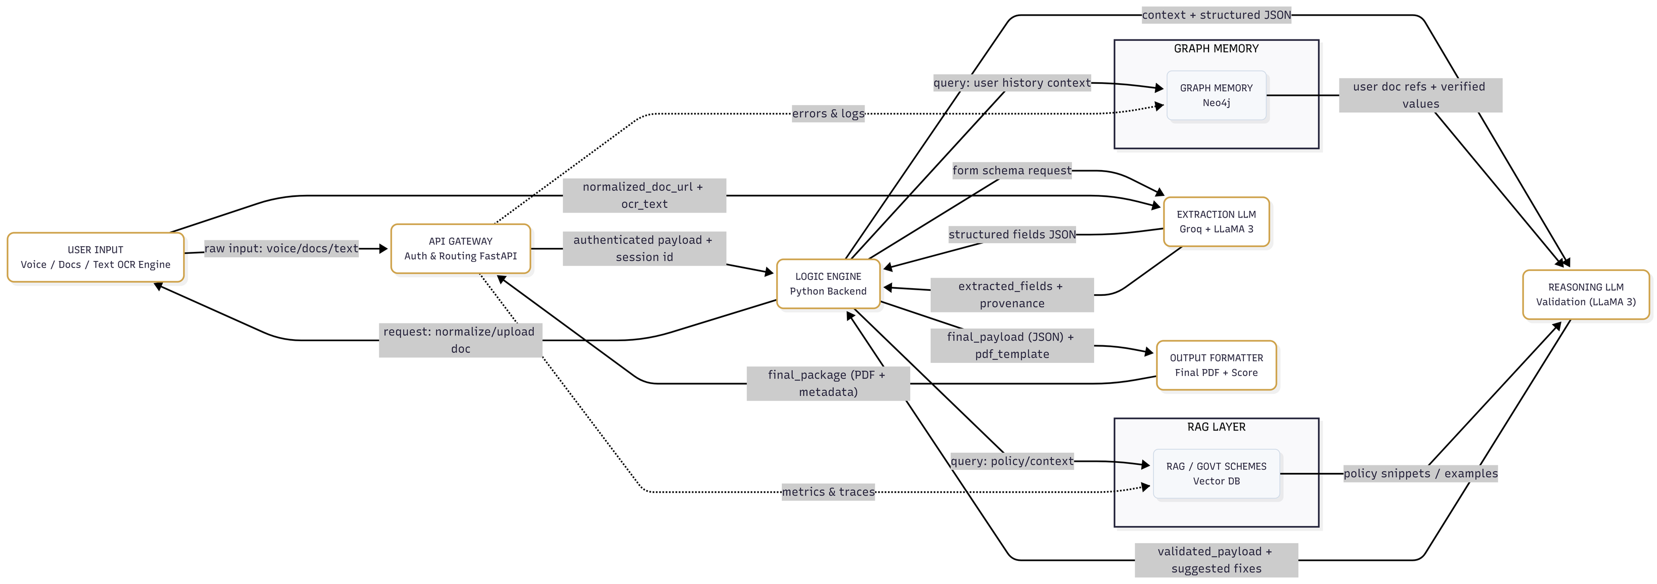
Flow Diagram

Slide 5
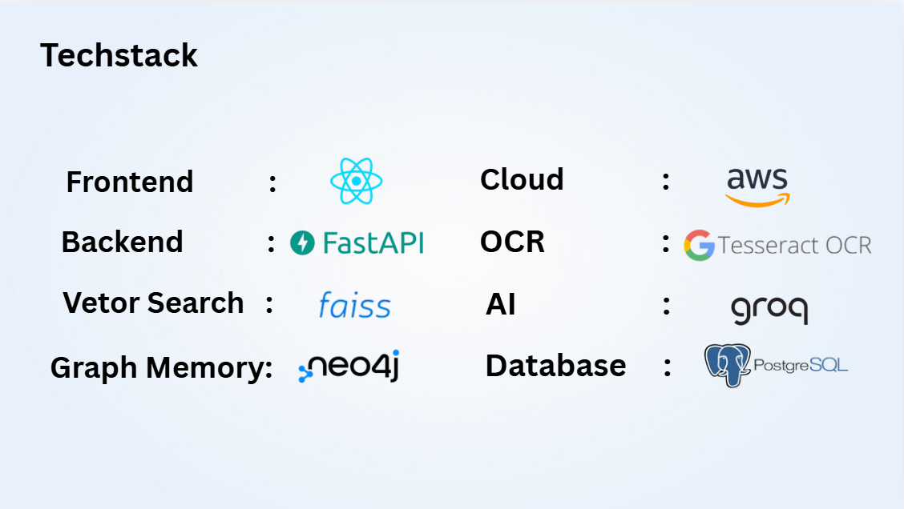

Slide 6
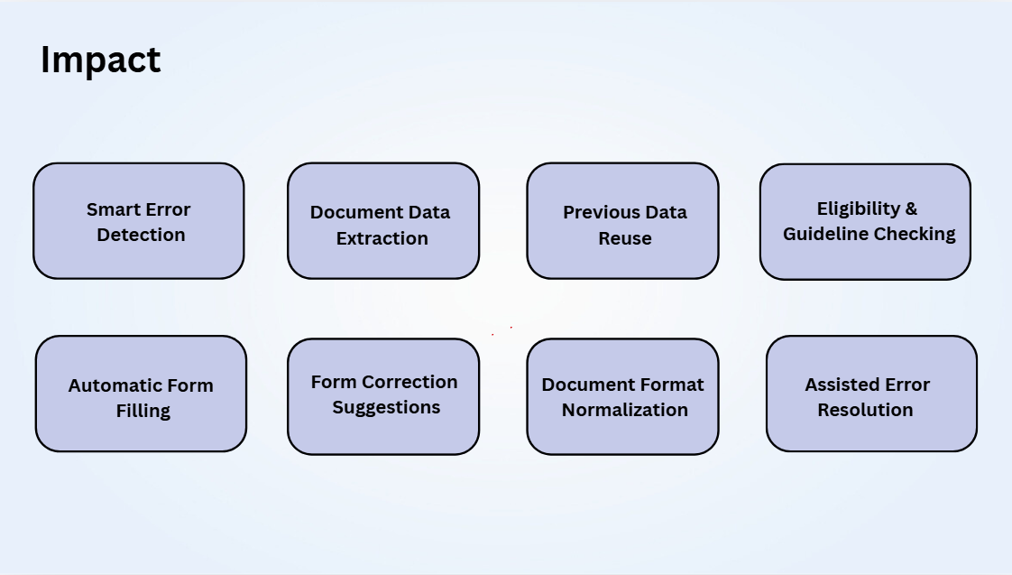

Slide 7
Business Model
USP (Unique Selling Point)
Automatic document extraction and smart error prevention
Reusable verified profile enables faster future submissions.
Reduce user time and cost for applications.
Voice-first Marathi support for low-literacy users.
Rejection predictor gives success score before submission.
Decrease rejection rate, improve success rate.
One-click autofill using verified digital IDs securely.
Increase adoption of government digital services.
Create scalable solution usable across all portals.

Slide 8
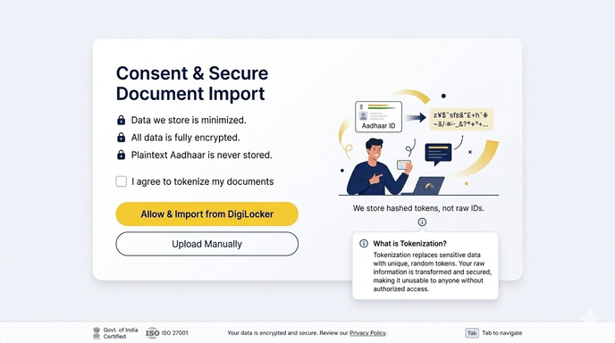
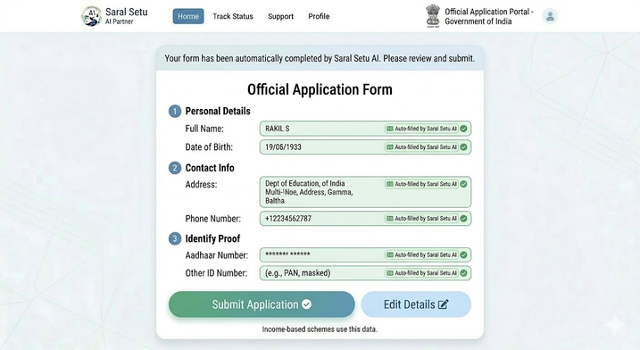
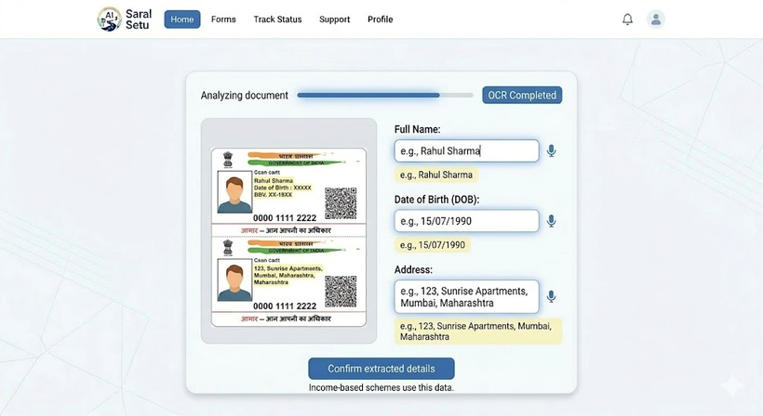
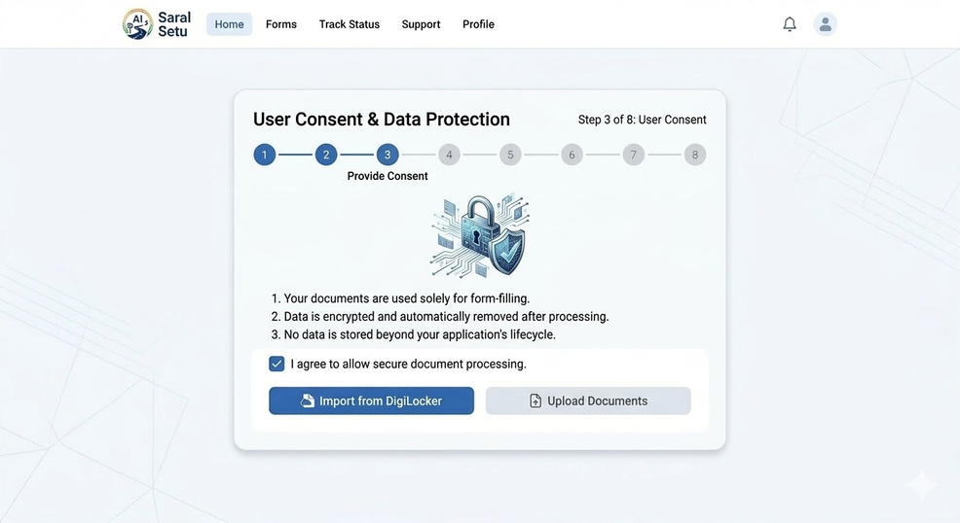
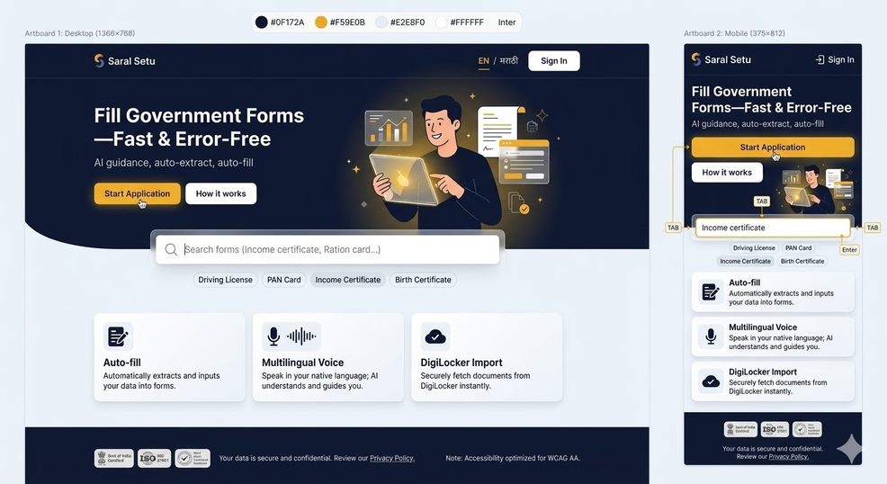
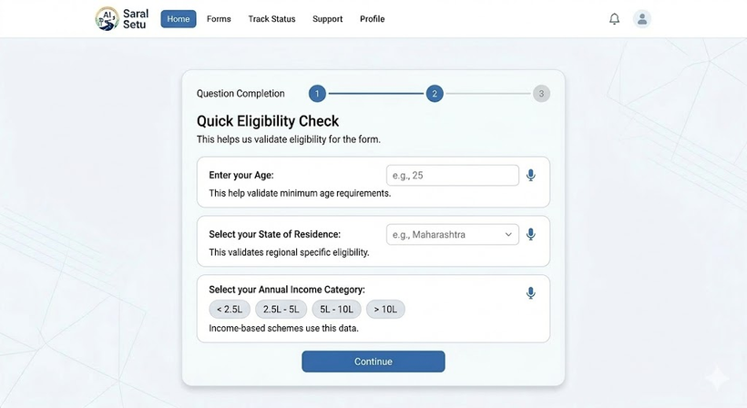
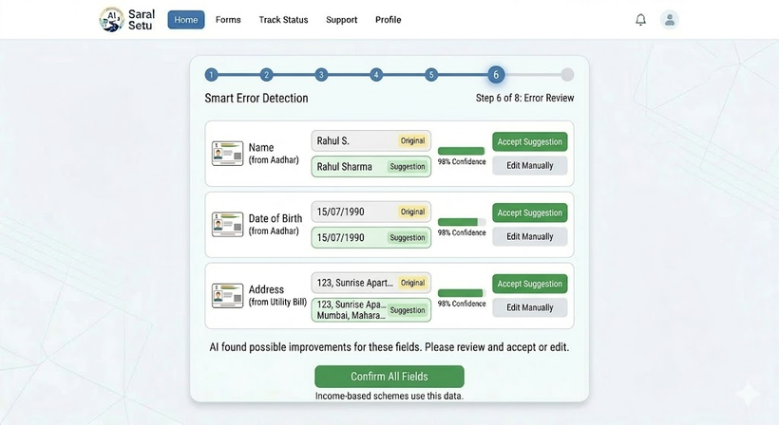
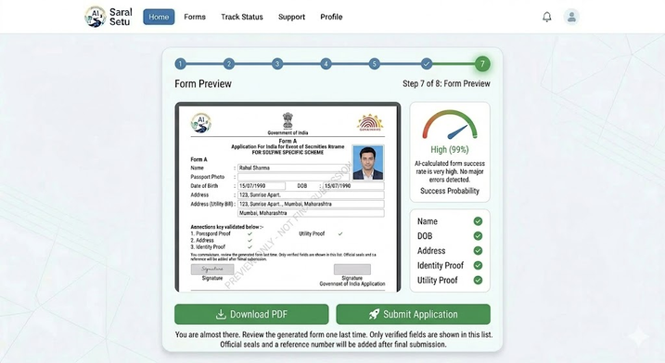
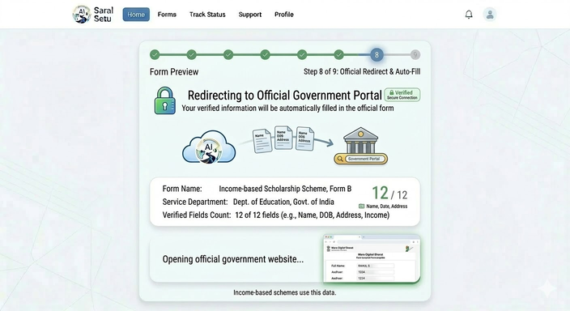
Expected outcome

Slide 9
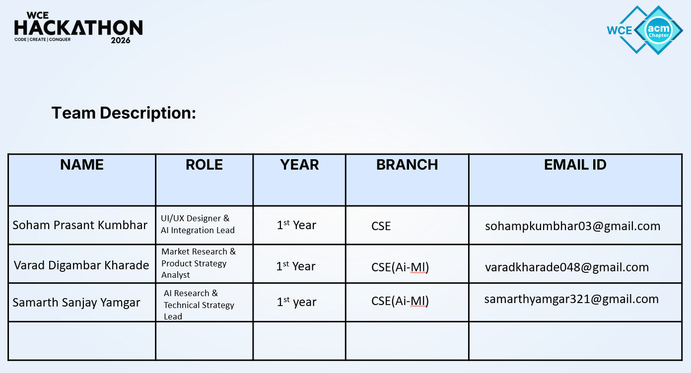
Team Description:
2029
2029
2029

