Slide 1

Project Presentation on “Smart Job Recommendation System”
(SPONSORED BY: )
(Domain : )
Under Guidance of Name of Guide
2024-25 Sem- I
Roll No. | GR. No. | Division | Name of Student
411028 | 22110594 | A | Soham Mahajan
413031 | 22110578 | C | Navneet Kawde
411002 | 22111229 | A | Abdul Razique
411013 | 22110559 | A | G Aman Kumar
Bansilal Ramnath Agarwal Charitable Trust’s
Vishwakarma Institute of Information Technology
Department of Electronics & Telecommunication

Slide 2
PROJECT outline
INTRODUCTION
LITERATURE SURVEY
OBJECTIVES
MOTIVATION
BLOCK DIAGRAM
METHODOLOGY
HARDWARE AND SOFTWARE SPECIFICATION
RESULT ANALYSIS AND DISCUSSION
APPLICATIONS
FUTURE SCOPE
IMPLEMETATION PLAN
REFERENCES
Bansilal Ramnath Agarwal Charitable Trust’s
Vishwakarma Institute of Information Technology
Department of Electronics & Telecommunication

Slide 3
INTRODUCTION
Smart Job Recommendation System is an innovative web application designed to revolutionize the job search experience. As the job market becomes increasingly competitive, it is crucial for job seekers to find opportunities that align perfectly with their skills and experiences.
Our system leverages the power of Artificial Intelligence (AI) to bridge the gap between job seekers and employers by providing highly accurate and personalized job recommendations. By analyzing user profiles and job descriptions, our platform matches candidates with the most suitable job opportunities, enhancing the efficiency of the job search process.
Bansilal Ramnath Agarwal Charitable Trust’s
Vishwakarma Institute of Information Technology
Department of Electronics & Telecommunication

Slide 4
OVERVIEW
Data Collection
Applying NLP
Building of recommendation System
Testing
Development
Deployment
Bansilal Ramnath Agarwal Charitable Trust’s
Vishwakarma Institute of Information Technology
Department of Electronics & Telecommunication

Slide 5
OVERVIEW
CV
OCR
NLP
Database
Recommendations
Methodology
Bansilal Ramnath Agarwal Charitable Trust’s
Vishwakarma Institute of Information Technology
Department of Electronics & Telecommunication

Slide 6
METHODOLOGY
Web Scraping
Data Collection
Data Processing
OCR
Exploratory Data Analysis
Bansilal Ramnath Agarwal Charitable Trust’s
Vishwakarma Institute of Information Technology
Department of Electronics & Telecommunication

Slide 7

METHODOLOGY
Optical Character Recognition (OCR)
Optical character recognition or optical character reader is the electronic or mechanical conversion of images of typed, handwritten or printed text into machine-encoded text, whether from a scanned document, a photo of a document, a scene photo or from subtitle text superimposed on an image
Bansilal Ramnath Agarwal Charitable Trust’s
Vishwakarma Institute of Information Technology
Department of Electronics & Telecommunication

Slide 8
METHODOLOGY
Natural Language Processing NLP
Word tokenization
Tokenize words into a list of strings
Stopwords:
Remove words like ('i', 'me', 'my', 'myself', 'we')
Lemmatization:
Return the words back to the original form
Bansilal Ramnath Agarwal Charitable Trust’s
Vishwakarma Institute of Information Technology
Department of Electronics & Telecommunication

Slide 9
OBJECTIVES
Assist applicant in searching for potential jobs
Provide accurate and reliable recommendations personalized for applicant
Bansilal Ramnath Agarwal Charitable Trust’s
Vishwakarma Institute of Information Technology
Department of Electronics & Telecommunication

Slide 10
BUSINESS VALUE
Simplicity
Tailor made
Time valuable
Bansilal Ramnath Agarwal Charitable Trust’s
Vishwakarma Institute of Information Technology
Department of Electronics & Telecommunication

Slide 11
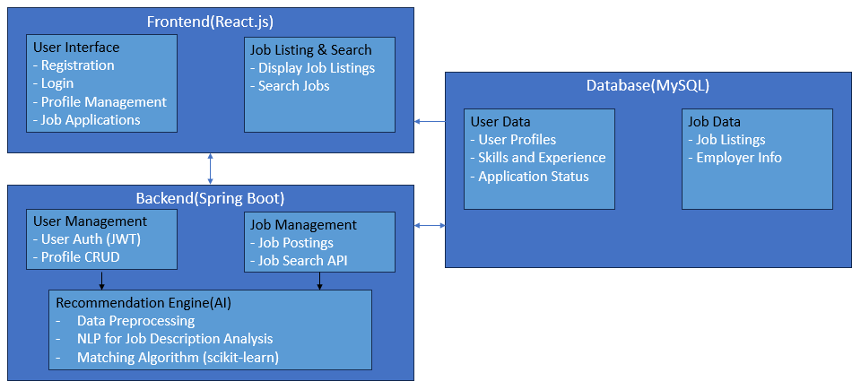
BLOCK DIAGRAM
Bansilal Ramnath Agarwal Charitable Trust’s
Vishwakarma Institute of Information Technology
Department of Electronics & Telecommunication

