Slide 1

Department of Information Technology
NBA Accredited
A.P. Shah Institute of Technology
G.B.Road, Kasarvadavli, Thane (W), Mumbai-400615
UNIVERSITY OF MUMBAI
Academic Year 2024-2025

Slide 2


A Project Presentation on
EduFlex: ML-Driven Cross-Platform Application for Displaying and Acknowledging Student’s Achievements.
Submitted in partial fulfillment of the degree of
Bachelor of Engineering(Sem-8)
in
INFORMATION TECHNOLOGY
Sankalp Gunjal(21104087)
Sumit Mesta(21104069)
Soham Dalvi(21104010)
Siddharth Devare(21104136)
Under the Guidance of
Ms. Sonal Jain

Slide 3

1.Project Conception and Initiation

Slide 4

1.1 Abstract
In today’s education system, traditional assessments focus heavily on academics, often overlooking co-curricular achievements, soft skills, and personal growth. EduFlex addresses this gap with a machine learning-driven, cross-platform web application that provides a holistic view of student development. By leveraging ML and Generative AI, the platform dynamically builds student profiles, identifies learning gaps, and offers soft skills assessments. Integration with Credly enables secure digital credentialing, while an ML-based certificate verification module ensures authenticity. An intuitive dashboard visualizes performance trends, and gamification elements boost engagement. Developed using scalable technologies like Node.js and Flask, EduFlex redefines student evaluation through inclusive, data-driven, and automated assessment practices.

Slide 5
1.2 Objectives
To develop a web-based, cross-platform framework that provides a holistic view of student achievements by integrating academic, co-curricular, and extracurricular records.
To implement AI-powered psychometric assessments using llama 3.1:8b model to identify students learning gaps and evaluate cognitive abilities, personality traits, and career readiness.
To ensure ML-based certificate verification based on CNN model to detect tampered certificates and maintain the authenticity of student achievements.
To enable digital credentialing via Credly API to validate and showcase verified student accomplishments.
To build a data visualization platform using Google-Charts that presents clear, actionable insights through interactive dashboards, helping educators and students make informed decisions.

Slide 6
1.3 Literature Review
Sr No | Paper Title | Author | Year | Key Findings | Key Innovations
1. | Generative AI for Customizable Learning Experiences | Ivica Pesovski et al. | 2024 | Generative AI enables adaptive learning environments by assessing progress and generating quizzes. | Generative Adversarial Networks(GANs), Adaptive Algorithms
2. | AI-Powered Personalized Learning Journeys: Revolutionizing Information Management for College Students | Yang M. et al. | 2023 | AI-powered platforms create detailed student profiles, enabling tailored recommendations | NLP, ML Algorithms

Slide 7
1.4 Problem Definition
Problem Identified:
Traditional assessments focus primarily on grades, overlooking soft skills, co-curricular achievements, and personal growth.
Students miss out on recognition for a broader range of talents, limiting academic and career opportunities.
Solution Proposed:
A unified, cross-platform application that displays verified academic, co-curricular, and skill-based achievements.
AI-based tests provide deep insights into student capabilities, including soft skills assessments.

Slide 8
1.5 Scope
Can provide holistic student assessment by collecting and analyzing academic records, co-curricular participation, and extracurricular achievements for a well-rounded evaluation.
Can conduct psychometric assessments to evaluate cognitive abilities, personality traits, and career readiness, offering personalized insights.
Can verify certificates using machine learning to detect tampered or forged documents, ensuring authenticity.
Can enable digital credentialing through Credly API integration, allowing students to receive standardized, verifiable digital credentials for their achievements.
Can offer interactive data visualization with real-time dashboards, graphs, and reports for better progress tracking and decision-making.

Slide 9
1.6 Technology stack
Frontend (GUI): HTML, CSS, JS
Machine Learning Models: Random Forest and Convolutional Neural Network
Python and ML Libraries: Flask, Playwright, BeautifulSoup, pdfminer
Large Language Model: Llama 3.1:8b
External API: Credly
Backend: Node.js, Express.js
Database: MongoDB

Slide 10
1.7 Benefits for environment & Society
Holistic Development:
By tracking soft skills, co-curricular, and extracurricular activities, the platform fosters well-rounded personal growth, contributing to the development of responsible and capable citizens.
Paperless Verification and Documentation:
EduFlex digitizes student achievements significantly reducing the dependency on printed documents. This shift contributes to the conservation of natural resources and minimizes paper waste.
Efficient Operations:
The use of cloud-based technologies and optimized backend systems (Node.js, Flask, MongoDB) ensures low-resource consumption and efficient data handling.

Slide 11
2. Project Design

Slide 12
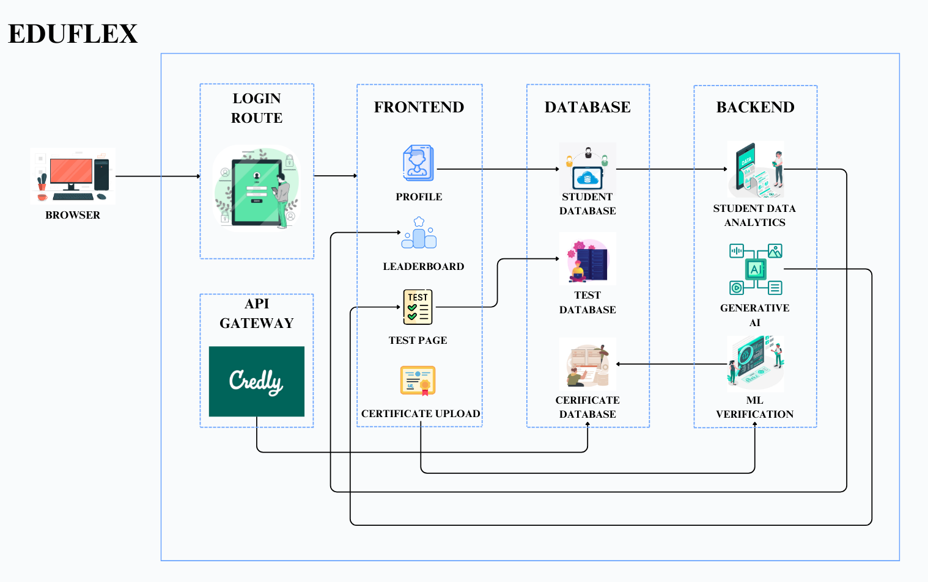
2.1 Proposed System

Slide 13
2.2 Design(Flow Of Modules)
1. User Interaction and Data Input
Students and Admin log in to the platform using secure authentication.
Profiles are created with academic details, skill links, and personal data.
Students take AI-based soft skills assessments.
Certificates are uploaded for academic and co-curricular achievements.
2. Processing and Validation
The Machine Learning Verification System authenticates uploaded certificates, detecting forgery or tampering.
The Generative AI Engine generates AI-based assessments to evaluate career readiness, ensuring students are equipped with relevant skills for future opportunities.

Slide 14
3. Data Storage and Updates
All verified certificates, test results, and students data are securely stored in the EduFlex centralized database.
Profiles are continuously updated to reflect ongoing achievements and participation.
4. Gamification and Recognition
Real-time allocation of badges, points, and ranks based on student engagement and performance.
Leaderboards showcase top-performing students across various metrics, enhancing motivation.
5. Real-Time Insights
Students can access visual dashboards with actionable, data-driven insights.
The system helps students stay informed about emerging trends and allowing them to upgrade their skills accordingly.

Slide 15
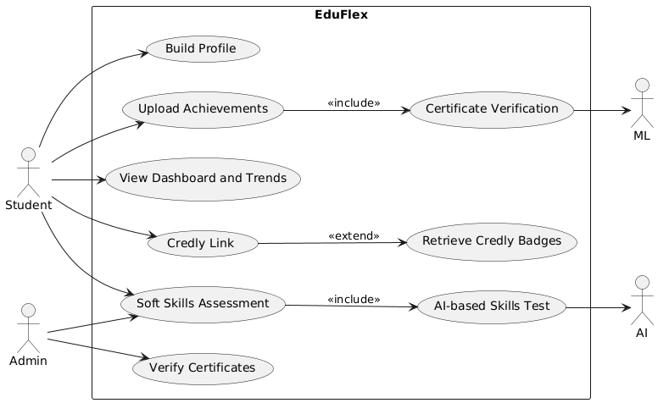
2.3 Use Case
Fig 2.3: Use Case

Slide 16
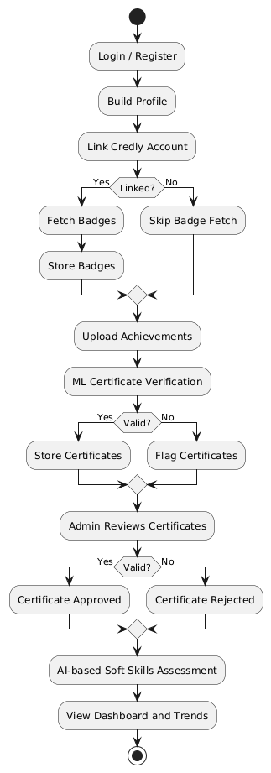
2.4 Activity diagram
Fig 2.4.1: Activiy Diagram

Slide 17
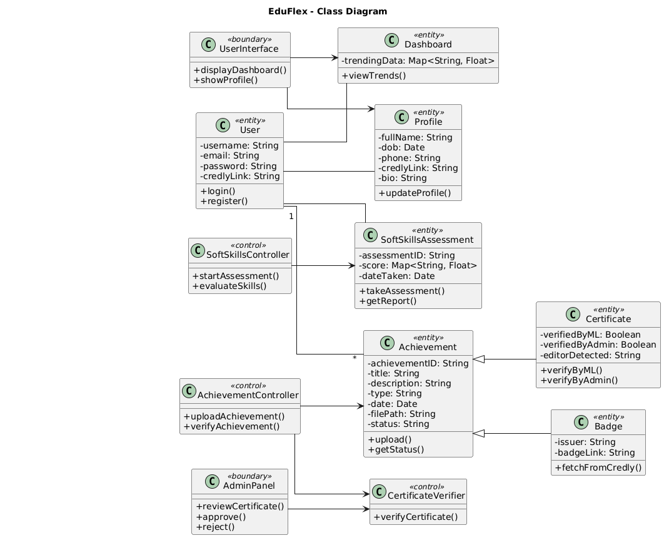
2.5 Class Diagram
Fig 2.5: Class Diagram

Slide 18
3. Implementation

Slide 19
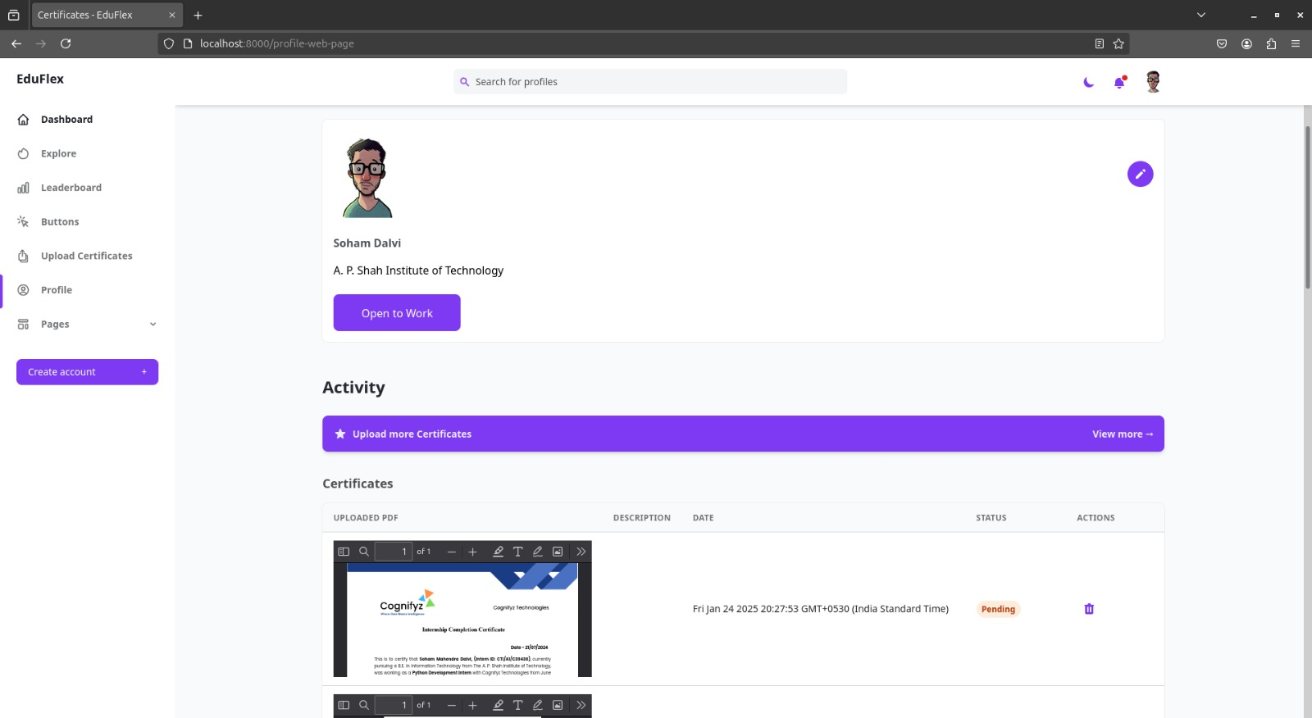
Fig 3.1: User Profile

Slide 20
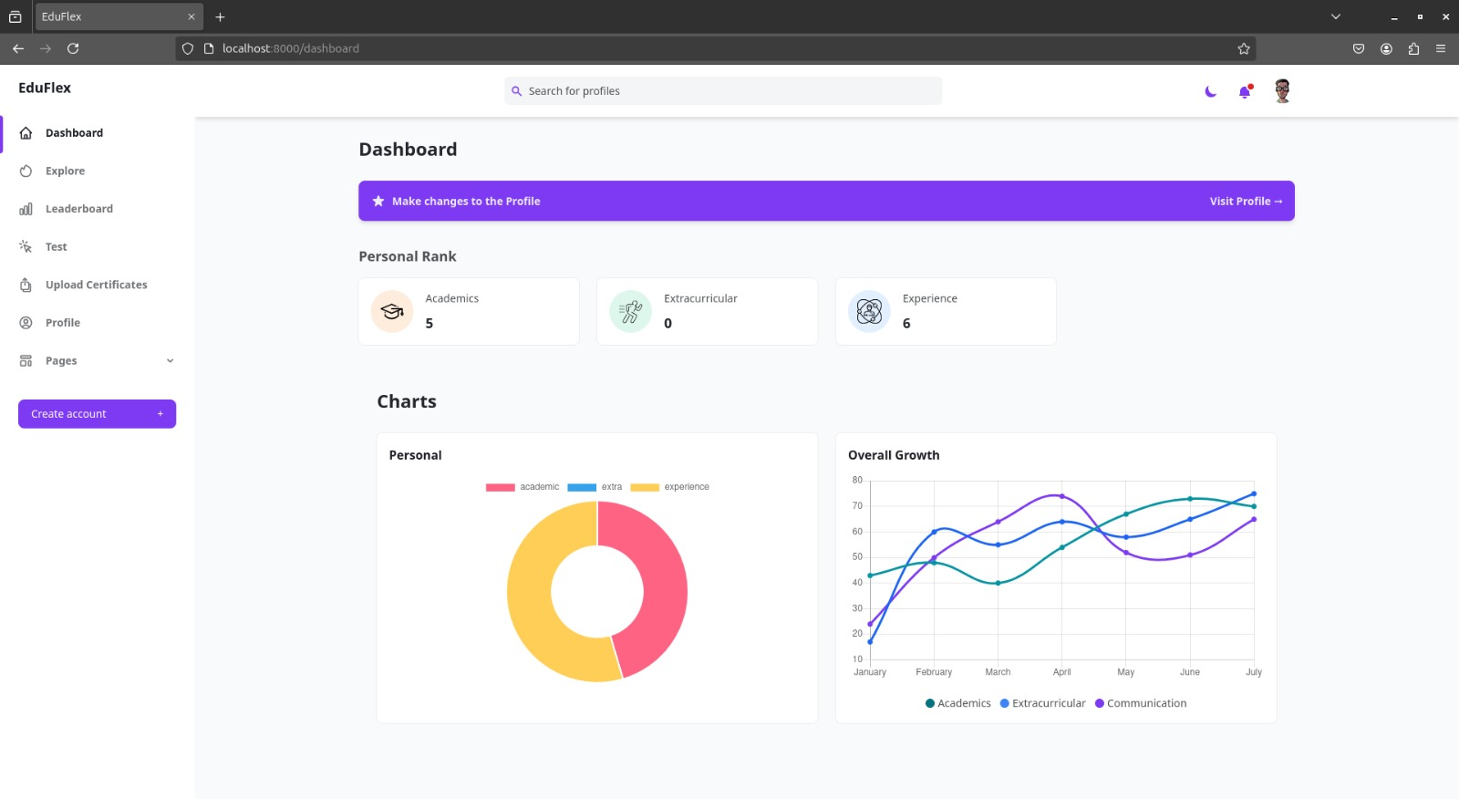
Fig 3.2: Dashboard

Slide 21
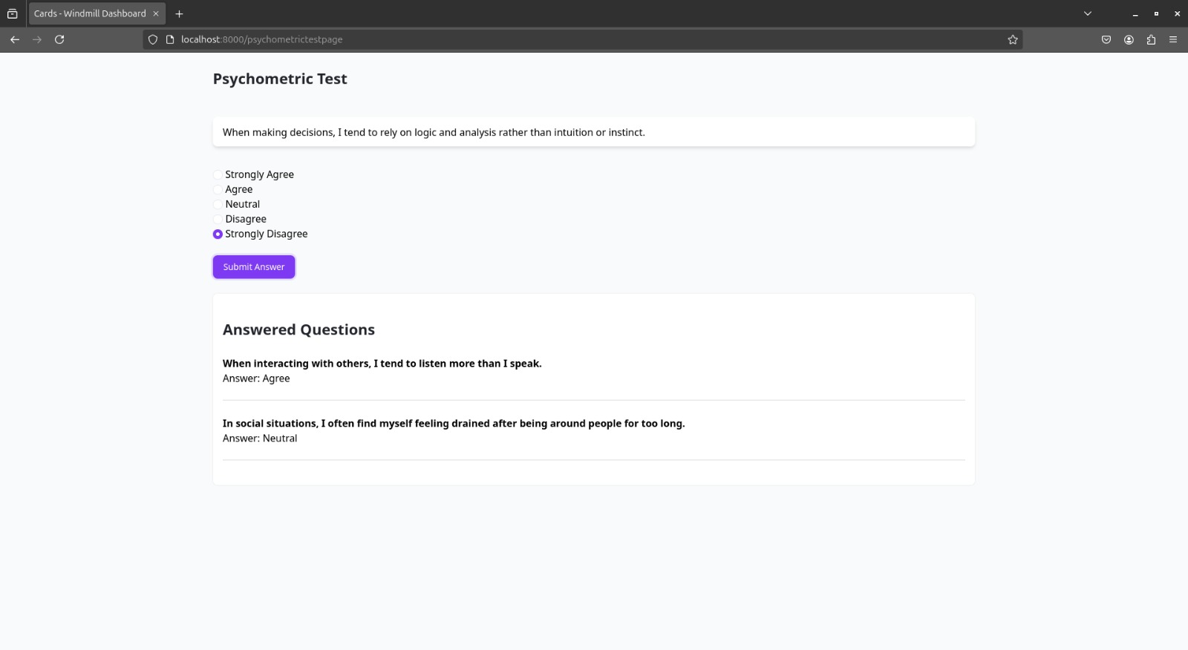
Fig 3.3: Test Page

Slide 22
4. Testing

Slide 23
Manual Testing
USER STORY U1-U6: Registration, Login, Certificate Verification, Psychometric Test, Credly Integration, Announcements.
Purpose: Verify each user-facing module for functionality and expected behavior.
Tester Name: | User1
Date(s) of Test: | dd-mm-yyyy
Server being used: | EduFlex Test Server
Prerequisites for this test: | Database active, user credentials prepared, ML services live
Software Versions: | Frontend: v1.0, Backend: Node.js v18, Flask v2.3, MongoDB v6.0
Required Configuration: | All modules deployed with testing roles assigned

Slide 24
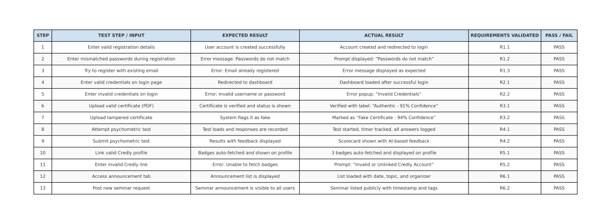

Slide 25
5. Result

Slide 27
6. Conclusion and Future
Scope

Slide 28
Conclusion
This work presents EduFlex, a scalable AI-driven platform for holistic student assessment. The system’s integration of certificate verification, gamification, and AI-based assessments establishes a reliable alternative to traditional evaluations. With 92% accuracy in certificate verification and real-time insights, EduFlex significantly enhances transparency and engagement in education.

Slide 29
Future Scopes
Developing ML Models for Gap Identification:
Advanced machine learning models will be designed to detect users gray areas (skill gaps) and generate personalized learning paths and courses tailored to each student's needs.
Mobile Application Development:
To enhance platform accessibility across mobile devices, allowing students and admin to interact on the go.
Reward Redemption Store:
A dedicated redeemable shop will be developed where students can exchange points earned through achievements for various rewards, thereby increasing platform engagement.

Slide 30
References
Pesovski, I., Santos, R., Henriques, R., Trajkovik, V.: Generative ai for customizable learning experiences. Sustainability 16(7), 3034 (2024).
Yang, M., Weng, F.: Ai-powered personalized learning journeys: Revolutionizing information management for college students in online platforms. Journal of Information Systems Engineering and Management 8(1), 23196 (2023).
Owoseni, A., Kolade, O., Egbetokun, A.: Enhancing personalised learning and student engagement using generative ai. In: Generative AI in Higher Education: Innovation Strategies for Teaching and Learning, pp. 123–150.Springer, (2024).

Slide 31
Paper Publication

Slide 32
Thank You

