Slide 1

EduFlex: An AI -ML driven cross-platform application for displaying and acknowledging students achievement.
Group No. 7
Project Guide:- Ms. Sonal Jain
Name | Moodle ID
Sumit Mesta | 21104069
Soham Dalvi | 21104010
Sankalp Gunjal | 21104087
Siddharth Devare | 21104136

Slide 2
Contents
Suggestions given during Review-1
Abstract
Introduction
Objectives
Project Scope
Literature Survey
Problem Statement
Technological Stack
Proposed System Architecture
UML Diagrams
Implementation Results
Gantt Chart of Sem VII
Summary
References

Slide 3
1. Suggestions given during Review-1
1. Refer to IEEE papers instead of general research papers for a more comprehensive understanding of implemented systems.

Slide 4
2. Abstract
Eduflex is a web-based platform that evaluates academic, co-curricular, and personal achievements using AI and ML.
Built with Python, Flask, and MongoDB for scalability and automation.
Integrates Credly for automated certification verification.
Uses Generative AI to let students create personalized courses.

Slide 5
3. Introduction
Problem Identified:
Traditional systems focus on grades, overlooking co-curricular activities, soft skills, and personal achievements, limiting a well-rounded evaluation.
Current education systems lack personalized learning, offering no tailored resources based on individual strengths and areas for improvement.
Solution Proposed:
EduFlex provides a comprehensive assessment by recognizing academic, co-curricular, and soft skills achievements through advanced technology.
EduFlex enables students to create personalized courses tailored to their goals and needs using Generative AI.

Slide 6
4. Objectives
To design and develop a web framework/cross-platform app offering a holistic view of student achievements.
To help students generate personalized courses, using ML to identify gaps and AI to create content.
To create a data visualization platform providing clear, actionable insights through interactive displays.
To build a scalable cloud infrastructure for real-time data processing and reliable app availability.

Slide 7
5. Project Scope
Can create student profiles by collecting academic and extracurricular achievements.
Can use AI for personalized course creation based on areas for improvement.
Can offer real-time analytics for educators to track student progress and enable timely support.
Can incorporate gamification to motivate students with points or badges for completing tasks.

Slide 8
6. Literature Survey
Paper Title | Author(s) | Year | Description | Technology Stack
Automated Student Achievement Recognition and Tracking Using Blockchain and AI | A. Verma, P. Gupta | 2022 | Problem Identified: Inefficient and insecure tracking of student achievements. Solution Proposed: Automated tracking with blockchain for security and AI for personalized recommendations. | Blockchain (Hyperledger), Python, Flask, AI
AI-Driven Student Profiling for Personalized Recommendations and Achievement Analysis in Education | M. Yang, X. Zhou | 2023 | Problem Identified: No personalized guidance for students' growth based on their achievements. Solution Proposed: AI-driven profiles with personalized recommendations and improvement insights. | AI, React, Django, PostgreSQL

Slide 9
7. Problem Statement
Narrow Focus on Academics: Current systems overlook extracurriculars and personal development.
No Personalized Learning Paths: Students lack tailored course recommendations based on strengths.
Non-Academic Achievements Undervalued: Contributions outside academics aren’t recognized properly.
Outdated Ranking Systems: Traditional rankings promote competition, not growth.
Manual Data Collection: Achievement tracking is inefficient and time-consuming.

Slide 10
8. Technology Stack
1. FRONTEND (GUI):
HTML
CSS
JAVASCRIPT
2. BACKEND:
Node.js
Express.js
MongoDB
Python
External API (Credly)

Slide 11
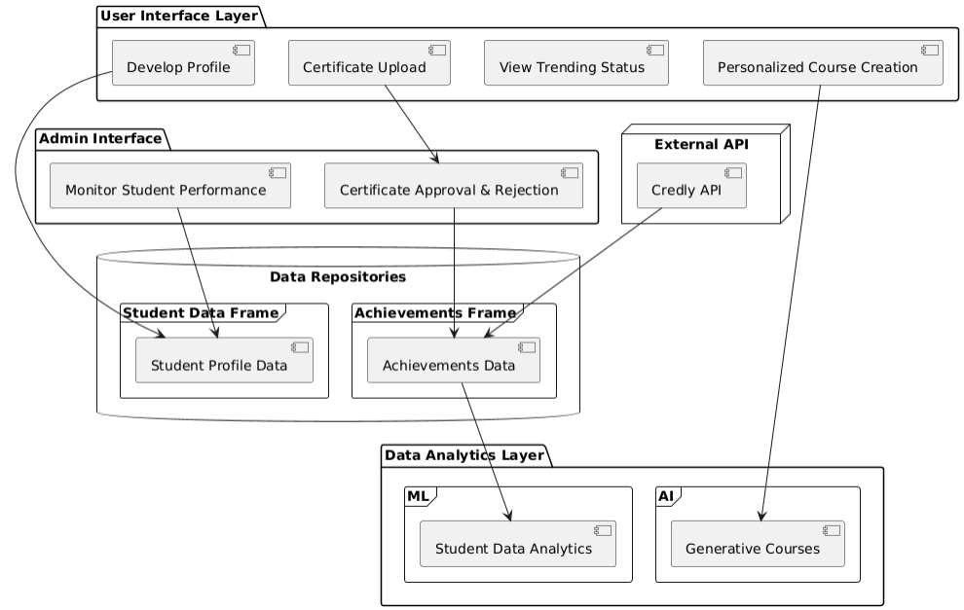
9. Proposed System Architecture
Fig 9.1: System Architecture

Slide 12
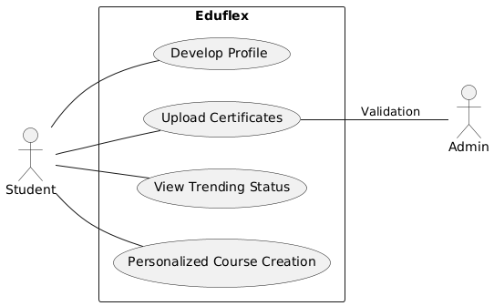
9. UML Diagrams
Fig 9.2: Usecase Diagram

Slide 13
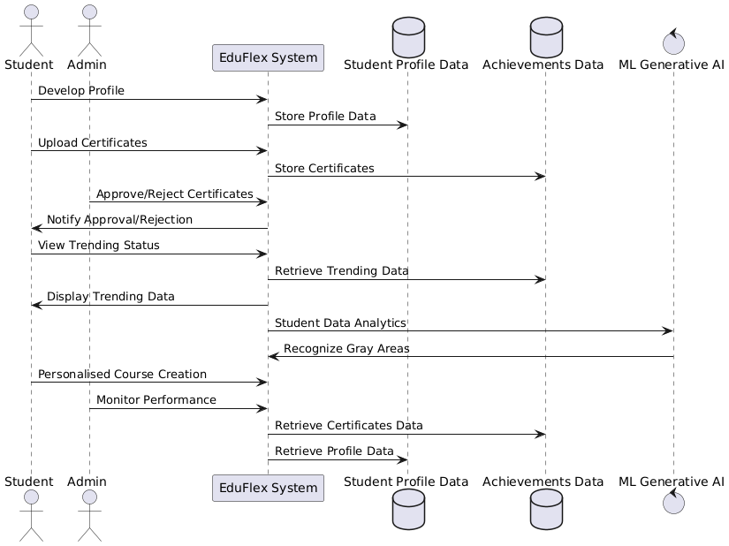
Fig 9.3: Sequence Diagram

Slide 14
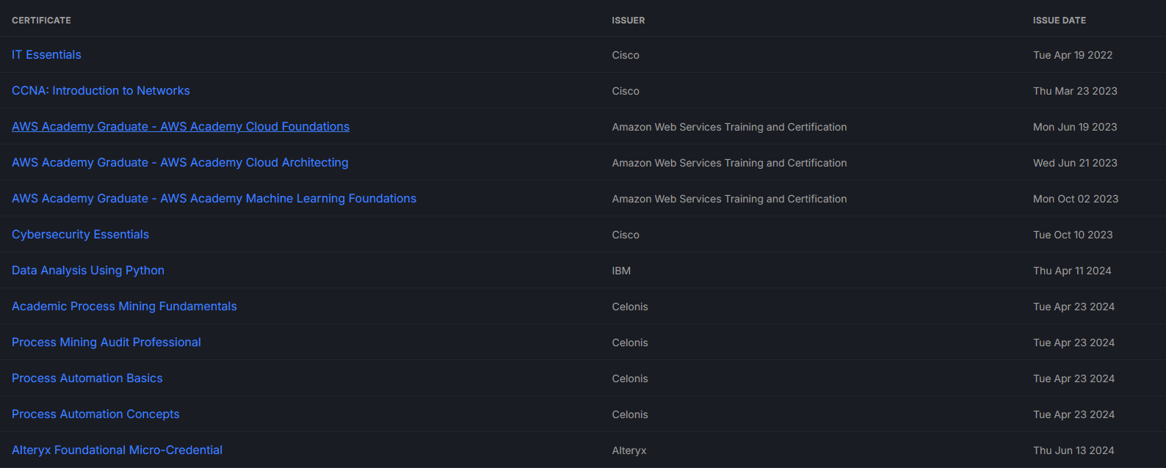
10. Implementation Results
Fig 10.1: Automation using Credly API

Slide 15
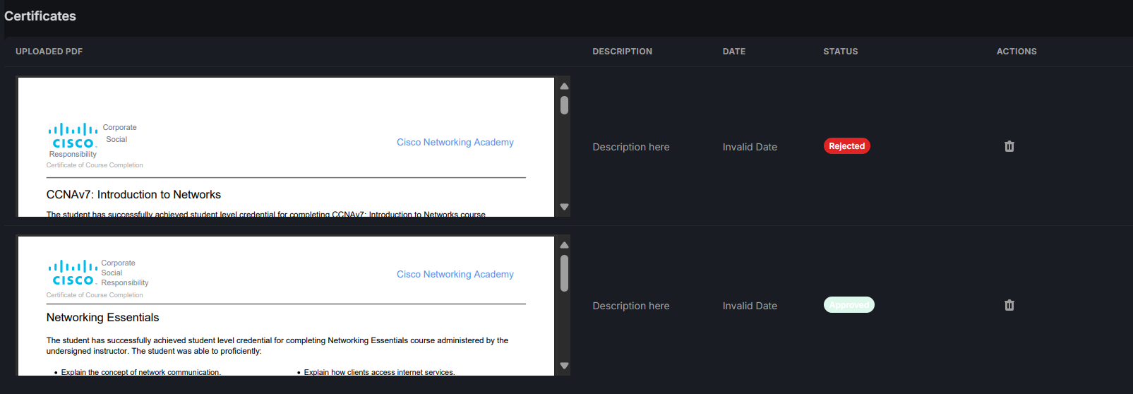
Fig 10.2: Certificate Validation

Slide 16
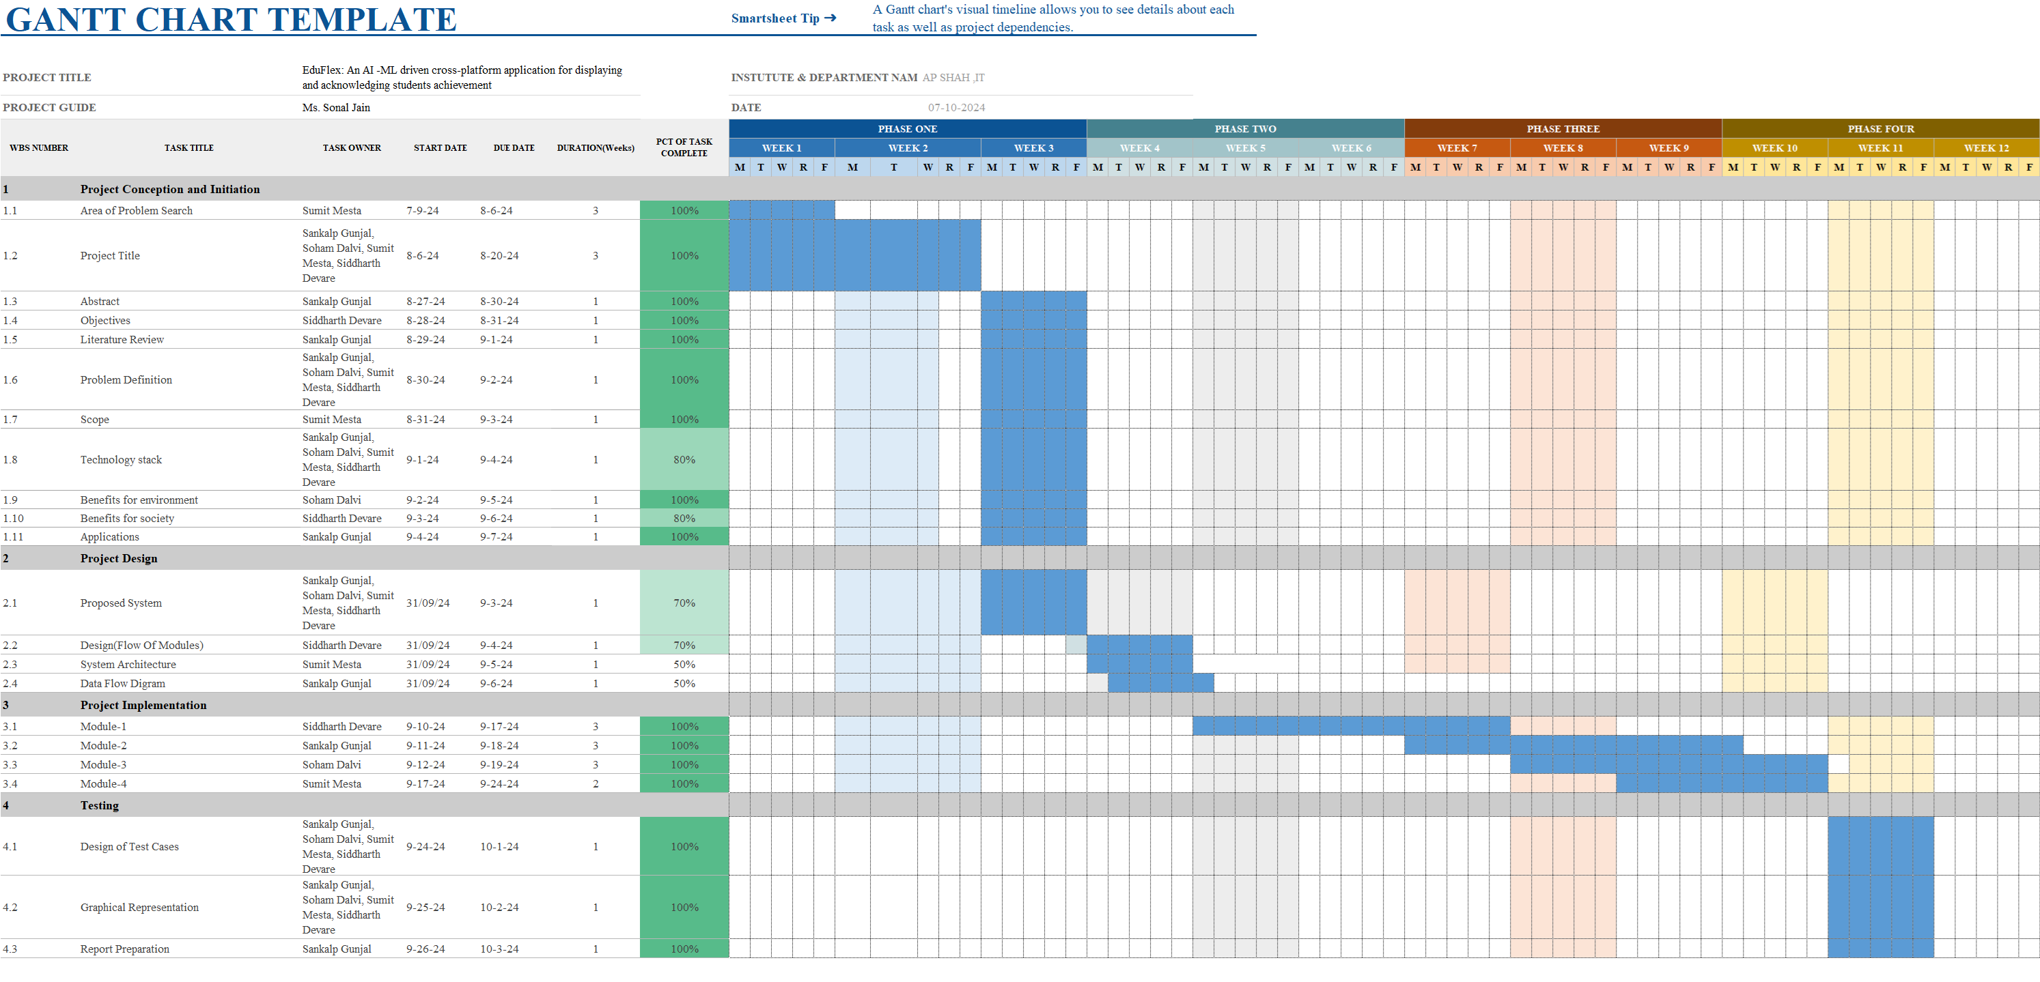
11. Gantt Chart of Sem VII

Slide 17
12. Summary
Data Collection Process:
The platform's user data collection system is fully implemented.
Credly Link Integration:
Users can provide their Credly links to automatically fetch their badges.
This simplifies the achievement data collection process.
Certificate Uploading Feature:
Users can upload their certificates easily.
A robust authentication mechanism verifies the validity of uploaded certificates.

Slide 18
13. References
[1] A. Verma and P. Gupta, "Automated Student Achievement Recognition and Tracking Using Blockchain and AI," IEEE Access, vol. 10, pp. 25567-25575, 2022.
[2] M. Yang and X. Zhou, "AI-Driven Student Profiling for Personalized Recommendations and Achievement Analysis in Education," IEEE Transactions on Learning Technologies, vol. 16, no. 2, pp. 78-86, 2023.
[3] L. Brown and H. Adams, "Enhancing Student Engagement and Achievement Tracking Through Gamified Learning Systems," Proceedings of the IEEE International Conference on Learning Technologies, 2021, pp. 45-50.

Slide 19
Thank You...!!

