Slide 1


CAPSTONE PROJECT
MIDSEM
PRESENTATION

Slide 2
:
NAME OF THE PROJECT :
STUDIFY: A STUDENTS’ MANAGEMENT PROGRAMME.
PROJECT BY: GROUP Q12
ROLL NO. | GR NO. | NAME OF THE STUDENT
61 | 12010442 | SHIKALGAR MOHIDDIN KAMALUDDIN
62 | 12011236 | SHIMPLE SANSKRUTI SANJAY
63 | 12011223 | SHIINDE ARYAN GOPALAN
64 | 12011223 | SHINDE CHETAN SHANTARAM
65 | 12010267 | SHINDE GAYATRI VISHVANATH
UNDER THE GUIDANCE OF : PROF. KALPESH V. JOSHI

Slide 3
INTRODUCTION IN BRIEF
OBJECTIVE
LITERATURE REVIEW
CONTENTS
TOOLS AND COMPONENTS USED
METHODOLOGY IMPLEMENTED
PROGRESS MADE SO FAR
PRESENT STATUS OF PROJECT

Slide 4
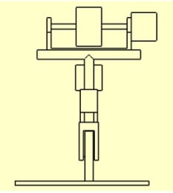
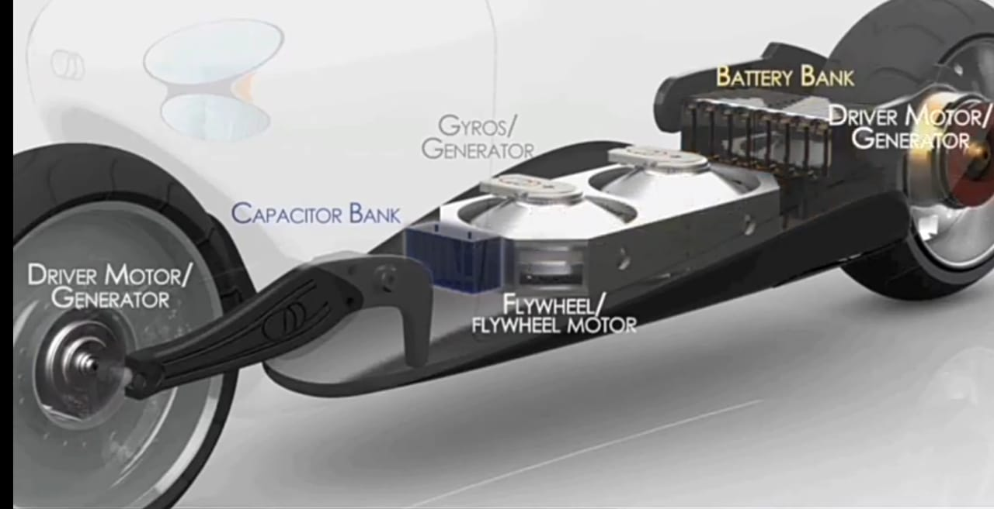
INTRODUCTION TO STUDIFY :
Studify is an underwork WebApp made for students and by the students to help ourselves from managing our notes and the deadlines in this uncertain time. This WebApp will also be usefull in offline mode as we mainly prefer pdf and online notes and it becomes quite hectic to manage pdfs and notes from various subjects, also the user can download the pdf uploaded, such that even if he/she losts any pdf, it can be downloaded again.
We are also trying to make a notification settings, which will mail the user 24hrs prior of the unchecked items in his/her todolists.
This WebApp will be beneficial to every student because of its dynamic behaviour of containing all the deadlines, works that need to be completed and all the notes in the same place

Slide 5
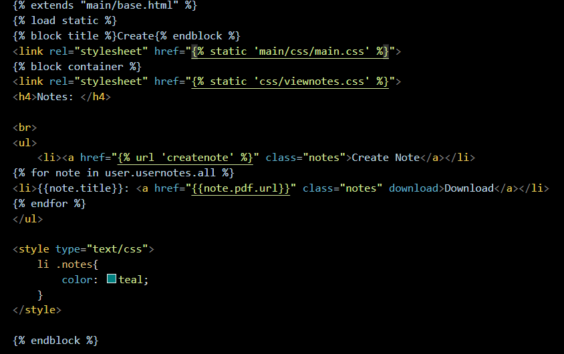
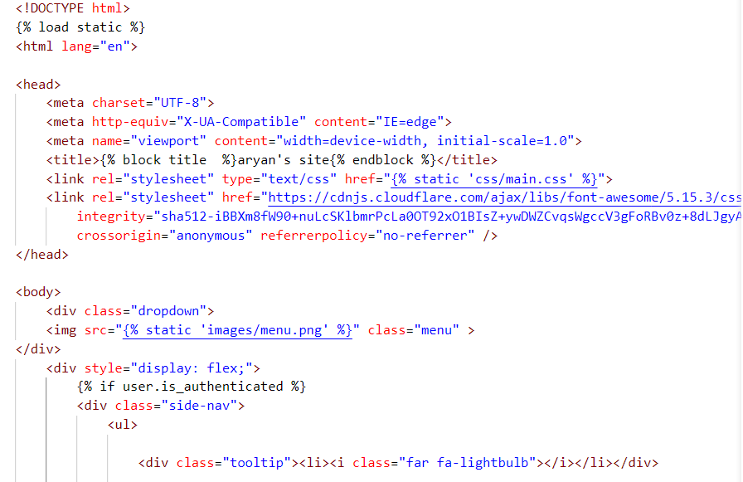
……contd.
UNSEEN PART OF WEBAPP:
We are using Python language as our primary language, moreover Django specially to handle the backend working and connecting with SQLite3 database, and html, css and javascript to handle the frontend part of it.
We have till date implemented- making number of todolist, notes uploading, login. Logout, user registration and quite a bit of UI/UX part of the WebApp

Slide 6
……contd.
RESEARCH SUMMARY :
The idea of our project is beneficial for students. Our project will provide a large variety of notes, it will also help students for remembering the work, and many more.
Our project is mostly based on Python, Django, HTML, CSS, Javascript, SQLITE.
Till now we are done with making to-do list, notes uploading, login, logout, user registration, designing, styling and etc.
The users will be able to personalize the settings accordingly.
Further studies on this topic will help many students to complete their pending work in time, easy access to a variety of notes and etc.

Slide 7
OBJECTIVES OF THE PROJECT :
To develop a technology which would make
students life much easier.
To help everyone in management.
T To help students in keeping all the materials
in a single App
To let students Study without any stress
of notes in such uncertain time.

Slide 8
LITERATURE REVIEW :
SR.NO. | 1 | 2 | 3
AUTHORS | Daniel Raviv(PhD) Anthony Radzins Morad Rahmani | Pratik D. Tak (Asst.Systems Engineer, TCS Pune.) | Pom Yuan Lam (B.E.(Hons.), NTU)
PAPER TITLE | FROM OBSERVATION TO PROTYPE :A HANDS ON UG RESEARCH. | SELF-STABILIZING BIKE USING GYROSCOPE | DESIGN AND DEVELOPMENT OF A SELF BALANCING BIKE USING C.M.G.
YEAR | 2017 | 2017 | 2012
JOURNAL | IEEE Conference Paper. | IJRET : International Journal of Research in Engineering and Technology
DESCRIPTION | This research is aimed at working out a safety complication that two wheeled vehicles experience | This research paper is about the concept of C.M.G. which when applied to the bike, it can be balanced without any support. | This thesis presents the work on the use of C.M.G. as a momentum exchange actuator to balance a bike.
FINDINGS | The Gyroscopic model has found to be convinient and reliable in case of balancing the bike. | A C.M.G. can be effectively used on bikes for self balancing purpose inspired from ships and airplane. | The C.M.G. is an effective torque amplification device and has short response time.

Slide 9



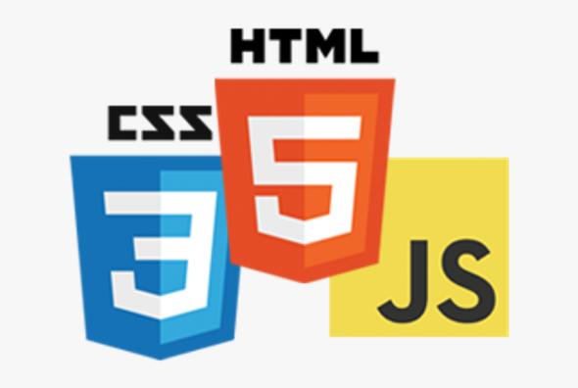


TOOLS AND COMPONENTS USED :
COMPONENTS :
Django
HTML-5
CSS-3
Javascript
SQLITE3
TOOLS :
VS Code
GIT and GITHUB
3) Python

Slide 10
Ready to present the prototype
Fixing bugs and issues with the website
Creating UI/UX for the website
Review the past study on similar projects
Understanding Django and its working with database.
METHODOLOGY
IMPLEMENTED

Slide 11
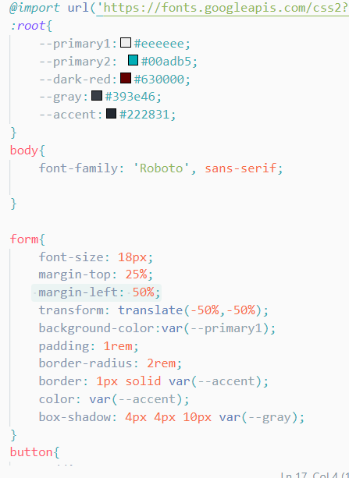
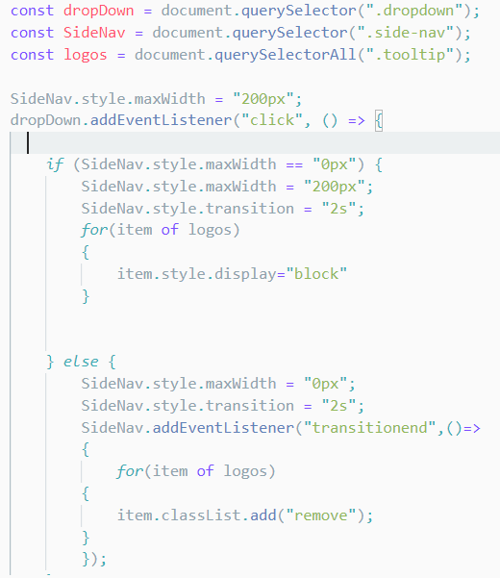
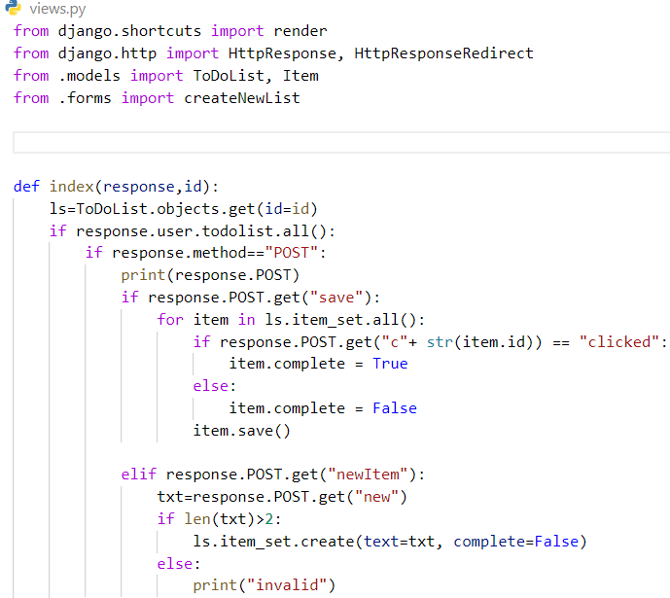
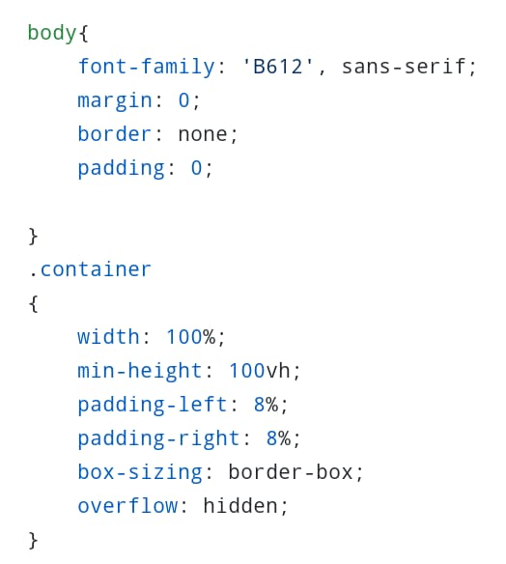
PROGRESS MADE SO FAR :

Slide 12
To view the source code of the website browse: http://github.com/AryanShinde/Studify

Slide 13
PRESENT STATUS OF PROJECT :
90%
Understanding of the tools and technologies used in the WebApp
75%
LITERATURE REVIEW
Analysis of past research on the prototype
75%
Implementing various functionalities for the WebApp
45%
Creating UI for the WebApp

Slide 14
REFERENCES :
THANK YOU..

