Slide 1


CAPSTONE PROJECT
MIDSEM
PRESENTATION

Slide 2
NAME OF THE PROJECT :
STUDIFY: A STUDENTS’ MANAGEMENT PROGRAMME.
PROJECT BY: GROUP Q12
ROLL NO. | GR NO. | NAME OF THE STUDENT
61 | 12010442 | SHIKALGAR MOHIDDIN KAMALUDDIN
62 | 12011236 | SHIMPLE SANSKRUTI SANJAY
63 | 12010823 | SHIINDE ARYAN GOPALAN
64 | 12011223 | SHINDE CHETAN SHANTARAM
65 | 12010267 | SHINDE GAYATRI VISHVANATH
UNDER THE GUIDANCE OF : PROF. KALPESH V.JOSHI

Slide 3
INTRODUCTION IN BRIEF
OBJECTIVE
LITERATURE REVIEW
CONTENTS
TOOLS AND COMPONENTS USED
METHODOLOGY IMPLEMENTED
PROGRESS MADE SO FAR
PRESENT STATUS OF PROJECT

Slide 4


INTRODUCTION TO STUDIFY:
Studify is an underwork WebApp made for students and by the students to help ourselves from managing our notes and the deadlines in this uncertain time. This WebApp will also be useful in offline mode as we mainly prefer pdf and online notes and it becomes quite hectic to manage Pdfs and notes from various subjects, also the user can download the pdf uploaded, such that even if he/she losts any pdf, it can be downloaded again.
We are also trying to make a notification settings, which will mail the user 24hrs prior of the unchecked items in his/her todolists.
This WebApp will be beneficial to every student because of its dynamic behaviour of containing all the deadlines, works that need to be completed and all the notes in the same place

Slide 5
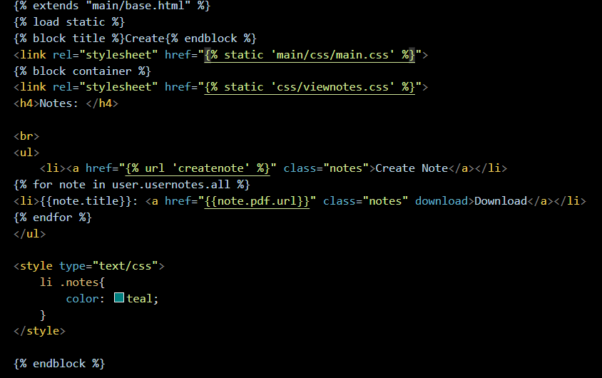
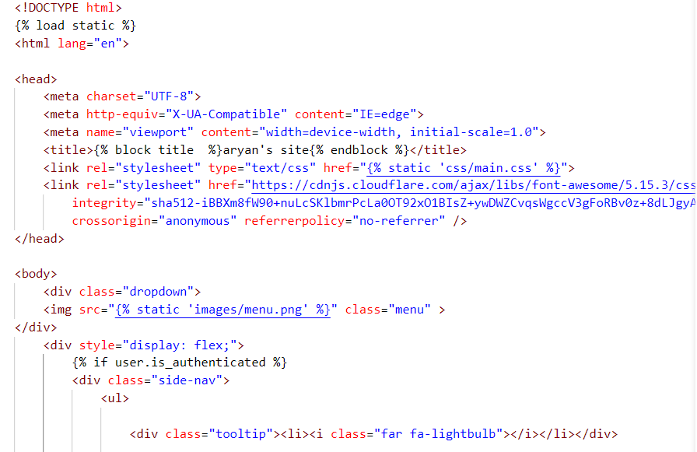
……contd.
UNSEEN PART OF WEBAPP:
We are using Python language as our primary language, moreover Django specially to handle the backend working and connecting with SQLite3 database, and html, css and javascript to handle the frontend part of it.
We have till date implemented- making number of todolist, notes uploading, login. Logout, user registration and quite a bit of UI/UX part of the WebApp

Slide 6
OBJECTIVES OF THE PROJECT :
To develop a technology which would make students life much easier.
To help everyone in management.
To help students in keeping all the materials in a single App
To let students Study without any stress of notes in such uncertain time.

Slide 7
LITERATURE REVIEW :
SR.NO. | 1 | 2 | 3
AUTHORS | Imed Romdhani, Martin Tawse, Safa Habibullah | Shrikant Patnanik & Khushboo Kumar Singh, Rashmi Ranjan, Niki Kumari. | Mrs. Selina Khoirom, Laimujam, Raj Singh, Soujaijam Nealson Singh, Lalshram Rabi Singh, Keisham Linthoigambi.
PAPER TITLE | Student Project performance management system for effective final year and dissertation projects supervision. | College management system. | Student management system.
YEAR | 2011 | 2016 | 2020
JOURNAL | LICE Conference London. | IRJET | IRJET
DESCRIPTION | The paper presents the at a new integrated and collaborative online supervision system and dissertation projects. | The project manages the college information, Notes, remainders and events going on. | The project includes computerizes the process, has facility to give unique ID to every student and stores details.
FINDINGS | The system needs to be fully implemented and then widely tested to confirm whether it helps to improve the quality of supervision and enhance student learning. | Assists the modifications in the system. Reducing manpower, accurate information are the basic facts to get covered. | The login credentials, the designs, the main core part of website is to be formed.

Slide 8






TOOLS AND COMPONENTS USED :
COMPONENTS :
Django
HTML-5
CSS-3
Javascript
SQLITE3
TOOLS :
VS Code
GIT and GITHUB
3) Python

Slide 9
Ready to present the prototype
Fixing bugs and issues with the website
Creating UI/UX for the website
Review the past study on similar projects
Understanding Django and its working with database.
METHODOLOGY
IMPLEMENTED

Slide 10
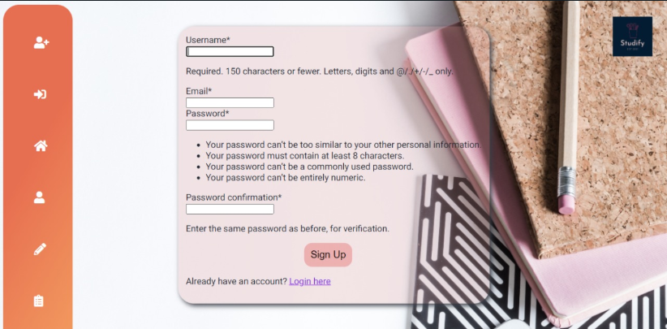
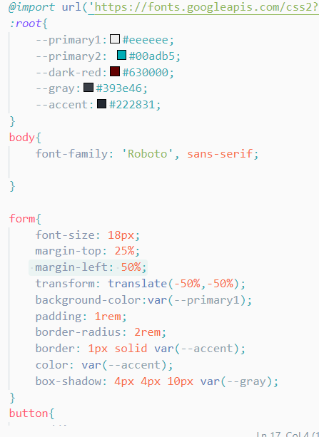
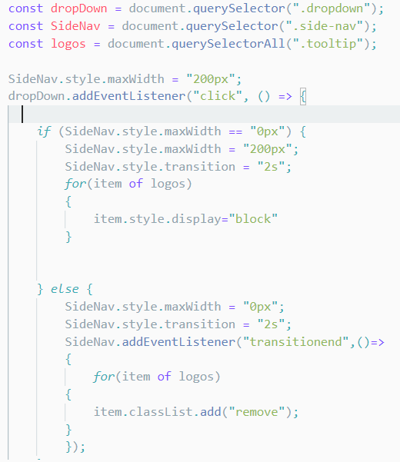

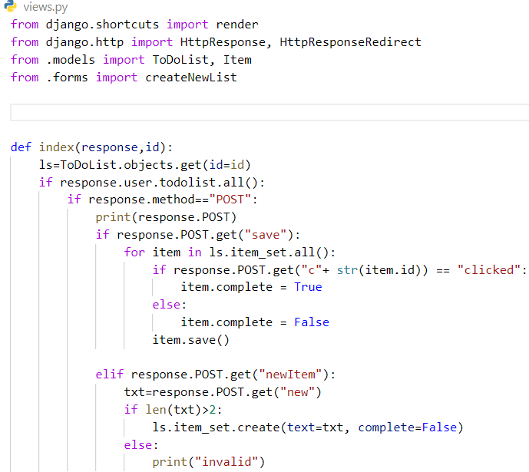
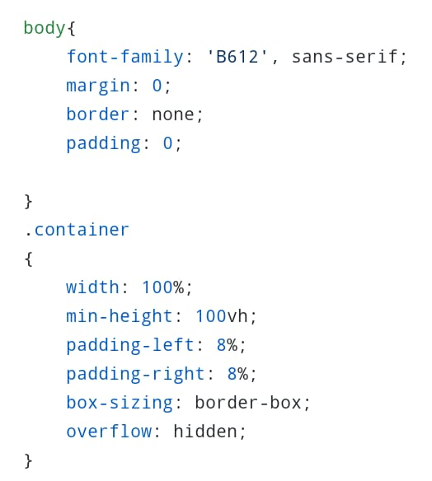

PROGRESS MADE SO FAR :

Slide 11
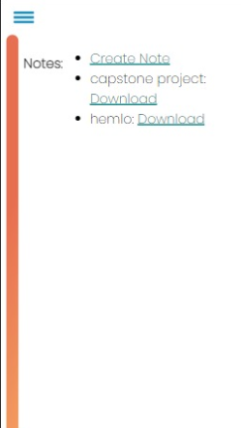
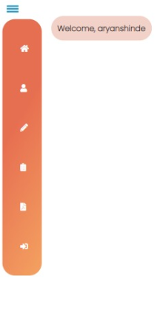
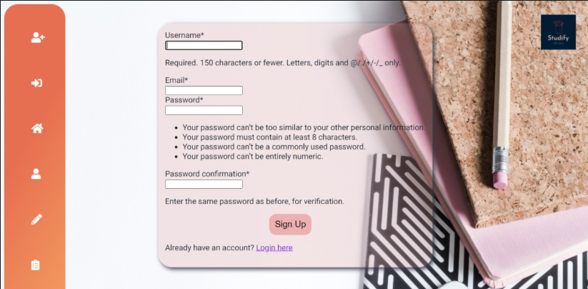
To view the source code of the website browse: http://github.com/AryanShinde/Studify

Slide 12
PRESENT STATUS OF PROJECT :
90%
Understanding of the tools and technologies used in the WebApp
75%
LITERATURE REVIEW
Analysis of past research on the prototype
75%
Implementing various functionalities for the WebApp
45%
Creating UI for the WebApp

Slide 13
REFERENCES :
YouTube
2) Stackoverflow
3) Research papers: i)
College management system.
ii)Student management system.
THANK YOU..

