Slide 1
Secure Data Hiding in Images Using Steganography
Capstone Project
Presented by: [Soham Gore]
K J SOMAIYA COLLEGE OF ENGINEERING COMPUTER ENGINEERING

Slide 2
Problem Statement
With increasing cyber threats, traditional encryption methods are susceptible to attacks. This project ensures secure message transmission by embedding secret data into images using Steganography, making it undetectable to unauthorized users.

Slide 3
Technology Used
- Programming Language: Python, Java (for Android)
- Libraries: OpenCV, NumPy, Pillow (PIL)
- Algorithm: Least Significant Bit (LSB) Technique
- Platforms: Google Colab, Android Studio

Slide 4
Wow Factors
- Highly Secure: Hides data within image pixels
- Dual-layer Security: Combines Steganography with encryption
- Efficient Storage: Minimal impact on image size
- Android Implementation: Portable and easy to use

Slide 5
End Users
- Government agencies for secure communication
- Journalists & Whistleblowers for confidential reporting
- Cybersecurity professionals for data protection
- Individuals seeking personal privacy

Slide 6
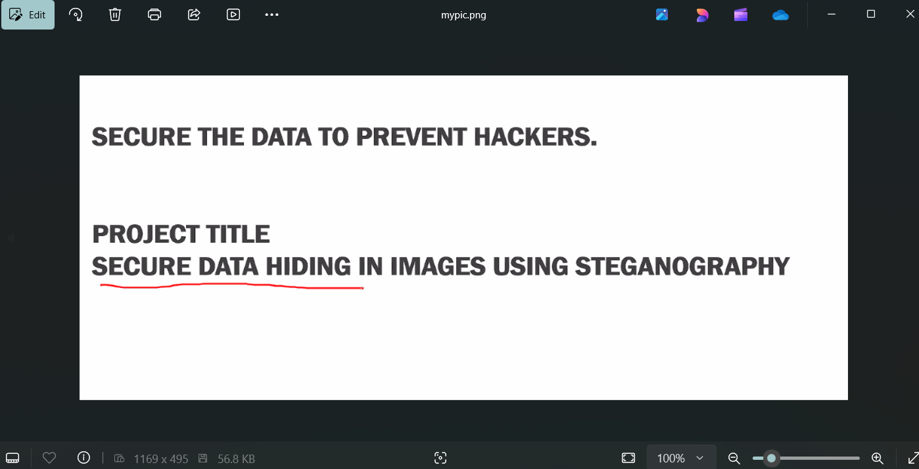
Results
Screenshots of:
- Original Image
-

Slide 7
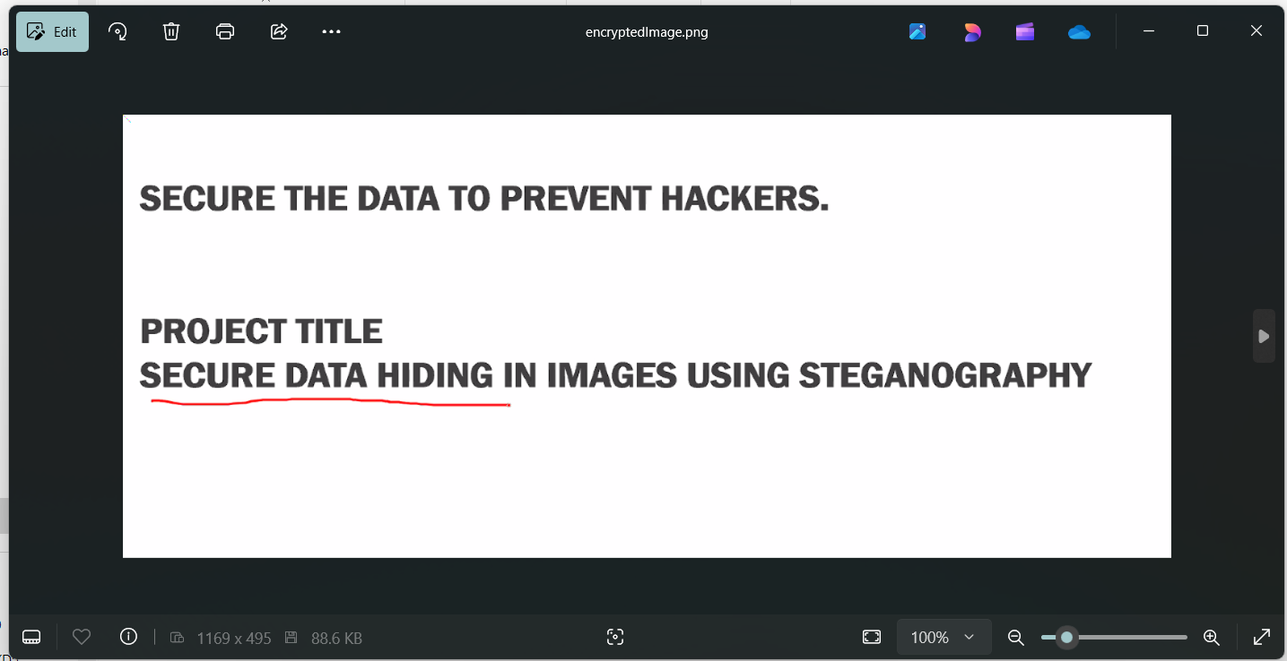
Results
Screenshots of:
- Encoded Image

Slide 8
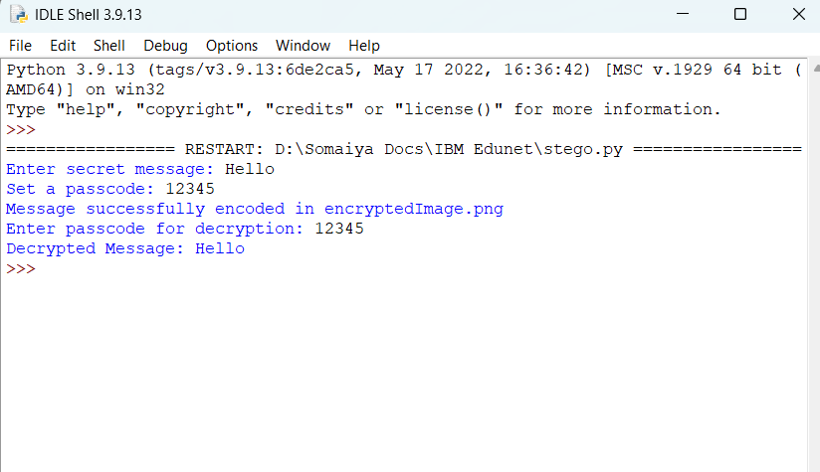
Results
Screenshots of:
Decoded Message

Slide 9
Conclusion
This project successfully implements Steganography to hide sensitive data in images securely. The approach ensures confidentiality and minimal detection risk, making it a valuable tool for secure communication.

Slide 10
GitHub Link
Project Repository: https://github.com/Soham07-coder/AicteProject

Slide 11
Future Scope
- Implementing Steganography for audio/video files
- AI-based detection resistance techniques
- Blockchain integration for message authenticity
- Mobile app with cloud-based encryption

Slide 12
Thank You
For more details, contact: [sohamgore2005@gmail.com]

