Slide 1
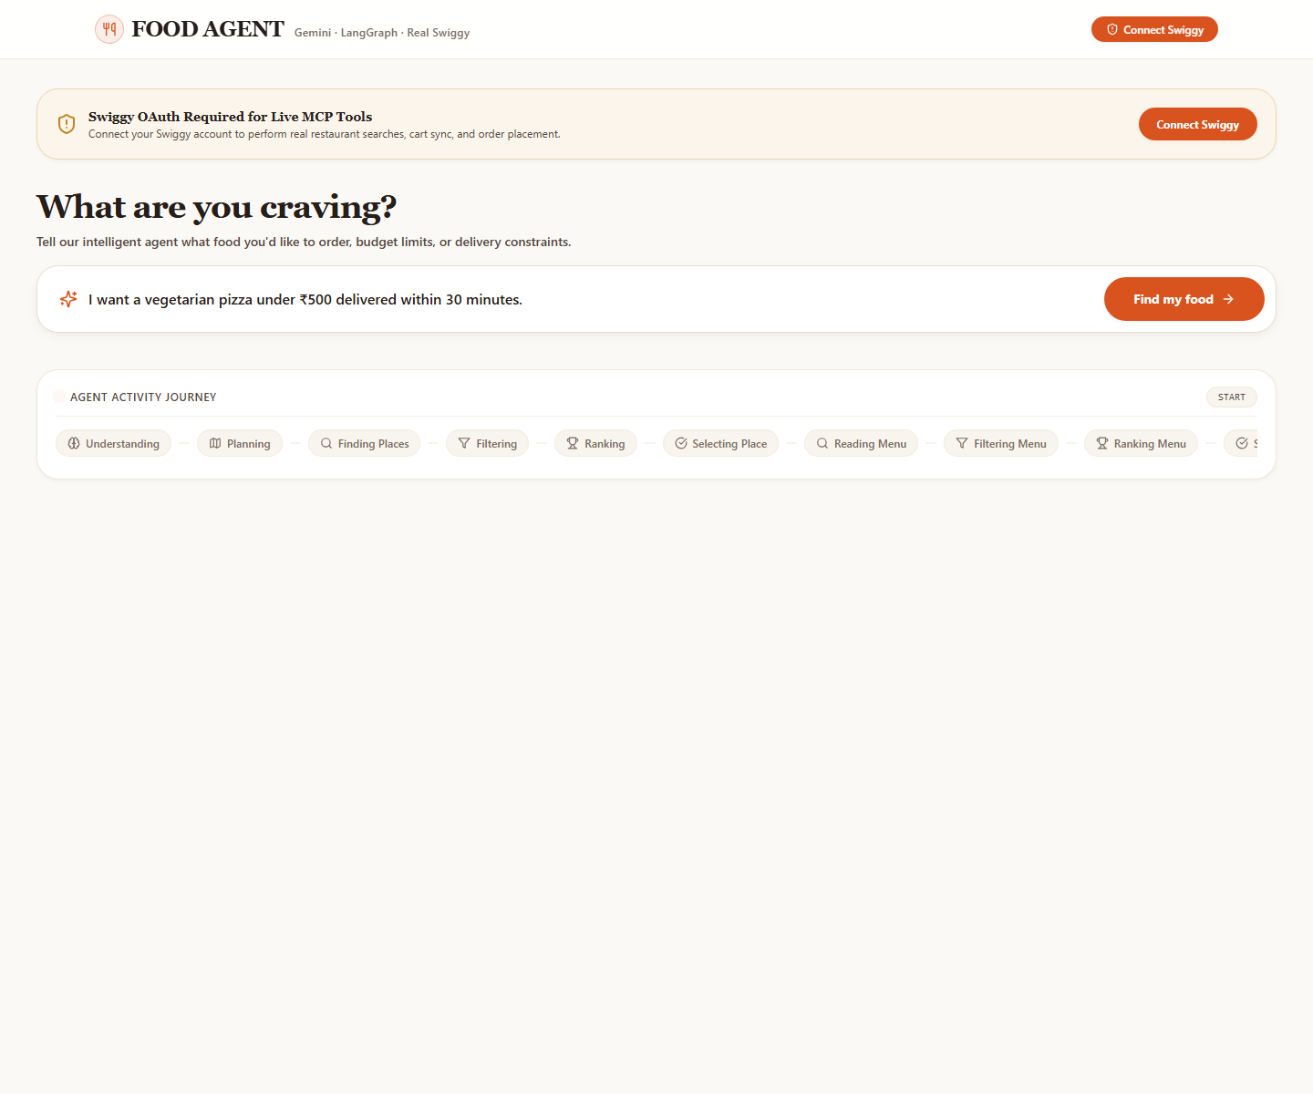
MIT ADT UNIVERSITY | MINI PROJECT SUBMISSION
FOOD ORDERING
AGENT
Conversational ordering, guided by your requirements
ORIGINAL PROJECT ? SCOPE UNCHANGED
Help users turn a natural-language food request into a suitable ordering workflow, while honoring constraints and requiring approval before order placement.
Objective: connect request understanding, real restaurant/menu data, and safe, user-controlled ordering.
The existing app and ordering workflow remain the project foundation.
PROJECT GROUP
Soham Satkur Roll No. 48
Tushar Bhite ? Roll No. 52
Tanishka Uttarkar ? Roll No. 51
UNIT 3 ? MEMORY + API
UNIT 4 ? AGENT WORKFLOW
Two course concepts are demonstrated through capabilities already integrated with the original project.
Food Ordering Agent ? Unit 3 and Unit 4 demonstrations

Slide 2
EXTENSION MODULE 1
02
Unit 3 | Memory storage + API calling
A persistent session plus live service integration makes the ordering workflow stateful and data-driven.
SESSION MEMORY
SQLite saves the session ID, current agent state, workflow step, event log, and encrypted Swiggy token. Paused work can resume from saved state.
API / MCP CALLS
The backend invokes Swiggy Food MCP tools for real address, restaurant, menu, cart, and order operations after account authorization.
DEMO PATH
Screenshot: real application request screen; live service calls require Swiggy OAuth.
User request ? API request ? MCP response ? structured AgentState ? SQLite persistence
Example input: ?Vegetarian pizza under ?500, within 30 minutes.?

Slide 3
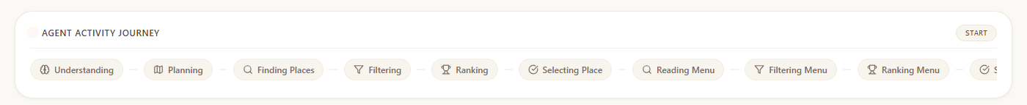
EXTENSION MODULE 2
03
Unit 4 | Multi-agent system concept
Implemented as a LangGraph-orchestrated workflow of specialist nodes sharing one typed state.
Shared AgentState carries requirements, selected items, cart, current step, and user-decision flags.
UNDERSTAND
PLAN
RESTAURANT
MENU + CART
PAYMENT
ORDER / TRACK
Parse request
Build plan
Search ? filter
? rank
Select ? customize
Pause for user
Confirm ? track
Conditional routes support re-planning and wait states.
LIVE FRONT-END VIEW ? THE ACTIVITY JOURNEY EXPOSES WORKFLOW PROGRESS
Accuracy note: these are centrally coordinated specialist nodes?not independent autonomous agents negotiating with one another.

Slide 4
INTEGRATED DEMO AND RESULTS
04
One request | Persistent, visible, user-controlled
The original ordering scope connects the Unit 3 and Unit 4 concepts in a single workflow.
SAMPLE INPUT
Vegetarian pizza ? budget ?500 ? delivery ? 30 min
WORKFLOW OUTPUTS
Parsed requirements ? API-backed restaurant/menu options ? filtered and ranked choices ? saved session progress.
INTEGRATION + SAFETY
LangGraph routes work between specialists. The flow pauses for payment/user input; explicit confirmation is required before order placement.
Screenshot: application home screen with the natural-language request and live workflow timeline.
Live restaurant/order results depend on successful Swiggy authorization and service availability.

Slide 5
CONCLUSION
05
Original project retained | Two concepts demonstrated
Unit 3 and Unit 4 capabilities are shown as extensions of the existing food-ordering system.
ORIGINAL PROJECT
UNIT 3
UNIT 4
Natural-language food ordering with real service integration, constraint handling, and a human confirmation boundary.
SQLite provides persistent per-session memory; Swiggy MCP provides authorized API-backed data and actions.
LangGraph coordinates specialist workflow nodes over shared state with conditional paths and user checkpoints.
FUTURE IMPROVEMENTS
THANK YOU
Add durable cross-session preference memory with user consent; add automated tests for API failures and graph branches; explore independent agent collaboration only if the project scope is expanded.
Soham Satkur 48
Tushar Bhite 52
Tanishka Uttarkar 51
MIT ADT University
Course / Section: [Add course and section before submission]

