Slide 1
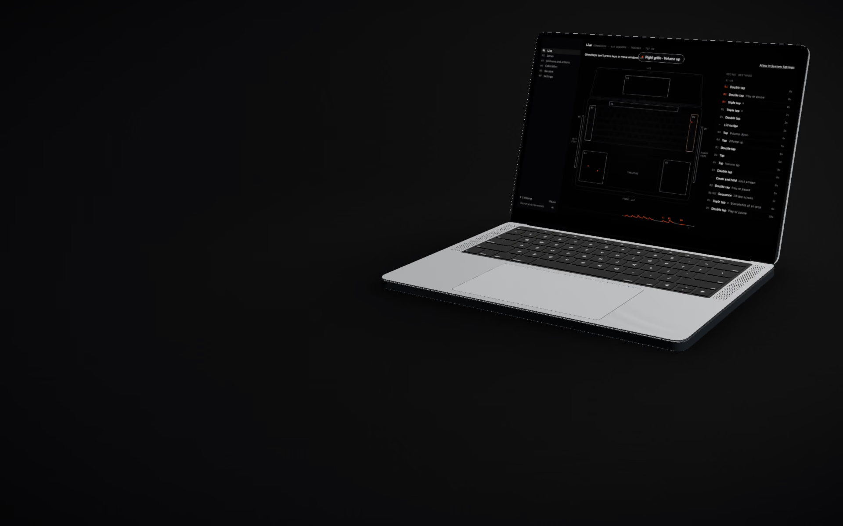
BADGER BUILDFEST 2026 · EMERGING TECHNOLOGY
Ghostkeys
Every blank surface is a key.

Slide 2
01 · THE PROBLEM
A MacBook is mostly dead space.
Palm rests. Speaker grilles. The strip above the keys.
None of it does anything, while we spend the day hunting for shortcuts.

Slide 3
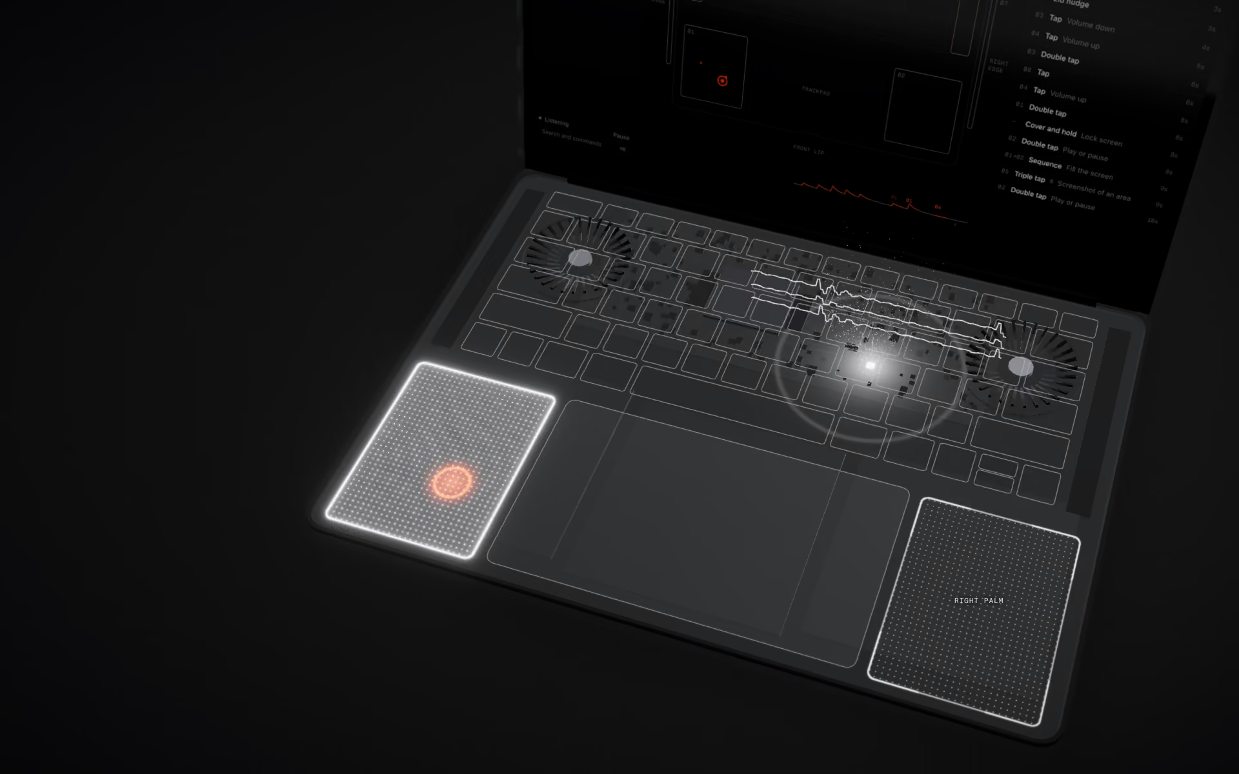
02 · THE PRODUCT
Tap it. It runs.
LEFT PALM REST
Mute the call
RIGHT GRILLE, TWICE
Screenshot
TOP STRIP
Back to the last app

Slide 4
03 · HOW IT WORKS
The sensor is already inside. We learned to read it.
800
33
0
READINGS A SECOND
MEASUREMENTS PER TAP
BYTES LEAVE THE MAC
From the motion sensor in every Apple silicon MacBook. No admin rights, no new hardware.
Two models vote on which spot you touched, and refuse to guess when a tap looks unfamiliar.
Calibration, detection and learning all run on the laptop.

Slide 5
04 · MEASURED, NOT PROMISED
16.5%
→ 1.4%
Wrong or false taps
2 / min
→ 0
False taps while picking up the laptop
0%
→ 84%
Taps recognised on a lap
On our own recordings. Every number re-run by an independent reviewer who did not write the code.

Slide 6
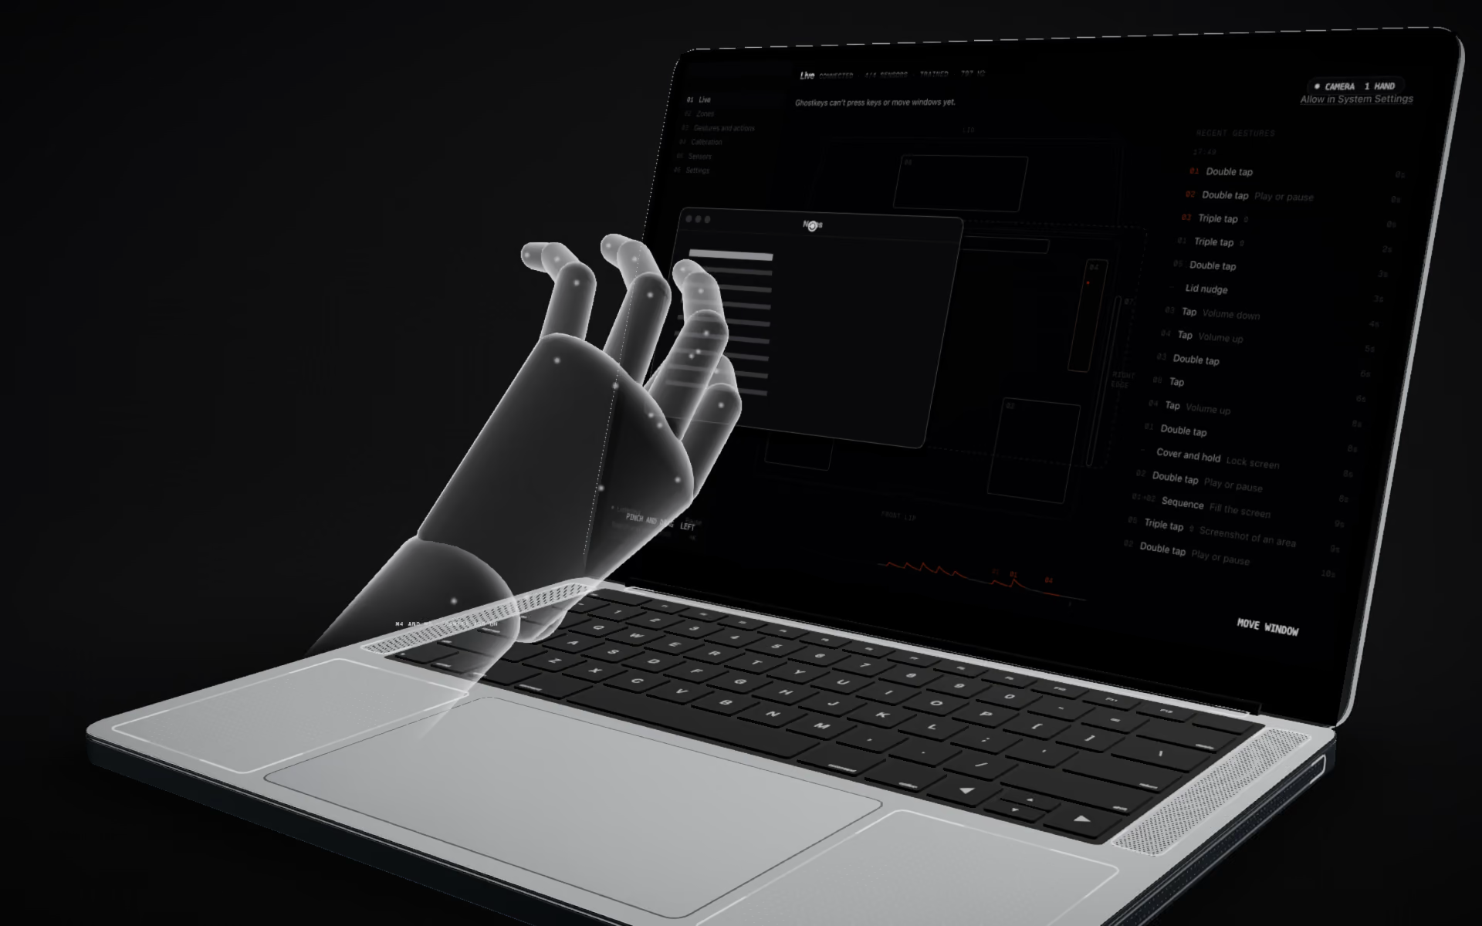
05 · BEYOND TAPS
Hands in the air. No camera.
The speakers play two tones too high to hear. The mic listens to how your hand bends them.

Slide 7
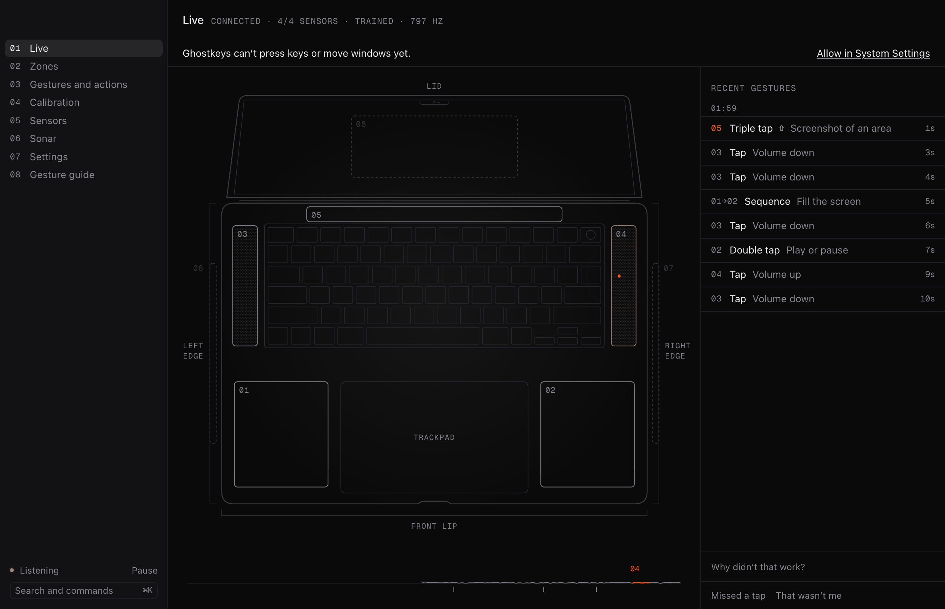
06 · THE APP
Calibrates in a minute.
Explains every miss.
A live view of every tap and where it was felt.
A tester that shows what fired and why.
Per-app layouts for Excel, Figma, Zoom.

Slide 8
07 · WHO PAYS
People who live on their laptop and hate reaching for shortcuts.
Analysts
Designers
Developers
Anyone on calls
Excel all day. Macros on a palm rest.
Tools and undo without leaving the canvas.
Build, run and switch without a chord.
Mute on a tap they can find blind.
Signal Mac users already pay for input tools like BetterTouchTool and Raycast. Every Apple silicon MacBook already has the sensor.

Slide 9
08 · BUSINESS MODEL
Free to try. Pay once to keep going.
FREE
PRO
TEAMS
$0
$29
$49
Forever
Once · $19 at launch
Per seat, per year
Two hidden buttons on your palm rests.
Every surface, every gesture, every action.
Pro for the whole desk, managed by IT. From 3 seats.

Slide 10
09 · WHY THIS WINS
No hardware. No camera. No cloud.
The Touch Bar is gone.
Apple removed the one extra input strip MacBooks had. The space is still there.
Macro pads cost money and desk space.
Ghostkeys uses the laptop you already carry, on a train or a couch.
Trackpad gestures are full.
Every swipe is taken. The rest of the chassis is not.

Slide 11
10 · NEXT 3 TO 6 MONTHS
MONTH 1
Signed public beta from the waitlist.
MONTH 2
Sonar at everyday volume. Swipes in the air.
MONTH 3
Learning from use, proven not to learn the wrong tap.
MONTHS 4 TO 6
Windows release. Team layouts. First paying teams.

Slide 12
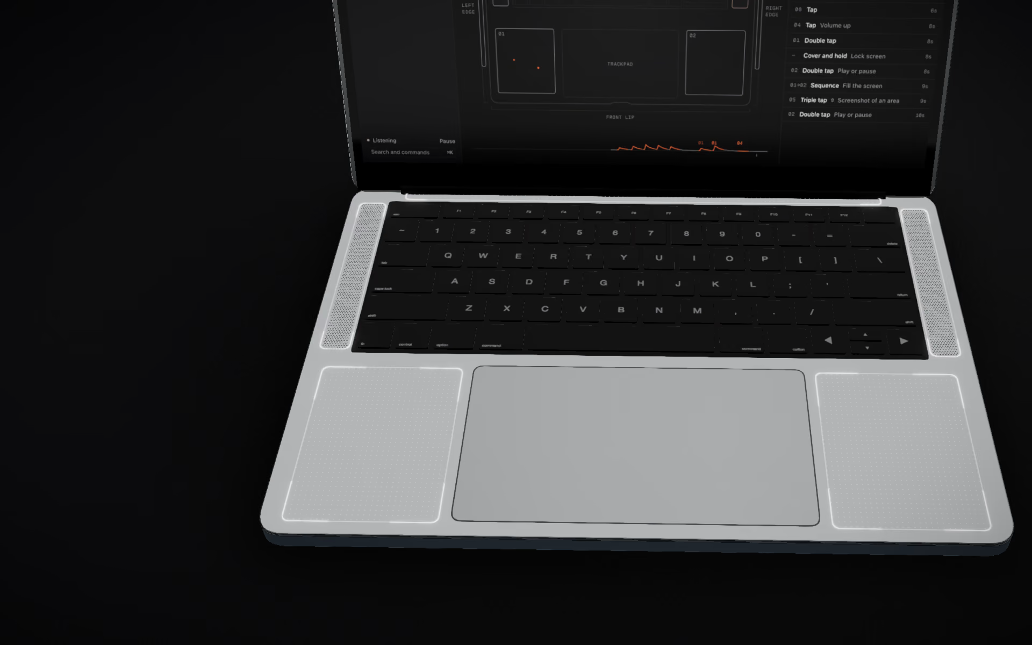
Ghostkeys
Try it on the laptop in front of you.
GHOSTKEYS-NINE.VERCEL.APP GITHUB.COM/SOHAM109/GHOSTKEYS

