Slide 1
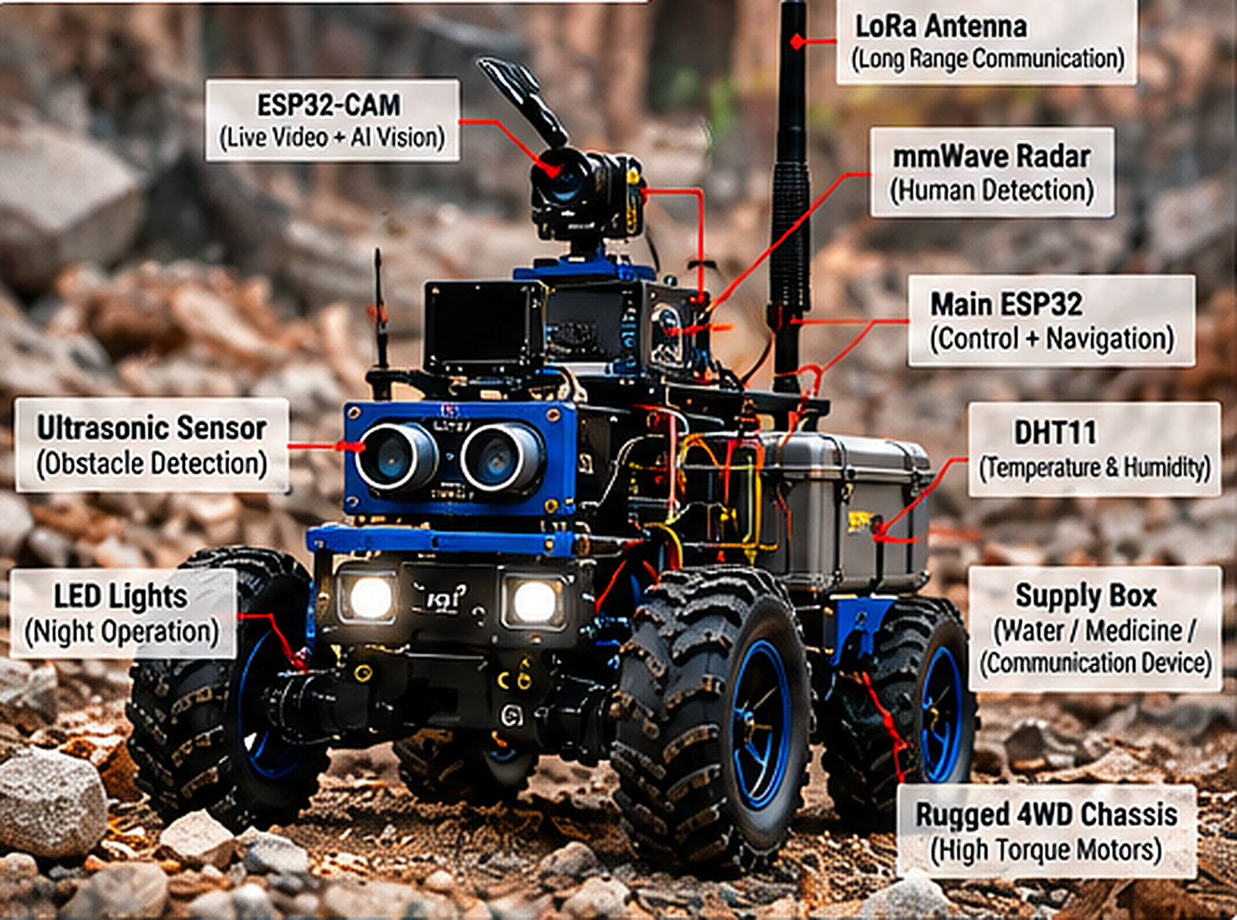
KURUKSHETRA 2.0 | 24-HR HACKATHON | FABTECH TECHNICAL CAMPUS, SANGOLA
AURA-X
AI-Powered Disaster Response Rover
Sees with AI. Thinks at the edge. Reports over LoRa.
Keeps responders in control.
AI & Intelligent Automation
IoT & Embedded Automation
Real-terrain prototype concept: 4WD chassis, ESP32-CAM, mmWave radar, LoRa
Team: [Team Name] | Members: [Add names] | Domain: AI + IoT

Slide 2
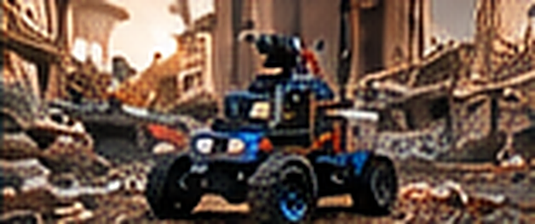
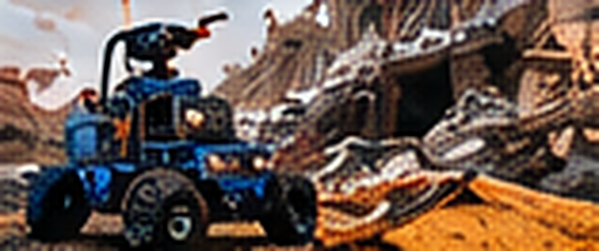

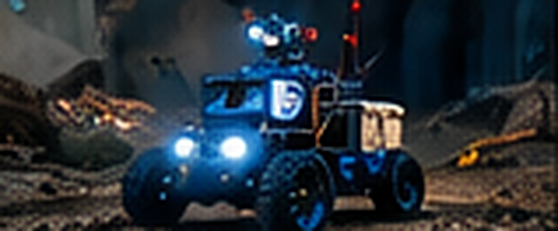
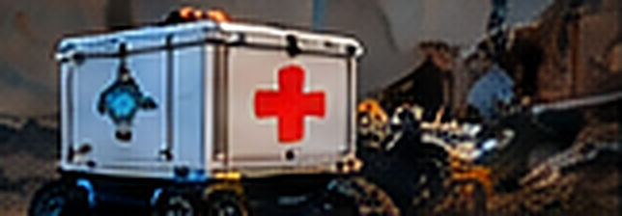


01 THE PROBLEM
The first look inside a disaster is the most dangerous
Hazardous
Collapses, fires and floods put rescuers at risk before anyone knows what is inside.
Collapsed buildings
Debris search
Blind
Debris, smoke and darkness hide survivors from responders at the entrance.
Night operation
Supply delivery
Disconnected
Wi-Fi and cell networks fail exactly where help is needed most.
The need: a low-cost robot that goes in first, flags possible people and reports back.

Slide 3



02 THE SOLUTION
AURA-X: a rugged AI rover that goes in first
DETECT
ESP32-CAM + vision AI flags possible people; mmWave radar adds supporting evidence.
NAVIGATE
Ultrasonic + IMU on a local ESP32 give autonomous obstacle avoidance.
COMMUNICATE
LoRa carries commands and alerts far beyond Wi-Fi range; Wi-Fi carries video.
ASSIST
Fixed supply compartment: water, medicine or a comm device, retrieved by a responder.

Slide 4

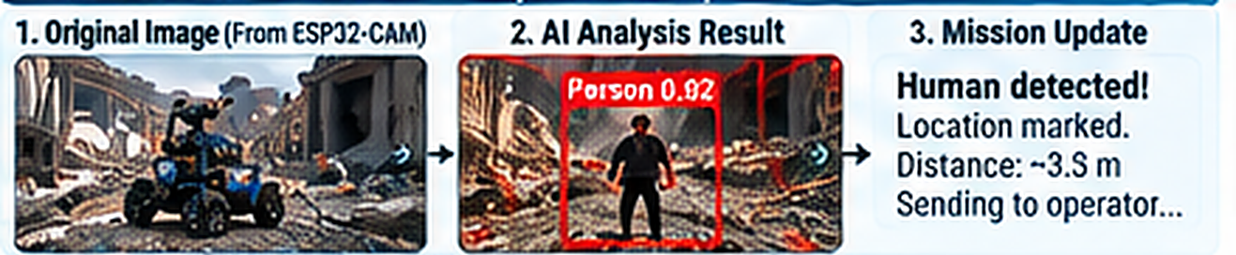
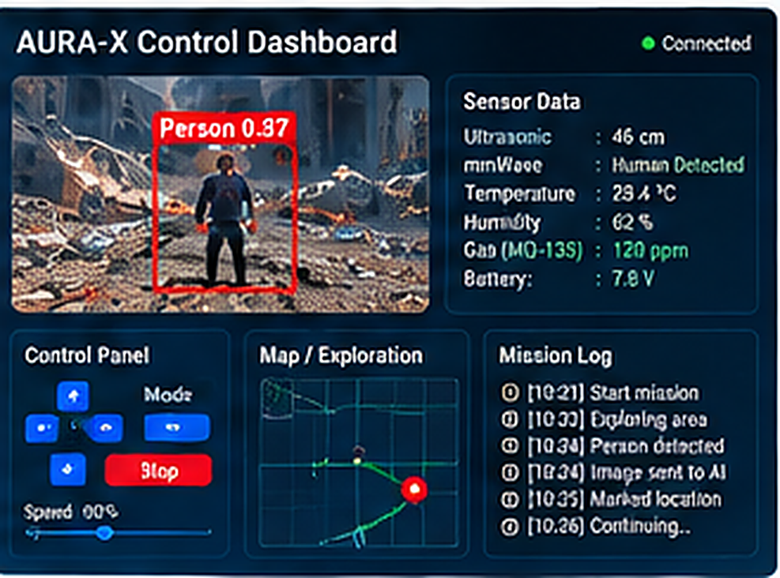

03 AI AT THE CORE
AI proposes. Humans decide. Firmware protects
1
Mission
2
Capture
3
Analyze
4
Fuse
5
Confirm
Operator: "search for people"
ESP32-CAM sends a frame
Vision AI finds a person + confidence
Add mmWave + sensor context
Operator verifies, then acts
Before / after: AI marks a possible person with a confidence score
Vision AI flags possible people from camera frames
mmWave radar is supporting evidence, never proof
Bad or missing AI output never moves the rover
Operator dashboard: live feed, detection box, sensor data

Slide 5



04 IoT + EMBEDDED SYSTEM
A four-layer IoT stack on low-cost embedded hardware
PERCEPTION
ESP32-CAM
HC-SR04 ultrasonic
MPU9250 IMU
mmWave radar
DHT11
Sensing the world
EDGE (EMBEDDED)
Main ESP32
Motor control
Sensor fusion
Safety state machine
E-stop
Real-time, offline-capable
CONNECTIVITY
Wi-Fi: video + dashboard
LoRa SX1278: commands, alerts
ACK + timeout
Two radios, two jobs
INTELLIGENCE
Gateway
Vision AI API
Mission planning
Incident summary
Advisory, not critical

Slide 6

05 DUAL COMMUNICATION
Wi-Fi for video. LoRa for survival
Wi-Fi / IP
LoRa
Live video + JPEG snapshots
Compact commands + telemetry
Dashboard + low-latency control
Event alerts + node health
Gateway sends frames to AI
Works with no Wi-Fi at all
Needs an IP path for cloud AI
Too slow for video, built for range
Reliability built in
Message IDs
Sequence numbers
ACK on critical commands
Timeout detection
Safe stop on link loss

Slide 7

06 EMBEDDED SAFETY
Deterministic onboard rules always win
BOOT / SELF-CHECK
Any mode to SAFE STOP when:
Sensors, radio, motor driver
fault / timeout
Physical E-stop pressed
SAFE STOP
Obstacle threshold crossed
Motors off. Report fault. Wait.
Critical sensor invalid
Command stale / link lost
MANUAL
AUTONOMOUS
SEARCH / ASSIST
Motor driver fault
Validated operator commands only
Local navigation + obstacle checks
Capture, AI advisory, operator confirms
AI output missing or malformed

Slide 8


07 OPERATION + LIVE DEMO
Three modes, one demo story
MANUAL
AUTONOMOUS
DISASTER ASSIST
Live video, web or LoRa control, real-time telemetry
Obstacle avoidance, explore area, AI human detection
Detect, mark location, deliver supplies, two-way contact
Mock disaster-zone demo flow
1
2
3
4
5
Drive
Traverse
Detect
Alert
Hand-off
Manual run with live video
Auto stop, scan, turn, re-check
Test image + radar event
LoRa telemetry, Wi-Fi unplugged
Stop; responder takes item

Slide 9

08 BUILD PLAN AND HONEST SCOPE
Reliable core first. AI on top. No overclaiming
01
02
03
04
05
06
Motor + E-stop
Ultrasonic safety
LoRa link
Camera + dashboard
AI gateway
Integrated tests
Demonstrates today
Not claimed
Next upgrades
Remote visual inspection
Seeing through smoke or rubble
Thermal camera
Possible-person image flagging
Reliable buried-survivor location
Calibrated gas sensors
Obstacle avoidance
Medical diagnosis
Wheel encoders + LiDAR SLAM
LoRa telemetry + alerts
Full autonomous mapping
On-device edge AI (TinyML)
Optional fixed supply box
Certified life-safety use
Solar charging

Slide 10
AURA-X
A practical step toward safer remote disaster inspection
AI-assisted perception + edge-safe navigation
LoRa-connected alerts + human-supervised assistance
"Detect possible signs. Report the evidence. Keep responders in control."
Thank you | Questions?

