Slide 1
B.TECH PROJECT · FINAL EVALUATION REPORT · AUGUST 2026
Event-Driven Traffic Congestion
Severity Prediction and Resource
Recommendation System
SUBMITTED BY
Department of Information Technology
ABV-IIITM Gwalior
Aman Kumar 2023IMT-010
Viswajit Sarak Patil 2023IMT-071
Sahil Pal 2023IMT-069
Stacked ensemble · 4 base learners
8,173 Bengaluru traffic events
Next.js · Go/Gin · FastAPI · Docker
SUPERVISOR
Dr. Saswata Roy

Slide 2
CHAPTER 1–2 · INTRODUCTION & MOTIVATION
The Problem
When a traffic event is first reported, the control room must decide how much to send — officers, barricades, diversions — before anyone has seen the site.
THE DATASET
8,173
That decision is currently made on experience alone.
traffic events, Bengaluru
46 → 30
Severity is not recorded. The raw log has no severity column — the target must be constructed.
raw columns → engineered features
Existing work predicts flow, not events. Most traffic ML forecasts speed or volume, not incident severity.
4
Rare classes matter most. Critical events are 3.6% of the data and the costliest to miss.
severity classes (Low → Critical)
91.7%
Prediction alone is not actionable. A severity number does not tell an officer what to deploy.
of events are just Low or High
Goal: predict how severe a traffic event will be at the moment it is reported, and convert that prediction into a concrete resource recommendation.
ASTRAM Gridlock · Aman Kumar · Viswajit Sarak Patil · Sahil Pal
2

Slide 3
CHAPTER 4 · OBJECTIVES & DELIVERABLES
What the Project Set Out to Do
01
02
03
Construct a severity target
Engineer 30 predictive features
Train four heterogeneous classifiers
where the raw data provides none, from priority and closure fields.
spatial, temporal and contextual — including K-Means location clustering.
LightGBM, XGBoost, an MLP and TabNet, each evaluated independently first.
04
05
06
Combine via out-of-fold stacking
Evaluate with imbalance-aware metrics
Deploy as a working full-stack service
with a LightGBM meta-learner — reported honestly, including where it fails.
macro-F1 and per-class recall, not accuracy alone.
so the model is exercised as an operator would, not from a notebook.
KEY DELIVERABLES
Reproducible preprocessing pipeline — imputation, encoding, K-Means clustering, all serialized.
Five trained models + comparative evaluation — four base learners, one stacked meta-learner.
Rule-based recommendation engine — severity to manpower, barricading and diversion plan.
ASTRAM Gridlock · Aman Kumar · Viswajit Sarak Patil · Sahil Pal
3

Slide 4
CHAPTER 3 · LITERATURE SURVEY
Related Work and Where This Thesis Sits
ML for incident severity
Deep learning for congestion
Ensembles & imbalance
Gradient-boosted tree ensembles consistently perform best on structured, tabular crash- and incident-severity data.
Research concentrates on recurring, sensor-driven congestion — leaving event-driven, non-recurring congestion under-explored.
Stacked generalization and imbalance-aware evaluation are each well established, but rarely applied together.
Iranitalab & Khattak · Zhu · Chen
Yin · Hussain · Dong
Wolpert · Chawla (SMOTE) · Zhang
THIS THESIS SITS AT THE INTERSECTION
It applies a stacked ensemble of tree-based and neural classifiers to event-driven severity prediction, evaluates it with explicit, front-loaded attention to class imbalance rather than accuracy alone, and — unlike most severity-prediction work surveyed — couples the prediction directly to a deterministic resource-recommendation engine that turns a severity label into an actionable deployment plan.
GAP 1
GAP 2
GAP 3
Event-driven congestion is under-studied next to recurring congestion.
Stacking and imbalance-aware evaluation are rarely combined.
Predictions are rarely converted into operational recommendations.
ASTRAM Gridlock · Aman Kumar · Viswajit Sarak Patil · Sahil Pal
4

Slide 5
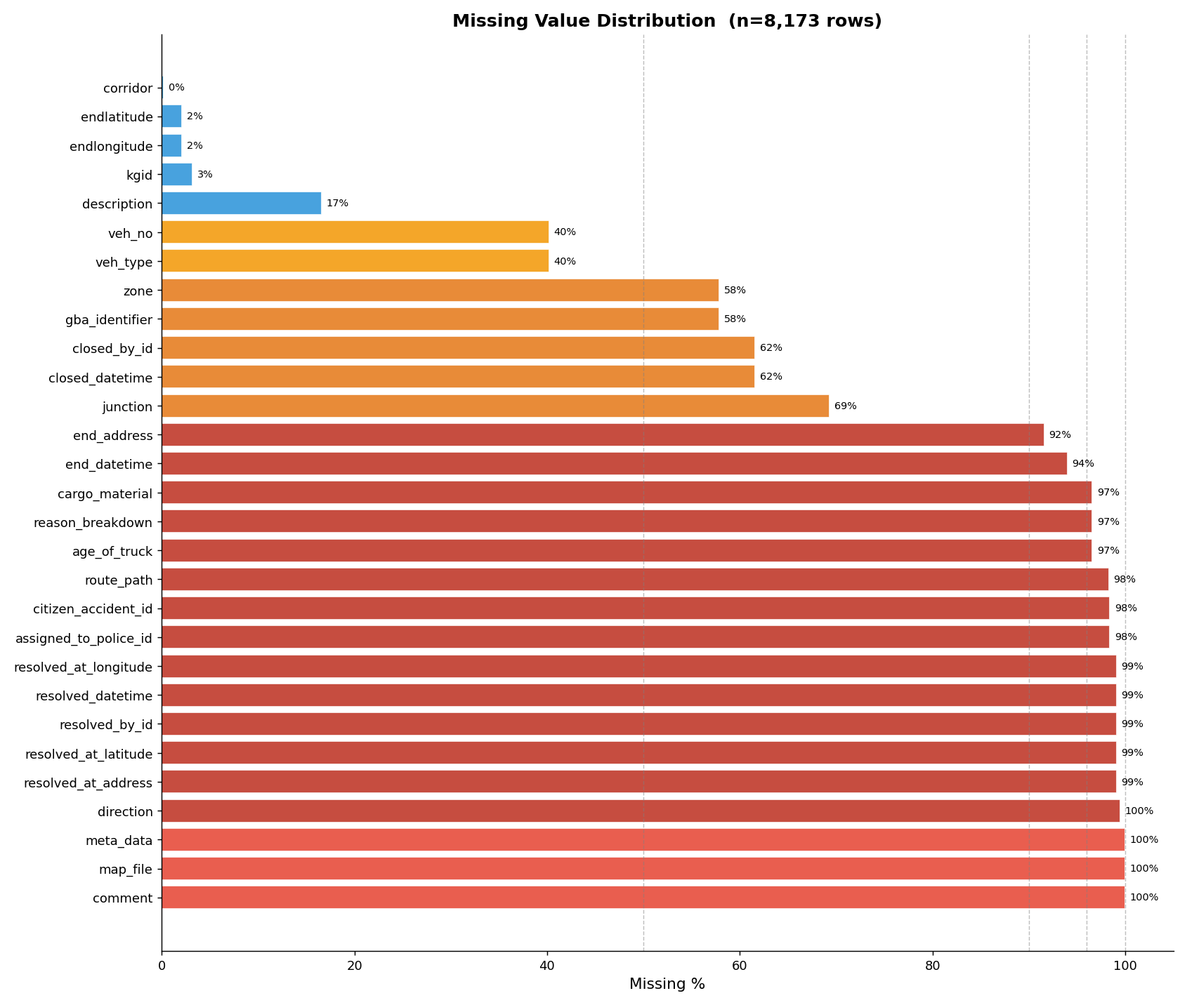
CHAPTER 5 · DATASET
The Data and Its Missing-Value Audit
An anonymised export of 8,173 Bengaluru traffic events with 46 raw attributes. A column-by-column missingness audit split them into four bands:
96–100% missing
comment · map_file · meta_data · resolution fields
Dropped outright — essentially no signal.
40–70% missing
junction 69.3% · closed_datetime 61.6% · zone 57.9% · veh_type 40.2%
Kept, with an explicit "unknown" category or presence flag.
0% missing
coordinates · event cause · priority · closure flag
Retained — these build the target and the core features.
Identifiers
id · client_id · created_by_id and similar keys
Dropped regardless — a database key carries no signal.
Missing-value distribution across the 46 raw columns (n = 8,173). Dropping the mid-band outright would have discarded real information.
ASTRAM Gridlock · Aman Kumar · Viswajit Sarak Patil · Sahil Pal
5

Slide 6
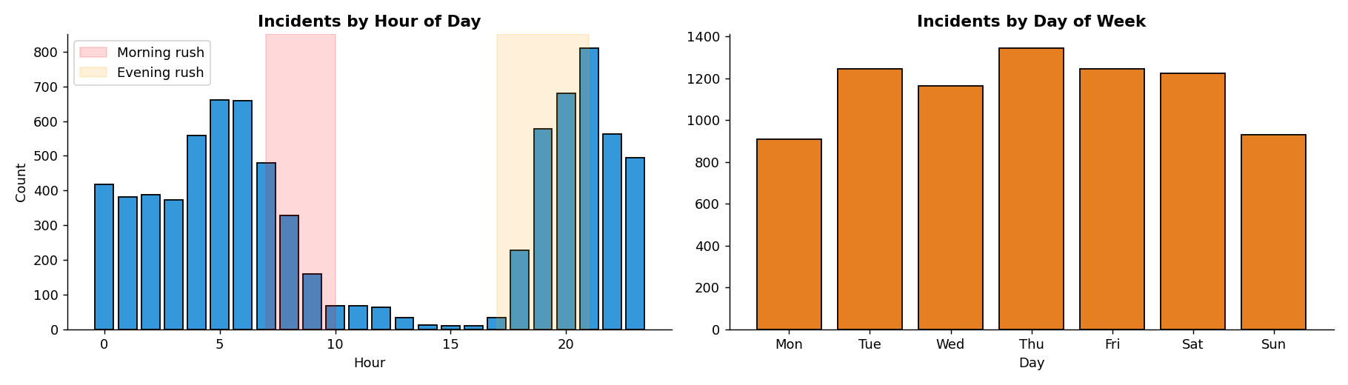
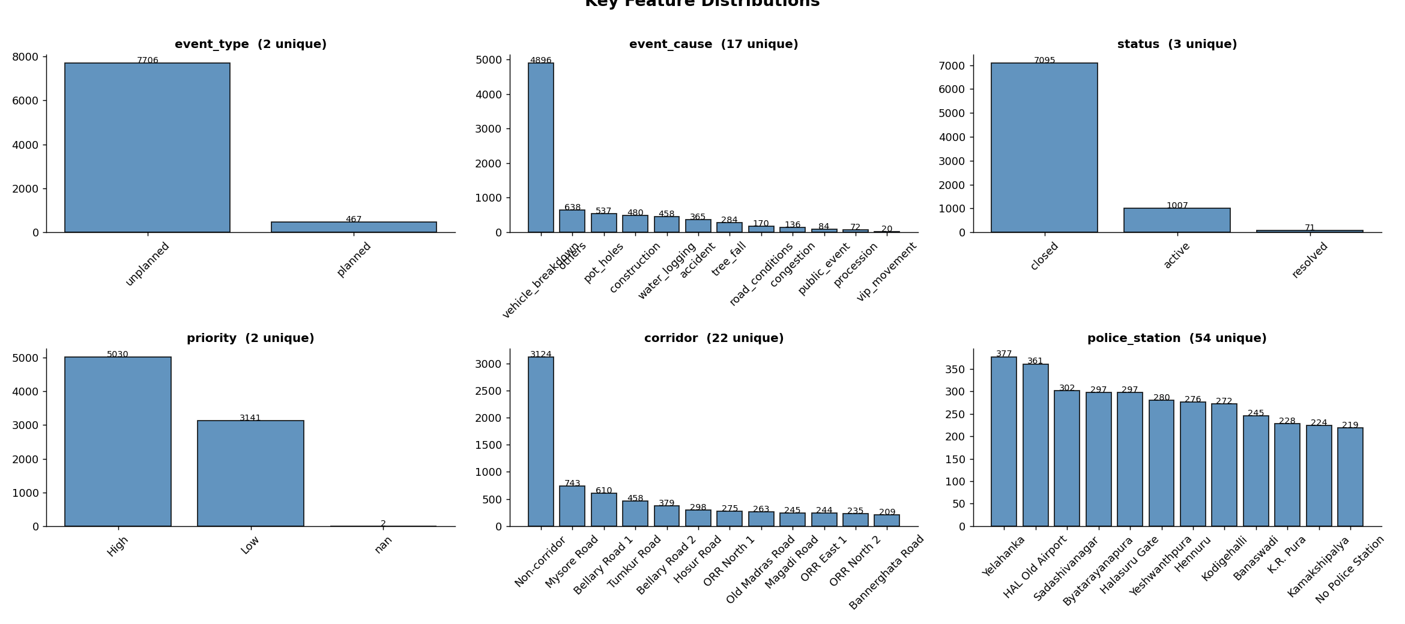
CHAPTER 5 · EXPLORATORY ANALYSIS
What the Data Looks Like Before Modelling
Exploratory analysis drove the feature design — the temporal structure below is the direct reason the engineered feature set carries rush-hour and day-of-week flags.
TEMPORAL STRUCTURE
Event volume by hour and by day of week across all 8,173 records.
FEATURE DISTRIBUTIONS
WHAT THIS MOTIVATED
Peak-hour flags 7–10 and 17–21 became binary features.
Day-of-week + weekend weekday and weekend traffic differ.
Time-of-day bucket a coarse grouping beside the raw hour.
Duration retained event length ties strongly to severity.
ASTRAM Gridlock · Aman Kumar · Viswajit Sarak Patil · Sahil Pal
6

Slide 7
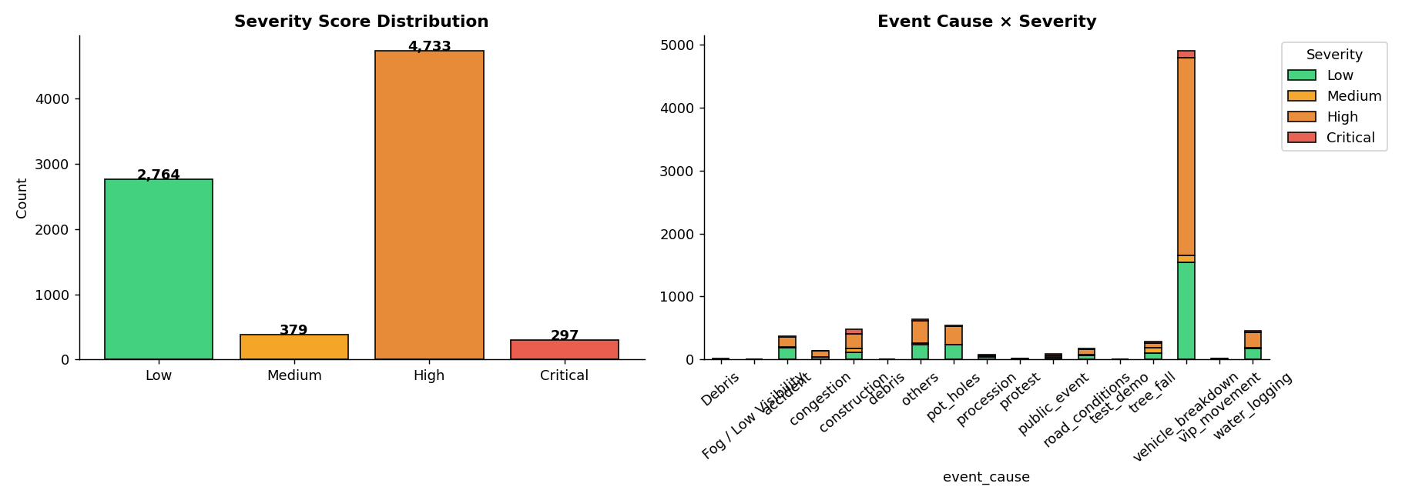
CHAPTER 5 · TARGET CONSTRUCTION
Building a Severity Label That Does Not Exist
No severity column exists in the raw log. The four-class target is built by crossing two fields the control room records independently for its own purposes.
Priority | Road closure | Code | Label
Low | No | 0 | Low
Low | Yes | 1 | Medium
High | No | 2 | High
High | Yes | 3 | Critical
Both source fields were then removed. If left in, a model would simply re-learn this deterministic mapping instead of inferring severity from spatial, temporal and contextual signals — and would be useless on a genuinely new, unassessed event.
The imbalance that shapes everything. Low and High together are 91.7% of all events. Medium and Critical make up under 9% between them — fewer than 300 Critical events in 8,173.
RESULTING CLASS DISTRIBUTION
Code | Label | Count | Share
0 | Low | 2,764 | 33.8%
1 | Medium | 379 | 4.6%
2 | High | 4,733 | 57.9%
3 | Critical | 297 | 3.6%
ASTRAM Gridlock · Aman Kumar · Viswajit Sarak Patil · Sahil Pal
7

Slide 8
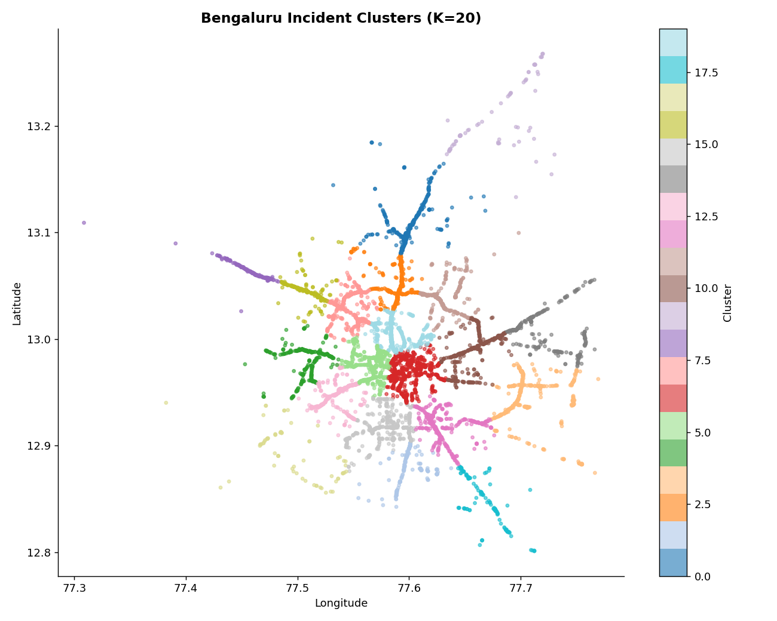
ML CONCEPT · FEATURE ENGINEERING
30 Features — and Why Coordinates Need Clustering
SPATIAL
latitude · longitude · corridor · police station · zone · junction · location cluster
TEMPORAL
hour · minute · day of week · month · weekend flag · rush-hour flags · time bucket
CONTEXTUAL
event type · event cause · vehicle type · duration · status · weather flag
K-MEANS · THE ONE UNSUPERVISED STEP
Supervised models learn from examples where the answer is known. K-Means is unsupervised — nobody tells it the answer, it just finds structure. It repeatedly assigns each event to the nearest cluster centre, then recomputes each centre as the mean of its points, until nothing moves.
Why it matters: raw lat/long are useless to a classifier — two events 100 m apart look like unrelated numbers. The cluster ID (0–19) becomes a feature instead.
20 K-Means clusters over Bengaluru incident coordinates.
ASTRAM Gridlock · Aman Kumar · Viswajit Sarak Patil · Sahil Pal
8

Slide 9
CHAPTER 5 · METHODOLOGY
End-to-End ML Pipeline
Raw log
›
Cleaning
›
30 features
›
K-Means
›
Encode + scale
›
80/20 split
8,173 × 46
impute / drop
spatial · temporal
K = 20
9 encoders
stratified
LightGBM
XGBoost
MLP
TabNet
16 meta-features = 4 models × 4 class probabilities · generated out-of-fold
Stacked meta-learner · LightGBM
learns how much to trust each base model
Severity 0 Low · 1 Medium · 2 High · 3 Critical
Stage 1 — learned. Four base classifiers with different structural biases, combined by a meta-learner trained on their out-of-fold probabilities.
Stage 2 — deterministic. A fixed rule table converts the predicted severity into a manpower, barricading and diversion plan. No ML involved.
ASTRAM Gridlock · Aman Kumar · Viswajit Sarak Patil · Sahil Pal
9

Slide 10
ML CONCEPT · BASE LEARNERS
Four Models, Two Very Different Learning Styles
GRADIENT-BOOSTED TREES · LightGBM, XGBoost
NEURAL APPROACHES · MLP, TabNet
A decision tree is a flowchart of yes/no questions ending in a prediction. One tree is weak — so build hundreds in sequence:
Layers of artificial neurons pass weighted signals forward; weights are adjusted over many passes to reduce error.
Tree 1
Tree 2
Tree 3
… ×1000
first guess
fixes T1 errors
fixes T2 errors
Each new tree specialises in the mistakes the previous ones made. Strongest family for mixed, table-shaped data — and the source of this project's best results.
256
128
64
32
TabNet adds attention — it learns which features to focus on at each decision step rather than weighing everything at once.
Early stopping
Class weighting
Stratified split
Training halts once the held-out score stops improving — prevents overfitting, where a model memorises quirks that don't generalise.
Errors on rare classes cost more. Applied to LightGBM and XGBoost only — and that single choice decides the results on slide 12.
6,538 train / 1,635 test, class proportions preserved. With only 297 Critical events, a careless split would make results noise.
Why four models? The data mixes continuous numbers, categories and time flags. Models with different structural biases make different mistakes — which is precisely what makes combining them worthwhile.
ASTRAM Gridlock · Aman Kumar · Viswajit Sarak Patil · Sahil Pal
10

Slide 11
ML CONCEPT · STACKED GENERALIZATION
Training the Meta-Learner Without Leakage
The problem: a model that has already seen an event predicts it far too confidently. Training the meta-learner on those inflated probabilities teaches it to trust an accuracy that will not exist on real new events — this is data leakage.
5-FOLD CROSS-VALIDATION
Fold 1
predict
train
train
train
train
Out-of-fold probability matrix
Fold 2
train
predict
train
train
train
6,538 rows × 16 columns — every row predicted
by a model that never trained on it
Fold 3
train
train
predict
train
train
Fold 4
train
train
train
predict
train
Meta-learner · LightGBM
Fold 5
train
train
train
train
predict
trained on the 16 columns → final severity
In each fold, fresh copies of all four base models train on the blue slices and predict the orange one.
Honest result: stacking did NOT beat the base models here — the ensemble posts the lowest accuracy of all five (0.8948). The in-fold model copies were lighter than the final tuned models, and with under 100 Critical examples per fold the meta-learner had too little signal to weight the rare classes well. It still reached the second-best Critical recall.
ASTRAM Gridlock · Aman Kumar · Viswajit Sarak Patil · Sahil Pal
11

Slide 12
ML CONCEPT · EVALUATION
Precision, Recall, and Why Accuracy Lies
CONFUSION MATRIX · MLP ON THE CRITICAL CLASS
MACRO-F1 · THE METRIC THIS THESIS LEADS WITH
PREDICTED
Critical
Not Critical
F1 combines precision and recall into one number (their harmonic mean — it stays low unless both are decent).
Macro-F1 averages F1 across all four classes, each counting equally. A rare class weighs as much as a common one, so a model that ignores Critical gets punished — which plain accuracy never does.
ACTUAL
Critical (59)
2
57
true positives
false negatives — missed
Not Critical
(1,576)
0
1,576
false positives
true negatives
WHY ACCURACY LIES HERE
PRECISION
RECALL
92.4% accurate · 3% Critical recall
TP / (TP + FP) = 2 / 2
TP / (TP + FN) = 2 / 59
1.00
0.03
Because 91.7% of events are Low or High, a model can lean on those two classes, clear 92% accuracy, and still be blind to the one class the system exists to catch. That single number pair is this thesis's core argument.
Of everything it CALLED Critical, how much really was? Perfect — and meaningless alone: it stays perfect precisely because the model almost never risks the call.
Of everything that TRULY WAS Critical, how much did it catch? 3%. It lets 57 of 59 critical events through, labelled less urgent.
Therefore: every model in this project is reported on macro-F1 and per-class recall, not accuracy alone.
ASTRAM Gridlock · Aman Kumar · Viswajit Sarak Patil · Sahil Pal
12

Slide 13
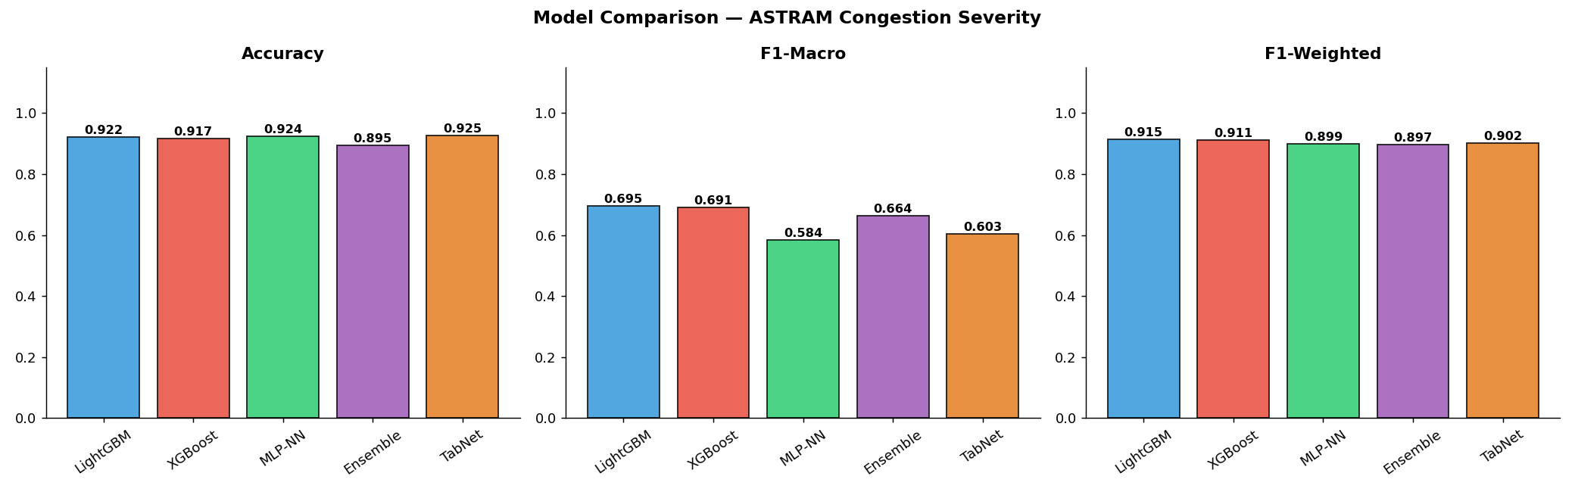
CHAPTER 7 · RESULTS
Model Comparison — n = 1,635 Held-Out Events
OVERALL PERFORMANCE
Model | Accuracy | Macro-F1 | Weighted-F1
LightGBM | 0.9223 | 0.6949 | 0.9148
XGBoost | 0.9168 | 0.6906 | 0.9114
MLP-NN | 0.9242 | 0.5843 | 0.8992
TabNet | 0.9254 | 0.6027 | 0.9020
Stacked Ensemble | 0.8948 | 0.6639 | 0.8968
CRITICAL CLASS · SUPPORT = 59
Model | Precision | Recall | F1
LightGBM | 0.54 | 0.32 | 0.40
XGBoost | 0.46 | 0.36 | 0.40
MLP-NN | 1.00 | 0.03 | 0.07
TabNet | 0.75 | 0.10 | 0.18
Stacked Ensemble | 0.28 | 0.34 | 0.31
The reversal. TabNet has the highest accuracy (0.9254). LightGBM has the best macro-F1 (0.6949). Ranking by accuracy picks the wrong model for deployment.
What fixed it. LightGBM and XGBoost are the only models trained with class-balanced weighting — and they are exactly the two with usable Critical recall (0.32, 0.36).
All five models handle the majority classes comfortably — Low F1 0.93–0.94, High F1 0.95–0.97.
ASTRAM Gridlock · Aman Kumar · Viswajit Sarak Patil · Sahil Pal
13

Slide 14
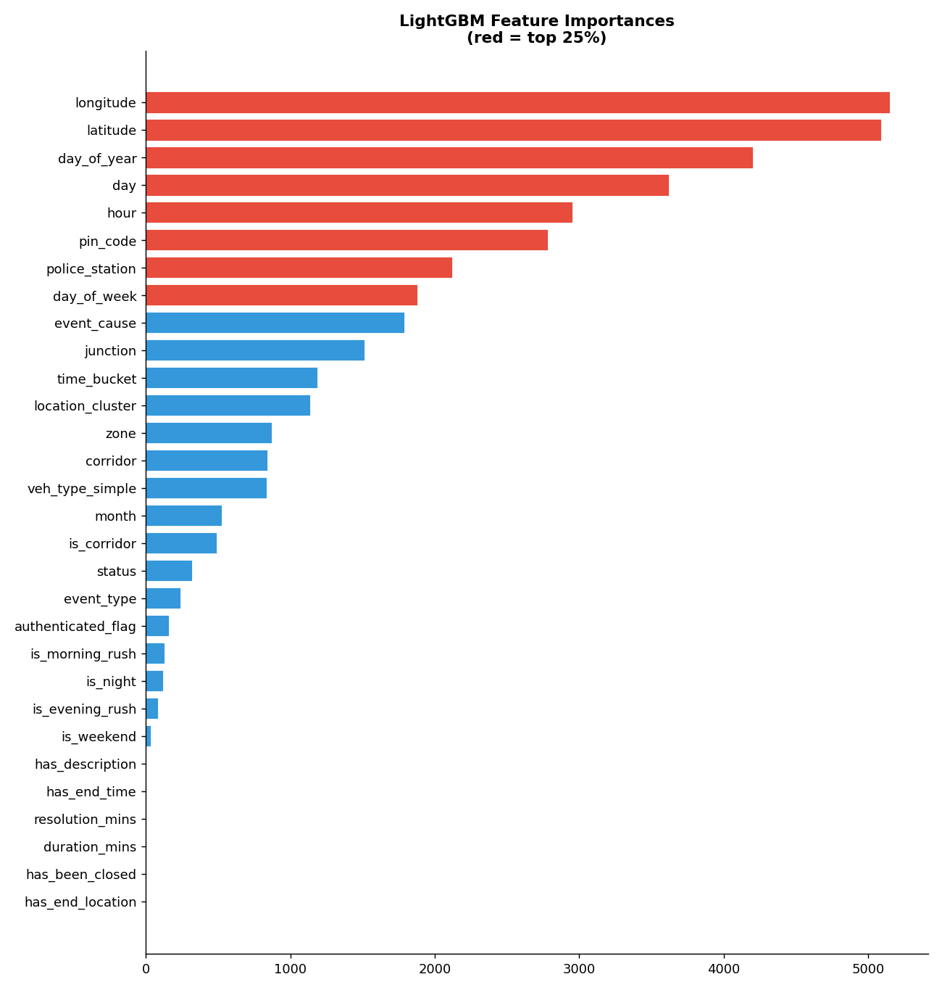
CHAPTER 7 · FEATURE IMPORTANCE
What the Strongest Model Actually Relies On
WHAT RANKS HIGHEST
Raw coordinates dominate
longitude and latitude are the two most-used split features — fine-grained geography carries the most signal.
Fine-grained time next
day_of_year, day and hour rank immediately below — the model prefers continuous time over the engineered rush-hour flags.
Then jurisdiction & cause
pin_code, police_station, day_of_week and event_cause form the following band.
The reading: severity is driven mainly by WHERE an event happens and WHEN — with event cause as the strongest non-geographic signal.
Caveat: split-count favours high-cardinality features — which is why the binary flags sit at the bottom. It counts how OFTEN a feature is split on, not its effect.
LightGBM split-based importance; red bars mark the top quartile.
ASTRAM Gridlock · Aman Kumar · Viswajit Sarak Patil · Sahil Pal
14

Slide 15
CHAPTER 5 · RECOMMENDATION ENGINE
From Severity to an Actionable Deployment
The learned models answer "how severe does this look". The rule engine answers "what do we do about it" — kept deterministic and separate so it stays auditable and tunable without retraining.
BASE SEVERITY-TO-ACTION MAPPING
Severity | Officers | Delay | Barricading | Diversion
Low | 2 – 4 | 15 min | Cones / indicators only | No diversion needed
Medium | 4 – 8 | 30 min | Partial barricade (1 lane) + 1 marshal | Advisory alternate route
High | 8 – 14 | 60 min | Full barricade, both sides, 2 marshal points | Mandatory route + digital signage
Critical | 15 – 25 | 90 min | Full corridor lockdown + marshal chain | Police-escorted + public advisory
CONTEXTUAL MULTIPLIERS
CAUSE-SPECIFIC ACTIONS
×1.4
public_event ≥ High
crowd-control perimeter + coordinate with organiser
on a designated high-density corridor
accident ≥ High
keep ambulance lane open + trauma centre on standby
×1.25
in a peak window — 7–10 or 17–21 hours
pre-announced event
pre-deploy minimum officers 2 hours before start
Note: this stage involves no machine learning at all — the ML predicts how severe, a hand-written rule decides what to do about it.
ASTRAM Gridlock · Aman Kumar · Viswajit Sarak Patil · Sahil Pal
15

Slide 16
WALKTHROUGH
One Event, End to End
An illustrative walkthrough of a single request through the whole system. The rule-engine figures are exact; the class probabilities are example values.
1 · EVENT REPORTED
2 · FEATURE VECTOR
3 · BASE MODELS
4 · VERDICT
cause
accident
Same encoders, scaler and K-Means as training:
· cause → encoded id
· 18:30 → evening peak = 1
· lat/long → cluster 7
· 30 features assembled
LightGBM
0.71
HIGH
time
18:30 Tue
XGBoost
0.68
corridor
Outer Ring Rd
MLP
0.62
severity 2
conf. 0.71
lat/long
12.93, 77.61
TabNet
0.65
veh_type
heavy
P(High) from each →
16 probabilities stacked
cluster 7
peak hour
duration
90 min
5 · RULE ENGINE · DETERMINISTIC, NO ML
Base for High severity: 8–14 officers
× 1.4 major corridor × 1.25 peak window (17–21)
→ 14–25 officers
Delay estimate
60 minutes
Barricading
Full barricade, both sides, 2 marshal points
Diversion
Mandatory alternate route + digital signage
Cause rule (accident ≥ High)
Keep ambulance lane open · trauma centre on standby
End to end: a raw event description becomes a severity class, a confidence, and a concrete deployment plan — in a single API call.
ASTRAM Gridlock · Aman Kumar · Viswajit Sarak Patil · Sahil Pal
16

Slide 17
CHAPTERS 5–6 · SYSTEM ARCHITECTURE
Backend Structure & Request Flow
Browser
:3000
API layer
:8080
Inference sidecar
:8001
Next.js 16 · React
TypeScript · Tailwind
Go 1.26 · Gin
routing · CORS · validation
Python · FastAPI
model bundle in memory
REQUEST LIFECYCLE · POST /api/predict
API SURFACE
1
Browser POSTs event attributes
lat/long · cause · time
POST
/api/predict
severity + recommendation
2
Gin handler validates & binds JSON
handlers/predict.go
GET
/api/meta
corridors, stations, zones
GET
/api/locate
nearest station + cluster
3
Go forwards to sidecar /infer
5 s timeout
GET
/api/health
sidecar reachability
4
Sidecar rebuilds the feature vector
encoders · scaler · K-Means
WHY A SEPARATE PYTHON SIDECAR?
5
Base models → meta-learner
The trained models are Python objects (LightGBM, XGBoost, scikit-learn). Go cannot load them, but handles HTTP, concurrency and validation better. Splitting the tiers keeps each in the language it is strongest in.
16 stacked probabilities
6
Rule engine attaches resources
manpower · barricading
7
JSON returns up the chain
severity · confidence
Deployment. Both services are containerised and orchestrated with Docker Compose; the model bundle is loaded once at sidecar startup and held in memory.
ASTRAM Gridlock · Aman Kumar · Viswajit Sarak Patil · Sahil Pal
17

Slide 18
CHAPTER 7 · CONCLUSION & FUTURE SCOPE
Conclusions
A four-class severity target was constructed from priority and closure fields, with both removed from the features to keep the task honest.
LIMITATIONS
Single city, single time period. Severity is a proxy built from operational fields, not a ground-truth measurement. Critical recall of 0.36 remains too low for unsupervised deployment.
LightGBM is the best model on macro-F1 (0.6949) despite TabNet posting the highest raw accuracy — the central metric-choice result.
Stacking did not improve on the base models posting the lowest accuracy (0.8948), reported honestly rather than omitted.
FUTURE SCOPE
Class weighting is what recovered rare-class recall the only two models with usable Critical recall are the two that used it.
SMOTE / focal loss for the rare classes · decision-threshold tuning for recall · live traffic and weather feeds · multi-city validation.
The pipeline runs as a deployed service Next.js → Go/Gin → FastAPI sidecar, containerised, not left inside a notebook.
Central contribution: on imbalanced, safety-relevant traffic data, accuracy actively misleads — a 92.4%-accurate model can be 97% blind to the class it exists to catch.
ASTRAM Gridlock · Aman Kumar · Viswajit Sarak Patil · Sahil Pal
18

Slide 19
Thank You
Questions and discussion
PRESENTED BY
Aman Kumar 2023IMT-010
Event-Driven Traffic Congestion Severity Prediction
Under the supervision of Dr. Saswata Roy
Department of IT · ABV-IIITM Gwalior
Viswajit Sarak Patil 2023IMT-071
Sahil Pal 2023IMT-069

