Slide 1

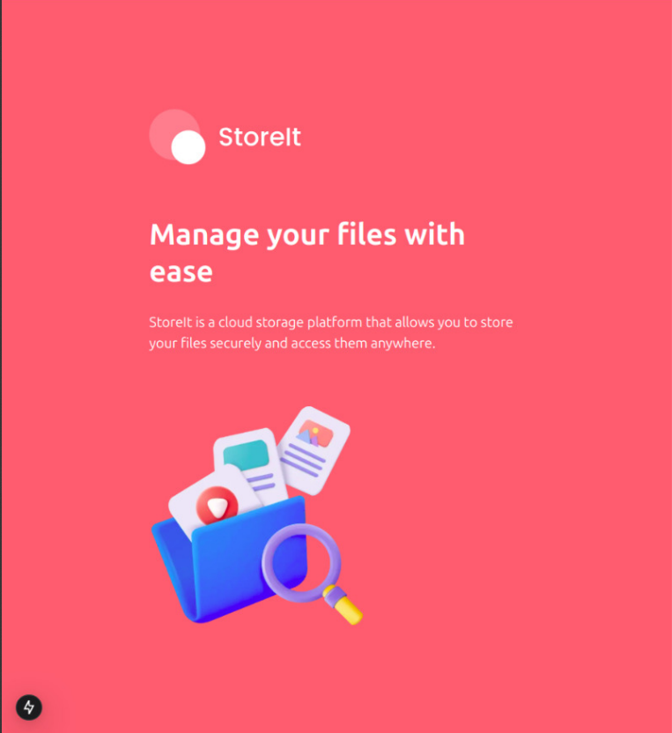
StoreIT – File Storage Platform
Secure | Scalable | User-Friendly
Soham Satpute | 16/04/25 | Roll No: 51/D15A

Slide 2
Problem Statement
User Needs
Existing Solutions
Opportunity
Secure, simple, scalable platform for file storage and sharing.
Often complex, paid, or lack customization options.
Responsive, user-friendly system with secure access and efficient handling.

Slide 3
Project Overview
Platform
Technologies
Inspiration
Cloud-based file storage and sharing.
React frontend
Inspired by Google Drive and Dropbox.
Flask backend
MongoDB + GridFS storage

Slide 4

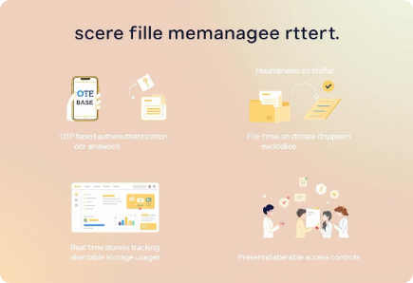




Key Features
Secure Login
File Management
OTP-based user authentication.
Upload, view, delete, and categorize files.
Storage Tracking
Sharing
Real-time usage monitoring.
Generate shareable links with access control.

Slide 5
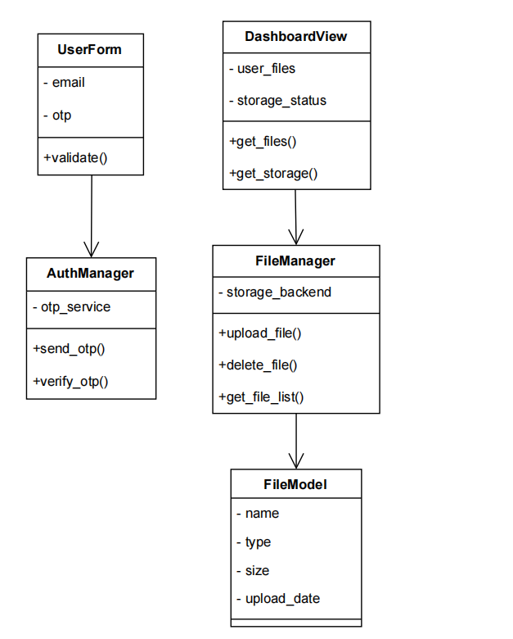
Architecture
Frontend
Backend
React for dynamic UI components.
Flask with REST API for server logic.
Storage
Authentication
MongoDB for metadata, GridFS for large files.
JWT and OTP for secure login.

Slide 6





Functional Requirements
OTP Authentication
Secure user login via one-time password.
File Management
Upload, preview, and delete files easily.
Dashboard
Storage analytics and file overview.
Link Sharing
Generate and manage shareable file links.

Slide 7

Non-Functional Requirements
Security
Secure API communication with JWT and HTTPS.
Scalability
Modular design to support growth.
Performance
Fast async operations for responsiveness.
Accessibility
Mobile-responsive user interface.

Slide 8
Technology Stack
Frontend
Backend
Database
Security
React
Python
MongoDB
JWT
HTML/CSS
Flask
GridFS
OTP service
Axios

Slide 9
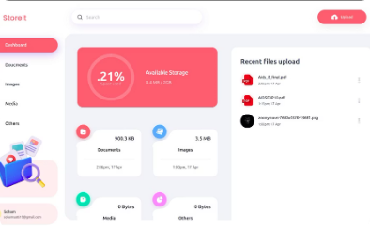
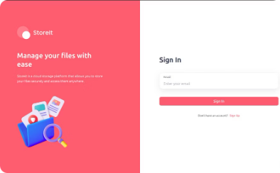
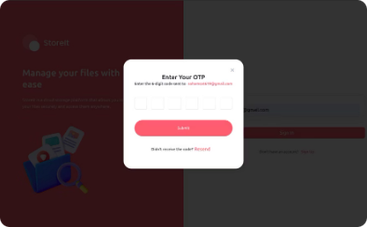
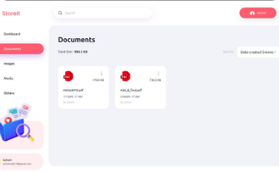
Conclusion & Future Scope
Login Page
Dashboard View
Upload Interface & File List
Shareable Link Modal

Slide 10





Working & Use Case
Login
User enters email and receives OTP.
Authenticate
Access dashboard after OTP verification.
Manage Files
Upload, organize, and track storage usage.
Share
Generate secure shareable links for files.

Slide 11
Conclusion & Future Scope
Conclusion:
StoreIT simplifies cloud file management through a secure, scalable, and intuitive
platform . It integrates modern tools for efficient storage, sharing, and
user experience.
Future Scope:
Role-based access control
File versioning and history tracking
Real-time collaboration tools
Integration with third-party cloud services

