Slide 1
Drone fundamentals (sensors etc)

Slide 2
SENSORS
The essential perceiving part of the drone

Slide 3
AI Approach and the Model which can be considered
AI-Driven Autonomous Surveillance System
Intelligent Real-Time Human Identification
AI + Human Collaboration and Real-Time Feedback
1
2
3

Slide 4
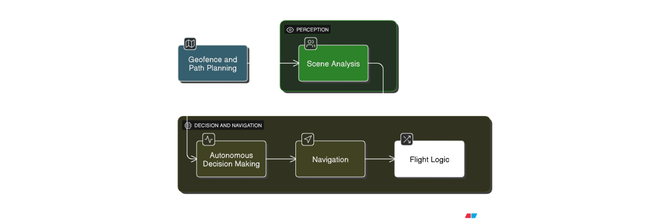
01
AI-Driven Autonomous Surveillance System
Objective:
Enable the drone to autonomously patrol and monitor a designated area without human intervention.
Component | AI/ML Model or Tool | Purpose
Geofence Planning | A* Path Planning, RRT (Rapidly-exploring Random Trees) | Navigate predefined area while avoiding obstacles.
Scene Analysis | YOLOv8 / SAM (Segment Anything) | Real-time detection of people or points of interest.
Autonomous Decision Making | Reinforcement Learning (RL) — Proximal Policy Optimization (PPO) | Learn how to scan more effectively over time.
Navigation | ORB-SLAM3 / RTAB-Map | Visual SLAM for indoor/outdoor GPS-denied environment.
Flight Logic | Custom Python FSM (Finite State Machine) or Behavior Tree | Switch between Scan → Detect → Track → Hover modes.

Slide 5
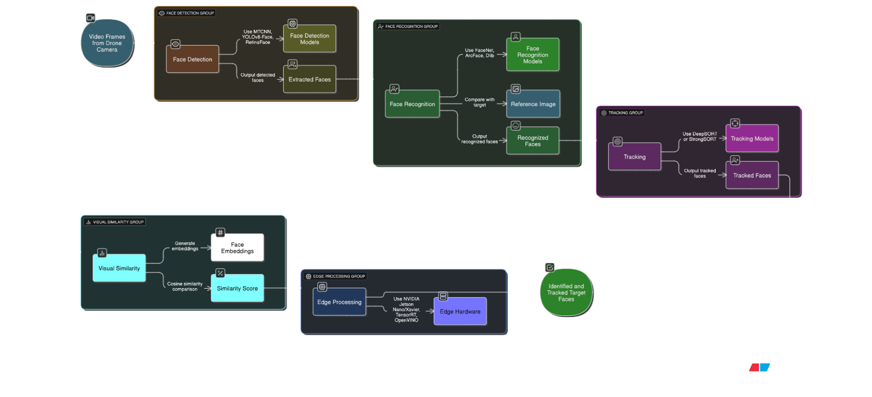
02
AI-Driven Autonomous Surveillance System

Slide 6
Objective:
Enable the drone to recognize a specific individual (e.g., a missing child) using an image sent by the user.
Idea for vertical flowchart representing the face detection and recognition pipeline for a drone surveillance system. Include the following blocks in order:
1. Face Detection
- Tools/Models: MTCNN, YOLOv8-Face, RetinaFace
- Purpose: Extract all visible faces from video frames
2. Face Recognition
- Tools/Models: FaceNet, ArcFace, Dlib
- Purpose: Compare faces with the target reference image
3. Tracking
- Tools/Models: DeepSORT or StrongSORT
- Purpose: Persistently follow the identified person in motion
4. Visual Similarity
- Tools/Models: Cosine Similarity on Face Embeddings
- Purpose: Perform high-speed vector comparison to match faces
5. Edge Processing
- Tools/Models: NVIDIA Jetson Nano/Xavier, TensorRT, OpenVINO
- Purpose: Perform fast, low-latency inference onboard the drone

Slide 7
03
AI + Human Collaboration and Real-Time Feedback
Objective:
Allow the drone to operate independently, but provide manual override, live feed, and status notifications.
1) Live Streaming The drone transmits a real-time video feed using tools like GStreamer, FFmpeg RTMP, or WebRTC. This live feed can be viewed on a mobile device or web dashboard by the operator or parent, enabling constant visual monitoring of the drone’s surroundings.
2) Manual Override In case the AI encounters difficulty or confusion, a manual override is possible through a ROS2 Action Server or a custom-built controller app. This ensures that a human operator can take control instantly when necessary.
3) Smart Notifications The system is integrated with Firebase Cloud Messaging, MQTT, or Twilio to send automatic alerts when:
The child is detected.
The drone's path is modified.
Important decisions (like switching to manual control) occur.
4) Edge + Cloud Hybrid AI To optimize performance, the drone performs lightweight AI tasks locally (on edge devices like Jetson Nano), while heavier computations and storage can be offloaded to the cloud using services like AWS Greengrass or Azure IoT Edge. This ensures fast decision-making with synchronized updates to the ground station or monitoring app.

Slide 8
These are mandatory for basic flight stabilization, orientation, and altitude control.
Sensor | Purpose | Typical Placement
IMU (Inertial Measurement Unit) | Measures acceleration and angular velocity (pitch, roll, yaw) | Internal (Pixhawk/FC)
Barometer (Altimeter) | Estimates altitude using air pressure | Internal (Pixhawk/FC)
Magnetometer (Compass) | Provides heading (yaw), necessary for navigation | External (with GPS) or internal
GPS | Provides global coordinates, speed, altitude, UTC time | External, on mast for clear sky view

Slide 9
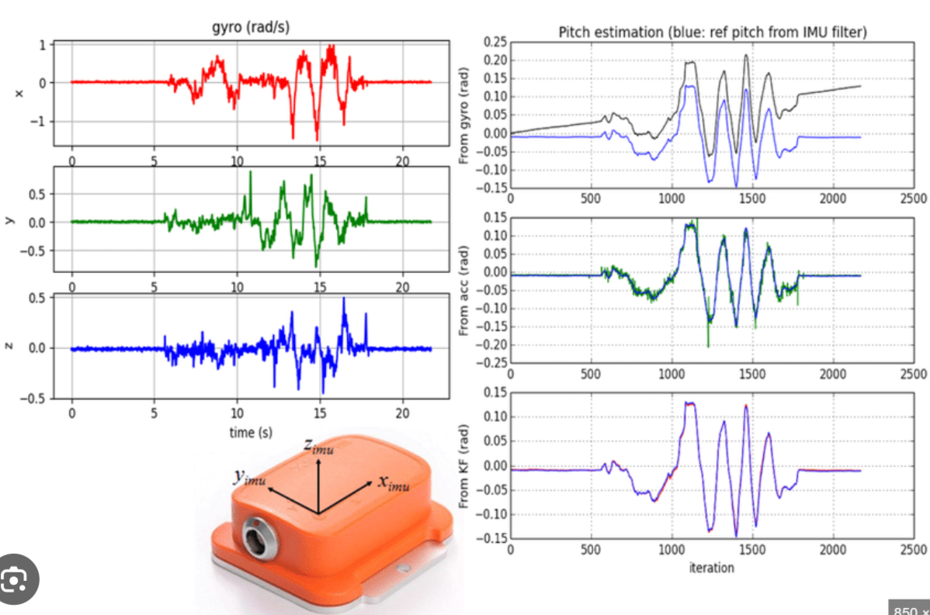
IMU (Inertial Measurement Unit)
1. IMU (Inertial Measurement Unit)
Function: Measures linear acceleration (accelerometer) and angular velocity (gyroscope).
Usage: Determines orientation (pitch, roll, yaw) and detects motion changes.
Placement: Internal to the flight controller (e.g., Pixhawk 6C has redundant IMUs).
Interface: Built-in or via I²C/SPI for external IMUs.
Example Module: MPU6000, ICM20689

Slide 10
NAVIGATION & POSITIONING SUPPORT SENSORS
These enhance navigation accuracy, particularly in GPS-denied or cluttered environments.
Sensor | Purpose | Typical Use
LiDAR (e.g., RPLiDAR, TF-Luna) | Obstacle avoidance, terrain mapping, height estimation | Forward, downward
Ultrasonic Sensor | Altitude hold in low altitudes, proximity sensing | Bottom-mounted
Optical Flow Sensor | Measures ground-relative motion; useful indoors | Downward-facing
Camera (Monocular/Stereo) | Visual navigation, object detection, SLAM | Front-facing / Downward
RTK GPS | Centimeter-level accurate GPS (vs standard GPS) | Mounted externally

Slide 11
MISSION & ENVIRONMENT INTERACTION SENSORS
Sensor | Purpose | Usage Example
RGB Color Sensor (e.g., TCS34725) | Detect color-coded landing zones or line-following | Bottom-facing
Infrared Sensors (IR) | Obstacle detection (short-range) | Side / front
Thermal Camera | Thermal mapping, night vision, search & rescue | Mounted on gimbal
CO₂ / Gas Sensors | Environmental sensing | Research / industrial drones
Environmental Sensors (Temp, Humidity) | Weather/environmental monitoring | Data collection drones

Slide 12
ADVANCED SENSOR SYSTEMS (Optional but powerful)
Sensor/System | Purpose | Example
3D LiDAR | Full 3D obstacle map generation, SLAM | HolyBro, Rp Lidar
Stereo Depth Cameras | Depth sensing, terrain reconstruction | Intel RealSense, Zed
Radar (FMCW) | Penetrates fog, dust, low-light conditions | High-end mapping drones
SLAM Modules | Visual + sensor fusion for autonomous mapping | ORB-SLAM, RTAB-Map

