Slide 1
AI-Driven Learning Style Prediction for Adaptive E-Learning Systems
Team Members:
Manas Dutt (22BCE1350)
Urvi Samirkumar Shah (22BCE1174)
Soham Yogesh Amberkar (22BCE1770)
Guide: Dr. Vijayalakshmi A

Slide 2
Introduction
• E-Learning (MOOCs, LMS) is growing but often lacks personalization.
• One-size-fits-all approach reduces student engagement.
• Traditional learning style identification relies on static surveys.
• Need for real-time, behavior-based detection using AI.

Slide 3
Problem Statement
• Existing LMS Lack Scalability: Manual surveys are impractical for large classes.
• Static & Biased: Self-reported questionnaires may not reflect actual behavior.
• Underuse of Advanced AI: Modern techniques like Graph Learning are unexplored.
• Lack of Explainability: Educators need to understand 'WHY' a style is predicted.

Slide 4
Objectives
• Develop an automated, AI-driven system to predict learning styles from LMS logs.
• Implement Semi-Supervised Learning to handle limited labeled data.
• Map behavioral features to the Felder-Silverman Learning Style Model (FSLSM).
• Create an Analytics Dashboard for faculty insights.

Slide 5
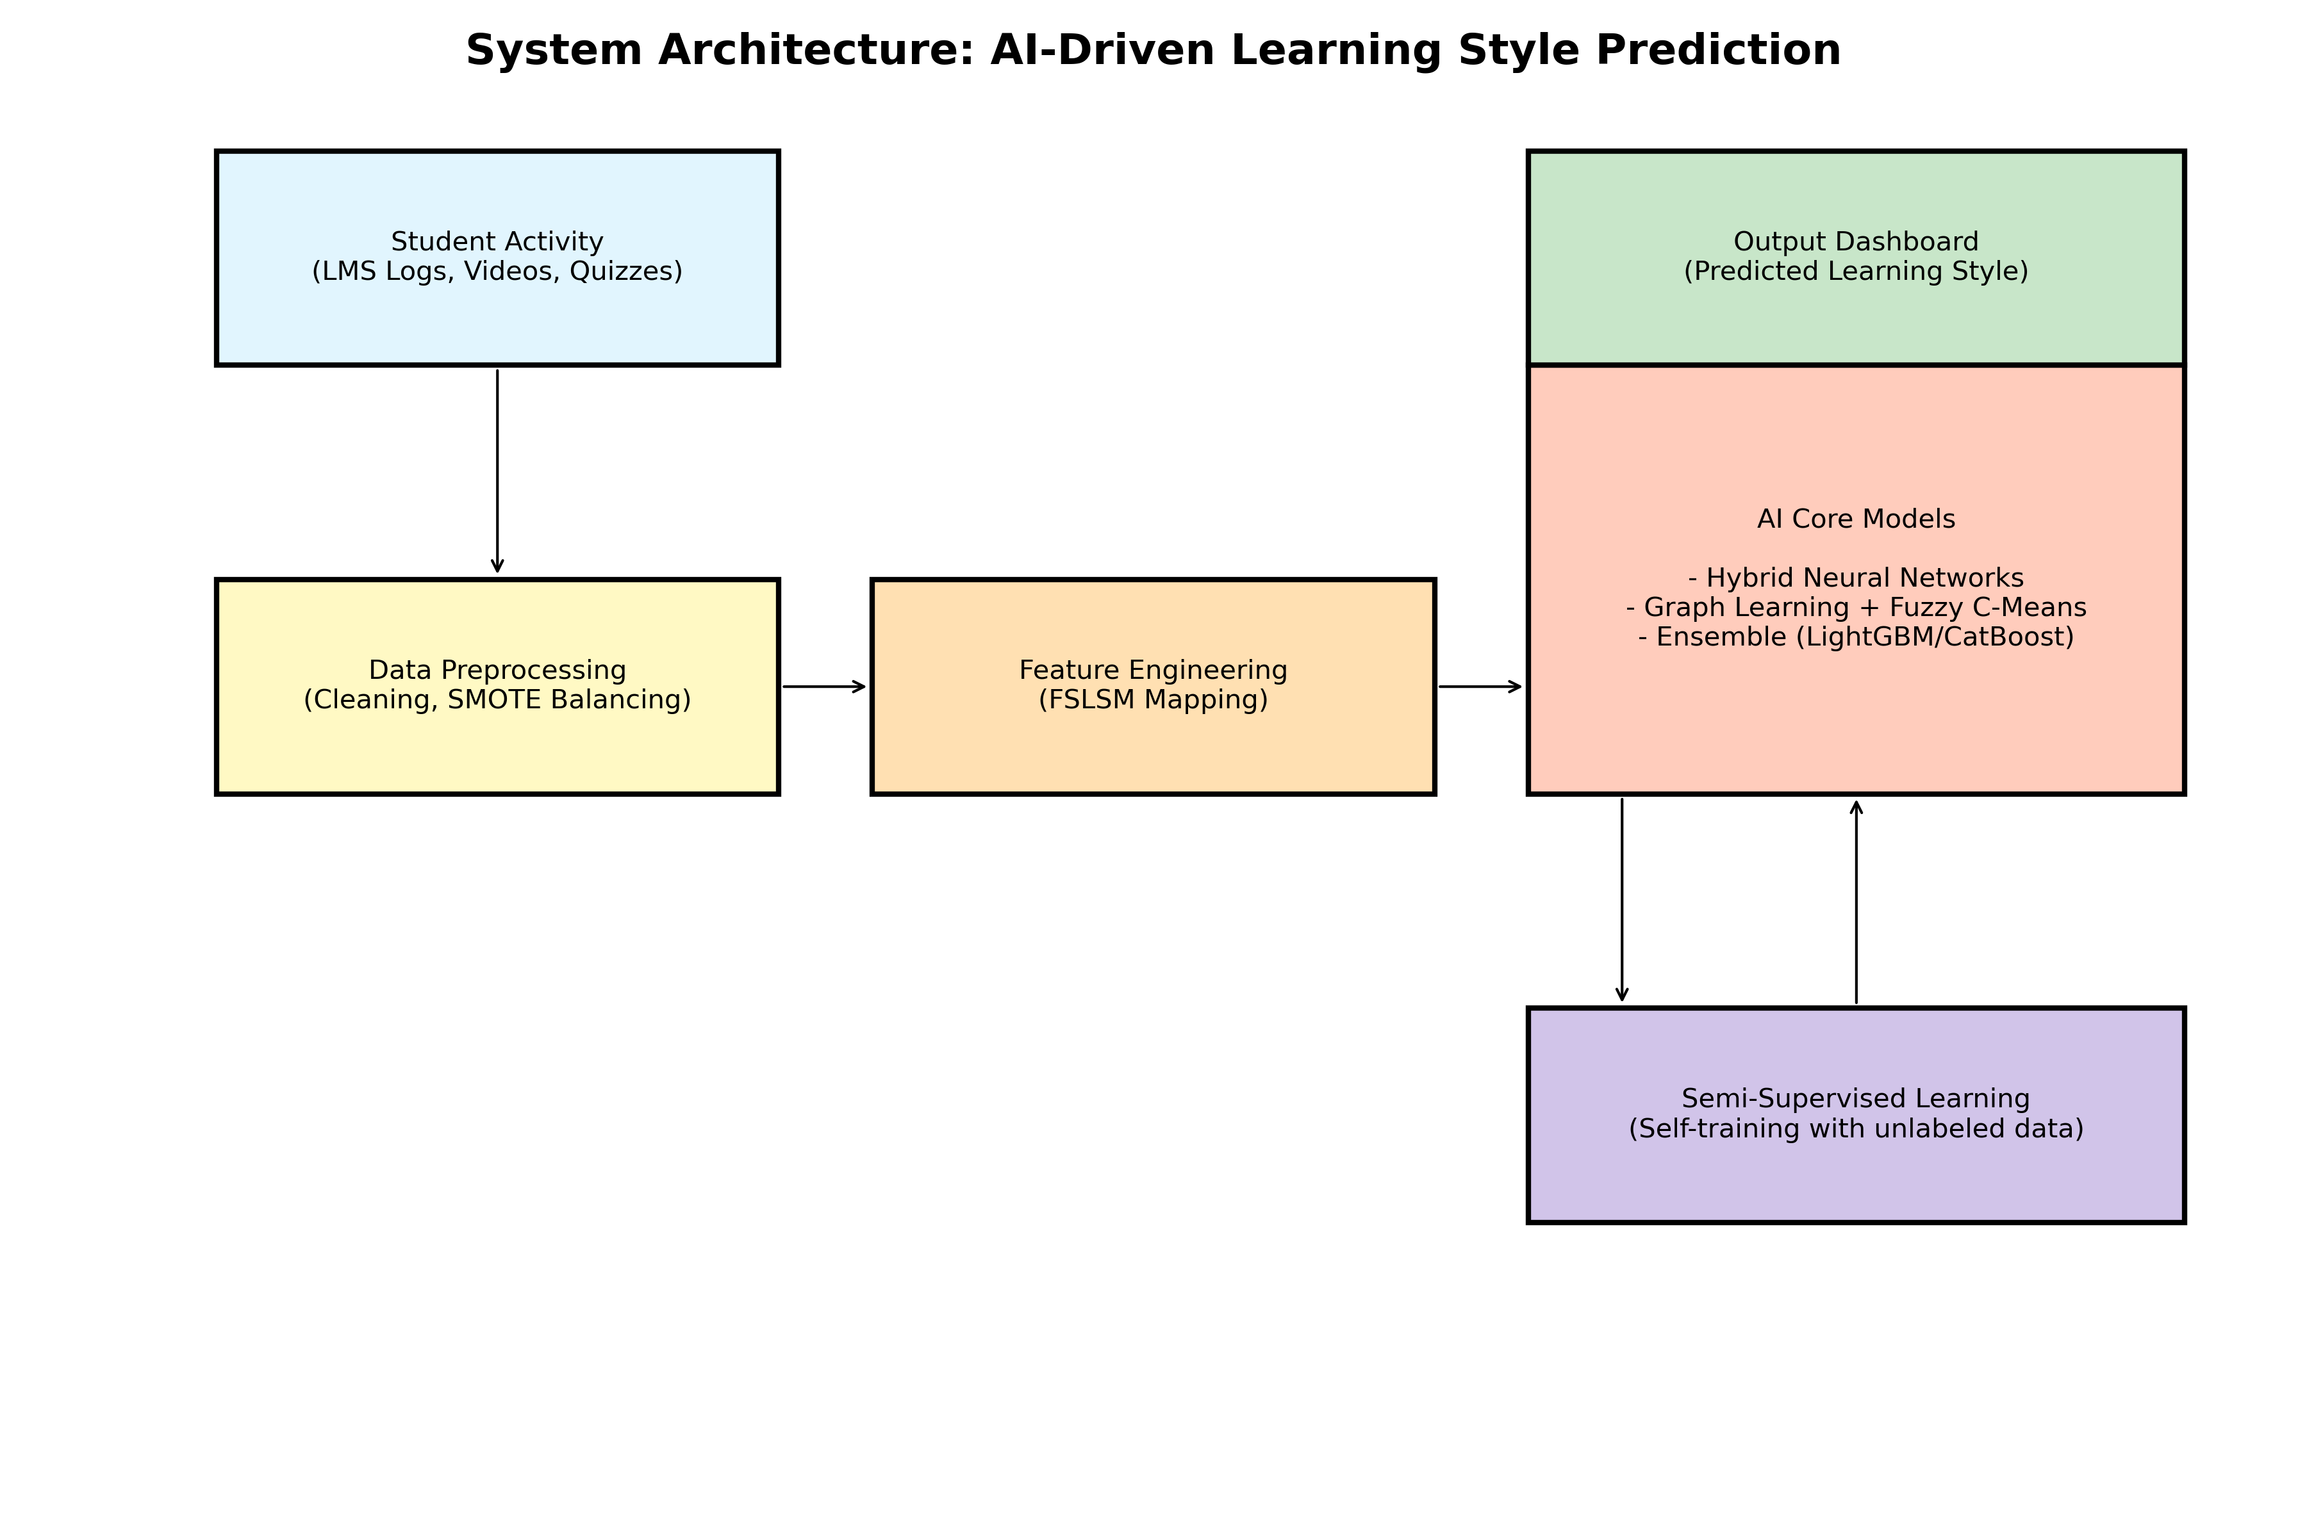
Proposed Methodology
1. Data Collection: Extract logs (video views, quizzes).
2. Feature Engineering: Align actions with FSLSM dimensions.
3. Modeling: Hybrid Neural Networks & Ensemble Boosting.
4. Semi-Supervised: Leverage unlabeled data.

Slide 6
System Architecture

Slide 7
Tools and Technologies
• Languages: Python (3.x)
• Machine Learning: Scikit-learn, LightGBM, CatBoost, PyTorch/TensorFlow
• Data Processing: Pandas, NumPy, SMOTE (Imbalanced-learn)
• Visualization: Matplotlib, Seaborn, SHAP (Explainability)
• Tools: Jupyter Notebooks, Git

Slide 8
Expected Outcomes
• >85% Accuracy in Learning Style Prediction.
• Real-time, scalable detection without surveys.
• Actionable insights for instructors via dashboard.
• Framework for future Adaptive Content Delivery.

Slide 9
References
1. IEEE Transactions on Learning Technologies (2024). 'Learning Style Identification...'
2. Felder, R. M. & Silverman, L. K. (1988). 'Learning and Teaching Styles in Engineering Education.'
3. GitHub Datasets: 'Learning-style-prediction-identification-using-Machine-Learning'

Slide 10
Thank You
Questions?

