Slide 1
PROJECT TITLE
Problem Statement Title-.
AI-Driven Career Hub for Graduate Employment & Internships
Team Members’ Name and Roll Number-
1: 13000222064-SOURYADEEP DEB 2:13000222065 -SOHAM BHATTACHARJEE
3: 13000222066 -SRIJA BASAK 4: 13000222067 -SNEHA SINGH
5: 13000222068 -SHRESTHA SAMANTA 6:13000222069 -SHREEMOY MONDAL
Group Number -12

Slide 2
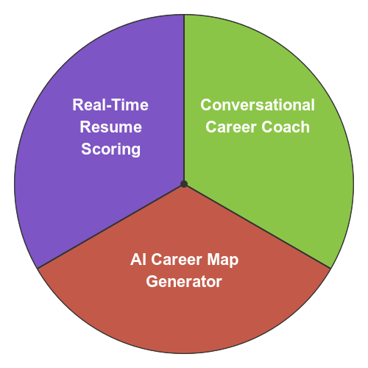
IDEA TITLE
CareerCompass AI is an AI-driven platform that assists graduates in navigating their career paths by providing personalized job and internship recommendations, resume analysis, skill gap identification, and mentorship opportunities.
.
Key Features
Innovation & Uniqueness
Personalized Job Matching
Utilizing NLP and machine learning to align user profiles with suitable opportunities.
Resume Analysis
Offering feedback and improvements to enhance ATS compatibility.
Skill Gap Identification
Highlighting areas for development and suggesting relevant courses.

Slide 3
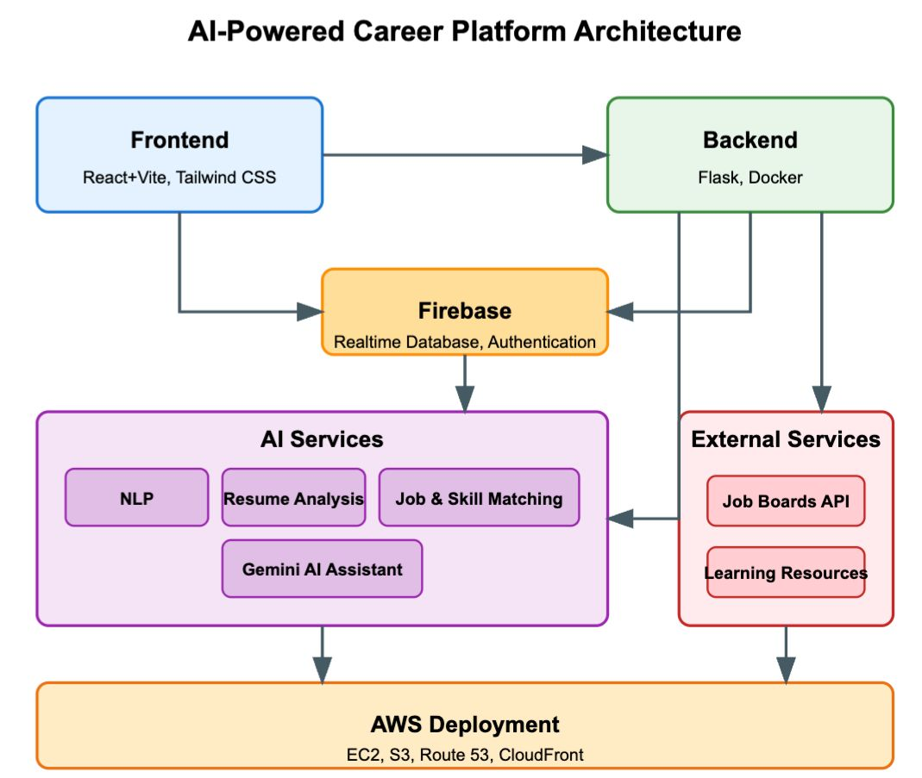






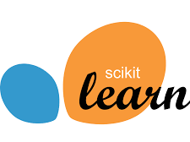






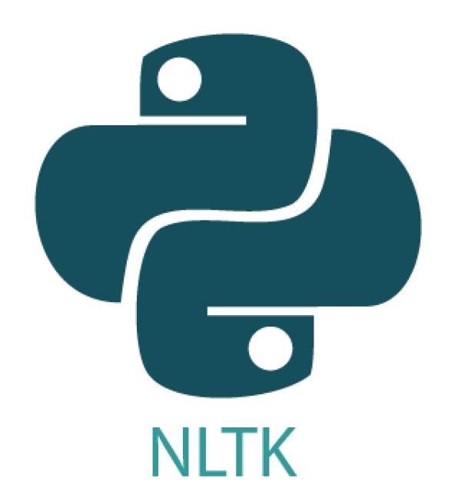

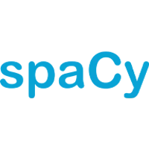
TECHNICAL APPROACH & WORKFLOW DIAGRAM
Frontend
Backend
Database & APIs
Ai/Ml

Slide 4

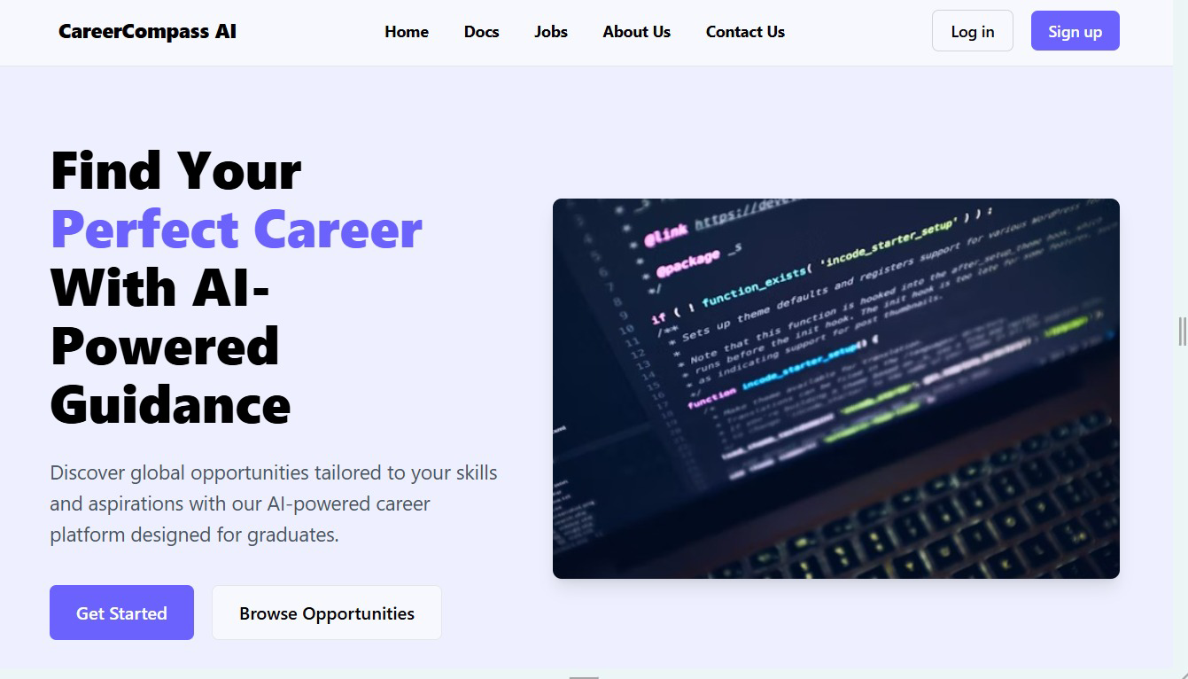
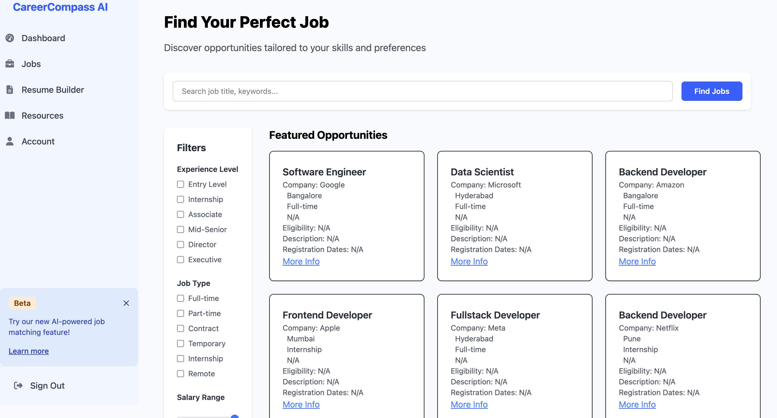
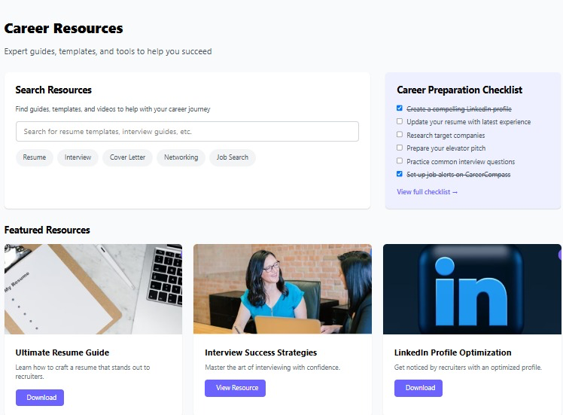
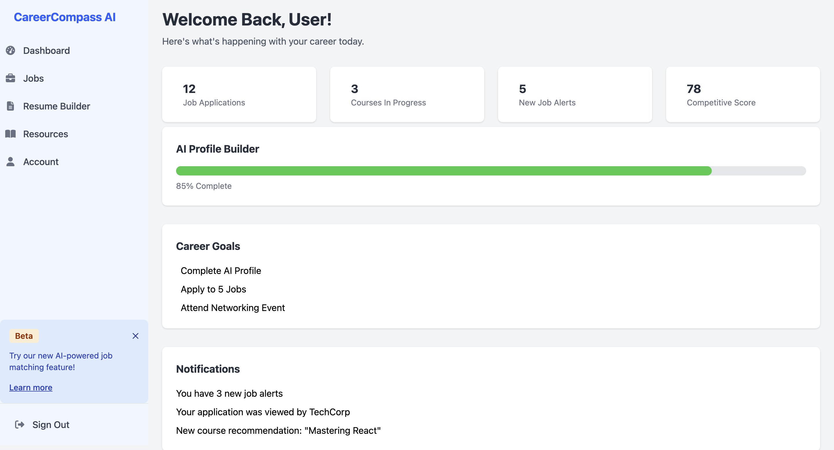
RESULTS
Guided Home Page
AI Recommended Job Portal
Easy access Library
User-friendly Dashboard

Slide 5
IMPACT AND BENEFITS
Target Impacts
Benefits
Empower 100K+ students annually from Tier-II/Tier-III colleges
Increase placement chances via skill matching & mentorship
Social: Democratizes access to global job opportunities.
Economic: Reduces underemployment and enhances skill relevance.
Technological: Integrates AI/ML for personalized employment pathways.
Environmental: Encourages remote work options, reducing urban migration

Slide 6
RESEARCH AND REFERENCES
HuggingFace Transformers – https://huggingface.co/
Gemini API – httpJobdataAPIgle.dev/
SpaCy for NLP – https://spacy.io/
Scikit-Learn- https://scikit-learn.org/0.21/documentation.html
R. Kumar, ”AI in Employment Services,” International Conference on AI Applications, 2022.

