Slide 1

GENESIS: GENe Evaluation System with Integrated Security
A Federated Learning Framework for Detecting Gene Variant Pathogenicity
Presented by:
Sobhan Bose (13000222056)
Satirtha Ghosal (13000222057)
Soumya Ghosh (13000222058)
Soumik Bag (13000222059)
Group 15
Under the supervision of:
Dr. Aparajita Chowdhury
Department of Information Technology
Techno Main Salt Lake
Kolkata -700091

Slide 2
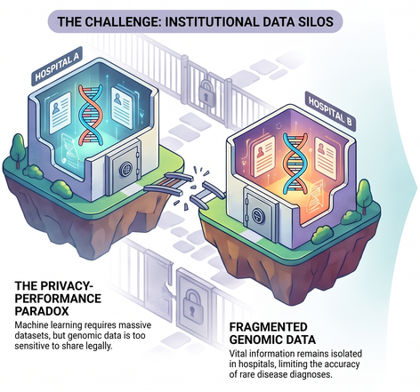


PROBLEM STATEMENT
Addressing the conflict between data-driven medical research and patient privacy in genetic variant pathogenicity prediction
AI models need massive diverse datasets to learn effectively and make breakthroughs.
Strict privacy regulations create data silos, preventing the aggregation of genomic data
"
The reliance on centralized datasets is a primary limitation of privacy-conscious world!

Slide 3
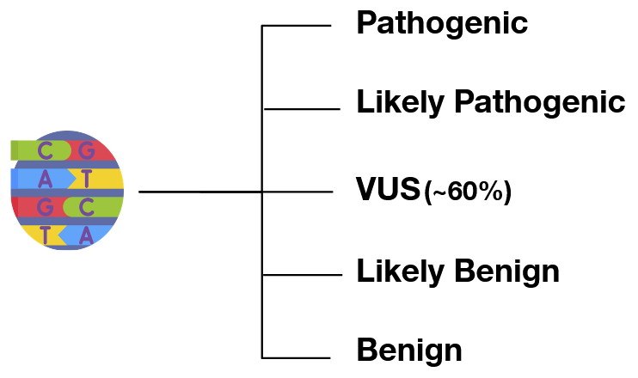
PROPOSED SOLUTION
A novel full-stack framework using Federated Learning (FL) to predict the pathogenicity of Single Nucleotide Variants (SNVs)
What can it do?
How does this solve the problem?
It allows institutions to train a global model collaboratively without moving sensitive raw genomic data out of their secure local environments.
It breaks down "data silos" created by strict privacy regulations (like GDPR or HIPAA), enabling models to learn from large, diverse datasets while remaining legally and ethically compliant.
It’s Built for Privacy and Security!
Cross platform Electron app for secure and easy user interaction.
Mutual TLS (mTLS) for authenticated, encrypted communication.
SSL enabled federated learning server for secure communication
Robust backend to coordinate the learning process securely.
Role-Based Access Control (RBAC) to manage user permissions.

Slide 4
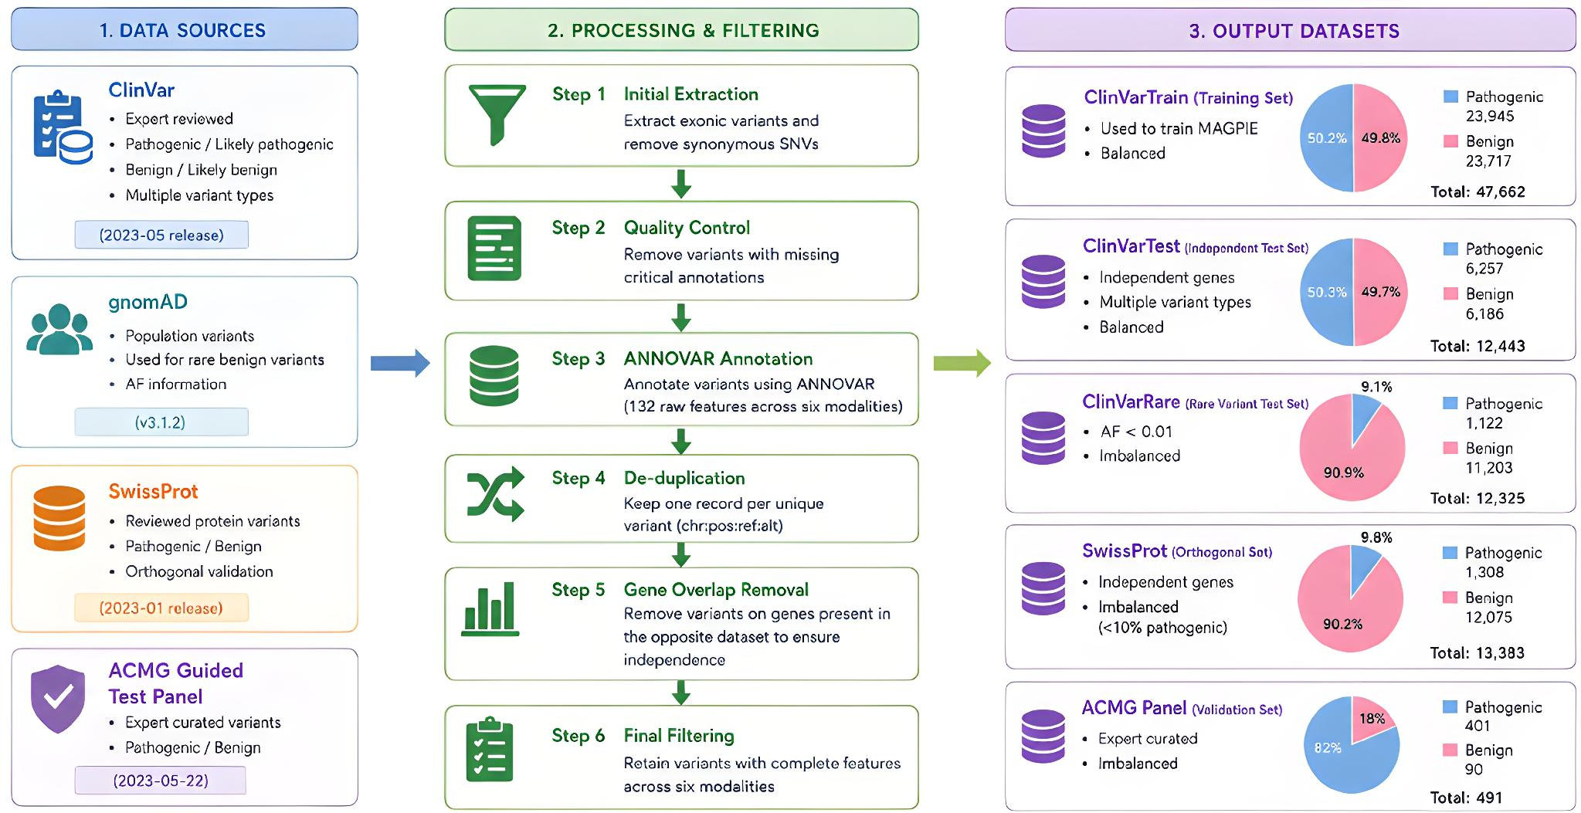
PROPOSED METHODOLOGY - Data Preparation

Slide 5
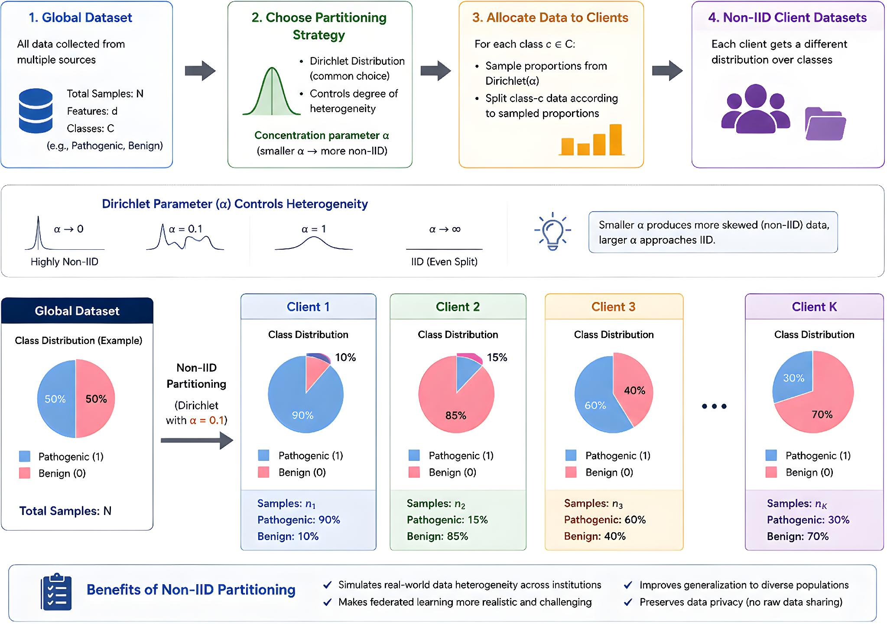
PROPOSED METHODOLOGY - Data Partitioning

Slide 6
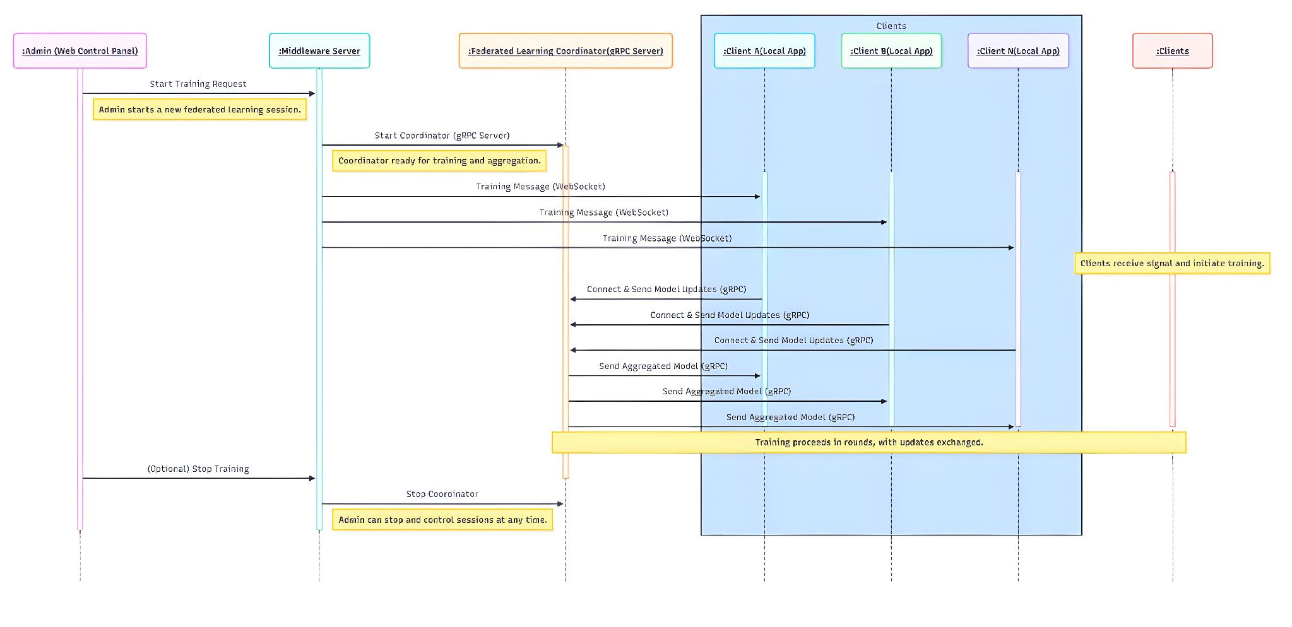
SEQUENCE DIAGRAM

Slide 7
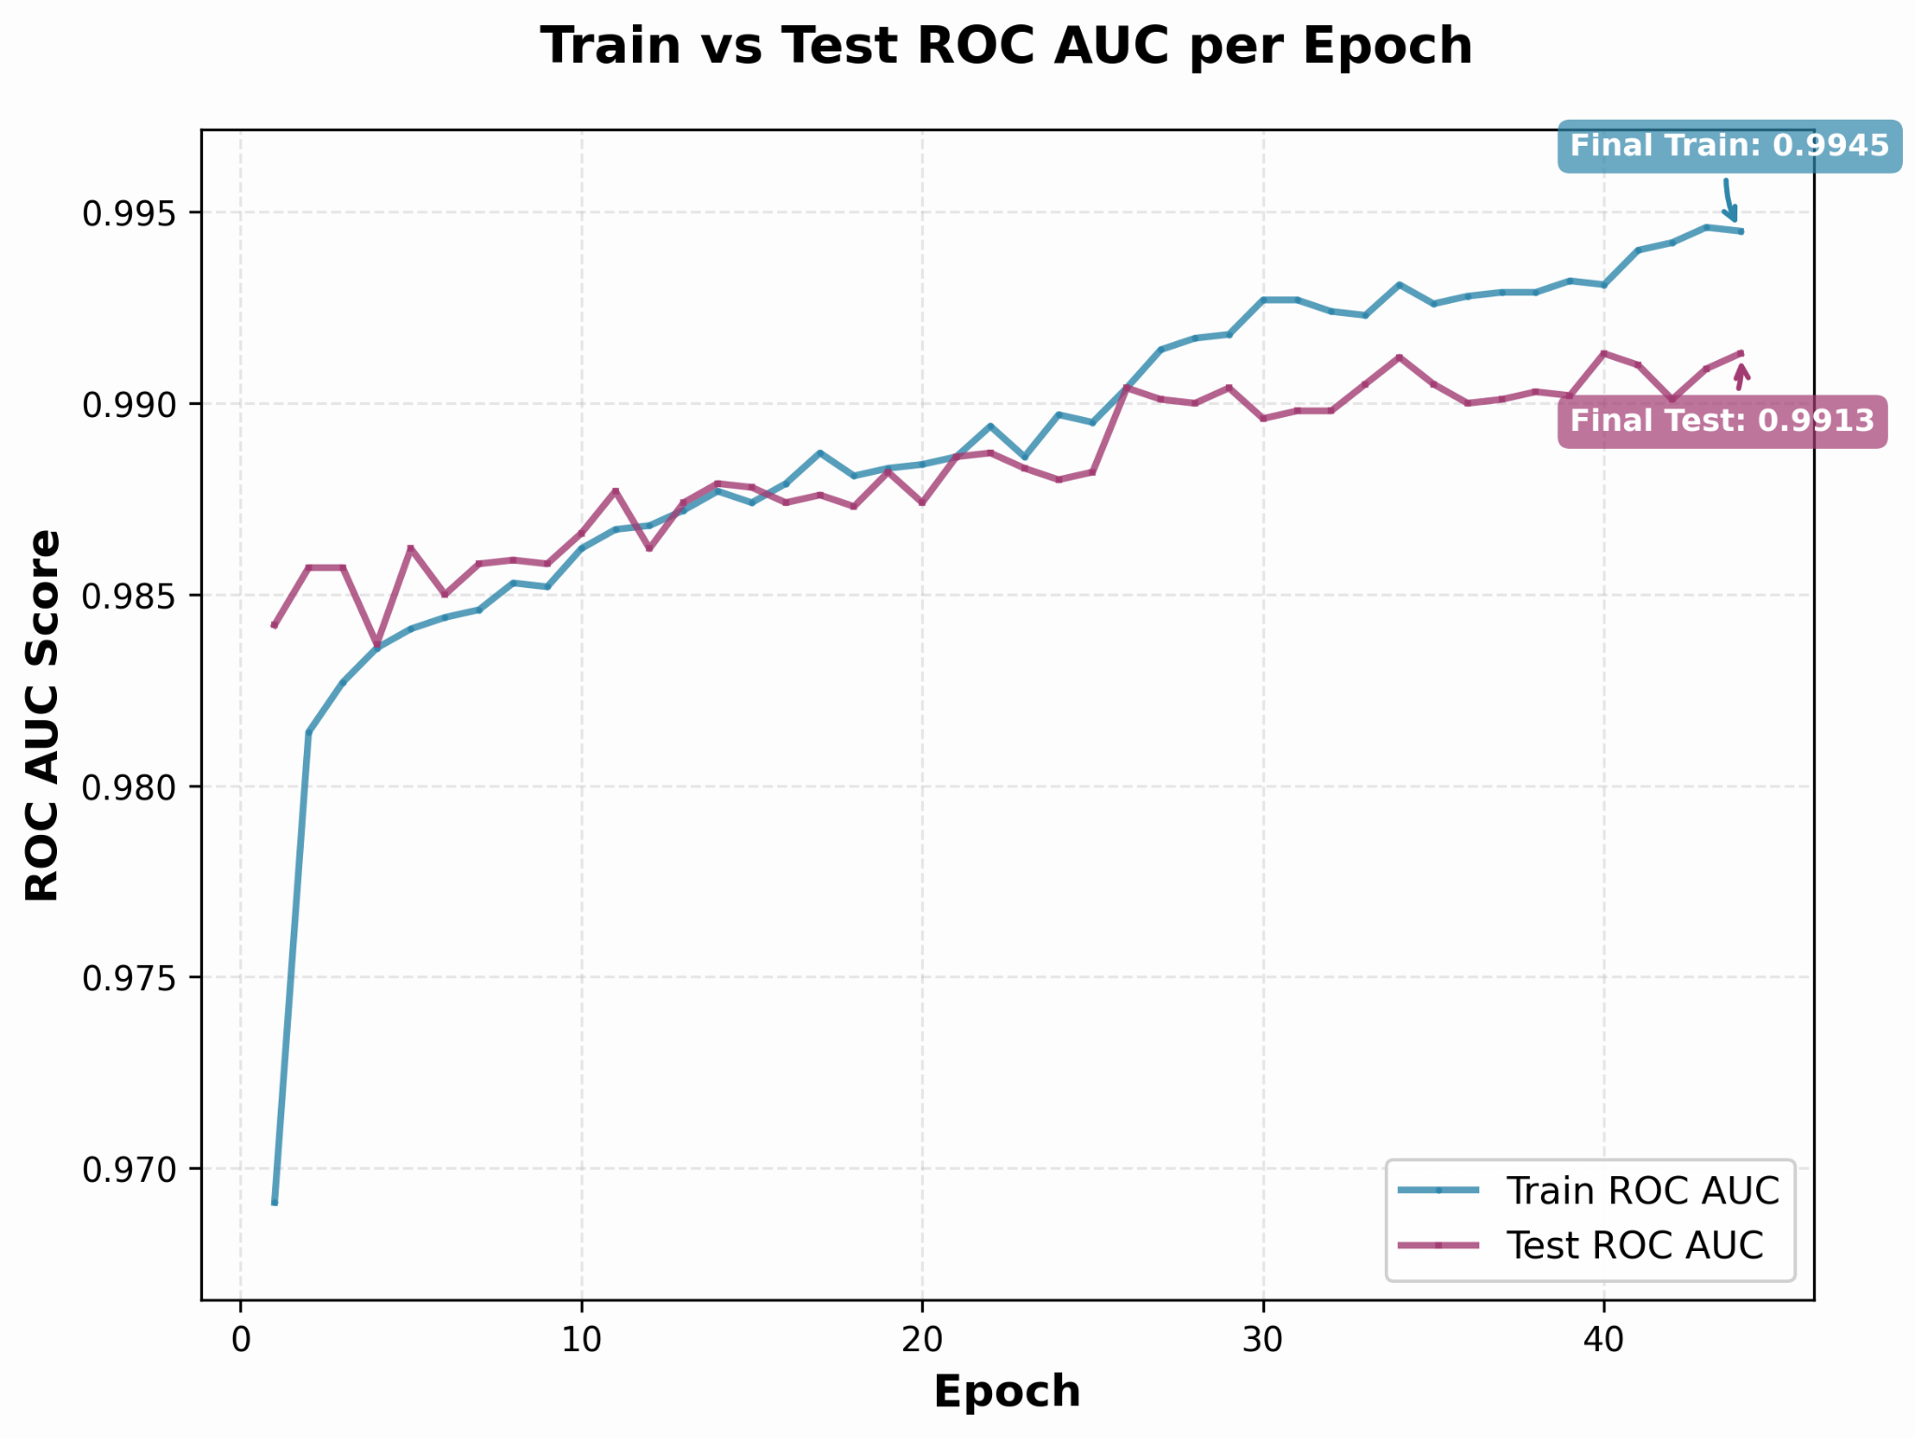
RESULTS AND ANALYSIS
Baseline Model:
Comparison of ROC-AUC with MAGPIE:
 | GENESIS | MAGPIE
ClinVarTrain | 99.84 | 99.80
ClinVarTest | 99.53 | 99.50
ClinVarRare | 96.72 | 97.00
SwissProt | 96.13 | 96.23
ACMG Panel | 98.60 | 99.10
GENESIS is comparable and competitive when compared to MAGPIE while also maintaining patient privacy.
Fig.: Performance of baseline model per epoch

Slide 8
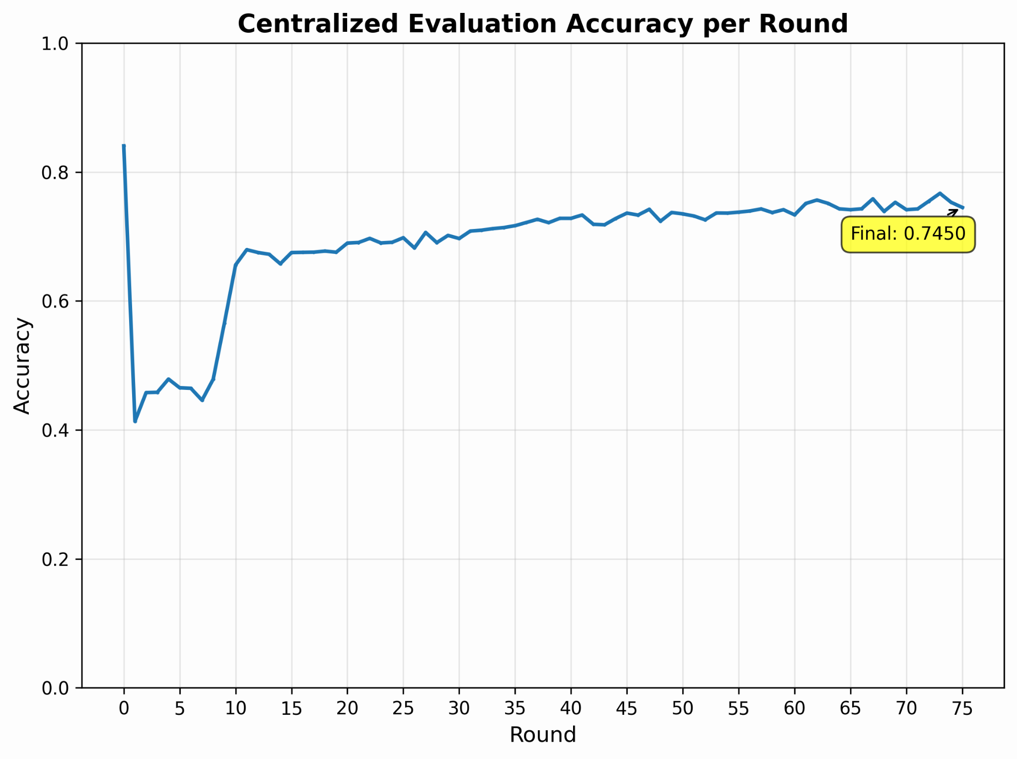
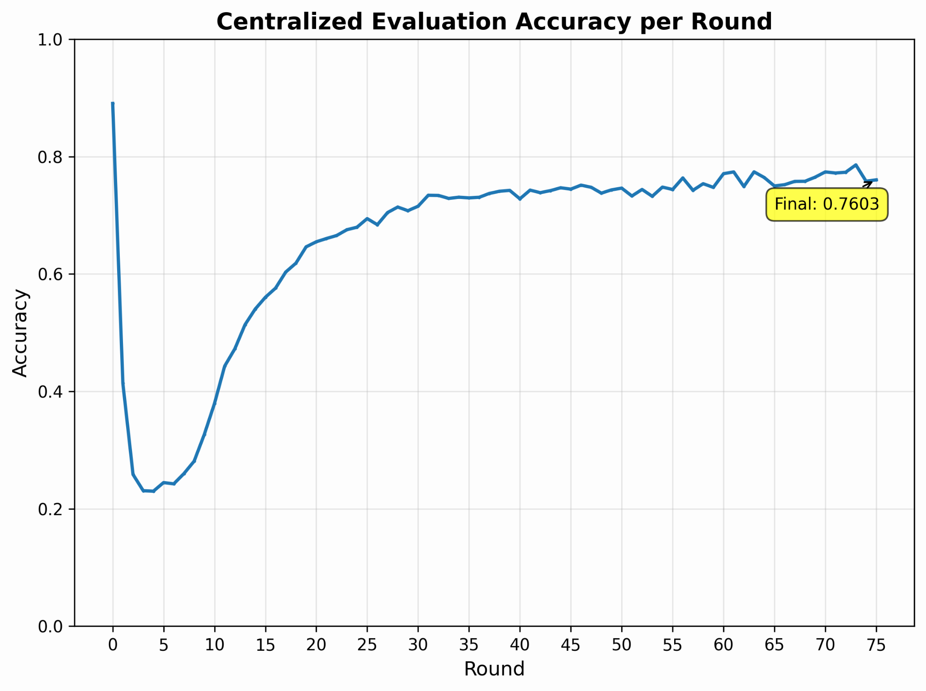
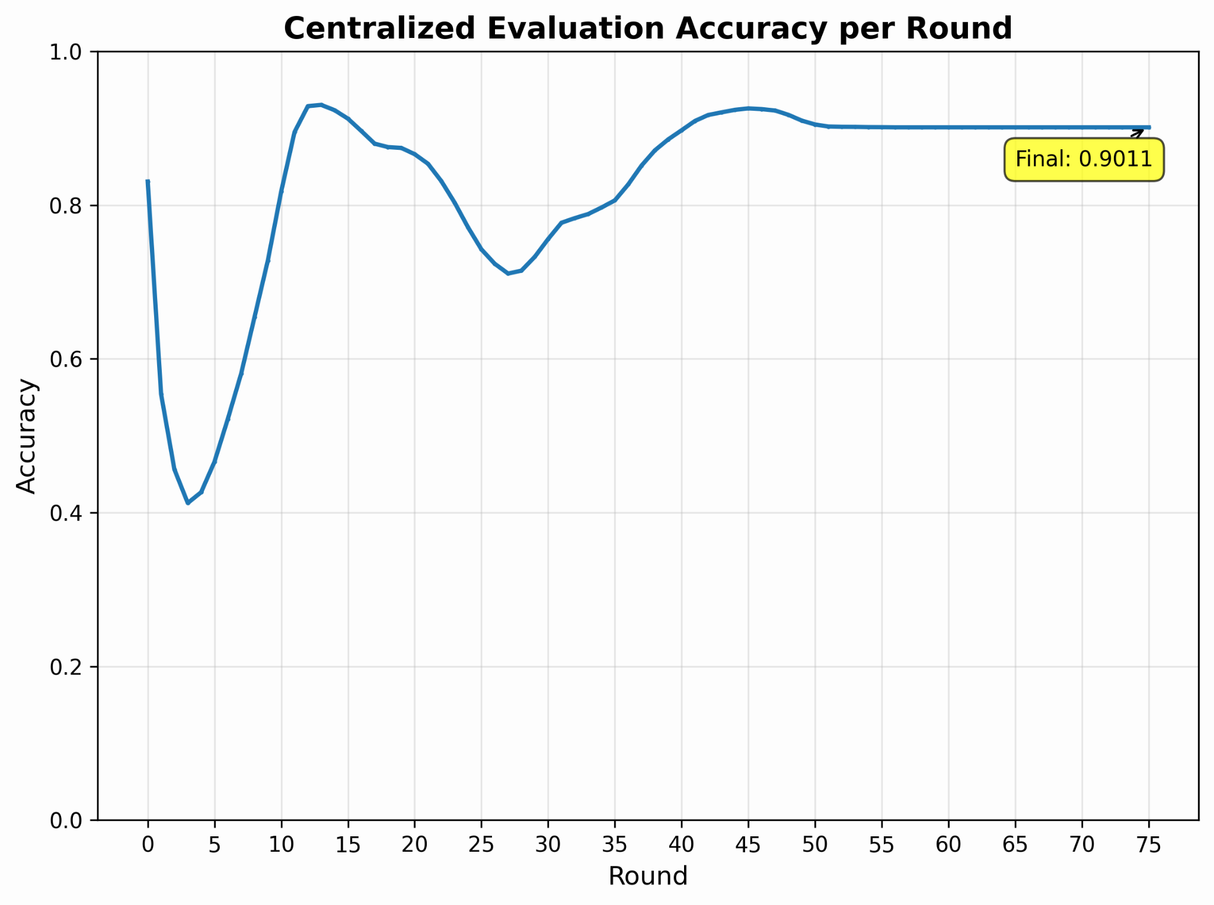
RESULTS AND ANALYSIS
Comparison of Aggregation Algorithms:
FedAvg
FedProx
FedAdam

Slide 9
IMPROVEMENTS MADE
FUTURE SCOPE
ROC-AUC on Orthogonal Set
95.34 ➔ 96.72
Differential Privacy
Integrate privacy-preserving techniques to ensure strong mathematical privacy guarantees.
Robust Client Reconnections
Successfully handling reconnection scenarios utilizing an integrated Message Queue.
Support for Other Variant Types
Expand capabilities to seamlessly process and analyze diverse genetic variant formats.
Model Versioning
Implemented systematic tracking and versioning controls for all deployed models.
Disease-Specific Training
Optimize accuracy by training localized, specialized models tailored to target diseases.

Slide 10
IMPACTS AND BENEFITS
Federated models work with data silos and not against them, unlocking global collaboration.
Faster diagnosis, better patient outcomes and an era of collaborative science that respects privacy!

Slide 11
REFERENCES
Auton A et al., A global reference for human genetic variation. Nature, 526:68, 10 2015.
Sue Richards et al., Standards and guidelines for the interpretation of sequence variants: A joint consensus recommendation of the american college of medical genetics and genomics and the association for molecular pathology.Genetics in medicine: official journal of the American College of Medical Genetics, 17, 03 2015.
Pauline C. Ng and Steven Henikoff. Sift: predicting amino acid changes that affect protein function. Nucleic Acids Research, 31(13):3812–3814, 07 2003.
Ivan A Adzhubei, Steffen Schmidt, Leonid Peshkin, Vasily E Ramensky, Anna Gerasimova, Peer Bork, Alexey S Kondrashov, and Shamil R Sunyaev. A method and server for predicting damaging missense mutations. Nature Methods, 7(4):248–249, 2010.
Martin Kircher, Daniela M Witten, Preti Jain, Brian J O’Roak, Gregory M Cooper, and Jay Shendure. A general framework for estimating the relative pathogenicity of human genetic variants. Nature Genetics, 46(3):310–315, 2014.
Daniel Quang, Yifei Chen, and Xiaohui Xie. Dann: a deep learning approach for annotating the pathogenicity of genetic variants. Bioinformatics, 31(5):761–763, 10 2014
Nilah M. Ioannidis et al., Revel: An ensemble method for predicting the pathogenicity of rare missense variants. The American Journal of Human Genetics, 99(4):877–885, 2016
Melissa J. Landrum et al., Clinvar: updates to support classifications of both germline and somatic variants. Nucleic Acids Research, 53(D1):D1313–D1321, 2025.
Najmeh Alirezaie, Kristin D. Kernohan, Taila Hartley, Jacek Majewski, and Toby Dylan Hocking. Clinpred: Prediction tool to identify disease-relevant nonsynonymous single-nucleotide variants. The American Journal of Human Genetics, 103(4):474–483, 2018.
Yicheng Liu, Tianyun Zhang, Ningyuan You, Sai Wu, and Ning Shen. Magpie: accurate pathogenic prediction for multiple variant types using machine learning approach. Genome Medicine, 16, 01 2024.
Brendan McMahan, Eider Moore, Daniel Ramage, Seth Hampson, and Blaise Aguera y Arcas. Communication-Efficient Learning of Deep Networks from Decentralized Data. In Aarti Singh and Jerry Zhu, editors, Proceedings of the 20th International Conference on Artificial Intelligence and Statistics, volume 54 of Proceedings of Machine Learning Research, pages 1273–1282. PMLR, 20– 22 Apr 2017.
Felix Sattler, Simon Wiedemann, Klaus-Robert Muller, and Wojciech Samek. Robust and communication-efficient federated learning from non-iid data, 2019.
Tian Li, Anit Kumar Sahu, Manzil Zaheer, Maziar Sanjabi, Ameet Talwalkar, and Virginia Smith. Federated optimization in heterogeneous networks, 2020.

Slide 12
THANK YOU

