Slide 1
AUTOMATIC ATTENDANCE SYSTEM USING
MULTIPLE FACE RECOGNITION
Team Members' Name and Roll Number-
1. Souryadeep Deb (13000222064) 2. Soham Bhattacharya (13000222065)
3. Srija Basak (13000222066) 4. Sneha Singh (13000222067)
Group Number- 18
Mentor Name- Mr Prodipta Bhowmik
Department of Information Technology
Techno Main Salt Lake
Kolkata -700091

Slide 2
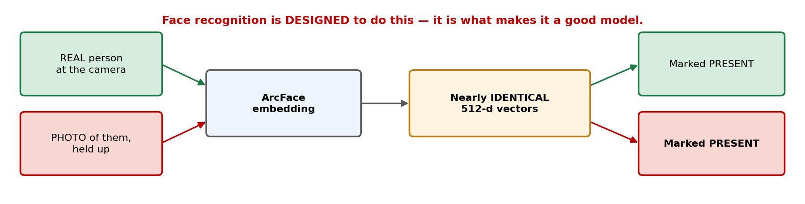
PROJECT TITLE
Automatic Attendance System using Multiple Face Recognition
Spoof-Resistant Multi-Face Attendance with Liveness-Gated Commit
We tested it: a printed photograph was marked present 100% of the time.
This project is about closing that gap.
1

Slide 3
OBJECTIVE OF THE PROJECT
To detect and recognise multiple faces simultaneously in a single frame.
To reject strangers — an open-set system that is allowed to answer "nobody".
To resist presentation attacks: a photo or phone screen must NOT be marked present.
To make the attendance commit reliable — it is written once a day and cannot be undone.
To run offline on a laptop CPU: no GPU, no cloud, no student data leaving campus.
2

Slide 4
PROBLEM DEFINITION
Traditional manual attendance is slow, error-prone and vulnerable to proxy marking —
a 60-student roll-call costs ~5 minutes of every lecture, about 80 teaching hours a year.
But automating it with face recognition introduces a NEW problem — and this is the gap our project addresses:
Face recognition is DESIGNED to give a photo of you the same embedding as you. That is exactly what makes it a good face model.
So recognition ALONE cannot prevent proxy attendance. We measured it: a printed photo was marked present 100% of the time.
Four failures a real classroom deployment must survive:
• A photograph or phone screen held to the camera → marked present
• A stranger walking past → a softmax classifier has no way to say "nobody"
• A student at the back of the room → too few pixels to identify, but still named
• One misread frame → the wrong student marked present for the entire day
3

Slide 5
LITERATURE REVIEW
D'Souza et al. (2019) [1] proposed an automated attendance system using facial recognition with histogram-based feature extraction; efficient, but sensitive to lighting and pose.
Arsenovic et al. (2017) [2] applied CNN-based deep learning for face recognition, achieving higher accuracy and real-time performance.
Kakarla et al. (2020) [3] proposed a CNN smart attendance system recognising multiple students under moderate pose and expression change.
Varadharajan et al. (2016) [4] developed a face-detection classroom attendance system; accuracy drops under occlusion and poor lighting.
Siswanto et al. (2014) [5] introduced face biometrics as a hygienic alternative to fingerprint attendance systems.
RESEARCH GAP — every paper above reports one accuracy number on clean data. None test a presentation attack, none report a stranger-rejection rate, and none treat "recognised" and "marked present" as different decisions.
4

Slide 6
PROPOSED METHODOLOGY
How it Works:
• Detects EVERY face in one frame (RetinaFace), embeds each into a 512-d vector (ArcFace),
and matches it against each enrolled student's centroid.
• Records name, confidence and status to a CSV file. Nothing leaves the machine.
Problem Addressed:
Proposed Solution
• Replaces manual attendance and eliminates the signed-register proxy.
• Rejects strangers, and blocks the photo / screen proxy that defeats ordinary
face recognition.
Innovation and uniqueness of the solution
• We do NOT claim a new face model — ArcFace is pretrained and FROZEN.
• LIVENESS that works at 1.4 frames/sec, where blink detection provably fails.
• Threshold calibrated on 2,880 impostor faces — not hand-picked.
• Attendance as an irreversible commit. Enrolment: 607 s → 1.4 s.
• We also report a guard that did NOT work (top-2 margin).
5

Slide 7
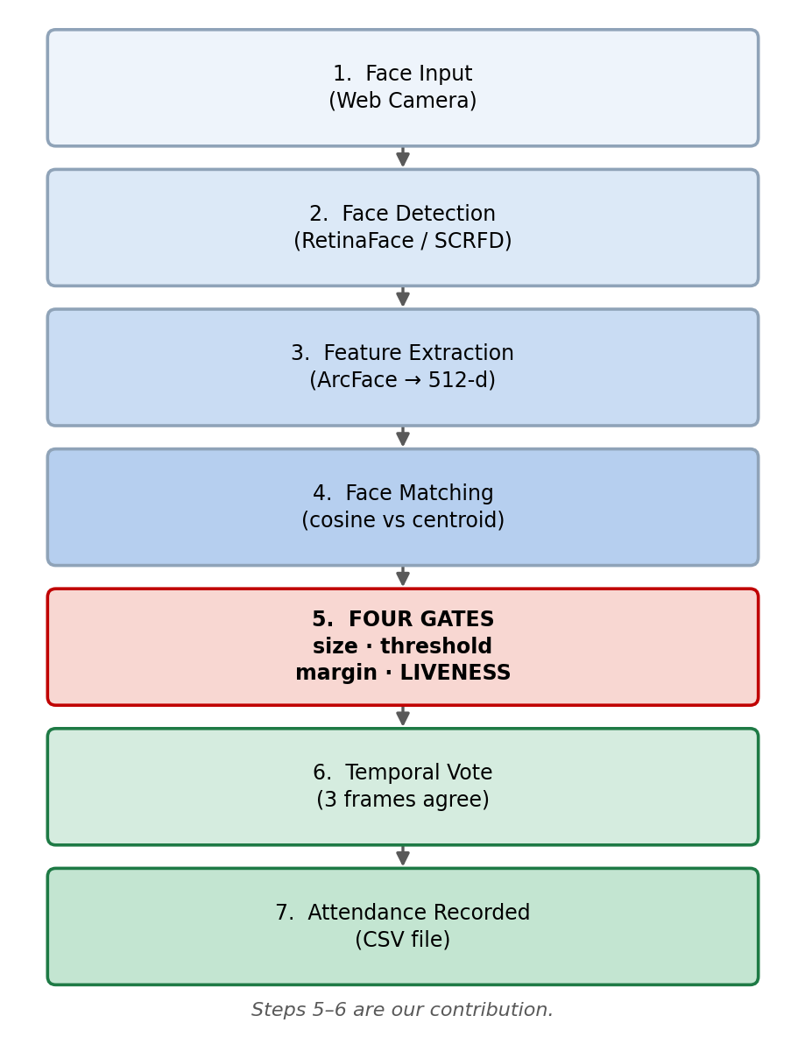
EXPERIMENTAL DETAILS
Programming Language: Python 3.13
Face Detection
RetinaFace / SCRFD (det_10g)
Recognition
ArcFace ResNet-50 (buffalo_l) → 512-d embedding
Runtime
ONNX Runtime — CPU only, NO GPU
Matching
Nearest-centroid, cosine similarity (no classifier)
Frontend
React · Vite · TailwindCSS
Backend
Flask REST API (Bearer-token auth)
Storage
CSV + JSON on disk — no cloud, no database server
WORKFLOW
6

Slide 8
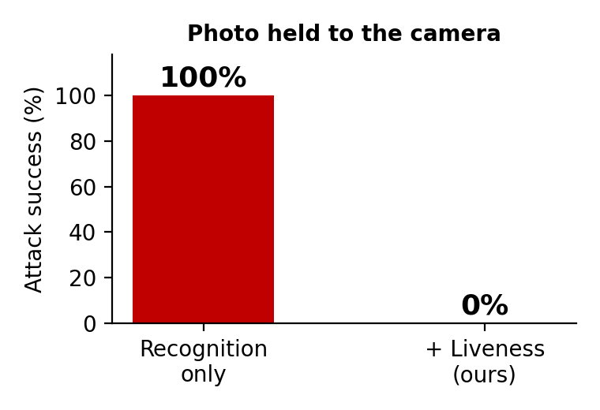
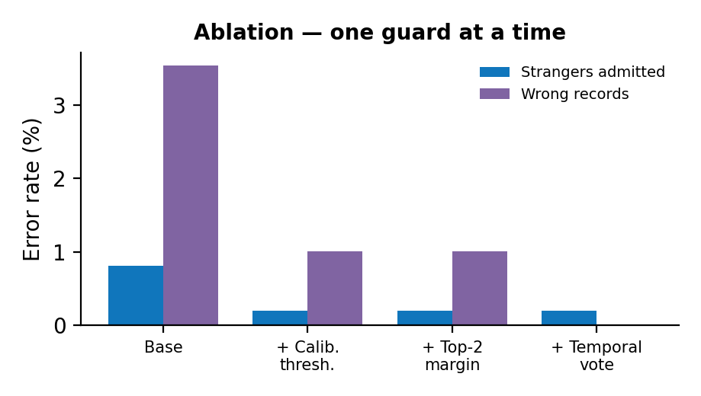
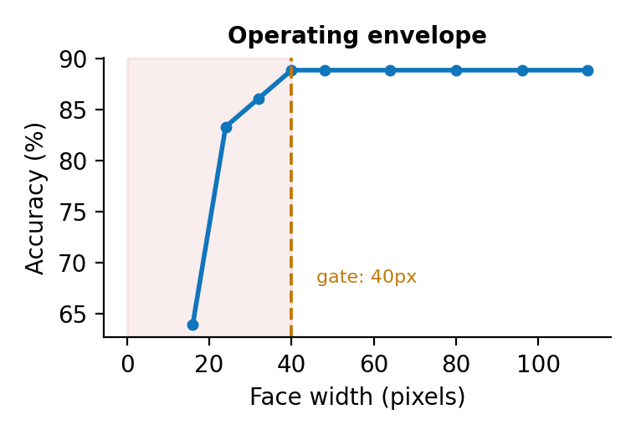
RESULTS AND ANALYSIS
Presentation Attack
Ablation of Each Guard
Operating Envelope
A printed photo was marked present 100% of the
time by recognition alone.
With liveness — motion measured from the
detector's own landmarks — it is 0%.
Calibrating the threshold cut strangers admitted
4× (0.81% → 0.20%).
Temporal voting drove wrong attendance records
to zero (3.54% → 0%).
Accuracy collapses below 24 px and is fully
recovered by 40 px — so faces under 40 px are
refused, not guessed at.
One 1080p camera therefore covers about 7 m.
Honest limitation — a VIDEO replay of a real person would still pass, because a recorded face genuinely moves. We raise the attack cost from "print a photo" to "record and replay a video": a real gain, not a complete defence.
7

Slide 9
CONCLUSION
A pretrained face model is NOT an attendance system.
It fails in three measurable ways — and each one is fixable in the decision layer, not the model.
Automation
Detects and identifies every face in one frame. Enrolling a new student takes 1.4 s (was 607 s) — no retraining, no GPU.
Integrity
Manual proxy eliminated. Photo / screen proxy BLOCKED by liveness: attack success 100% → 0%. Strangers admitted: 0.20%.
Limitations
• A video replay would still pass.
• The look-alike guard is unproven.
• Only 2 real users enrolled — all numbers come from the 30-identity cohort.
Precision
Open-set rejection with a threshold calibrated on 2,880 impostor faces. Faces under 40 px are refused, not guessed. Wrong attendance records: 0%.
Efficiency
16 faces in one frame in 1.3 s on a laptop CPU. Fully offline — no cloud, no GPU, no recurring cost.
8

Slide 10
REFERENCES
1. D'Souza, J. W. S., et al. (2019). Automated Attendance Marking and Management System by Facial Recognition Using Histogram. Array, 3–4: 100014. DOI: 10.1016/j.array.2019.100014
2. Arsenovic, M., Sladojevic, S., Anderla, A., Stefanovic, D. (2017). FaceTime — Deep Learning Based Face Recognition Attendance System. IEEE SISY 2017, pp. 53–58. DOI: 10.1109/SISY.2017.8080587
3. Kakarla, S., Gangula, P., Rahul, M. S., Singh, C. S. C., Sarma, T. H. (2020). Smart Attendance Management System Based on Face Recognition Using CNN. IEEE-HYDCON 2020, pp. 1–5. DOI: 10.1109/HYDCON48903.2020.9242847
4. Varadharajan, E., Dharani, R., Jeevitha, S., Kavinmathi, B., Hemalatha, S. (2016). Automatic Attendance Management System Using Face Detection. IC-GET 2016, pp. 1–3. DOI: 10.1109/GET.2016.7916753
5. Siswanto, A. R. S., Nugroho, A. S., Galinium, M. (2014). Implementation of Face Recognition Algorithm for Biometrics Based Time Attendance System. ICISS 2014, pp. 149–154. DOI: 10.1109/ICTSS.2014.7013165
6. Deng, J., Guo, J., Xue, N., Zafeiriou, S. (2019). ArcFace: Additive Angular Margin Loss for Deep Face Recognition. CVPR 2019, pp. 4690–4699. DOI: 10.1109/CVPR.2019.00482 ← the model this system uses
7. Deng, J., Guo, J., Ververas, E., Kotsia, I., Zafeiriou, S. (2020). RetinaFace: Single-Shot Multi-Level Face Localisation in the Wild. CVPR 2020. DOI: 10.1109/CVPR42600.2020.00525
8. Pan, G., Sun, L., Wu, Z., Lao, S. (2007). Eyeblink-based Anti-Spoofing in Face Recognition from a Generic Webcamera. ICCV 2007, pp. 1–8. DOI: 10.1109/ICCV.2007.4409068
9. ISO/IEC 30107-3:2023 — Biometric presentation attack detection — Part 3: Testing and reporting.
9

Slide 11
THANK YOU
10

