Slide 1
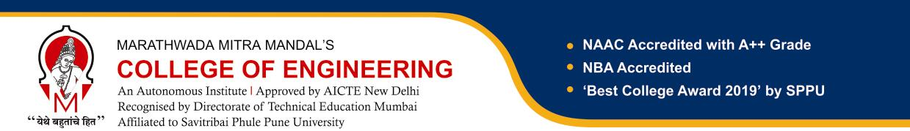
Understanding the 5th Semester Mini Project
Department of Artificial Intelligence & Data Science
Mini Project Framework
Academic Year: 2026–27
Presented By : [Your Team Name]
Medi-Flow Systems: AI-Powered Pharmacy Management
Date: 17/8/2026

Slide 2
Suggested Common Rubric
Problem definition and mapping to foundational courses - 10 marks
Concept generation / architecture / design alternatives - 10 marks
Detailed design calculations / database design / algorithms - 10 marks
Implementation progress, logbook, and review discipline - 10 marks
Testing, validation, and interpretation of results - 10 marks
Working model / executable software / demonstrator quality - 15 marks
Final presentation and demo - 20 marks
Final report and individual viva - 15 marks

Slide 3
Foundational Courses
First-year/common foundational courses:
Fundamentals of Programming Languages
Fundamentals of Artificial Intelligence
Engineering Exploration Lab I & II (basic of IoT, C, Python)
Second-year department core courses:
Data Structures and Algorithms
Problem Solving and Object Oriented Programming
Database Management Systems
Operating System and Administration
Discrete Mathematics
EDIL Lab (Basic Statistics, Data Visualization, Python)

Slide 4
PROJECT MILESTONE TRACKING
Weeks | Phase | Key Activities | Deliverable / Checkpoint
1–2 | 1. Orientation & Topic Selection | Understand project domain, identify problem, team formation, topic selection | Idea Note / Problem Statement
3–4 | 2. Problem Definition & Requirements | Define objectives, scope, functional & non-functional requirements, mapping to foundational courses | Requirement Specification
5–6 | 3. Concept Design & Architecture | System architecture, workflow, technology selection, database/model design | Architecture & Design Document
7–8 | 4. Detailed Design & Planning | Module design, algorithms, dataset planning, task allocation, project schedule | Detailed Design & Work Plan
9–11 | 5. Implementation & Integration | Coding, model development, database integration, module integration | Working Prototype
12–13 | 6. Testing, Validation & Improvement | Functional testing, model evaluation, debugging, performance improvement | Test & Validation Report
14–15 | 7. Final Demonstration & Reporting | Final integration, demonstration, documentation, presentation and viva preparation | Final Report + Demo + Presentation

Slide 5
Project Theme:
AI-Powered Medical Store Management
Modules of the Project :
Module 2: Inventory & Expiry Management
Functions:
Add/update/delete inventory
Medicine Expiry Prediction & Alerts
FEFO dispensing logic
Dead-Stock Detection
Batch tracking
Subjects:
DBMS
Data Structures and Algorithms
OOP
Python
Concepts used:
Classes and objects
Inheritance
CRUD operations
SQL queries
Functions and modules
Module 1: E-Commerce & Family Medicine Management
Functions:
Dual-portal architecture
Family Medicine Management
Searchable product catalog
Shopping cart & checkout
Product search
Subjects Mapped:
Object Oriented Programming
Database Management Systems
Fundamentals of Programming Languages
Concepts used:
Classes and objects
Inheritance
CRUD operations
SQL queries
Functions and modules

Slide 6
Module 3: AI & Image Processing (OCR)
Functions:
Prescription image upload
Prescription OCR extraction
Automatic Medicine Extraction
Cross-referencing inventory
AI text parsing
Subjects:
Fundamentals of AI
Python
Statistics
Principles of Programming Languages
This module demonstrates how raw retail data is converted into usable analytical data.
Module 4: Demand Analytics & Smart Replenishment
Functions:
Medicine Demand Heatmap
Stock Replenishment Prediction
Aggregate POS Sales & Online Orders
Identify unusual demand spikes
Data visualization arrays
Subjects:
Data Structures and Algorithms
OOP
Python
Concepts:
Arrays/Lists
Sets
Dictionaries/Hash Tables
Searching
Sorting
Hashing

Slide 7
Module 5: Market Basket Analysis
Functions:
Find frequently purchased products
Generate frequent item sets
Identify product combinations
Apply Apriori/FP-Growth
Subjects:
Fundamentals of Artificial Intelligence
Data Structures and Algorithms
Discrete Mathematics
Statistics
Python
AI concepts:
Pattern discovery
Association rule mining
Module 6: Association Rule Mining
Functions:
Generate rules such as:
Bread + Butter → Jam
Subjects:
AI
Discrete Mathematics
Statistics
DSA
Concepts
Set operations such as:
Union
Intersection
Subset
Cardinality

Slide 8
Module 7: Customer Segmentation
Functions:
Analyse customer purchase frequency
Identify high-value customers
Group customers based on purchasing behaviour
Find frequent vs occasional customers
Subjects:
Fundamentals of AI
Statistics
Python
Data Visualization
Module 8: Product Recommendation System
Functions:
The system recommends products based on previously purchased items.
Subjects:
AI
DSA
Discrete Mathematics
Python
Statistics

Slide 9
Module 9: Dashboard & Visualization
Create an interactive dashboard showing:
Retail Basket Analysis Dashboard
Top Selling Products
Frequently Brought Together
Subjects:
EDIL Lab
Python
Statistics
Fundamentals of AI
Visualization:
Bar chart
Pie chart
Line graph
Product association graph
Module 10: Business Recommendation & Report
The system converts analytical results into business suggestions.
Bread and Butter frequently purchased - Create combo offer
Subjects:
AI
Statistics
Data Visualization
Python

Slide 10
Module 11: System Administration
Functions:
Admin login
User management
Database backup
Data import/export
System monitoring
Access control
Subjects:
Operating System and Administration
DBMS
OOP
Programming Languages

Slide 11
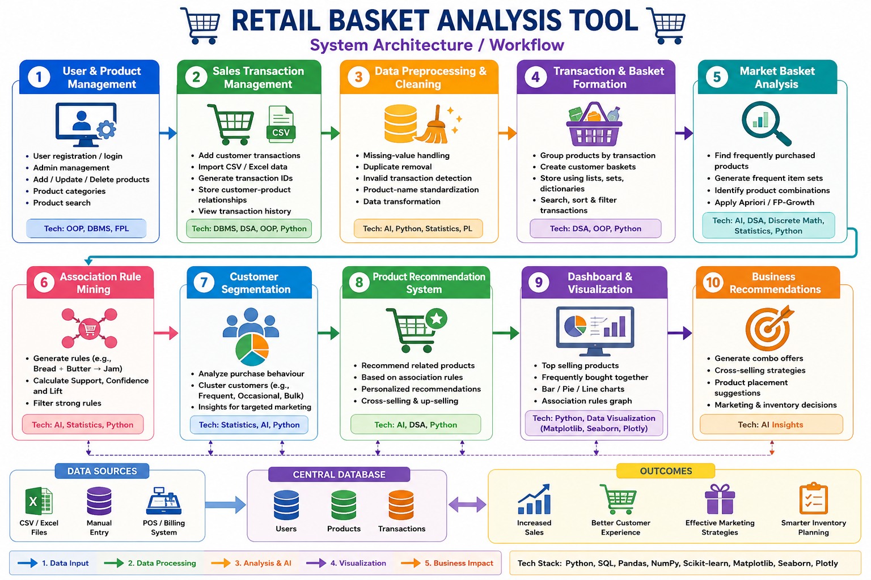
System Workflow

Slide 12
Critical Risk Areas and Potential Challenges
Failure Area | How Failure Can Occur | Possible Reasons
Database | Incorrect relationship between customers, products and transactions | Wrong IDs, incorrect relationships, duplicate records, improper mapping
Basket Formation | Products are assigned to the wrong transaction or customer basket | Incorrect grouping, transaction ID errors, improper data transformation
Association Rule Mining | Irrelevant or incorrect rules are generated | Incorrect support/confidence/lift calculation or poorly selected thresholds
Product Recommendation | System recommends products that are not relevant | Weak association rules, insufficient transaction history, incorrect recommendation logic
Customer Segmentation | Customers are placed into inappropriate groups | Incorrect purchase-frequency calculation or poorly defined segmentation rules
Dashboard & Visualization | Charts and results do not match the actual transaction data | Calculation errors, outdated data, incorrect filtering or visualization logic
Business Recommendation | Generated business suggestions are not useful | Incorrect analytical results or weak product associations

Slide 13
Critical Risk Areas and Potential Challenges
Failure Area | How Failure Can Occur | Possible Reasons
Testing & Validation | System generates unreliable basket analysis results | Insufficient test cases, small dataset, lack of validation
Project Scope | Students cannot complete all planned modules | Too many modules, limited time, insufficient task distribution

Slide 14
Project Theme 2:
Crop Yield Advisory Analytics
Modules of the Project :
Module 1: Data Collection
Functions:
Collect crop and soil data
Collect weather and rainfall data
Record fertilizer and irrigation details
Store historical crop-yield data
Subjects:
Fundamentals of Programming Languages
Engineering Exploration Lab
DBMS
Python
Module 2: Database Management
Functions:
Store farmer and farm details
Store crop, soil and weather data
Manage yield records
Perform CRUD operations
Retrieve data using SQL queries
Subjects:
Database Management Systems
Object Oriented Programming
Data Structures and Algorithms
Python

Slide 15
Module 3: Statistical Analysis
Functions:
Calculate mean, median and standard deviation
Analyze crop-yield trends
Identify relationships between weather, soil and yield
Compare crop performance
Identify important yield factors
Subjects:
Statistics
Python
Discrete Mathematics
Fundamentals of Artificial Intelligence
Module 4: Recommendation Engine
Functions:
Estimate expected yield using historical statistics
Recommend suitable crops based on soil, weather and rainfall
Recommend fertilizer based on soil nutrient levels
Suggest irrigation requirements based on rainfall and soil moisture
Generate rule-based yield improvement advice
Input Data → Statistical Analysis → Rule-Based Decision Engine → Recommendation
Subjects:
Fundamentals of Artificial Intelligence
Data Structures and Algorithms
Object Oriented Programming
Python
Statistics

Slide 16
Module 5: Dashboard & Reports
Functions:
Display predicted crop yield
Show crop-wise and seasonal trends
Visualize weather and yield relationships
Display recommendations
Generate analytical reports
Subjects:
EDIL Lab
Python
Statistics
Fundamentals of Artificial Intelligence
DBMS

Slide 17
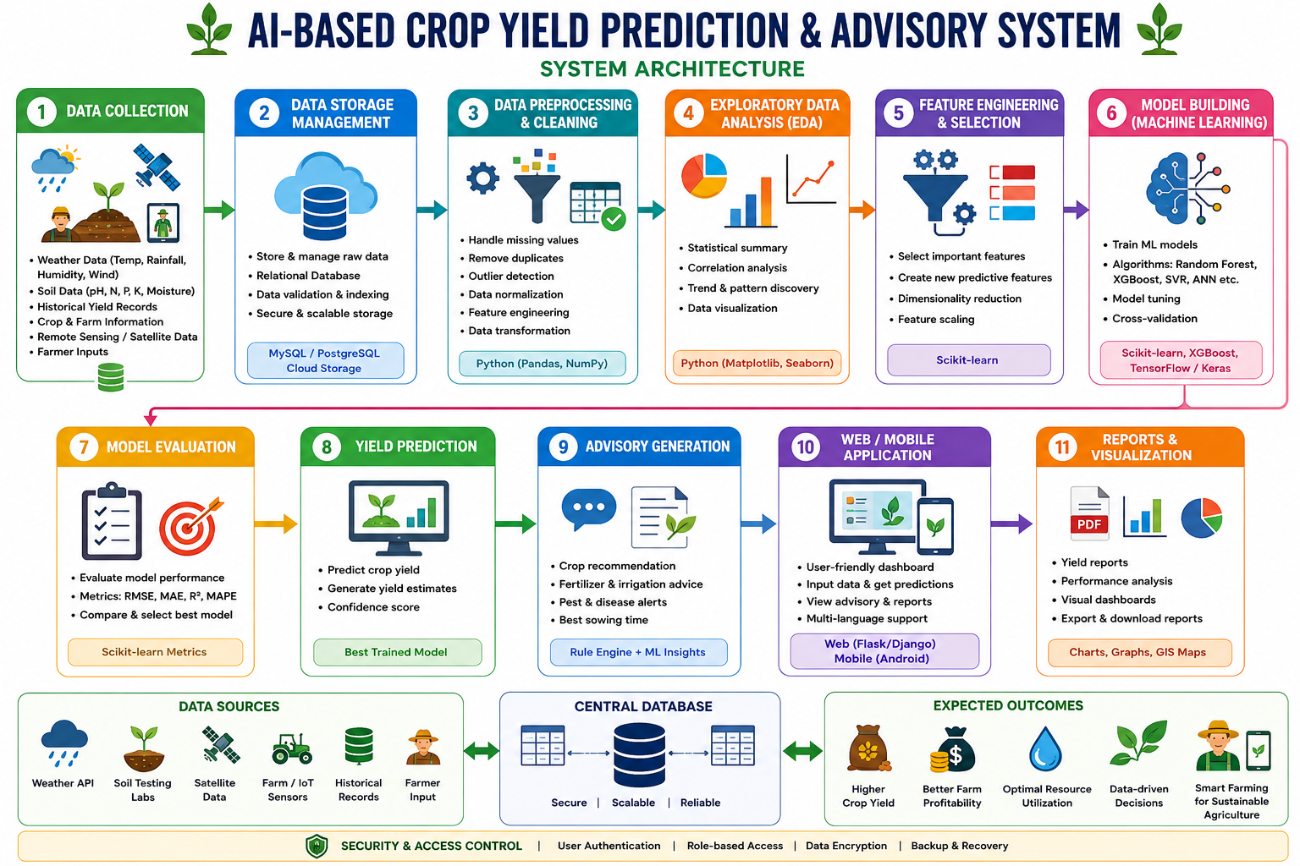
System Workflow

Slide 18
Critical Risk Areas and Potential Challenges
Failure Area | How Failure Can Occur | Possible Reasons
Data Collection | Incomplete or incorrect agricultural data is collected | Missing weather, soil, fertilizer, irrigation, or yield data
Database | Incorrect relationship between farm, crop, weather and yield records | Wrong IDs, incorrect relationships, duplicate records, improper mapping
Statistical Analysis | Incorrect conclusions are drawn from the data | Other factors may influence yield; correlation alone does not prove causation
Yield Estimation | Estimated yield differs significantly from actual yield | Insufficient historical data, inaccurate records, or important factors not considered
Crop Recommendation | System recommends an unsuitable crop | Incorrect soil/weather conditions, incomplete rules, or insufficient historical data
Recommendation Engine | Recommendations are not relevant to the given farm conditions | Poorly defined IF–THEN rules or incorrect input data
System Integration | Individual modules work but fail when integrated | Data-flow errors, incompatible modules, or incorrect function/API integration

Slide 19


