Slide 1




SRM INSTITUTE OF SCIENCE AND TECHNOLOGY,
CHENNAI.
18CSC205J-Operating Systems
Unit- IV

Slide 2

Syllabus
Basics- Virtual Address Space
Demand Paging
Page table, Handling Page faults, Performance of demand paging, Copy on write
Page Replacement Algorithm
Pros and Cons of Page Replacement
FIFO, Optimal, LRU, LRU Approximation ,Counting based Page replacement algorithms.
Allocation of Frames
Global Vs Local Allocation
MFC ,MVC
Thrashing
Cause of Thrashing
Working Set Model

Slide 3
Virtual Memory
Virtual memory – separation of user logical memory from physical memory
Only part of the program needs to be in memory for execution
Logical address space can therefore be much larger than physical address space
Allows address spaces to be shared by several processes
Allows for more efficient process creation
More programs running concurrently
Less I/O needed to load or swap processes

Slide 4
Virtual Memory
Virtual memory is a technique that allows the execution of processes that are not completely in memory.
One major advantage of this scheme is that programs can be larger than physical memory.
Further, virtual memory abstracts main memory into an extremely large, uniform array of storage, separating logical memory as viewed by the user from physical memory.
This technique frees programmers from the concerns of memory-storage limitations.
Virtual memory also allows processes to share files easily and to implement shared memory.
In addition, it provides an efficient mechanism for process creation.

Slide 5
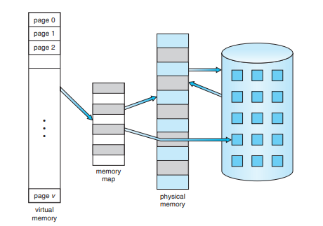
Diagram Showing Virtual Memory Larger than Physical Memory

Slide 6
Virtual address space
Virtual address space – logical view of how process is stored in memory
Usually start at address 0, contiguous addresses until end of space
Meanwhile, physical memory organized in page frames
MMU must map logical to physical
Virtual memory can be implemented via:
Demand paging
Demand segmentation

Slide 7
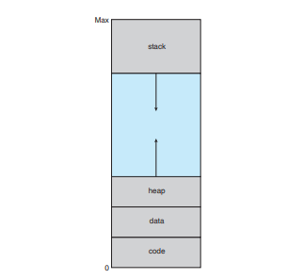
Virtual Address Space

Slide 8
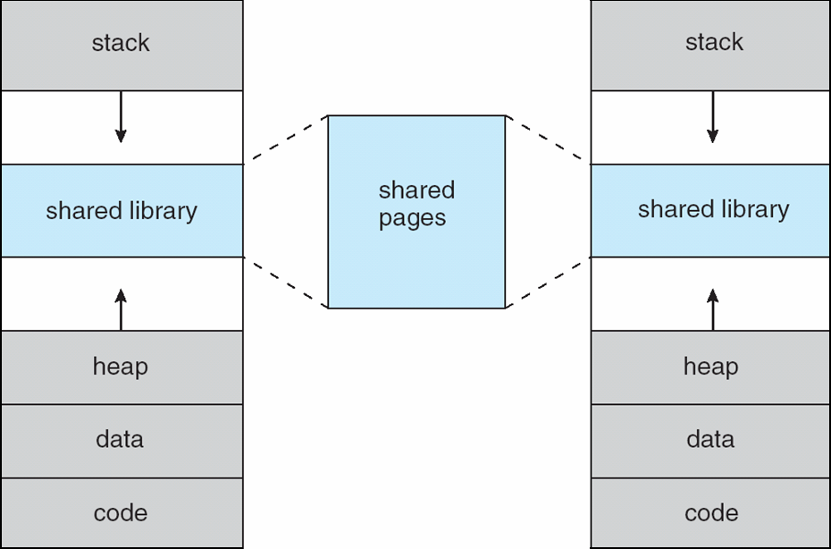
Shared Library Using Virtual Memory

Slide 9
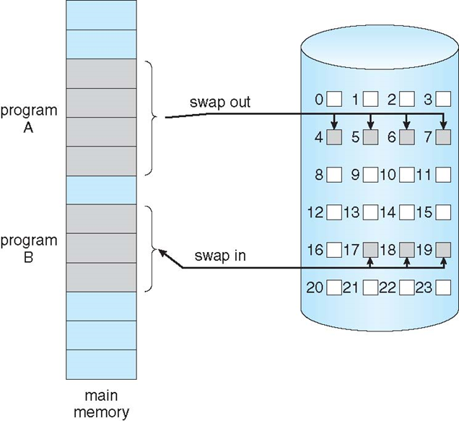
Demand Paging
Could bring entire process into memory at load time
Or bring a page into memory only when it is needed
Less I/O needed, no unnecessary I/O
Less memory needed
Faster response
More users
Similar to paging system with swapping (diagram on right)
Page is needed ⇒ reference to it
invalid reference ⇒ abort
not-in-memory ⇒ bring to memory
Lazy swapper – never swaps a page into memory unless page will be needed
Swapper that deals with pages is a pager

Slide 10
Basic Concepts
With swapping, pager guesses which pages will be used before swapping out again
Instead, pager brings in only those pages into memory
How to determine that set of pages?
Need new MMU functionality to implement demand paging
If pages needed are already memory resident
No difference from non demand-paging
If page needed and not memory resident
Need to detect and load the page into memory from storage
Without changing program behavior
Without programmer needing to change code

Slide 11
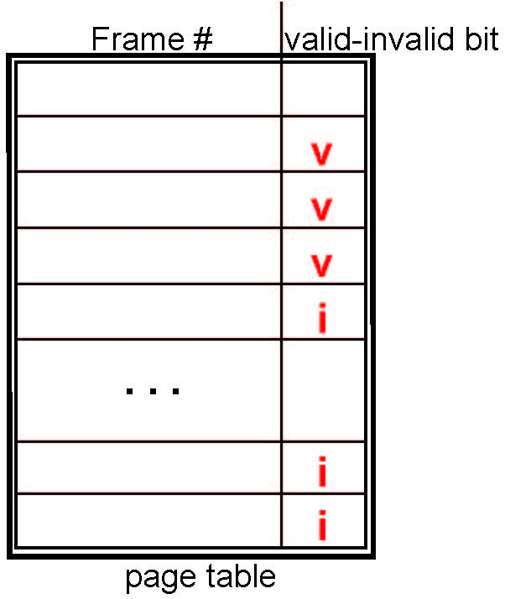
Valid-Invalid Bit
With each page table entry a valid–invalid bit is associated (v ⇒ in-memory – memory resident, i ⇒ not-in-memory)
Initially valid–invalid bit is set to i on all entries
Example of a page table snapshot:
During MMU address translation, if valid–invalid bit in page table entry is i ⇒ page fault

Slide 12
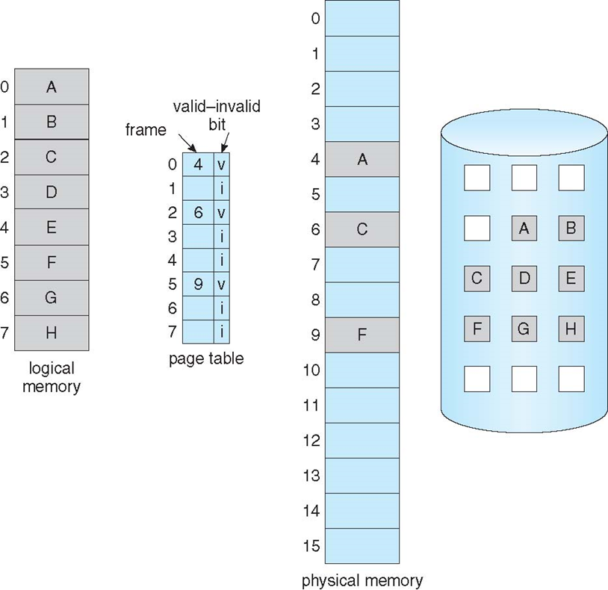
Page Table When Some Pages Are Not in Main Memory

Slide 13
Page Fault
If there is a reference to a page, first reference to that page will trap to operating system:
page fault
Operating system looks at another table to decide:
Invalid reference ⇒ abort
Just not in memory
Find free frame
Swap page into frame via scheduled disk operation
Reset tables to indicate page now in memory Set validation bit = v
Restart the instruction that caused the page fault

Slide 14
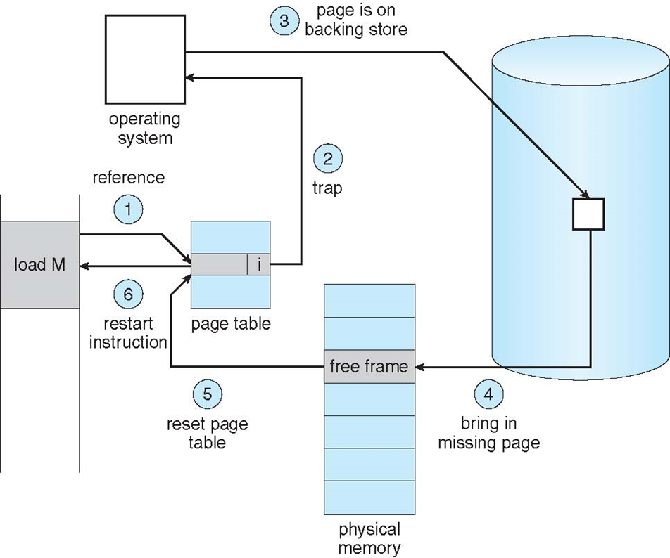
Steps in Handling a Page Fault

Slide 15
Aspects of Demand Paging
Extreme case – start process with no pages in memory
OS sets instruction pointer to first instruction of process, non-memory-resident -> page fault
And for every other process pages on first access
Pure demand paging
Actually, a given instruction could access multiple pages -> multiple page faults
Consider fetch and decode of instruction which adds 2 numbers from memory and stores result back to memory
Pain decreased because of locality of reference
Hardware support needed for demand paging
Page table with valid / invalid bit
Secondary memory (swap device with swap space)
Instruction restart

Slide 16
Performance of Demand Paging
Stages in Demand Paging (worse case)
Trap to the operating system
Save the user registers and process state
Determine that the interrupt was a page fault
Check that the page reference was legal and determine the location of the page on the disk
Issue a read from the disk to a free frame:
Wait in a queue for this device until the read request is serviced
Wait for the device seek and/or latency time
Begin the transfer of the page to a free frame
While waiting, allocate the CPU to some other user
Receive an interrupt from the disk I/O subsystem (I/O completed)
Save the registers and process state for the other user
Determine that the interrupt was from the disk
Correct the page table and other tables to show page is now in memory
Wait for the CPU to be allocated to this process again
Restore the user registers, process state, and new page table, and then resume the interrupted instruction

Slide 17
Performance of Demand Paging (Cont.)
Three major activities
Service the interrupt – careful coding means just several hundred instructions needed
Read the page – lots of time
Restart the process – again just a small amount of time
Page Fault Rate 0 ≤ p ≤ 1
if p = 0 no page faults
if p = 1, every reference is a fault
Effective Access Time (EAT)
EAT = (1 – p) x memory access
+ p (page fault overhead
+ swap page out
+ swap page in )

Slide 18
Demand Paging Example
Memory access time = 200 nanoseconds
Average page-fault service time = 8 milliseconds
EAT = (1 – p) x 200 + p (8 milliseconds)
= (1 – p x 200 + p x 8,000,000
= 200 + p x 7,999,800
If one access out of 1,000 causes a page fault, then
EAT = 8.2 microseconds.
This is a slowdown by a factor of 40!!
If want performance degradation < 10 percent
220 > 200 + 7,999,800 x p 20 > 7,999,800 x p
p < .0000025
< one page fault in every 400,000 memory accesses

Slide 19
Demand Paging Optimizations
Swap space I/O faster than file system I/O even if on the same device
Swap allocated in larger chunks, less management needed than file system
Copy entire process image to swap space at process load time
Then page in and out of swap space
Used in older BSD Unix
Demand page in from program binary on disk, but discard rather than paging out when freeing frame
Used in Solaris and current BSD
Still need to write to swap space
Pages not associated with a file (like stack and heap) – anonymous memory
Pages modified in memory but not yet written back to the file system
Mobile systems
Typically don’t support swapping
Instead, demand page from file system and reclaim read-only pages (such as code)

Slide 20
Page replacement Algorithms

Slide 21
Page Fault in OS
A page fault occurs when a page referenced by the CPU is not found in the main memory.
The required page has to be brought from the secondary memory into the main memory.
A page has to be replaced if all the frames of main memory are already occupied.

Slide 22
Page replacement
Page replacement is a process of swapping out an existing page from the frame of a main memory and replacing it with the required page.
Page replacement is required when-
All the frames of main memory are already occupied.
Thus, a page has to be replaced to create a room for the required page.

Slide 23
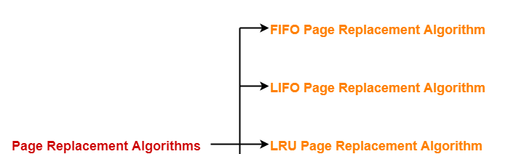
Page Replacement Algorithms
Page replacement algorithms help to decide which page must be swapped out from the main memory to create a room for the incoming page.
Various page replacement algorithms are-

Slide 24
FIFO Page Replacement Algorithm
As the name suggests, this algorithm works on the principle of “First in First out“.
It replaces the oldest page that has been present in the main memory for the longest time.
It is implemented by keeping track of all the pages in a queue.

Slide 25
LIFO Page Replacement Algorithm
As the name suggests, this algorithm works on the principle of “Least Recently Used“.
It replaces the page that has not been referred by the CPU for the longest time.

Slide 26
Optimal Page Replacement Algorithm
This algorithm replaces the page that will not be referred by the CPU in future for the longest time.
It is practically impossible to implement this algorithm.
This is because the pages that will not be used in future for the longest time can not be predicted.
However, it is the best known algorithm and gives the least number of page faults.
Hence, it is used as a performance measure criterion for other algorithms.

Slide 27
Example
Consider a reference string: 4, 7, 6, 1, 7, 6, 1, 2, 7, 2. the number of frames in the memory is 3. Find out the number of page faults respective to:
FIFO Page Replacement Algorithm
LRU Page Replacement Algorithm
Optimal Page Replacement Algorithm

Slide 28
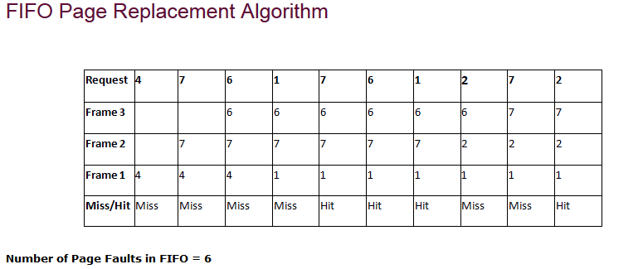
FIFO Page replacement algorithms

Slide 29
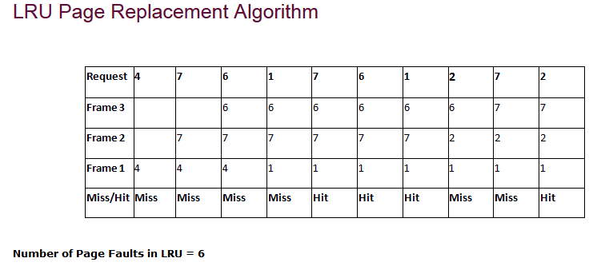
LRU Page replacement algorithms

Slide 30
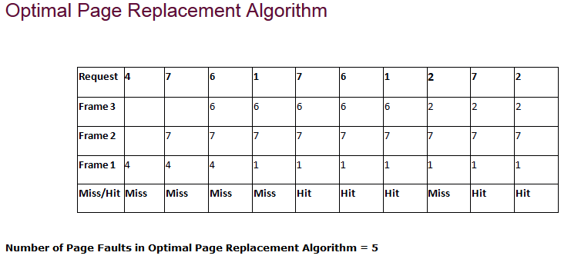
Optimal Page replacement algorithm

Slide 31
LRU Approximation Algorithms
LRU needs special hardware and still slow
Reference bit
With each page associate a bit, initially = 0
When page is referenced bit set to 1
Replace any with reference bit = 0 (if one exists)
We do not know the order, however
Second-chance algorithm
Generally FIFO, plus hardware-provided reference bit
Clock replacement
If page to be replaced has
Reference bit = 0 -> replace it
reference bit = 1 then:
set reference bit 0, leave page in memory
replace next page, subject to same rules

Slide 32
Second-Chance (clock) Page-Replacement Algorithm

Slide 33
Enhanced Second-Chance Algorithm
Improve algorithm by using reference bit and modify bit (if available) in concert
Take ordered pair (reference, modify)
(0, 0) neither recently used not modified – best page to replace
(0, 1) not recently used but modified – not quite as good, must write out before replacement
(1, 0) recently used but clean – probably will be used again soon
(1, 1) recently used and modified – probably will be used again soon and need to write out before replacement
When page replacement called for, use the clock scheme but use the four classes replace page in lowest non-empty class
Might need to search circular queue several times

Slide 34
Counting Algorithms
Keep a counter of the number of references that have been made to each page
Not common
Lease Frequently Used (LFU) Algorithm: replaces page with smallest count
Most Frequently Used (MFU) Algorithm: based on the argument that the page with the smallest count was probably just brought in and has yet to be used

Slide 35
Page-Buffering Algorithms
Keep a pool of free frames, always
Then frame available when needed, not found at fault time
Read page into free frame and select victim to evict and add to free pool
When convenient, evict victim
Possibly, keep list of modified pages
When backing store otherwise idle, write pages there and set to non-dirty
Possibly, keep free frame contents intact and note what is in them
If referenced again before reused, no need to load contents again from disk
Generally useful to reduce penalty if wrong victim frame selected

Slide 36
Copy-on-Write
Copy-on-Write (COW) allows both parent and child processes to initially share the same pages in memory
If either process modifies a shared page, only then is the page copied
COW allows more efficient process creation as only modified pages are copied
In general, free pages are allocated from a pool of zero-fill-on-demand pages
Pool should always have free frames for fast demand page execution
Don’t want to have to free a frame as well as other processing on page fault
Why zero-out a page before allocating it?
vfork() variation on fork() system call has parent suspend and child using copy-on-write address space of parent
Designed to have child call exec()
Very efficient

Slide 37
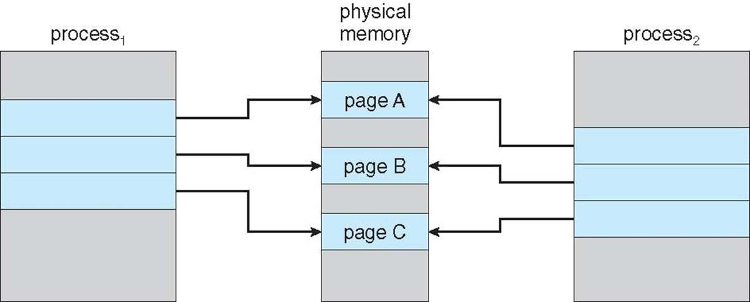
Before Process 1 Modifies Page C

Slide 38
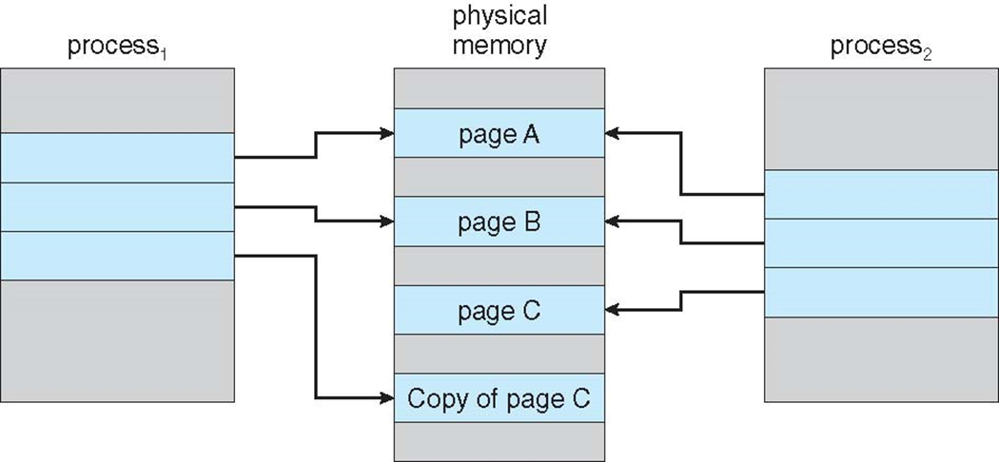
After Process 1 Modifies Page C

Slide 39
What Happens if There is no Free Frame?
Used up by process pages
Also in demand from the kernel, I/O buffers, etc
How much to allocate to each?
Page replacement – find some page in memory, but not really in use, page it out
Algorithm – terminate? swap out? replace the page?
Performance – want an algorithm which will result in minimum number of page faults
Same page may be brought into memory several times

Slide 40
Frames
When main memory is divided in to small fragments for paging purpose , the small fragments are called frames.
whereas if the process is divided into small fragments for paging it is called page. ( Page_size = Frame_size )
A frame refers to a storage frame or central storage frame.
In terms of physical memory, it is a fixed sized block in physical memory space, or a block of central storage.
In computer architecture, frames are analogous to logical address space pages.

Slide 41
Frame Allocation Algorithm
An important aspect of operating systems, virtual memory is implemented using demand paging. Demand paging necessitates the development of a page replacement algorithm and a frame allocation algorithm.
Frame allocation algorithms are used if you have multiple processes; it helps decide how many frames to allocate to each process.
There are various constraints to the strategies for the allocation of frames:
You cannot allocate more than the total number of available frames.
At least a minimum number of frames should be allocated to each process.
This constraint is supported by two reasons. The first reason is, as less number of frames are allocated, there is an increase in the page fault ratio, decreasing the performance of the execution of the process. Secondly, there should be enough frames to hold all the different pages that any single instruction can reference.

Slide 42
Types of Frame Allocation Algorithm
The algorithms that are commonly used to allocate frames to a process are:
Equal allocation: In a system with x frames and y processes, each process gets equal number of frames, i.e. x/y. For instance, if the system has 48 frames and 9 processes, each process will get 5 frames. The three frames which are not allocated to any process can be used as a free-frame buffer pool.
Disadvantage: In systems with processes of varying sizes, it does not make much sense to give each process equal frames. Allocation of a large number of frames to a small process will eventually lead to the wastage of a large number of allocated unused frames.

Slide 43
Proportional Allocation
Proportional allocation: Frames are allocated to each process according to the process size. For a process p_{i} of size s_{i}, the number of allocated frames is a_{i} = (s_{i}/S)*m, where S is the sum of the sizes of all the processes and m is the number of frames in the system.
For instance, in a system with 62 frames, if there is a process of 10KB and another process of 127KB, then the first process will be allocated (10/137)*62 = 4 frames and the other process will get (127/137)*62 = 57 frames.
Advantage: All the processes share the available frames according to their needs, rather than equally.

Slide 44
Priority Allocation
Use a proportional allocation scheme using priorities rather than size
If process P_{i} generates a page fault,
select for replacement one of its frames
select for replacement a frame from a process with lower priority number

Slide 45
Comparison between Local and Global Replacement
Local replacement: When a process needs a page which is not in the memory, it can bring in the new page and allocate it a frame from its own set of allocated frames only.
Advantage: The pages in memory for a particular process and the page fault ratio is affected by the paging behavior of only that process.
Disadvantage: A low priority process may hinder a high priority process by not making its frames available to the high priority process.
Global Replacement:
When a process needs a page which is not in the memory, it can bring in the new page and allocate it a frame from the set of all frames, even if that frame is currently allocated to some other process; that is, one process can take a frame from another.
Advantage: Does not hinder the performance of processes and hence results in greater system throughput.
Disadvantage: The page fault ratio of a process can not be solely controlled by the process itself. The pages in memory for a process depends on the paging behavior of other processes as well.

Slide 46
MFT-Multiprogramming with a Fixed number of Tasks
MFT (Multiprogramming with a Fixed number of Tasks) is one of the old memory management techniques in which the memory is partitioned into fixed size partitions and each job is assigned to a partition.
The memory assigned to a partition does not change.

Slide 47
MVT-Multiprogramming with Variable number of Tasks
MVT (Multiprogramming with a Variable number of Tasks) is the memory management technique in which each job gets just the amount of memory it needs.
That is, the partitioning of memory is dynamic and changes as jobs enter and leave the system. MVT is a more ``efficient'' user of resources. MFT suffers with the problem of internal fragmentation and MVT suffers with external fragmentation.

Slide 48
Thrashing
If a process does not have “enough” pages, the page-fault rate is very high. This leads to:
low CPU utilization.
operating system thinks that it needs to increase the degree of multiprogramming.
another process added to the system.
Thrashing ≡ a process is busy swapping pages in and out.
This high paging activity is called thrashing. A process is thrashing if it is
spending more time paging than executing.

Slide 49
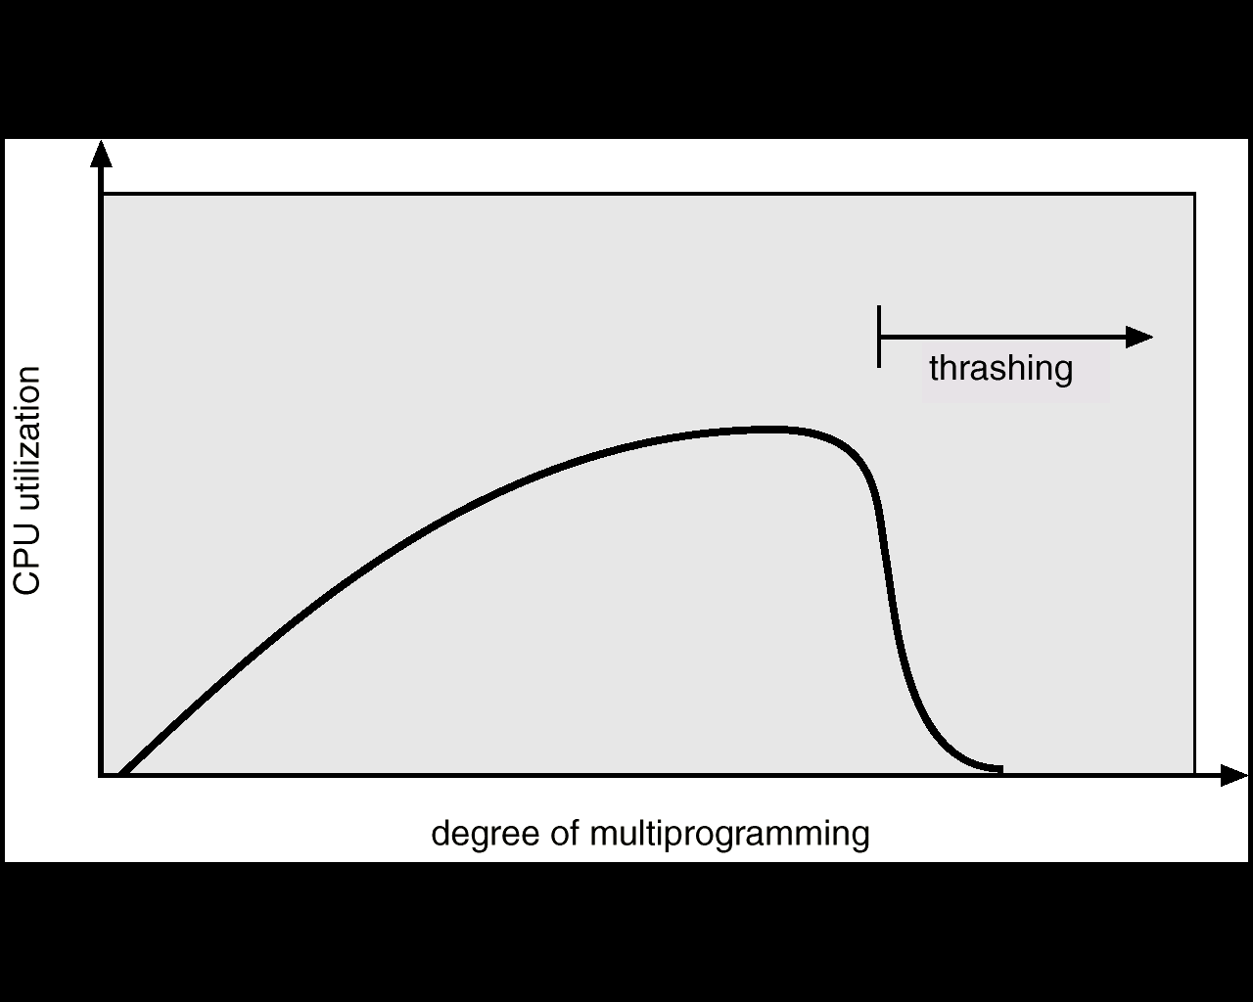
Thrashing Diagram
while (true) { /* produce an item in next produced */
while (counter == BUFFER_SIZE) ;
/* do nothing */
buffer[in] = next_produced;
in = (in + 1) % BUFFER_SIZE;
counter++;
}
Why does paging work? Locality model
Process migrates from one locality to another
Localities may overlap.
Why does thrashing occur? Σ size of locality > total memory size

Slide 50
Thrashing
We can limit the effects of thrashing by using a local replacement algorithm(or priority replacement algorithm).
local replacement - if one process starts thrashing, it cannot steal frames from another process to thrash.
This problem is not entirely solved. If processes are thrashing, they will be in the queue for the paging device most of the time.
The average service time for a page fault will increase Thus, the effective access time will increase even for a process that is not thrashing.

Slide 51
Locality Model
To prevent thrashing, we must provide a process with as many frames as
it needs.
But how do we know how many frames it “needs”?
Technique - working-set strategy starts by looking at how many frames a process is actually using. This approach defines the locality model of process execution.
The locality model states that, as a process executes, it moves from locality
to locality. A locality is a set of pages that are actively used together
A program is generally composed of several different localities that may
overlap.

Slide 52
Locality Model
Why does paging work? Locality model
Process migrates from one locality to another
Localities may overlap.
Why does thrashing occur? Σ size of locality > total memory size

Slide 53
Working Set Model
Δ ≡ working-set window ≡ a fixed number of page references Example: 10,000 instruction
WSS_{i} (working set of Process P_{i}) = total number of pages referenced in the most recent Δ (varies in time)
if Δ too small will not encompass entire locality.
if Δ too large will encompass several localities.
if Δ = ∞ ⇒ will encompass entire program.
D = Σ WSS_{i} ≡ total demand frames
if D > m ⇒ Thrashing
Policy if D > m, then suspend one of the processes.

Slide 54
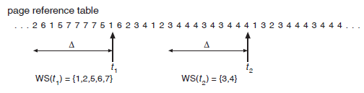
Working Set Model

Slide 55
Keeping Track of the Working Set
Approximate with interval timer + a reference bit
Example: Δ = 10,000
Timer interrupts after every 5000 time units.
Keep in memory 2 bits for each page.
Whenever a timer interrupts copy and sets the values of all reference bits to 0.
If one of the bits in memory = 1 ⇒ page in working set.
Why is this not completely accurate?
Improvement = 10 bits and interrupt every 1000 time units.

Slide 56
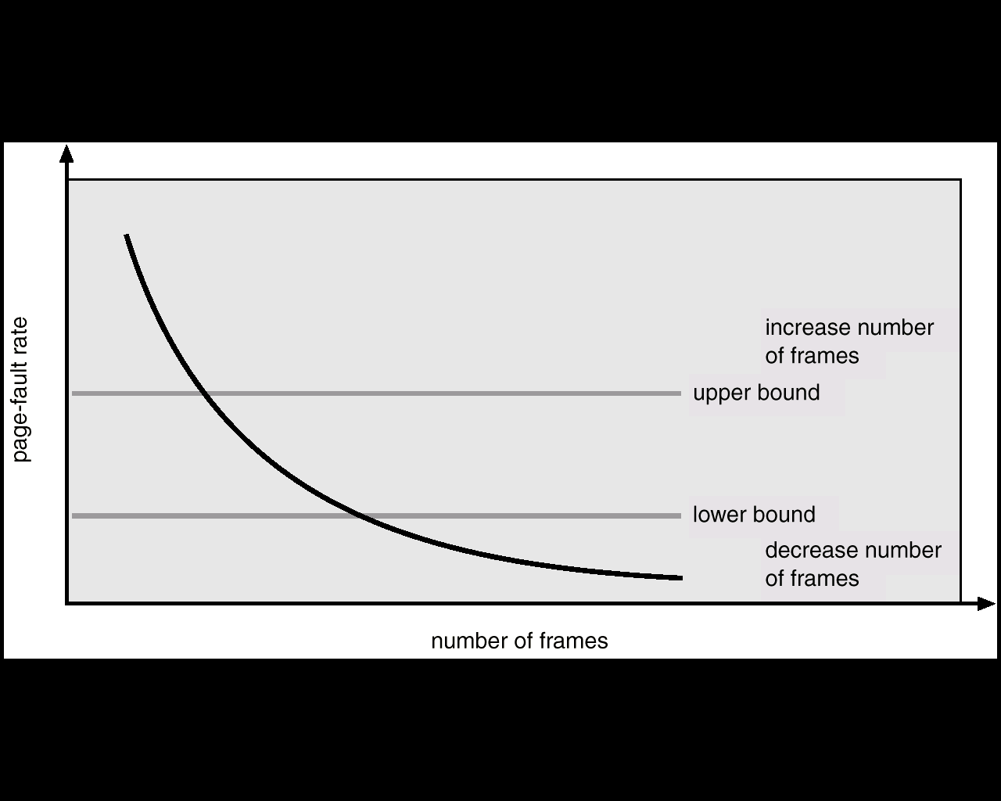
Page-Fault Frequency
Establish “acceptable” page-fault rate.
If actual rate too low, process loses frame.
If actual rate too high, process gains frame.

