Slide 1
18CSC261T
Unit –III
Push Down Automata (PDA), Context Free Grammar (CFG), Context Sensitive Grammar (CSG) and Linear Bounded Automata (LBA)

Slide 2
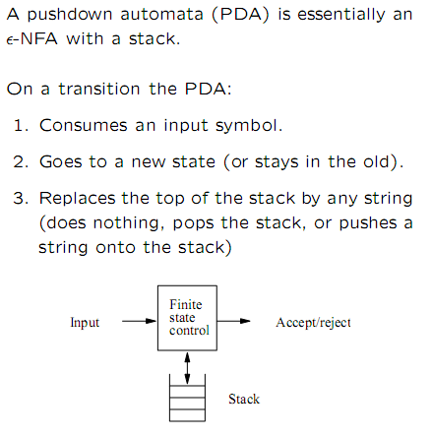
Push Down Automata (PDA)

Slide 3
Pushdown Automata (PDA)
Informally:
  A PDA is an NFA-ε with a stack.
  Transitions are modified to accommodate stack operations.
Questions:
  What is a stack?
  How does a stack help?
A DFA can “remember” only a finite amount of information, whereas a PDA can “remember” an infinite amount of (certain types of) information, in one memory-stack

Slide 4
Example:
{0^{n}1^{n} | 0=<n} is not regular, but
{0^{n}1^{n} | 0≤n≤k, for some fixed k} is regular, for any fixed k.
For k=3:
L = {ε, 01, 0011, 000111}
0
q₁
0
q₂
0
q₃
q₀
1
1
1
1
0/1
1
1
0/1
q₇
q₆
q₅
q₄
0
0
0

Slide 5
In a DFA, each state remembers a finite amount of information.
To get {0^{n}1^{n} | 0≤n} with a DFA would require an infinite number of states using the preceding technique.
An infinite stack solves the problem for {0^{n}1^{n} | 0≤n} as follows:
  Read all 0’s and place them on a stack
  Read all 1’s and match with the corresponding 0’s on the stack
Only need two states to do this in a PDA
Similarly for {0^{n}1^{m}0^{n+m} | n,m≥0}

Slide 6
Formal Definition of a PDA
A Deterministic pushdown automaton (DPDA) is a seven-tuple:
M = (Q, Σ, Г, δ, q₀, z₀, F)
Q A finite set of states
Σ A finite input alphabet
Г A finite stack alphabet
q₀ The initial/starting state, q₀ is in Q
z₀ A starting stack symbol, is in Г // need not always remain at the bottom of stack
F A set of final/accepting states, which is a subset of Q
δ A transition function, where
δ: Q x (Σ U {ε}) x Г → Q x Г*

Slide 7
Example: 0^{n}1^{n}, n>=0
M = ({q₁, q₂}, {0, 1}, {L, #}, δ, q₁, #, Ø)
δ:
(1) δ(q₁, 0, #) = {(q₁, L#)} // stack order: L on top, then # below
(2) δ(q₁, 1, #) = Ø // illegal, string rejected, When will it happen?
(3) δ(q₁, 0, L) = {(q₁, LL)}
(4) δ(q₁, 1, L) = {(q₂, ε)}
(5) δ(q₂, 1, L) = {(q₂, ε)}
(6) δ(q₂, ε, #) = {(q₂, ε)} //if ε read & stack hits bottom, accept
(7) δ(q₂, ε, L) = Ø // illegal, string rejected
(8) δ(q₁, ε, #) = {(q₂, ε)} // n=0, accept
Goal: (acceptance)
  Read the entire input string
  Terminate with an empty stack
Informally, a string is accepted if there exists a computation that uses up all the input and leaves the stack empty.
How many rules should be there in delta?

Slide 8
Language: 0^{n}1^{n}, n>=0
δ:
(1) δ(q₁, 0, #) = {(q₁, L#)} // stack order: L on top, then # below
(2) δ(q₁, 1, #) = Ø // illegal, string rejected, When will it happen?
(3) δ(q₁, 0, L) = {(q₁, LL)}
(4) δ(q₁, 1, L) = {(q₂, ε)}
(5) δ(q₂, 1, L) = {(q₂, ε)}
(6) δ(q₂, ε, #) = {(q₂, ε)} //if ε read & stack hits bottom, accept
(7) δ(q₂, ε, L) = Ø // illegal, string rejected
(8) δ(q₁, ε, #) = {(q₂, ε)} // n=0, accept
0011
(q1, 0 011, #) |-
(q1, 0 11, L#) |-
(q1, 1 1, LL#) |-
(q2, 1, L#) |-
(q2, e, #) |-
(q2, e, e): accept
011
(q1, 0 11, #) |-
(q1, 1 1, L#) |-
(q2, 1, #) |-
Ø : reject
Try 001

Slide 9
Example: balanced parentheses,
e.g. in-language: ((())()), or (())(), but not-in-language: ((())
M = ({q₁}, {“(“, “)”}, {L, #}, δ, q₁, #, Ø)
δ:
(1) δ(q₁, (, #) = {(q₁, L#)} // stack order: L-on top-then- # lower
(2) δ(q₁, ), #) = Ø // illegal, string rejected
(3) δ(q₁, (, L) = {(q₁, LL)}
(4) δ(q₁, ), L) = {(q₁, ε)}
(5) δ(q₁, ε, #) = {(q₁, ε)} //if ε read & stack hits bottom, accept
(6) δ(q₁, ε, L) = Ø // illegal, string rejected
// What does it mean? When will it happen?
Goal: (acceptance)
  Read the entire input string
  Terminate with an empty stack
Informally, a string is accepted if there exists a computation that uses up all the input and leaves the stack empty.
How many rules should be in delta?

Slide 10
Transition Diagram:
Example Computation:
Current Input Stack Transition
(()) # -- initial status
()) L# (1) - Could have applied rule (5), but
)) LL# (3) it would have done no good
) L# (4)
ε # (4)
ε - (5)
(, # | L#
ε, # | ε
q₀
(, L | LL
), L | ε

Slide 11
Example PDA #1: For the language {x | x = wcw^{r} and w in {0,1}*, but sigma={0,1,c}}
Is this a regular language?
Note: length |x| is odd
M = ({q₁, q₂}, {0, 1, c}, {#, B, G}, δ, q₁, #, Ø)
δ:
(1) δ(q₁, 0, #) = {(q₁, B#)} (9) δ(q₁, 1, #) = {(q₁, G#)}
(2) δ(q₁, 0, B) = {(q₁, BB)} (10) δ(q₁, 1, B) = {(q₁, GB)}
(3) δ(q₁, 0, G) = {(q₁, BG)} (11) δ(q₁, 1, G) = {(q₁, GG)}
(4) δ(q₁, c, #) = {(q₂, #)} (12) δ(q₂, 1, G) = {(q₂, ε)}
(5) δ(q₁, c, B) = {(q₂, B)}
(6) δ(q₁, c, G) = {(q₂, G)}
(7) δ(q₂, 0, B) = {(q₂, ε)}
(8) δ(q₂, ε, #) = {(q₂, ε)}
Notes:
  Stack grows leftwards
  Only rule #8 is non-deterministic.
  Rule #8 is used to pop the final stack symbol off at the end of a computation.

Slide 12
Example Computation:
(1) δ(q₁, 0, #) = {(q₁, B#)} (9) δ(q₁, 1, #) = {(q₁, G#)}
(2) δ(q₁, 0, B) = {(q₁, BB)} (10) δ(q₁, 1, B) = {(q₁, GB)}
(3) δ(q₁, 0, G) = {(q₁, BG)} (11) δ(q₁, 1, G) = {(q₁, GG)}
(4) δ(q₁, c, #) = {(q₂, #)} (12) δ(q₂, 1, G) = {(q₂, ε)}
(5) δ(q₁, c, B) = {(q₂, B)}
(6) δ(q₁, c, G) = {(q₂, G)}
(7) δ(q₂, 0, B) = {(q₂, ε)}
(8) δ(q₂, ε, #) = {(q₂, ε)}
State Input Stack Rule Applied Rules Applicable
q₁ 01c10 # (1)
q₁ 1c10 B# (1) (10)
q₁ c10 GB# (10) (6)
q₂ 10 GB# (6) (12)
q₂ 0 B# (12) (7)
q₂ ε # (7) (8)
q₂ ε ε (8) -

Slide 13
Example Computation:
(1) δ(q₁, 0, #) = {(q₁, B#)} (9) δ(q₁, 1, #) = {(q₁, G#)}
(2) δ(q₁, 0, B) = {(q₁, BB)} (10) δ(q₁, 1, B) = {(q₁, GB)}
(3) δ(q₁, 0, G) = {(q₁, BG)} (11) δ(q₁, 1, G) = {(q₁, GG)}
(4) δ(q₁, c, #) = {(q₂, #)} (12) δ(q₂, 1, G) = {(q₂, ε)}
(5) δ(q₁, c, B) = {(q₂, B)}
(6) δ(q₁, c, G) = {(q₂, G)}
(7) δ(q₂, 0, B) = {(q₂, ε)}
(8) δ(q₂, ε, #) = {(q₂, ε)}
State Input Stack Rule Applied
q₁ 1c1 #
q₁ c1 G# (9)
q₂ 1 G# (6)
q₂ ε # (12)
q₂ ε ε (8)
Questions:
  Why isn’t δ(q₂, 0, G) defined?
  Why isn’t δ(q₂, 1, B) defined?
TRY: 11c1

Slide 14
Formal Definition of a NDPDA
A Non- Deterministic pushdown automaton (NDPDA) is a seven-tuple:
M = (Q, Σ, Г, δ, q₀, z₀, F)
Q A finite set of states
Σ A finite input alphabet
Г A finite stack alphabet
q₀ The initial/starting state, q₀ is in Q
z₀ A starting stack symbol, is in Г // need not always remain at the bottom of stack
F A set of final/accepting states, which is a subset of Q
δ A transition function, where
δ: Q x (Σ U {ε}) x Г → 2 ^{Q x Г*}

Slide 15
Example PDA #2: For the language {x | x = ww^{r} and w in {0,1}*}
Note: length |x| is even
M = ({q₁, q₂}, {0, 1}, {#, B, G}, δ, q₁, #, Ø)
δ:
(1) δ(q₁, 0, #) = {(q₁, B#)} (6) δ(q₁, 1, G) = {(q₁, GG), (q₂, ε)}
(2) δ(q₁, 1, #) = {(q₁, G#)} (7) δ(q₂, 0, B) = {(q₂, ε)}
(3) δ(q₁, 0, B) = {(q₁, BB), (q₂, ε)} (8) δ(q₂, 1, G) = {(q₂, ε)}
(4) δ(q₁, 0, G) = {(q₁, BG)} (9) δ(q₁, ε, #) = {(q₂, #)}
(5) δ(q₁, 1, B) = {(q₁, GB)} (10) δ(q₂, ε, #) = {(q₂, ε)}
Notes:
  Rules #3 and #6 are non-deterministic: two options each
  Rules #9 and #10 are used to pop the final stack symbol off at the end of a computation.

Slide 16
Example Computation:
(1) δ(q₁, 0, #) = {(q₁, B#)} (6) δ(q₁, 1, G) = {(q₁, GG), (q₂, ε)}
(2) δ(q₁, 1, #) = {(q₁, G#)} (7) δ(q₂, 0, B) = {(q₂, ε)}
(3) δ(q₁, 0, B) = {(q₁, BB), (q₂, ε)} (8) δ(q₂, 1, G) = {(q₂, ε)}
(4) δ(q₁, 0, G) = {(q₁, BG)} (9) δ(q₁, ε, #) = {(q₂, ε)}
(5) δ(q₁, 1, B) = {(q₁, GB)} (10) δ(q₂, ε, #) = {(q₂, ε)}
State Input Stack Rule Applied Rules Applicable
q₁ 000000 # (1), (9)
q₁ 00000 B# (1) (3), both options
q₁ 0000 BB# (3) option #1 (3), both options
q₁ 000 BBB# (3) option #1 (3), both options
q₂ 00 BB# (3) option #2 (7)
q₂ 0 B# (7) (7)
q₂ ε # (7) (10)
q₂ ε ε (10)
Questions:
  What is rule #10 used for?
  What is rule #9 used for?
  Why do rules #3 and #6 have options?
  Why don’t rules #4 and #5 have similar options? [transition not possible if the previous input symbol was different]
Notes:
What is rule #10 used for – emptying the stack.
What is rule #9 used for – emptying the stack.
Why do rules #3 and #6 have options – you don’t know where the middle of the string is.
Why don’t rules #4 and #5 have similar options – suppose rule #4 had option (q₂, λ). Then 0100 would be accepted.

Slide 17
Negative Example Computation:
(1) δ(q₁, 0, #) = {(q₁, B#)} (6) δ(q₁, 1, G) = {(q₁, GG), (q₂, ε)}
(2) δ(q₁, 1, #) = {(q₁, G#)} (7) δ(q₂, 0, B) = {(q₂, ε)}
(3) δ(q₁, 0, B) = {(q₁, BB), (q₂, ε)} (8) δ(q₂, 1, G) = {(q₂, ε)}
(4) δ(q₁, 0, G) = {(q₁, BG)} (9) δ(q₁, ε, #) = {(q₂, ε)}
(5) δ(q₁, 1, B) = {(q₁, GB)} (10) δ(q₂, ε, #) = {(q₂, ε)}
State Input Stack Rule Applied
q₁ 000 #
q₁ 00 B# (1)
q₁ 0 BB# (3) option #1
(q2, 0, #) by option 2
q₁ ε BBB# (3) option #1 -crashes, no-rule to apply-
(q2, ε, B#) by option 2
-rejects: end of string but not empty stack-
Notes:
What is rule #10 used for – emptying the stack.
What is rule #9 used for – emptying the stack.
Why do rules #3 and #6 have options – you don’t know where the middle of the string is.
Why don’t rules #4 and #5 have similar options – suppose rule #4 had option (q₂, λ). Then 0100 would be accepted.

Slide 18
Example Computation:
(1) δ(q₁, 0, #) = {(q₁, B#)} (6) δ(q₁, 1, G) = {(q₁, GG), (q₂, ε)}
(2) δ(q₁, 1, #) = {(q₁, G#)} (7) δ(q₂, 0, B) = {(q₂, ε)}
(3) δ(q₁, 0, B) = {(q₁, BB), (q₂, ε)} (8) δ(q₂, 1, G) = {(q₂, ε)}
(4) δ(q₁, 0, G) = {(q₁, BG)} (9) δ(q₁, ε, #) = {(q₂, ε)}
(5) δ(q₁, 1, B) = {(q₁, GB)} (10) δ(q₂, ε, #) = {(q₂, ε)}
State Input Stack Rule Applied
q₁ 010010 #
q₁ 10010 B# (1) From (1) and (9)
q₁ 0010 GB# (5)
q₁ 010 BGB# (4)
q₂ 10 GB# (3) option #2
q₂ 0 B# (8)
q₂ ε # (7)
q₂ ε ε (10)
Exercises:
  0011001100 // how many total options the machine (or you!) may need to try before rejection?
  011110
  0111
Notes:
What is rule #10 used for – emptying the stack.
What is rule #9 used for – emptying the stack.
Why do rules #3 and #6 have options – you don’t know where the middle of the string is.
Why don’t rules #4 and #5 have similar options – suppose rule #4 had option (q₂, λ). Then 0100 would be accepted.

Slide 19
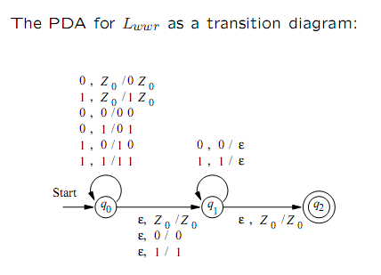
Transition diagram for PDA

Slide 20
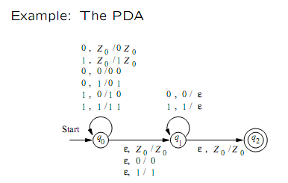
Example

Slide 21
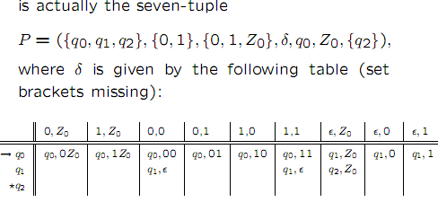
Example

Slide 22
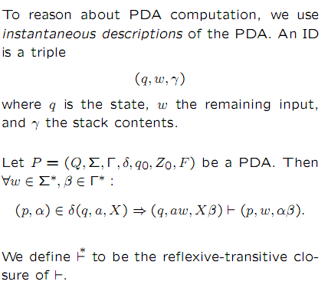
Instantaneous description of PDA

Slide 23
Example
Suppose the PDA P=({q0,q1,q2},{0,1},{0,1,Z0},δ,q0,Z0,{q2}) has the following transition functions:
1.δ(q0,0,Z0)={(q0,0Z0)}
2.δ(q0,1,Z0)={(q0,1Z0)}
3..δ(q0,0,0)={(q0,00)}
4.δ(q0,0,1)={(q0,01)}
5.δ(q0,1,0)={(q0,10)}
6.δ(q0,1,1)={(q0,11)}
7.δ(q0,є,Z0)={(q1,Z0)}
8.δ(q0,є,1)={(q1,1)}
9.δ(q0,є,0)={(q1,0)}
10.δ(q1,0,0)={(q1,є)}
11.δ(q1,1,1)={(q1,є)}
12.δ(q1,є,Z0)={(q2,Z0)}
Starting from the initial ID (q0,w,Z0), show all reachable ID’s when the input ‘w’ are: a)1111

Slide 24
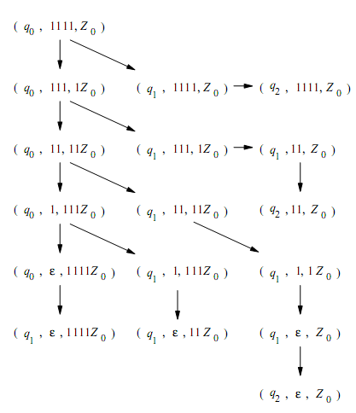
Acceptance of input 1111 by PDA

Slide 25
Exercise
1.Suppose the PDA P=({q,p},{0,1},{X,Z0},δ,q,Z0,{p}) has the following transition function: 1.δ(q,0,Z0)={(q,XZ0)} 2.δ(q,0,X)={(q,XX)}
3.δ(q,1,X)={(q,X)} 4.δ(q,є,X)={(p,є)}
5.δ(p,1,X)={(p,XX)} 6.δ(p,1,Z0)={(p,є)}
7. δ(p,є,X)={(p,є)}
Starting from the initial ID (q,w,Z0), show all reachable
ID’s when the input ‘w’ are:
a)0011 b)010 c)01

Slide 26
Acceptance by PDA
Acceptance with empty stack.
Acceptance with final state.

Slide 27

Acceptance with final state

Slide 28
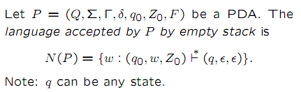
Acceptance with empty stack

Slide 29
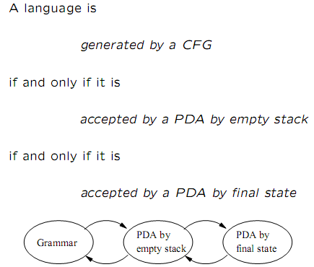
Equivalence of CFG and PDA

Slide 30
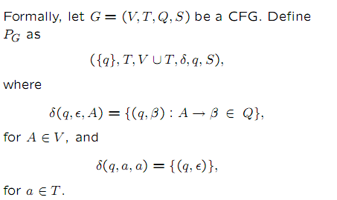
Rules to construct a PDA from given CFG

Slide 31
Example
Let G be a CFG and G=(V,T,P,S) where V={S,A} T={a,b} p: S->aAA,A->aS/bS/a.
To find the equivalent PDA
Q={q0}
∑=T={a,b}
Г=VUT={S,A,a,b}
F=Ø

Slide 32
Answer
Mapping function for PDA:
  For each variable S,A
[q0,Є,S]={(q0,aAA)}
[q0,Є,A]={(q0,aS),(q0,bS),(q0,a)}
For each terminal a,b
[q0,a,a]={q0,Є}
[q0,b,b]={q0,Є}

Slide 33
Exercise: CFG - PDA
Convert the grammar S-> 0S1/A, A->1A0/S/є to a PDA that accepts the same language by empty stack.

Slide 34
CFG to PDA conversion
Formally, the given PDA is
M = (Q, Σ, Г, δ, q₀, z₀, F). Define CFG G=(V, T, P, S), where
V=[p x q] for all p & q Є Q and x Є Σ,
T= Σ,
P=Set of Production rules constructed from δ
And S=Starting Symbol

Slide 35
Rules to construct P using δ
R1 – Production Rules for S
S → [q₀ z₀ p] for all p Є Q
R2 – Production Rules corresponding to the transition move for pop operation
(q, a, z) = (p, ϵ)
[q z p] →a

Slide 36
Cont…
R3 - Production Rules corresponding to the transition move for push and read operation
(q, a, z) = (q’, z₁z₂…….z_{n})
[q z p] → a [q’ z₁ q1] [q₁ z₂ q₂] ………[q_{n} z_{n} p]

Slide 37
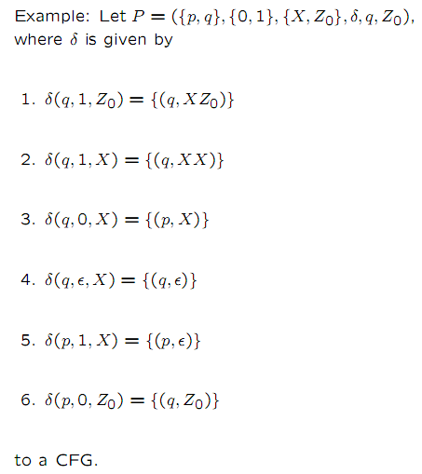
Convert the following PDA in to a CFG

Slide 38
Formula
G=(V,T,P,S)
V={([p,A,q]/ for all p,q in Q and A in Г) U S}
T=∑={0,1}
S->[q,z0,q] [q,z0,p].

Slide 39
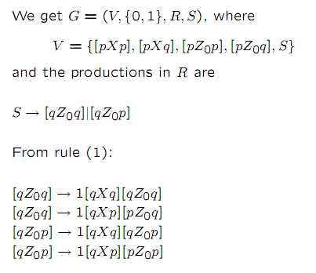
Cont…

Slide 40
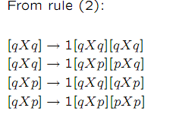
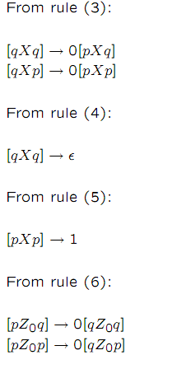
Cont…

Slide 41
Exercises: PDA to CFG
Convert the PDA P=({q0,q1},{0,1},{X,Z0},δ,q,Z0,Ø) to a CFG,
if δ is given by:
1.δ(q0,1,Z0)={(q0,XZ0)}
2.δ(q0,0,X)={(q1,X)}
3.δ(q0,1,X)={(q0,XX)}
4.δ(q1,0,Z0)={(q0,Z0)}
5.δ(q0,Є,Z0)={(q0,є)}
6.δ(q1,1,x)={(q1,є)}

Slide 42
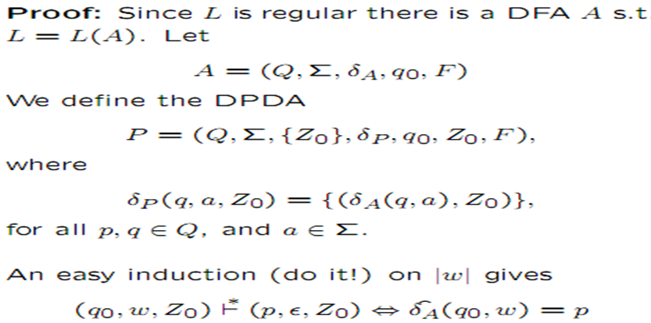
Regular Language and DPDA
Theorem 1: If L is Regular, then L = L(P) for some DPDA P.

Slide 43
DPDA and Ambiguous grammar
Theorem 2 : If L=N(P) for some DPDA, then L has unambiguous grammar G.
  Proof:
  Suppose DPDA (P) accepts the terminal string ‘w’ by an empty stack. Then it has an unique sequence of moves because it is deterministic and can not move more than once in a stack.
  Knowing the sequence of moves we can determine a one choice of this production in the left most derivation and to derive terminal string “w” by the grammar G.

Slide 44
DPDA and Ambiguous grammar
δ(q,a,x) = {r,Y1,Y2…Yk} be the many productions of G.
i.e., P is a deterministic, only one of the sequence of choice will be consistent and only one production will actually lead a string “w”.

Slide 45
Clouser Properties of Context Free Grammar
Context-free languages are closed under −
Union- If L₁ and L₂ are CFL’s then L₁ꓴL₂ is also CFL.
Concatenation- If L₁ and L₂ are CFL’s then L₁L₂ is also CFL.
Kleene Star- If L₁ is CFL then L*₁ is also CFL.

Slide 46
Clouser under Union
Begin with two grammars: G₁ = (V₁, Σ , P₁, S₁) and G₂ = (V₂, Σ , P₂, S₂), generating CFL’s L₁ and L₂ respectively.
The new CFG G_{x} is made as:
  Σ remains the same
  S_{x} is the new start variable
  V_{x} = V₁ ꓴ V₂ ꓴ {S_{x}}
  P_{x} = P₁ ꓴ P₂ ꓴ {S_{x} → S₁|S₂}
Explanation: All we have done is augment the variable set with a new start state and then allowed the new start state to map to either of the two grammars. So, we’ll generate strings from either L₁ or L₂, i.e. L₁ ꓴ L₂

Slide 47
Example
Let L1 = { a^{n}b^{n} , n > 0}. Corresponding grammar G1 will have P: S1 → aAb|ab
Let L2 = { c^{m}d^{m} , m ≥ 0}. Corresponding grammar G2 will have P: S2 → cBb| ε
Union of L1 and L2, L = L1 ∪ L2 = { a^{n}b^{n} } ∪ { c^{m}d^{m} }
The corresponding grammar G will have the additional production S → S1 | S2

Slide 48
Clouser under Concatenation
Begin with two grammars: G₁ = (V₁, Σ , P₁, S₁) and G₂ = (V₂, Σ , P₂, S₂), generating CFL’s L₁ and L₂ respectively.
The new CFG G_{y} is made as:
  Σ remains the same
  S_{y} is the new start variable
  V_{y} = V₁ ꓴ V₂ ꓴ {S_{y}}
  P_{y} = P₁ ꓴ P₂ ꓴ {S_{x} → S₁S₂}
Explanation: Again, all we have done is to augment the variable set with a new start state, and then allowed the new start state to map to the concatenation of the two original start symbols. So, we will generate strings that begin with strings from L₁ and end with strings from L₂, i.e. L₁L₂ .

Slide 49
Example
Let L1 = { a^{n}b^{n} , n > 0}. Corresponding grammar G1 will have P: S1 → aAb|ab
Let L2 = { c^{m}d^{m} , m ≥ 0}. Corresponding grammar G2 will have P: S2 → cBb| ε
Concatenation of the languages L1 and L2, L = L1L2 = { a^{n}b^{n}c^{m}d^{m} }
The corresponding grammar G will have the additional production S → S1 S2

Slide 50
Clouser under Kleene Star
Begin with two grammars: G₁ = (V₁, Σ , P₁, S₁) and G₂ = (V₂, Σ , P₂, S₂), generating CFL’s L₁ and L₂ respectively.
The new CFG G_{z} is made as:
  Σ remains the same
  S_{z} is the new start variable
  V_{z} = V₁ ꓴ {S_{z}}
  P_{z} = P₁ ꓴ {S_{z} → S₁S_{z} | ε}
Explanation: Again we have augmented the variable set with a new start state, and then allowed the new start state to map to either S₁S_{z} or ε. This means we can generate strings with zero or more strings made from expanding the variable S₁, i.e. L*₁ .

Slide 51
Example
Let L = { a^{n}b^{n} , n ≥ 0}. Corresponding grammar G will have P: S → aAb| ε
Kleene Star L1 = { a^{n}b^{n} }*
The corresponding grammar G1 will have additional productions S1 → SS1 | ε

Slide 52
Context-free languages are not closed under −
Intersection − If L1 and L2 are context free languages, then L1 ∩ L2 is not necessarily context free.
Intersection with Regular Language − If L1 is a regular language and L2 is a context free language, then L1 ∩ L2 is a context free language.
Complement − If L1 is a context free language, then L1’ may not be context free.

Slide 53
Context Sensitive Grammar
A context sensitive grammar G = (N, Σ, P, S), where
N is a set of nonterminal symbols
Σ is a set of terminal symbols
S is the start symbol, and
P is a set of production rules, of the form αAβ → αγβ where A in N, α, β ∈ (N ∪ Σ) and γ ∈ (N ∪ Σ)⁺
The production S → ℇ is also allowed if S is the start symbol and it does not appear on the right side of any production.

Slide 54
Context Sensitive Language
The language generated by the Context Sensitive Grammar is called context sensitive language.
If G is a Context Sensitive Grammar then,
L(G) = {w | (w ∈ Σ∗ ) ∧ (S ⇒⁺ w)}
Example - The following grammar(G) is context-sensitive.
S → aTb|ab, aT → aaTb|ac
L(G) = {ab} ∪ {a^{n}cb^{n} |n > 0}

Slide 55
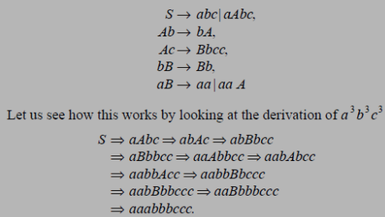

1. Design a context sensitive grammar for the language L={a^{n}b^{n} c^{n}, n>=1}

Slide 56
Linear Bounded Automata
A Turing machine that uses only the tape space occupied by the input is called a linear-bounded automaton (LBA).
A linear bounded automaton is a non-deterministic Turing machine M = (Q, Σ, Γ, δ, q₀, b, F, ₵, $ ) such that:
*There are two special tape symbols ₵ and $ (the left end marker and right end marker).
*The TM begins in the configuration (q₀, ₵ x $ , 0).
* The TM cannot replace ₵ or $ with anything else, nor move the tape ahead left of ₵ or right of $.

Slide 57
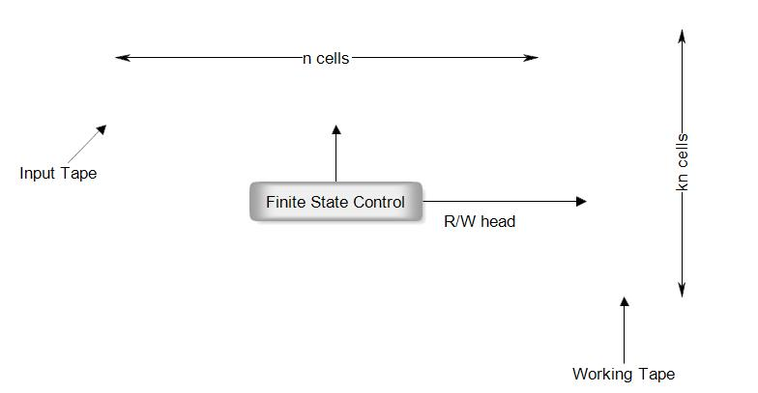
The following model of LBA having two tapes: one is called the input tape and the other, working tape.
On the input tape the head never prints and never moves to the left.
On the working tape the head can modify the contents in any way, without any restriction.
₵ |  |  |  | $

Slide 58
In LBA ID is denoted by(q, w, k), where q from Q, w from Γ and k is some integer between 1 and n.
The transition of IDs is similar except that k changes to k-1 if the R/W head moves to the left and to k+1 if the head moves to the right.
The language accepted by LBA is defined as the set
{wϵ (Ʃ – {₵, $})* |(q0, ₵w$, 1) = (q, α, i), for some q ϵ F and for some integer I between 1 and n}

Slide 59
Relation between LBA and Context Sensitive Languages
If L is a context sensitive language, then L is accepted by a linear bounded automata.
The coverse of above statement is also true.

Slide 60
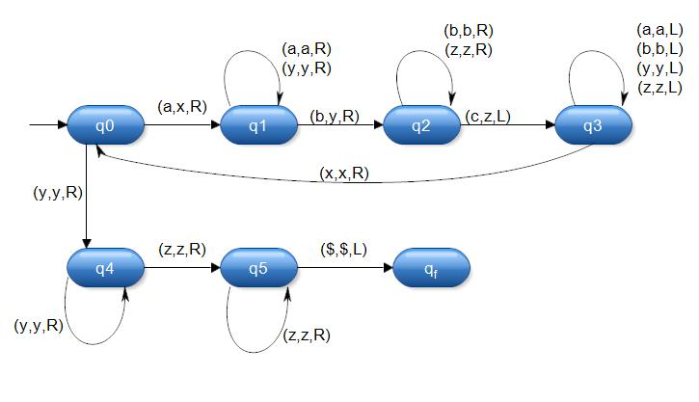
Construction of LBA corresponding to context sensitive language
L={a^{n}b^{n}c^{n} | n>0}
Let w=a⁶b⁶c⁶ , which belongs to L
₵ and $ are the end markers. q0 is initial state and q_{f} is final state of LBA.
₵ | a | a | a | a | a | a | b | b | b | b | b | b | c | c | c | c | c | c | $

Slide 61
Construction of Grammar corresponding to LBA
In construction of a grammar, assume that the transition table is given and initial ID is[q₁₵w$]
Step 1- (i) No change in length of IDs:
Right move- a_{k}Rq_{l} corresponding to q_{i}-row and a_{j}-column leads to the production
q_{i}a_{j} →a_{k}q_{l}
(b) Left move- a_{k}Lq_{l} corresponding to q_{i}-row and a_{j}-column yields several productions
a_{m}q_{i}a_{j} →q_{l}a_{m}a_{k} for all a_{m} ϵ Γ

Slide 62
(ii) Change in length of IDs:
Left End - a_{k}Lq_{l} corresponding to q_{i}-row and a_{j}-column gives
[q_{i}a_{j} → [q_{l}ba_{k}
When b occurs next to the left bracket, it can be deleted. This is achieved by including the production [b → [
(b) Right End – when b occurs to the left of ], it can be deleted. This is achieved by the production
a_{j}b] → a_{j}] for all a_{j} ϵ Γ
When the R/W head moves to the right of], the length increases. Corresponding to this we have the productions
q_{i}] → q_{i}b] for all q_{i} ϵ Q
(iii) Introduction to endmarkers:
a_{i} → [q₁ ₵ a_{i} for a_{i} ϵ Γ, a_{i}!= b
a_{i} → a_{i} $] for a_{i} ϵ Γ, a_{i}!= b
[q_{f}b] → S
q₁ and q_{f} are the initial and final states, respectively.

Slide 63
Step 2 –
a_{i}q_{f}$ → q_{f}$ for all a_{j} ϵ Γ
₵ q_{f}$ → ₵ q_{f}
Step 3 - Reverse the arrows of the productions obtained in step 1 and 2.

Slide 64
Example:
Find the grammar generating the set accepted by a LBA whose transition table as:
Present state | Tape input symbols
 | ₵ | $ | 0 | 1
→q₁ | ₵Rq₁ |  | 1Lq₂ | 0Rq₂
q₂ | ₵Rq₄ |  | 1Rq₃ | 1Lq₁
q₃ |  | $Lq₁ | 1Rq₃ | 1Rq₃
*q₄ |  | Halt | 0Lq₄ | 0Rq₄
Step 1- (i) No change in length of IDs:
Right move- There are 7 right moves in transition table so the productions are:
q₁ ₵ → ₵ q₁, q₃ 0 → 1 q₃, q₁ 1 → 0 q₂, q₃ 1→ 1 q₃,
q₂ ₵ → ₵ q₄, q₄ 1 → 0 q₄, q₂ 0 → 1 q₃

Slide 65
(b) left move – There are 4 left moves
1Lq₂, corresponding to q₁ row and 0 column gives
₵q₁0→q₂₵1, $q₁0→ q₂$1, 0q₁0→q₂01, 1q₁0→ q₂11
1Lq₁ , corresponding to q₁ row and 1 column gives
₵q₂1→ q₁₵1, $q₂1→ q₁$1, 0q₂1→q₁01, 1q₂1→ q₁11
$Lq₁, corresponding to q₃ row and $ column gives
₵q₃$ → q₁₵$, $q₃$ → q₁$$, 0q₃$ →q₁0$, 1q₃$ → q₁1$
0Lq₄, corresponding to q₄ row and 0 column gives
₵q₄0 → q₄₵0, $q₄0 → q₄$0, 0q₄0 →q₄00, 1q₄0 → q₄10
(ii) change in length of ID - There are no productions corresponding to change in length of ID.
(iii) Introduction to endmarker -
₵→[q₁₵₵, ₵→ ₵$], $→[q₁₵$, $→$$],
0→[q1₵0, 0→0$], 1→[q1₵1, 1→1$], [q4]→S

Slide 66
Step 2 –
₵q₄$→q₄$, $q₄$→q₄$, 0q₄$→q₄$,
1q₄$→q₄$, ₵q₄$→ ₵q₄, ₵q₄$→q₄
Step 3 – Reverse the arrows of productions obtained from step 1 and step 2.

