Slide 1
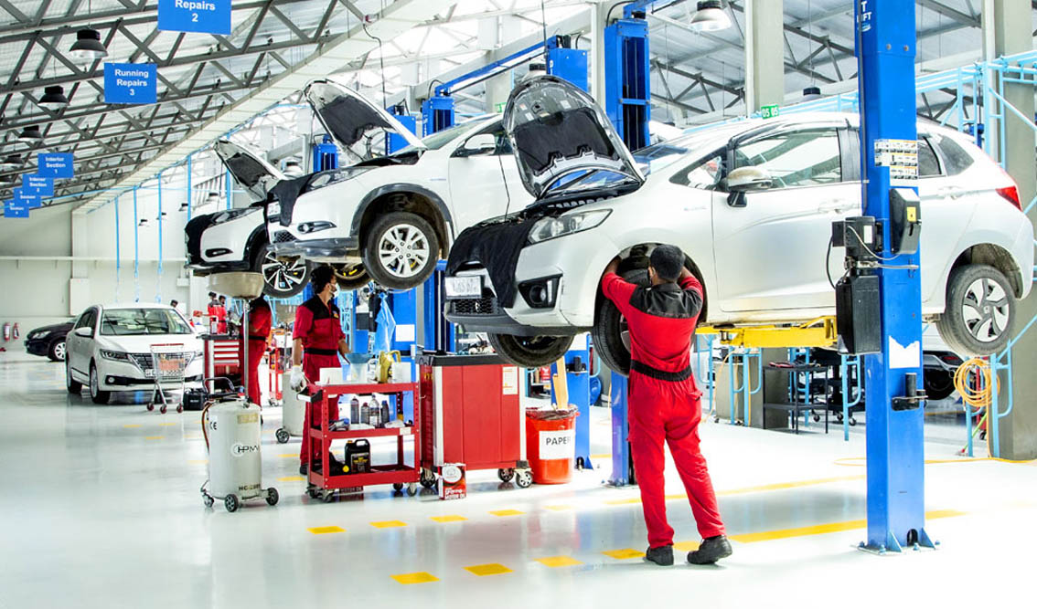
VehiCare (A Vehicle Service Hub)
By Soham M. Kulkarni
Roll No. 23334

Slide 2
Introduction
Have you ever felt frustrated with the paperwork and delays at a service center ?
If yes, then VehiCare is the remedy.
VehiCare is a smart solution designed to make managing vehicle services easy and efficient.
It's an all-in-one platform that simplifies how customers request service, how mechanics handle tasks, and how administrators keep everything running smoothly.
This system deals with the needs of customers, mechanics, and administrators by providing an efficient platform for managing service requests, assigning tasks to mechanics, and maintaining customer and mechanic profiles.

Slide 3

Existing System
Limited Mechanic Assignment Visibility:
The assignment of tasks to mechanics is often done manually, without a centralized system for administrators to efficiently allocate work based on skills and availability.
Manual Service Request Handling:
Customers typically submit service requests in person or via phone, requiring manual entry by administrative staff.
Inefficient Invoice Management:
Invoicing and billing processes are typically manual, with administrators manually calculating costs and generating invoices.
Communication Gaps:
Communication between customers, mechanics, and administrators relies heavily on verbal exchanges and written notes.

Slide 4
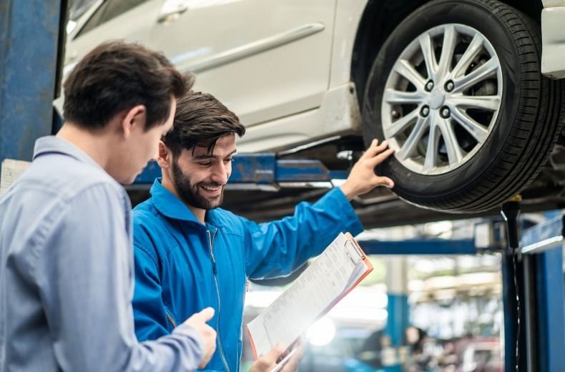




Need for The System
Improved Task Assignment:
A centralized system allows administrators to assign tasks to mechanics based on their skills and availability, optimizing resource utilization and improving overall efficiency.
Enhanced Efficiency:
Automation of service request approval, task assignment, and status tracking reduces manual effort and speeds up the overall service process.
BENEFITS
How employees benefit
Discover the advantages that employees can experience when commuting with public transportation.
Accurate Invoice Management:
Automation of invoicing processes ensures accurate and timely billing, reducing errors and enhancing customer satisfaction.
Real-Time Visibility:
Real-time tracking of service requests and mechanic assignments provides administrators with up-to-date information, enabling proactive decision-making.
Commuter Benefits
Increased Job Satisfaction
Reduced Carbon Footprint
Commuter benefits can significantly reduce the cost of commuting with public transportation.
Public transportation is a reliable and safe way to get to work, helping employees feel more satisfied with their job.
Commuting with public transportation can help reduce the carbon footprint

Slide 5
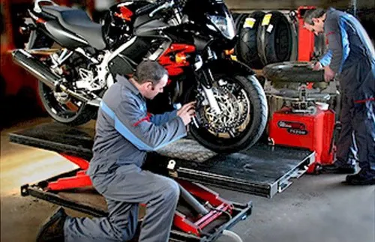
Scope & Objectives
The scope of the VehiCare includes customer registration, service request submission, mechanic application and approval, request approval and assignment by the administrator, real-time status tracking, and feedback mechanisms.
The objectives are to streamline service operations, enhance communication, and provide a transparent and user-friendly experience.

Slide 6

Technologies Used
Operating System: Windows
Front End: HTML, CSS, JavaScript
Back End: Django (Python)
Database: MongoDB
Software Development Tool:
PyCharm/Visual Studio Code

Slide 7
Modules & Functionalities
Customer Module:
Signup and Login
Service Request Submission
Status Tracking
Invoice Details
Feedback Submission
Profile Management
Live Tracking
Mechanic Module:
Job Application
Task Assignment
Status Update
Salary and Performance
Feedback Submission
Profile Management
Admin Module:
Dashboard with Overview
User Management (Customers and Mechanics)
Service Request Management
Mechanic Approval
Invoice Management
Feedback Review
System Configuration

Slide 8

Thank you for your time.
Any Questions ?

