Slide 1
Gauss-Jordan Method

Slide 2
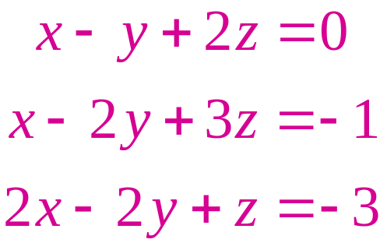
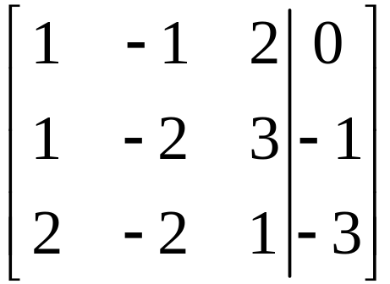
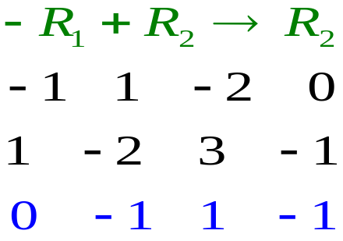
Solve the system of equations using Gauss-Jordan Method

Slide 3
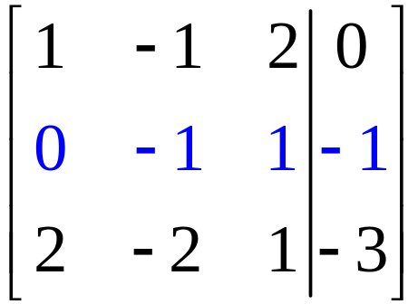
Solve the system of equations using Gauss-Jordan Method

Slide 4
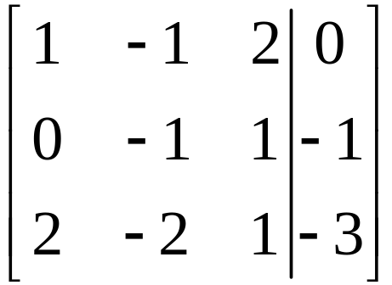
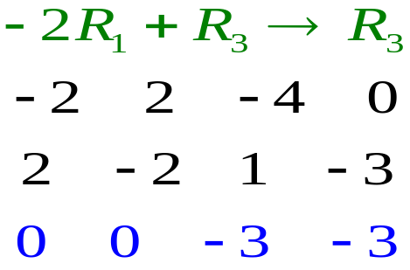
Solve the system of equations using Gauss-Jordan Method

Slide 5
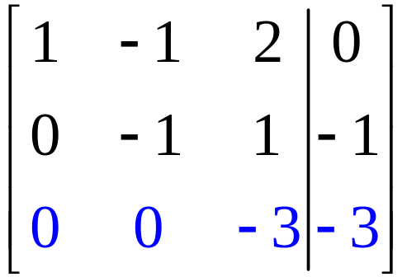
Solve the system of equations using Gauss-Jordan Method

Slide 6
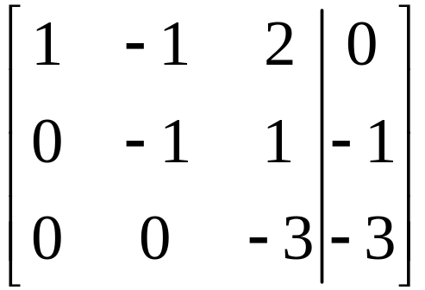
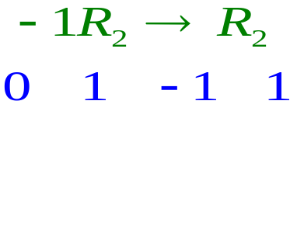
Solve the system of equations using Gauss-Jordan Method

Slide 7
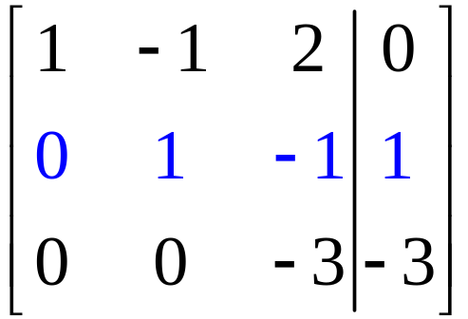
Solve the system of equations using Gauss-Jordan Method

Slide 8
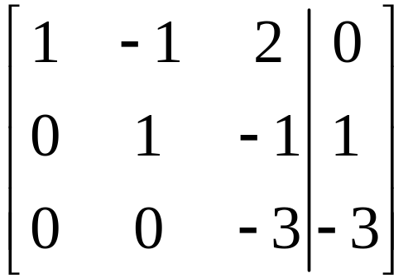
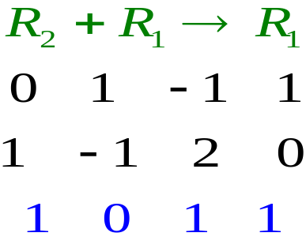
Solve the system of equations using Gauss-Jordan Method

Slide 9
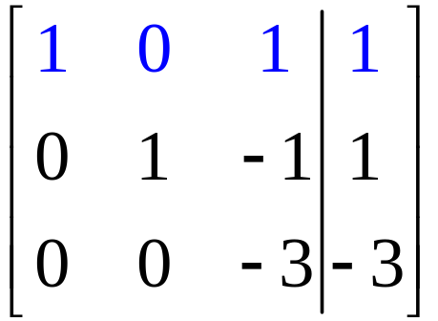
Solve the system of equations using Gauss-Jordan Method

Slide 10
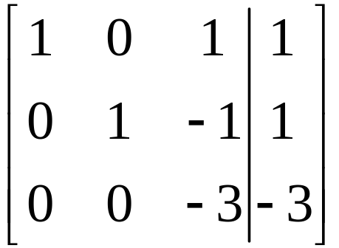
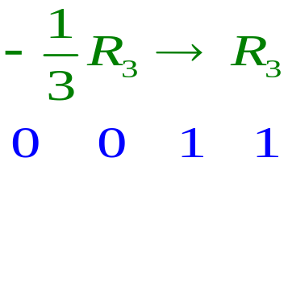
Solve the system of equations using Gauss-Jordan Method

Slide 11
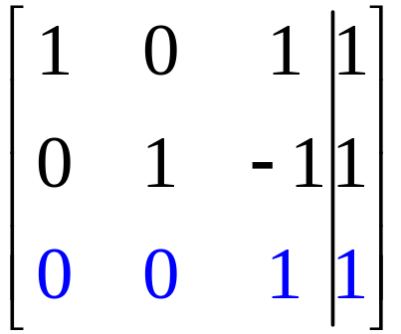
Solve the system of equations using Gauss-Jordan Method

Slide 12
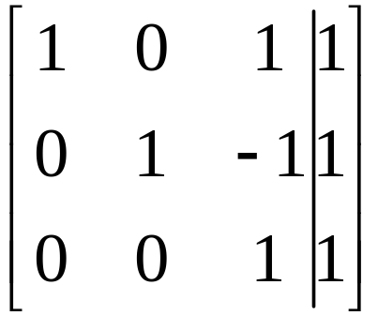
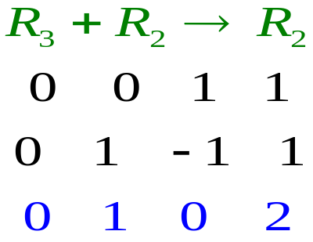
Solve the system of equations using Gauss-Jordan Method

Slide 13
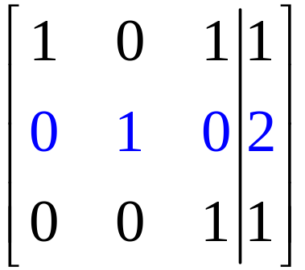
Solve the system of equations using Gauss-Jordan Method

Slide 14
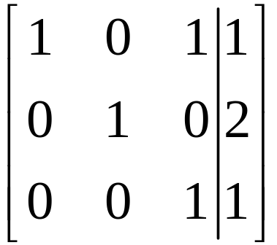
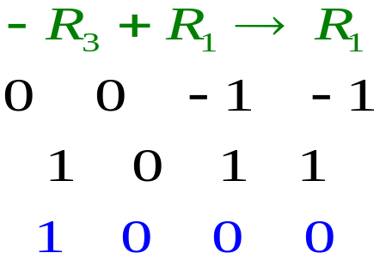
Solve the system of equations using Gauss-Jordan Method

Slide 15
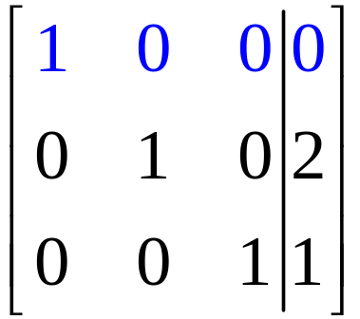
Solve the system of equations using Gauss-Jordan Method

Slide 16
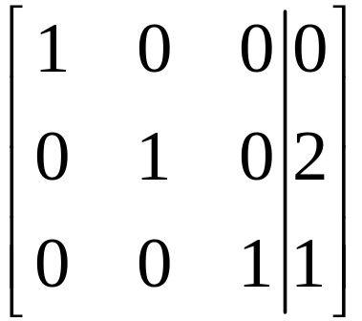
Solve the system of equations using Gauss-Jordan Method
(0, 2, 1)

