Slide 1
BLUESTOCK FINTECH
Mutual Fund Analytics Capstone Project
Soham Lone | July 2026 | D7 – Final Presentation

Slide 2
Project Overview
Dataset: 6 Mutual Fund Schemes, 19,899 daily NAV records, 4,224 investor transactions, 250 investors D1 ETL Pipeline: scripts/etl_pipeline.py — Fully automated, path-safe, error-handled D2 SQLite Star Schema: dim_fund, dim_date, fact_nav, fact_transactions, fact_performance, fact_aum D3 EDA: 15+ charts covering NAV trends, AUM, SIP inflows, demographics, sector allocation D4 Performance: CAGR (1/3/5yr), Sharpe, Sortino, Alpha/Beta, Max Drawdown, Fund Scorecard D6 Advanced Analytics: VaR/CVaR, Rolling Sharpe, Investor Cohorts, SIP Continuity, Recommender

Slide 3
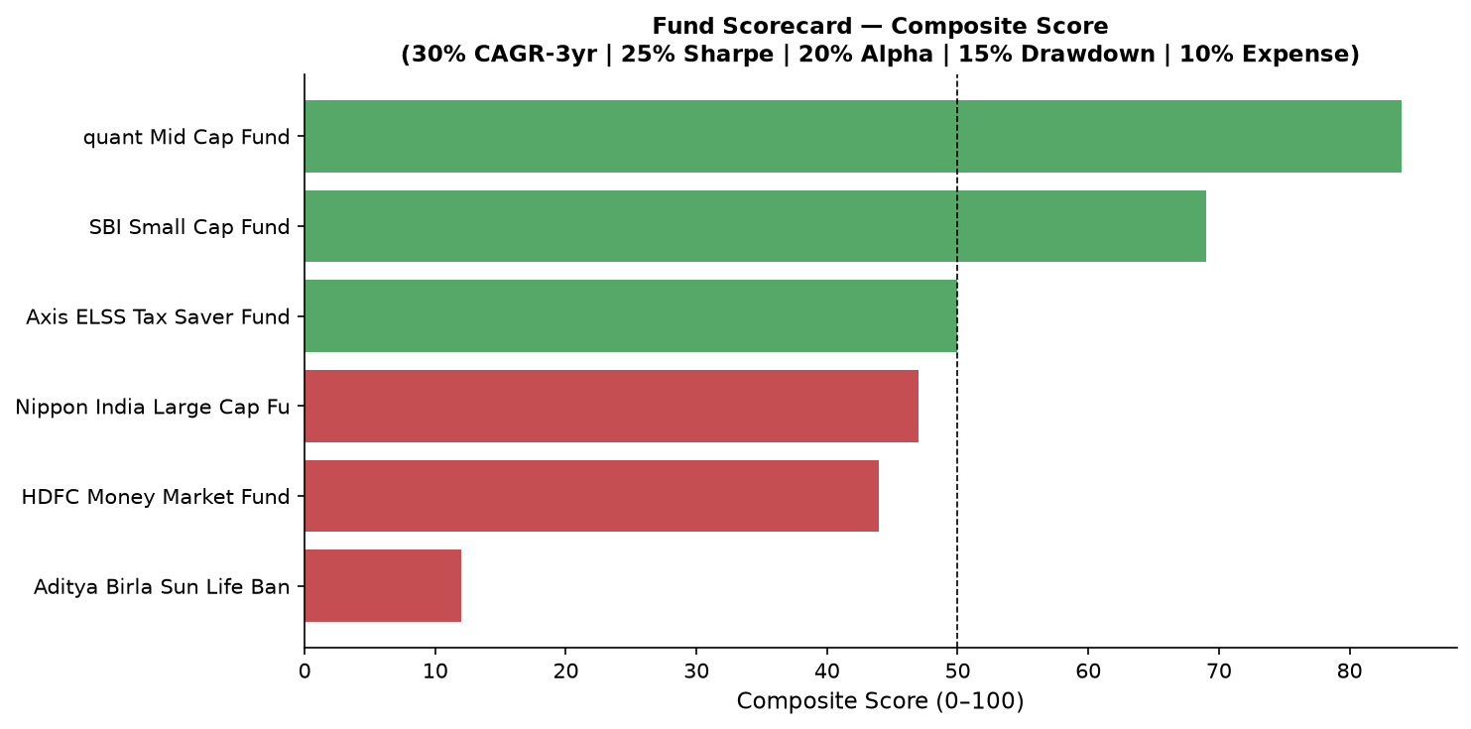
Fund Performance Scorecard (D4)
SBI Small Cap — highest Sharpe (1.04) & 5yr CAGR (+16.07%) Aditya Birla PSU Debt — underperforms; negative 5yr CAGR (-7.08%)

Slide 4
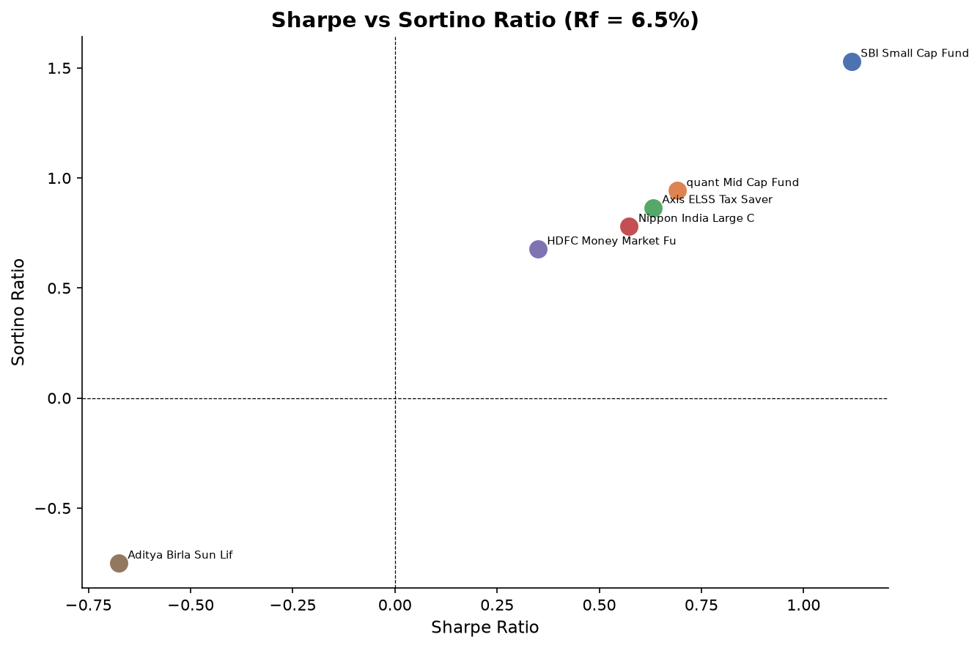
Risk-Adjusted Ratios: Sharpe vs Sortino (D4)

Slide 5
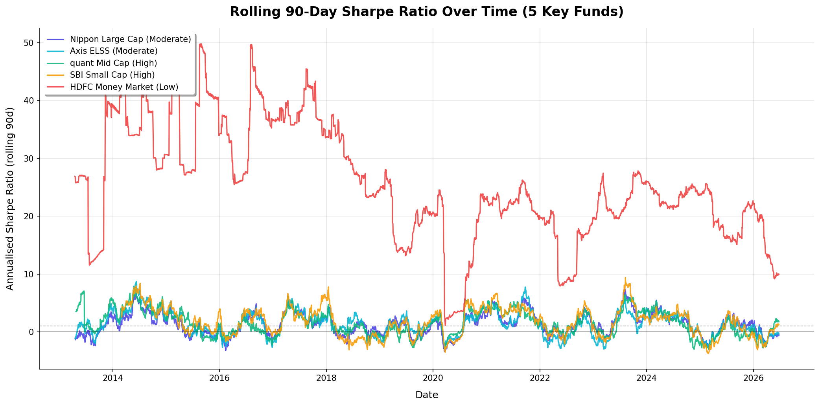
Tail Risk: 95% VaR & CVaR (D6)
Nippon India Large Cap: highest daily tail risk VaR -1.67% CVaR -2.39% HDFC Money Market: near-zero risk VaR -0.008% CVaR -0.021%

Slide 6
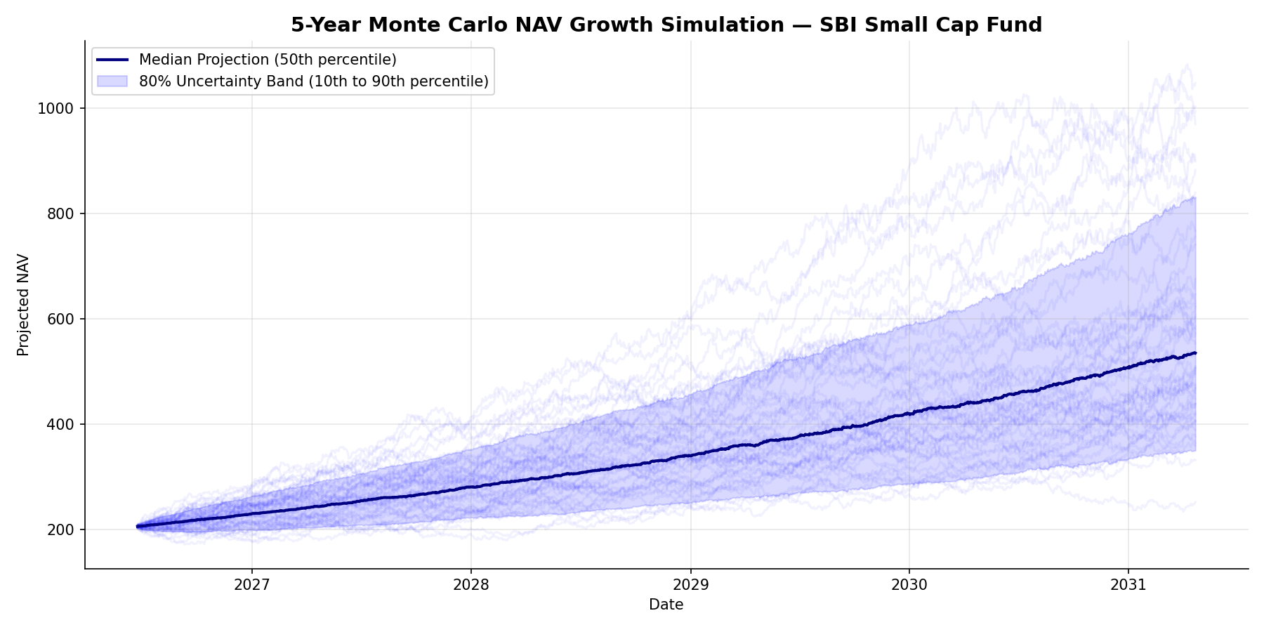
Bonus B3: Monte Carlo 5-Year NAV Projection (SBI Small Cap)

Slide 7
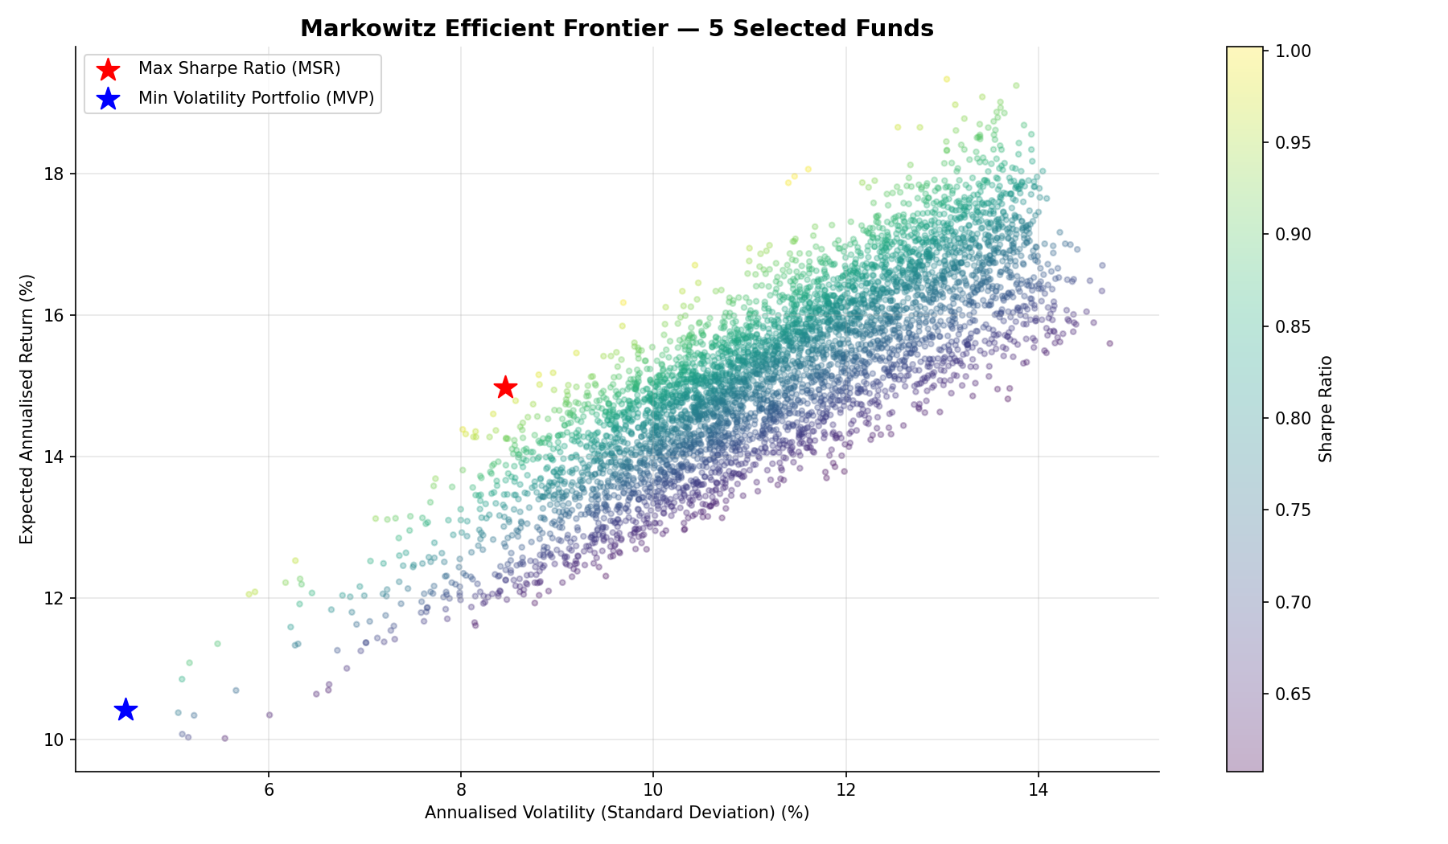
Bonus B4: Markowitz Efficient Frontier (5 Funds)

Slide 8
Key Takeaways
1. SBI Small Cap Fund dominates on risk-adjusted basis — Sharpe 1.04, 5yr CAGR +16.07% 2. Nippon India Large Cap has the highest daily tail risk — 95% VaR -1.67%, CVaR -2.39% 3. 100% of SIP investors flagged as at-risk — average gap between transactions exceeds 35 days 4. Efficient Frontier: MSR portfolio assigns 83% weight to SBI Small Cap for optimal Sharpe 5. HDFC Money Market is the safest instrument — near-zero VaR, minimal volatility (0.54% ann.)

