Slide 1
Agenda
What is Kernel
in
Operating System

Slide 2
Kernel :Background
As we know , OS is a complicated piece of software, which consists of a number of routines, subroutine.
Hence the size of the OS is very large and it is hard to keep the entire OS in memory all the time, as very little space would be left for other application programs, due to limited size of the memory.
Therefore, the OS routines are divided into two parts.
One part consists of very essential routines which are required very frequently or almost all the time.
Second consists of routines[less essentials] which are required sometimes, but not always. In this sense, they are not vital.
The important portion is called as kernel of the OS.
This is the inner most layers of the OS close to the hardware and control the actual hardware.
It is the heart of OS. All the other routines are loaded from the disk to the memory as and when its needed

Slide 3
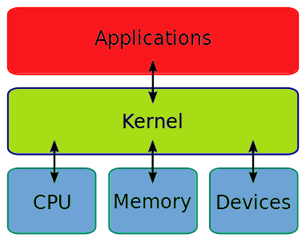
Main Points
Kernel is a part of OS that loads into memory during boot time and remains present into memory as long as computer is switched off.
Generally, kernel resides into protected memory area.
We can also say the Kernel is central module ,backbone, heart of computer system(OS).
Kernel is a place where the real work is done.
If Computer crashes it means kernel is also crash.
Sometimes Kernel is called an Operating System as well.
Objective/Functions
To establish communication between user level application and hardware.
To decide state of incoming processes.
Access Computer resource: It acts as a bridge between the user and the resources of the system.
Resource Management: between various process in such a way that there is uniform access to the resources
Memory Management: memory must be allocated and de-allocated for its execution.
Device Management:

Slide 4
Thank You
We will meet Soon!!!!!!!!!!

Slide 5
Agenda
Types of Kernel

Slide 6
Types of Kernel
Monolithic Kernel
Microkernel
Hybrid Kernel
Exo Kernel
Nano Kernel

Slide 7
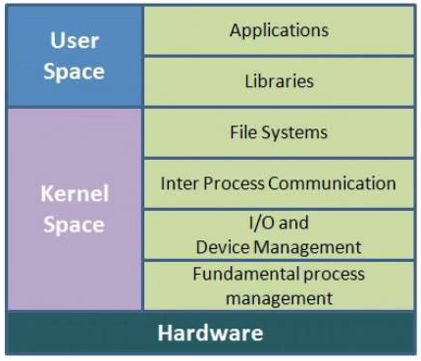
Monolithic Kernel
In monolithic kernel architecture, all the OS services (process, memory management, interrupt handling, etc.) are packed into single module in kernel space.
It has dependencies between systems components
But nowadays, modern approach for monolithic Kernel architecture is used, kernel consists of different modules which can be dynamically loaded and unloaded at run time.
Figure shows the memory layout of OS where user space and kernel space
The entire OS is loaded into kernel space and it acts as a supervisor.
All services are provided by the OS that is equivalent to monolithic kernel.
If kernel fails then we would say entire OS has failed.
The device drivers are loaded into the running Kernel and it become the part of available kernel.
Kernel image = (kernel core + kernel services)

Slide 8
Monolithic Kernel
Advantages:
Execution of the process is fast because there is no separate memory space for user and kernel
It provides CPU scheduling, memory scheduling, file management through System calls only
Disadvantages:
Size of Kernel become very huge.
Poor maintainability, which means bug fixing or addition of new feature requested in recompilation of the whole kernel which can consume lot of time.
If any service fails, then it leads to system failure.
If new services are to be added then the entire Operating System needs to be modified.
Unix, Linux, Open VMS, XTS-400 etc.

Slide 9
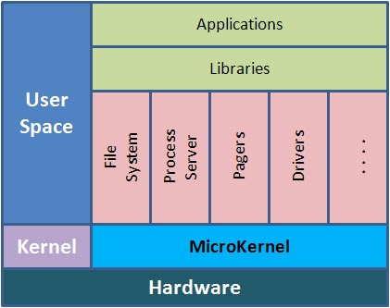
Microkernel
As we have seen in monolithic kernel, it requires abundant space to load kernel into main memory and it also leads to other problems.
In micro kernel, all nonessential programs are kept in a user memory space and essential system programs are kept in kernel space.
The communication between all components is provided by the message passing (IPC).
In micro kernel, user has flexibility to extend system at any level.
Kernel image = Kernel Core
The microkernel can be considered compact kernel as it performs only the basic function universal to all computers.
In figure the OS services are deployed at user space and only required code is kept at kernel space.
When the special routine is required at that time it can invoke to kernel space.

Slide 10
Microkernel
Advantages:
Extension of OS much easier.[If new services are to be added then it can be easily added.
Kernel becomes smaller due to separation of services at separate layers.
So changing, modification, maintenance and debugging is easy.
It is more secure and reliable.
It is also easy to port.
Disadvantages:
Poor performance due to increased system message passing, content switching and other.
It creates more confusion to other users because the code designed by one user may not be essential for other so they may get confused
Since we are using User Space and Kernel Space separately, so the communication between these can reduce the overall execution time.
Mach, L4, AmigaOS, Minix, K42 etc.

Slide 11
Thank You
We will meet Soon!!!!!!!!!!

