Slide 1

DATABASE
MANAGEMENT
SYSTEM

Slide 2
WHAT IS DATA?
In simple words , data are raw facts.
It is any sort of information which is stored in computer memory. This information can later be used for a website, an application or any other client to store for future purpose.

Slide 3
WHAT IS A DATABASE?
Database is a systematic collection of data. Databases support storage and manipulation of data and make data management easy.
The collection of programs which enables its users to access and manipulate a database is known as Database Management System (DBMS).

Slide 4
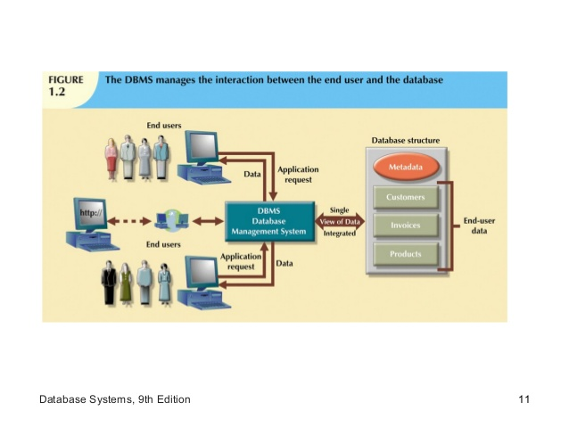

Slide 5
FILE SYSTEM V/S DATABASE
It has data redundancy which means same or duplicate data is stored at multiple locations.
It has no data redundancy.
It has data inconsistency which means contradicting data at multiple locations.
It provides higher data consistency.
It provides less security to data.
It provides more security to data by restricting unauthorized access.

Slide 6
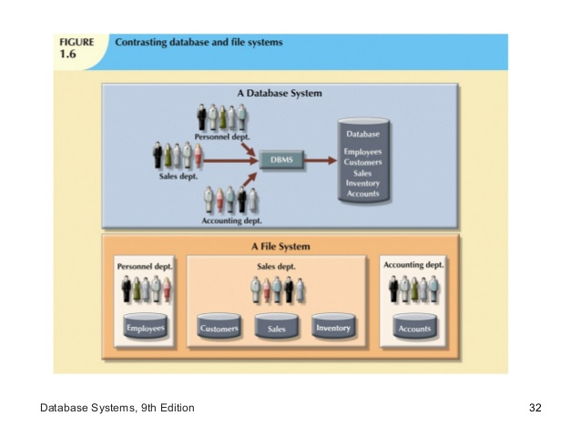
FILE SYSTEM V/S DBMS

Slide 7

HOW IS DATA STORED IN DBMS ?
Inside a database, data is stored into tables.
Tables are the simplest objects (structures) for data storage that exist in a database.
For example , the picture below is a screenshot of a table that has stored general information about some cars.
In the tables , each column is called a field and each row is called a record.

Slide 8
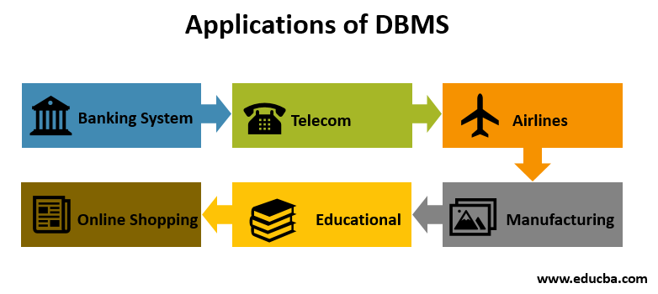
APPLICATIONS OF DBMS

Slide 9
LET’S RECALL
Database ?
Shortcoming of File system ?
Data storage ?
Applications of DBMS ?

Slide 10


