Slide 1

Transaction Management In

Slide 2
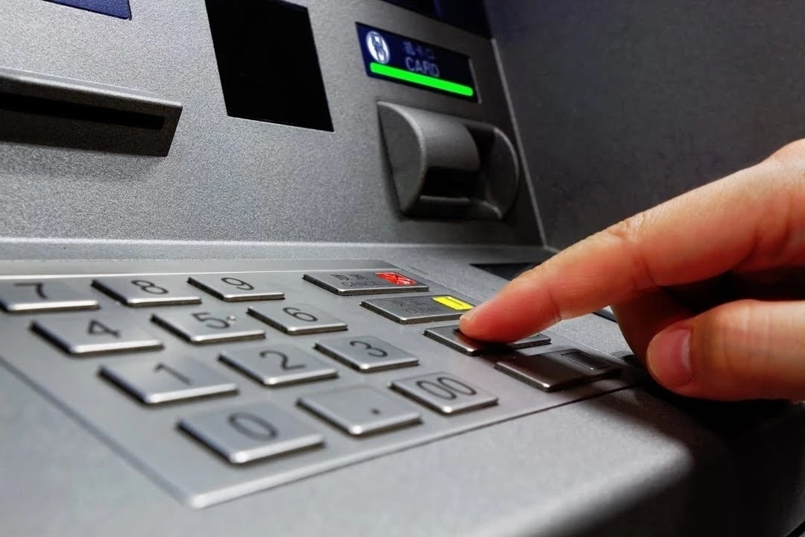
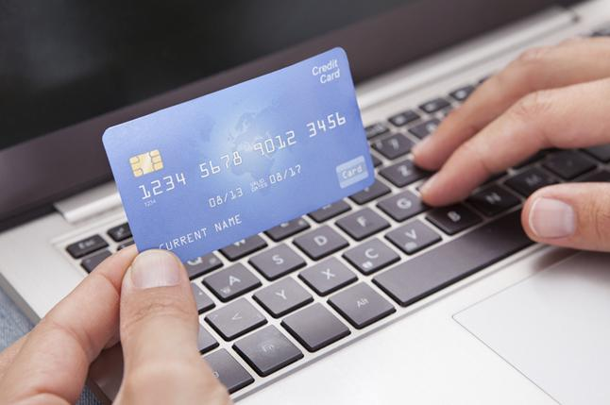
What do you understand by “Transaction??”
Technically, A transaction is a sequence of operations performed on the database as a unit.
For example: When you pay your bill in a restaurant using, say Google Pay or Paytm, you commit a transaction.

Slide 3

Transaction Control & its Need
Imagine the following scenario :
You order a smartphone from an online shopping site, and proceed to pay using your debit card.
The money gets debited from your account, then the system goes down abruptly due to some technical issue and hence your order could not be placed.
What should ideally happen in such a situation?

Slide 4
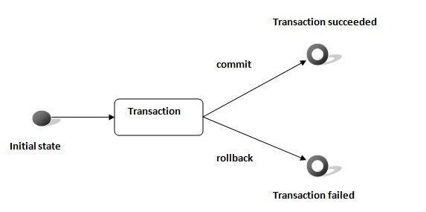
How to Manage Transactions?
SQL provides Transaction Control Language(TCL) to manage transactions
TCL commands :
Commit
Rollback
Savepoint

Slide 5
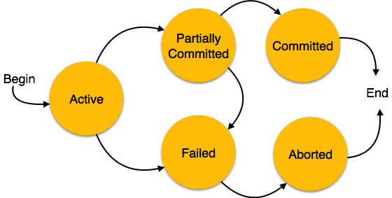
Life Cycle of a Transaction
.

Slide 6
THANK YOU!!..

