Slide 1

Cars
Soham Satpute

Slide 2
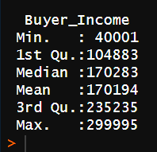
Mean buyer income
The Statistics of Buyer Income
Mean = 170194

Slide 3
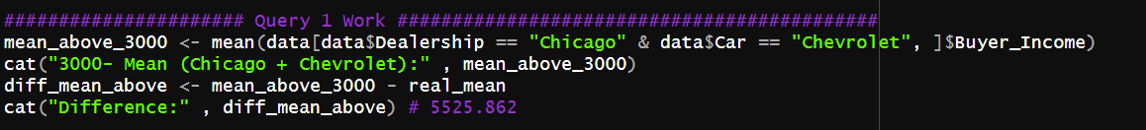
Q1 – Avg Higher than $3000
Firstly, I looked up the individual locations found by a unique function
Second, I used obvious combinations (like NYC and Male)
Then I realized since those values are negative, there is no association with the real world – So I started random combinations to produce a value > 3000 of mean buyer income
Then I came across the combination of (Chicago and Chevrolet), about 5000 above mean

Slide 4
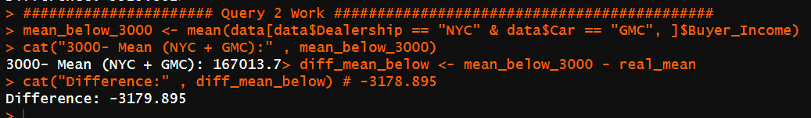
Q2 avg lower than 3000
As stated in Slide 3, since the real-world logic and dataset had no connections, I again tried random combinations and produced one that gives a value lower than $3000 of buyer income
The combination is NYC and GMC

Slide 5

Cross validation

Slide 6

Q1 cross validation
I tried the basic split of the first half of the database [1:25000] and the other half being [25000:50000]
FOR QUERY 1
The first half reported in difference up to 8930.507
The second half reported a Negative difference of 537.6488

Slide 7

Q2 cross validation
I tried the basic split of the first half of the database [1:25000] and the other half being [25000:50000]
FOR QUERY 2
The first half reported in Positive difference up to 2042.768
The second half reported a difference of 5683.738

Slide 8
Re-validation
I revalidated the dataset with the queries once again and produced different values, am only including the first one as the credit as it was written originally.
The values produced didn’t stand close to the true mean

Slide 9
CONCLUSION: Real or random?
The discoveries hold DIFFERENT for the two obvious subsets that we create through splitting the data extracted.
The biggest difference is seen in splitting the data into two sections through the middle, other sections I tested didn’t give such opposite or bizarre values and remained much closer to the real value.

Slide 10

Thank You

