Slide 1
Text Summarization and Paraphrase Generation
Team members
Sanika Katekar
Praveen Reddy
Soham Sajekar

Slide 2
Dataset- CNN-Daily Mail
Training pairs
Dataset consists of 287,226 training pairs
In use: 25000 training articles
Highlights
Validation and test sets
A separate column with summaries for every article.
13,368 validation pairs and 11,490 test pairs
03
02
04
01
05
News Articles
Extractive & Abstractive
300,000 unique news articles from CNN and Daily mail.
Works for both extractive and abstractive type summarization

Slide 3
Project Pipeline
TF-iDF
Paraphrasing
Pre-processing
LSA
POS Tag
Input text
Named Entity Recognition
Glove Embeddings
LDA
Output paraphrased summary

Slide 4
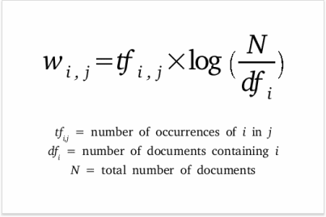
TF-IDF: Term Frequency-Inverse Document Frequency
TF: Count of occurrence of the word in the document
DF: Count of occurrence of the word in the corpus
01
02
03
04
Pre-processing
Tf-Idf Model
Sentence Scoring
Summarization
Data Sampling
Cleaning Text
Tokenization
Create a frequency matrix with bag of words by training on the corpus.
Build a Tf-Idf matrix for the training data
Calculate the Tf-Idf scores for all the words of the article
Score sentences from its respective word Tf-Idf scores
Pick the top N sentences with highest Tf-Idf scores
Send the output to Paraphraser

Slide 5
Latent Semantic Analysis
Raw Text Data
Document Term Matrix
SVD
Output
Pass in input text
Perform singular value decomposition on the doc-term matrix
Output: Topic Encoded data
Byproducts: dictionary, encoding matrix
Create doc-term matrix from the input data.

Slide 6
Sentence Ranking
Topic 1
Topic 2
Topic m
Word 1
Word 2
Word 3
Word n
Encoding Matrix

Slide 7
Sentence Ranking
Topic 1
Topic 2
Topic m
Word 1
Topic 1, 3.75
Word 2
Word 3
Topic 2, 7.75
Topic 3, 0.80
Topic m, -2.5
Word n

Slide 8
Sentence Ranking
Topic 1
Topic 2
Topic m
Word 1
Topic 1, 3.75
Word 2
Word 3
Topic 2, 7.75
Topic 3, 0.80
Topic m, -2.5
Word n

Slide 9
Sentence Ranking
Topic 1
Topic 2
Topic m
Word 1
Word 1
Word 2
Word 3
Word 2
Weight from Topic 2
Weight from Topic 2
Weight from Topic 2
Word 3
Word n

Slide 10
Latent Dirichlet Allocation
from gensim.models.ldamodel import LdaModel
Articles
Topic 1
Topic 2
Topic 3
Word 1
Word 2
Word n
0.06
0.48
0.21
Generates a probability distribution of words for each topic
Algorithm
Go through each word in article and randomly assign it to any one topic
Calculate p(topic t | document d) and p(word w| topic t)
Update probability of word in topic: p(word w with topic t) = p(topic t | document d) * p(word w | topic t)

Slide 11
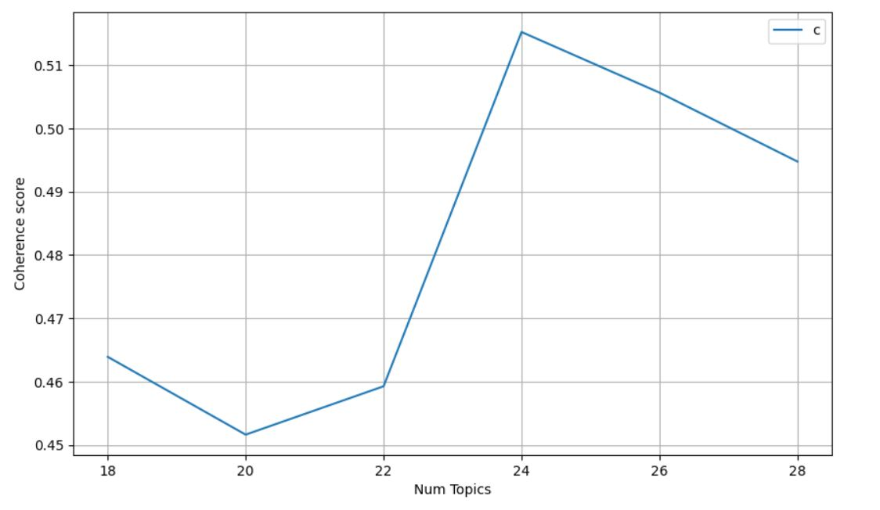
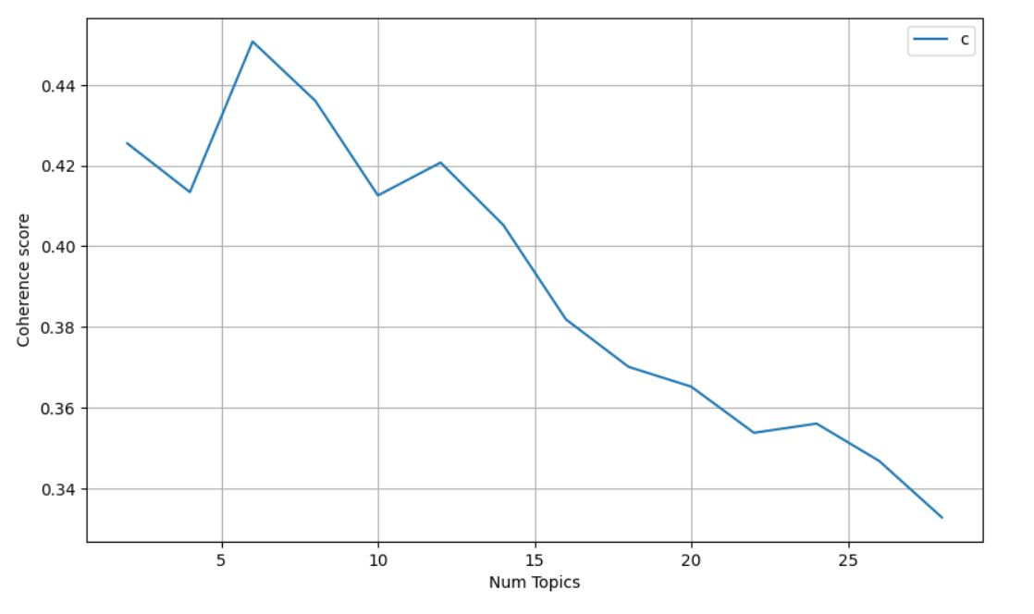
Choosing number of topics for models
What is topic coherence?
measures the degree of semantic similarity between high scoring words in the topic
LDA
LSA
K = 24
K = 6

Slide 12
Model Training
10 min
12 hours
Cleaning
TF-iDF
LSA
LDA
Cleaning of 25000 articles from CNN-DailyMail
Assigning weights
Topic Modeling with k=6
Topic Modeling
k =24

Slide 13
Paraphraser
Preprocessing:
Word Tokenization
POS Tagging
Named Entity recognition
Step 1
This is a synonym replacement paraphraser with least cosine angle between its word embedding vectors
Cosine Similarity Calculation:
Load Glove Embedding word vectors
Identify 50 synonyms with least cosine angle
Calculate the n-gram cosine angle for synonyms
Word Replacement Conditions:
Do not replace for stopwords, punctuations, named entities, measurable quantities, and its units
Do not replace for the following POS tags: 'NN', 'CD', 'RB', 'MD', 'VBN', 'VBD', 'NNP', 'NNPS'
Replace the synonym with least Trigram cosine angle for the other POS tags by giving first preference for the same POS tag synonym
Step 2
Word Replacement:
Replace the words from the summarized text as per the conditions listed
Step 3

Slide 14
ROUGE Evaluation Matrix
Rouge 1
Rouge 2
Rouge-L
Rouge-SU
Counts the number of overlapping units
bigram count
Tot count from ref.summary
Decides based on longest common sub-sequence
Uses the concept of skip-gram

Slide 15
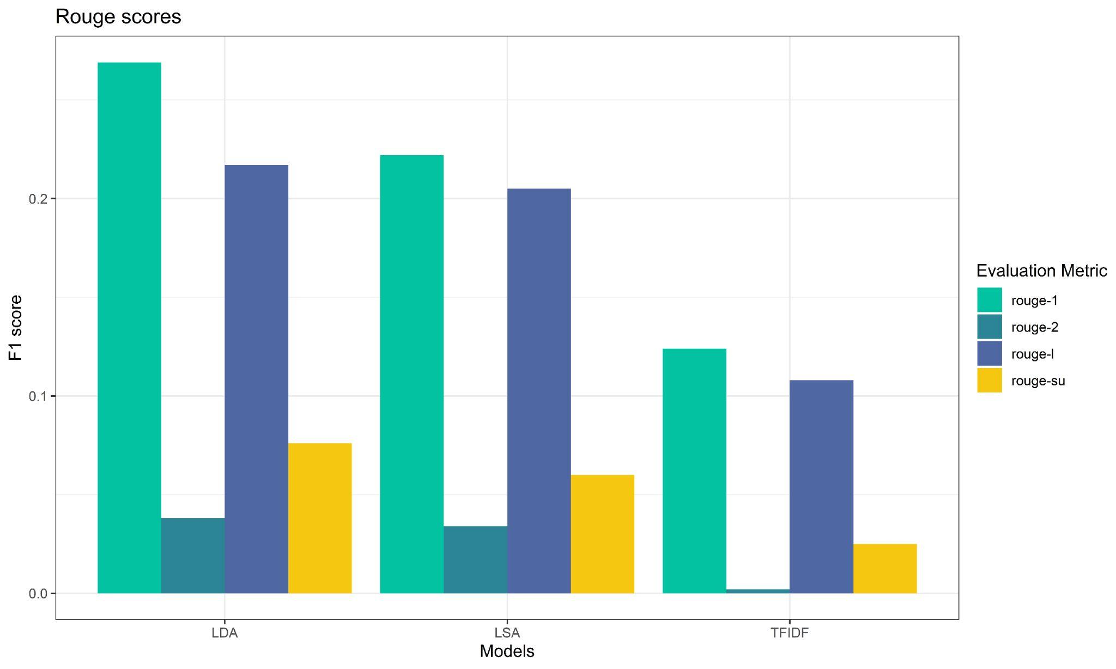
ROUGE Scores of the model

Slide 16
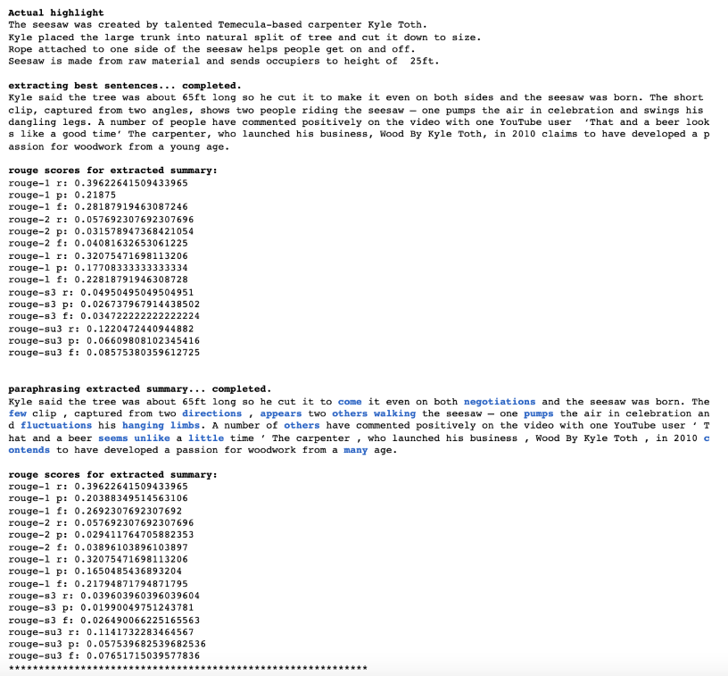
LDA Output

Slide 17
Drawbacks of the model
Time Complexity
The model takes a high computation time.
Evaluation Metric Value
The model gives out low scores when evaluated using ROUGE metrics.

Slide 18
Further Improvements
Optimization
Computational linguistics
More code optimization may result in lower time complexity
Add more concepts of computational linguistics in the paraphrase model.
Principles
Fine Tuning
Transformers
Fine tuning of some parameters of the model may improve the model.
Use transformer in the paraphrase for outstanding results

Slide 19
Thank you!

