Slide 1
EventZen
A Modern Event booking platform
By Soham Ghodke

Slide 2
Outline
Problem Statement
Objective
Microservices
Project Overview
Architecture
Architecture
Project Flow
Technology and Tools Used
Conclusion
Database Schema
Application Interface
Technology and Tools Used
Future scope
Conclusion

Slide 3
Problem Statement: Event Management
Complicated sign up processes drive people away from technology. Losing simplicity causes loss in efficiency and increases workload
Integration of multiple facets of management like venues and vendors along with customer management is a great challenge.
For customers, it is neither efficient nor convenient for the booking, attending and managing multiple venues and vendor services manually

Slide 4
Problem Statement: Architecture
The Monolithic Bottleneck: Because all features are "locked" into one giant code block, a single bug in the booking tool can crash the entire login and venue system.
Operational Inefficiency: This rigid structure makes the platform slow to update and impossible to scale during high-traffic registration peaks.
The Microservices Solution: By decoupling these services, our platform ensures that venue management, user auth, and bookings remain fast, independent, and fail-safe.

Slide 5
Objectives
Create a Modern Platform: To provide seamless service for event management that implements security, reliability and scalable functionality
Resilient Infrastructure: To implement a secure, microservices-based architecture that improves fault tolerance, scalability and provides a consistent experience for all end-users.

Slide 6
Project Overview
User Authentication & attendee Service
Venue & vendor Management Service
Events & Booking Service
User
Login
Admin
Home
View Events
View Venues
SQL
Server
SQL
Server
SQL
Server

Slide 7
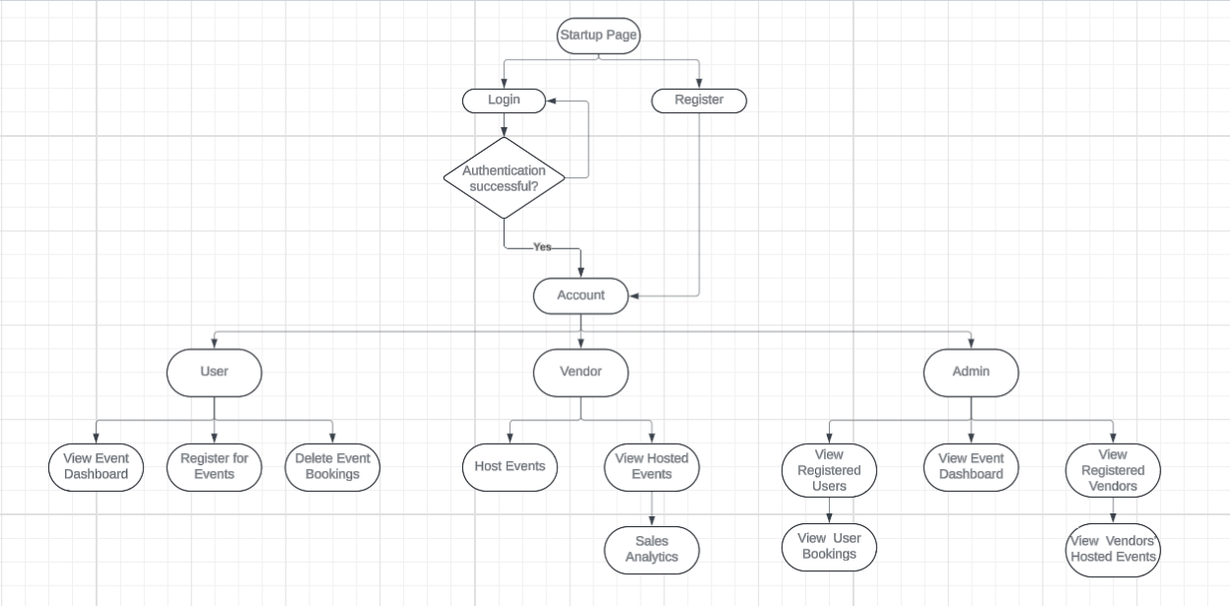
Sequence diagram

Slide 8
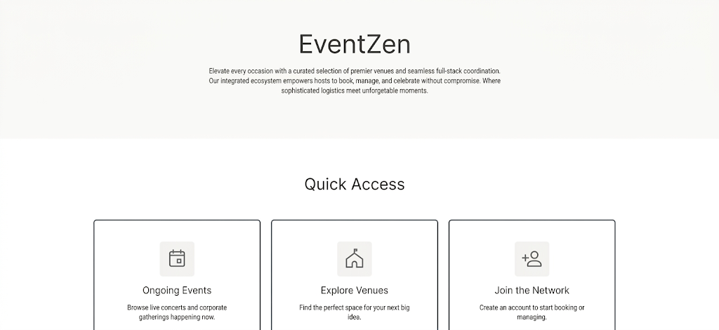
Sample Wireframe

Slide 9
Workflow: Admin
Admin can:
See overall analytics through dashboard
Can check all users
Check attendees for each events
Manage Venues and Vendors
Accept and reject booking requests for particular venues
Edit profile

Slide 10
Workflow: Customer
Customer can:
See overall analytics through dashboard
Can see all the approved public events and participate in them as attendees
Can check venues and vendors and request for their own events
See all the bookings for events
Edit profile

Slide 11
Microservices
Why Microservices?
Ensure independent scalability and fault isolation, allowing each business function to evolve without risking the entire system's stability.
User Authentication & attendee Service (Service 1)
Handles the core Auth flow (Register/Login), User Profile CRUD, and the administrative tracking of Event Attendees.
Venue & vendor Management Service (Service 2)
Manages the lifecycle of venues and vendors, provides customer-facing search filters (location/capacity), and performs real-time availability checks.
Events & Booking Service (Service 3)
Orchestrates the creation of events and handles the customer booking pipeline, including status tracking (Pending/Approved) and cancellation workflows.
User Authentication & attendee Service
Venue & vendor Management Service
Events & Booking Service

Slide 12
Architectural Diagram
User Authentication
& attendee Service
GET/POST
User services
Attendee services
GET/POST
SQL Database
PUT/DELETE
PUT/DELETE
Venue & vendor
Management Service
Front End
React.js
Vendor services
Venue services
GET/POST
GET/POST
SQL Database
PUT/DELETE
PUT/DELETE
Events &
Booking Service
Event services
Booking services
GET/POST
GET/POST
SQL Database
PUT/DELETE
PUT/DELETE

Slide 13
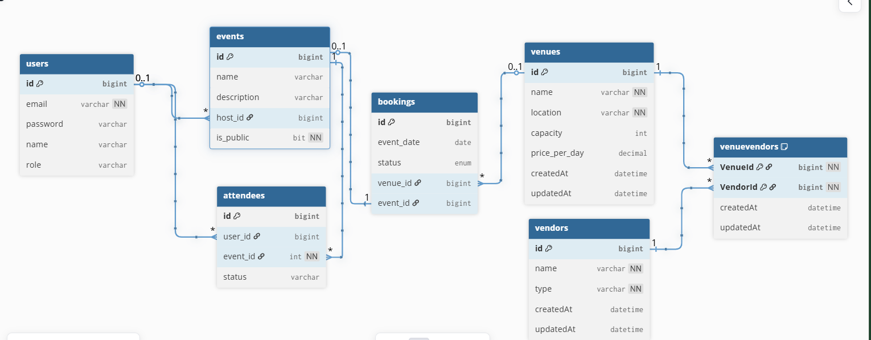
Database Schema

Slide 14
Application Interface

Slide 15
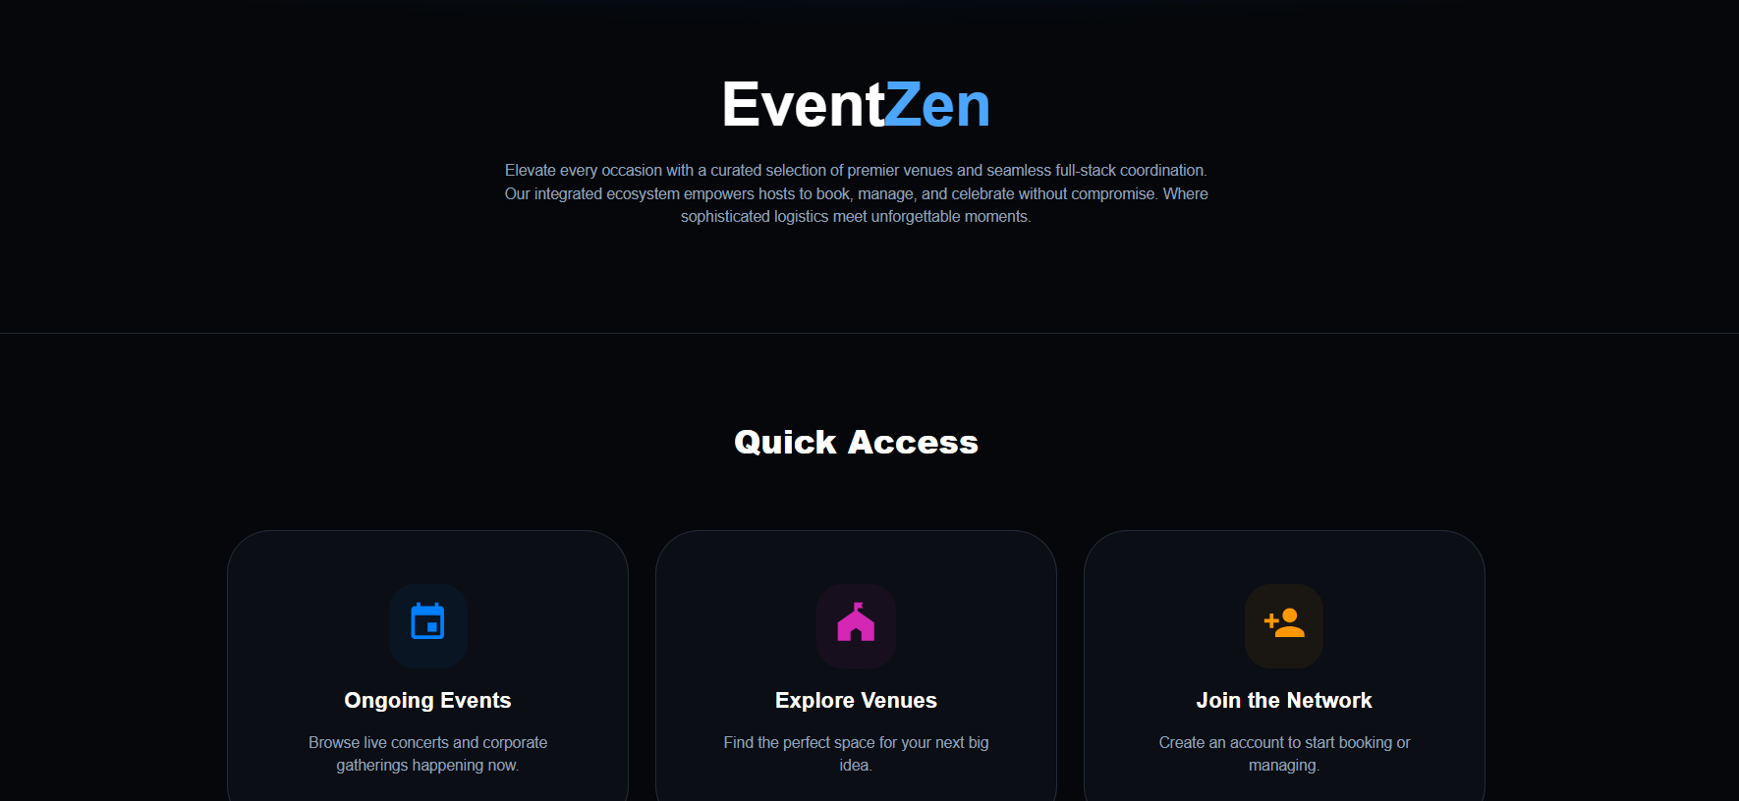
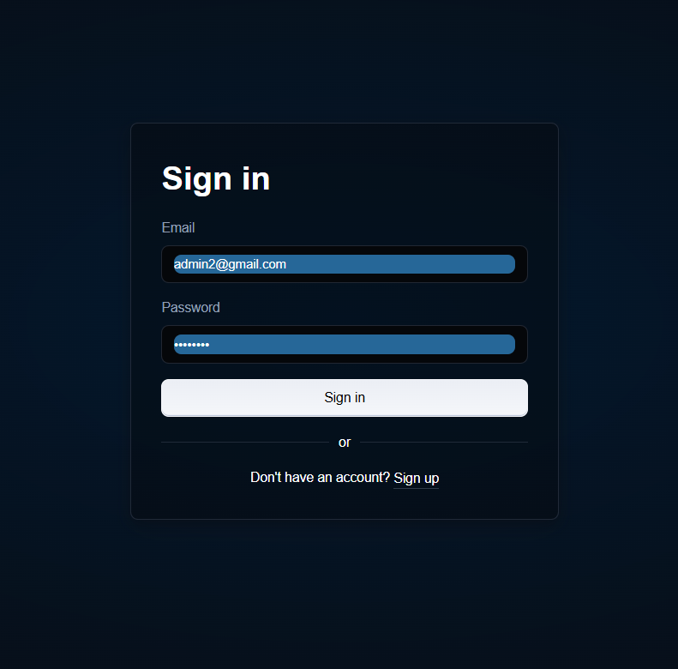
Main Page and Sign In Page

Slide 16
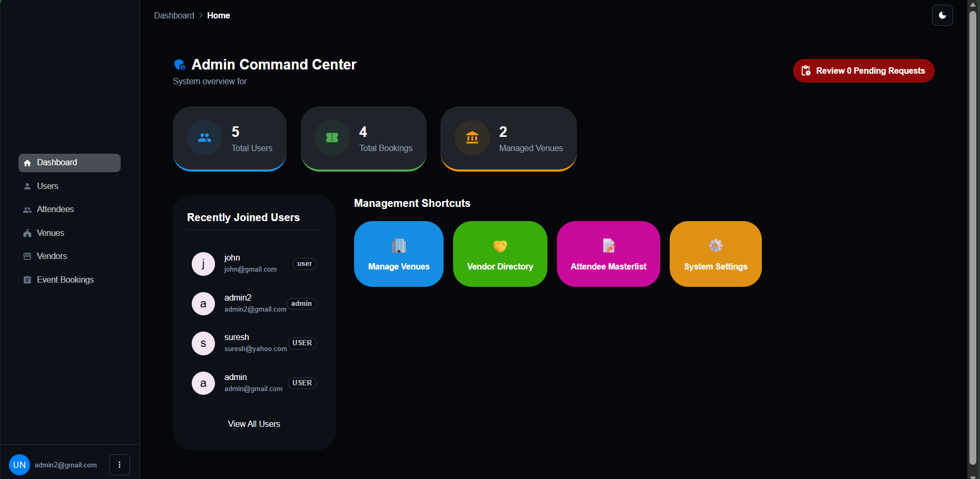
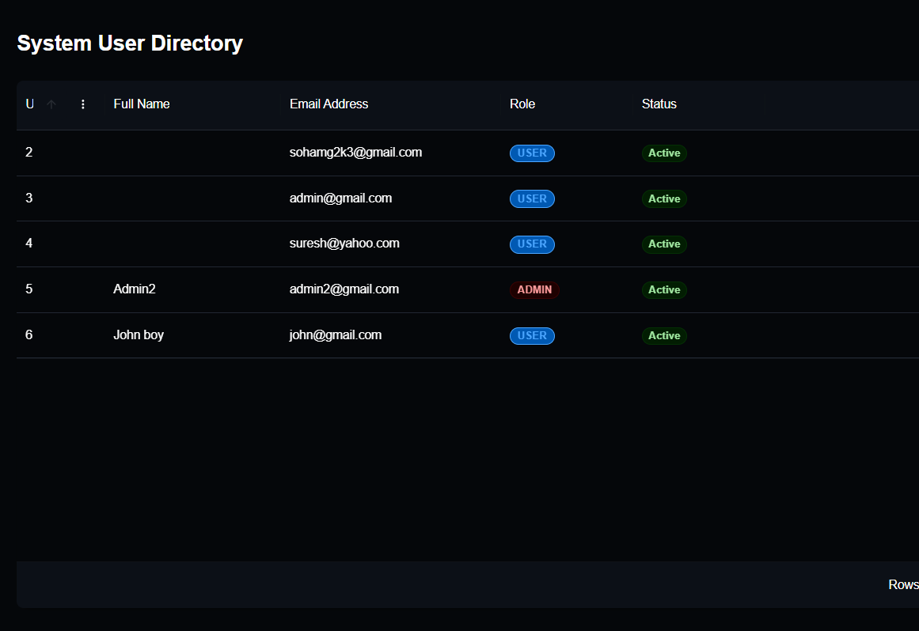
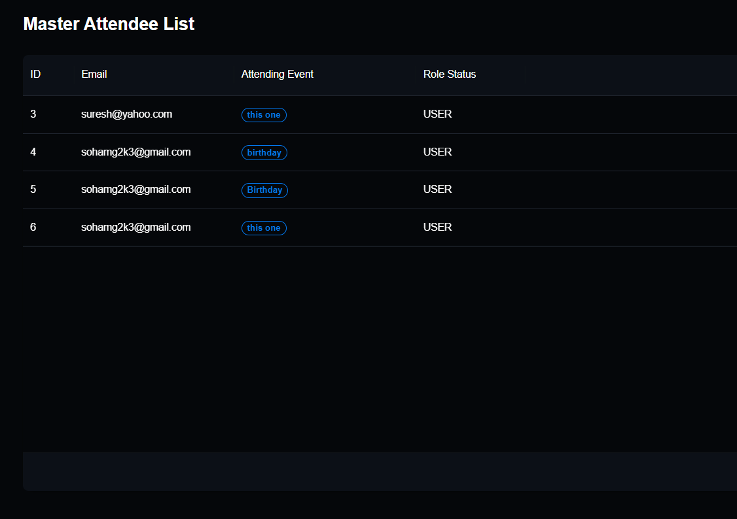
Admin Page
Users
Attendees

Slide 17
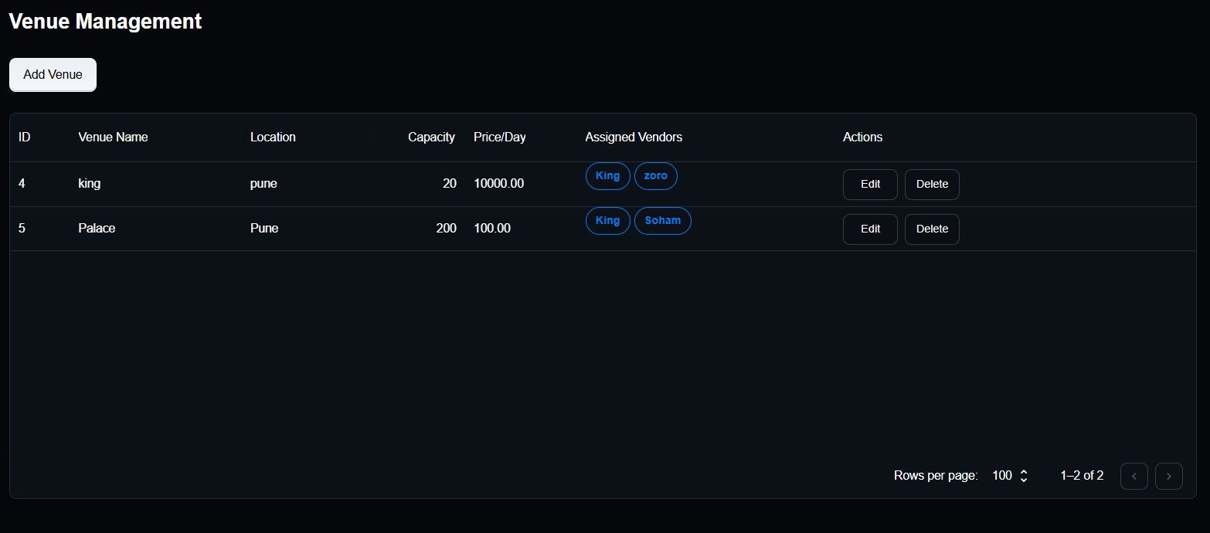
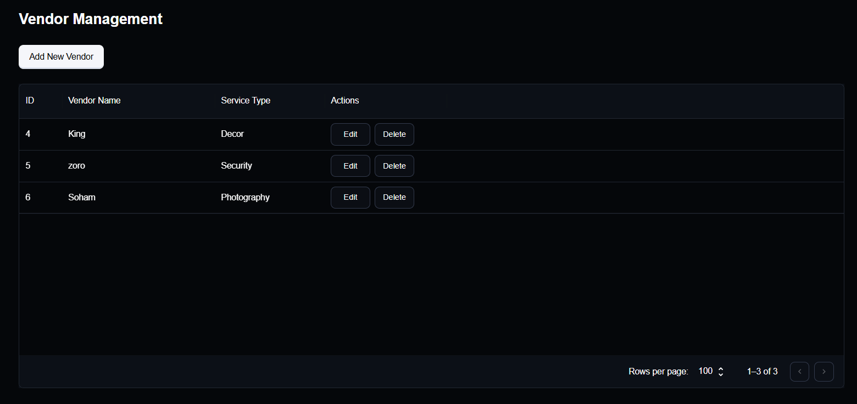
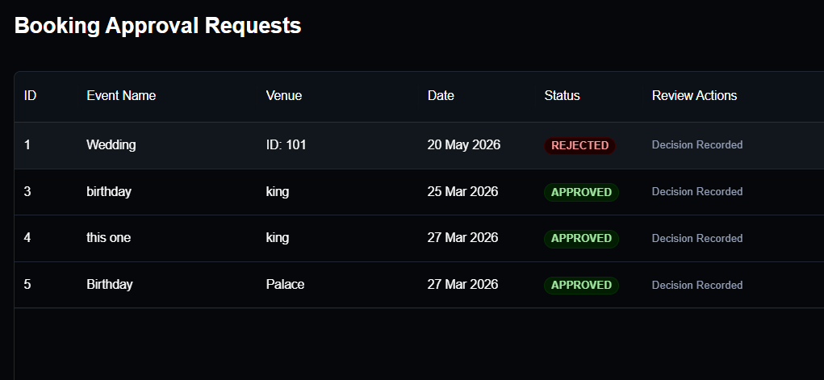
Venue Management
Vendor Management
Booking Approval

Slide 18
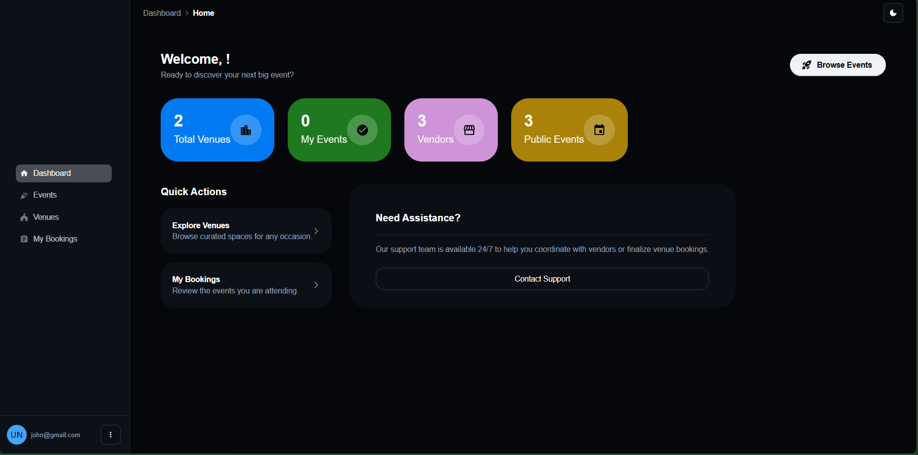
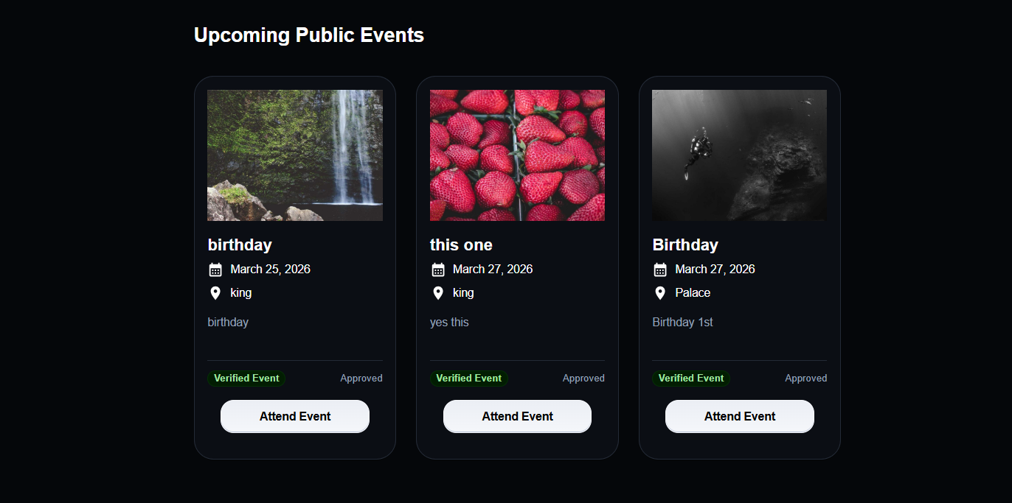
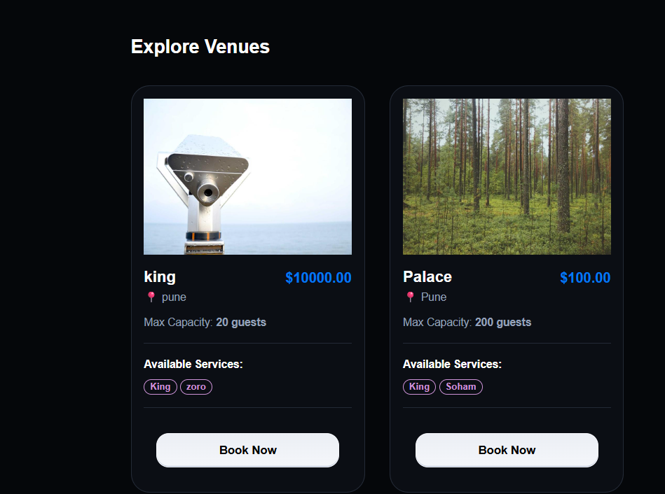
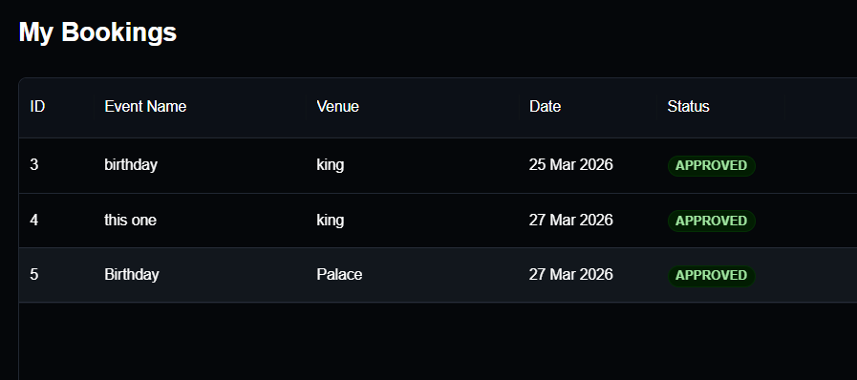
User Page
Public Events
Venues
My Bookings

Slide 19
Technologies and Tools used
Frontend (User Interface)
React.js: Core library for component-based UI.
Material UI (MUI): Professional themed components.
React Router: Client-side navigation management.
Fetch: Async REST API communication.
Backend (Microservices)
Java 17 & Spring Boot: Enterprise-grade microservices.
Spring Data JPA: Data persistence and ORM.
Spring Security: Auth and Role-Based Access Control.
Jackson: JSON-to-Java object mapping.
Data & Infrastructure
MySQL 8.0: Relational database storage.
Maven: Dependency and build management.
RESTful APIs: Standardized service communication.
Database-per-Service: Isolated schemas for scalability.
Testing & DevOps
JUnit 5 & Mockito: Unit and logic testing.
MockMvc: API endpoint verification.
Postman: Manual API testing and debugging.

Slide 20
Future Scope
Infrastructure & Deployment
Docker & Kubernetes: Containerization for automated scaling and orchestration.
AWS/Azure Cloud: Deployment to global cloud regions for high availability.
CI/CD Pipelines: Automated testing and deployment via Jenkins or GitHub Actions.
Feature Enhancements
Payment Gateway: Integration with Stripe or Razorpay for secure transactions.
Real-time Notifications: Automated email and SMS alerts via AWS SNS or Twilio.
Analytics Dashboard: Visual data insights for admins using Chart.js or D3.js.

Slide 21
Demo
Github:-
SohamTheG/EventZen: EventZen - An event management system

Slide 22
Thank you
Soham Ghodke
sohaghodke.ext@deloitte.com

