Slide 1
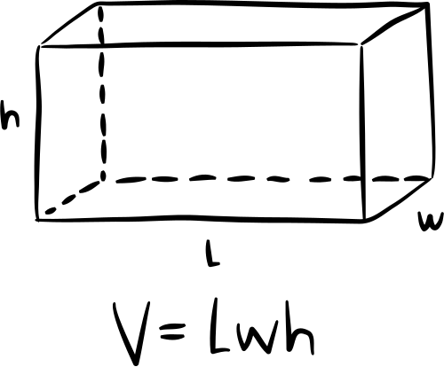
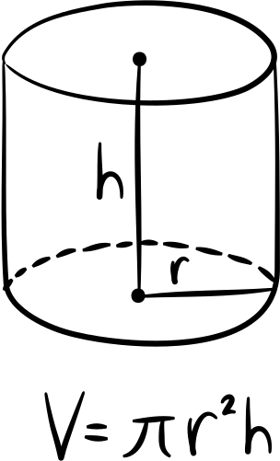
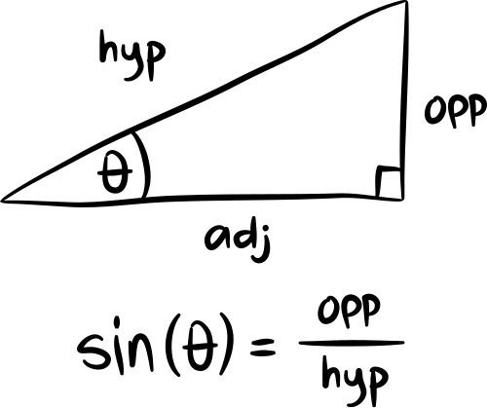
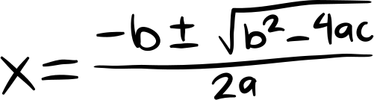
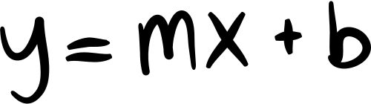
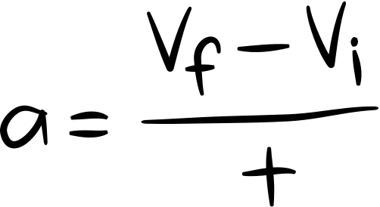
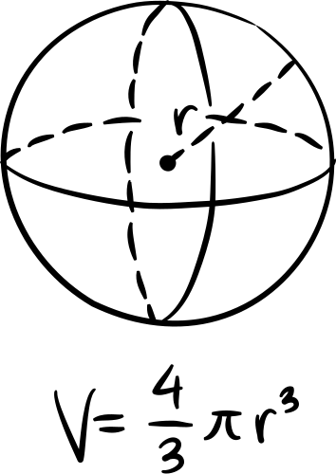
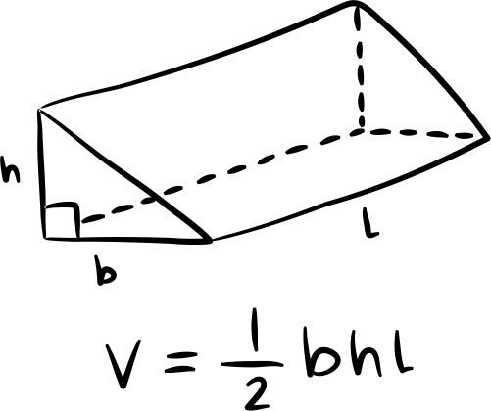
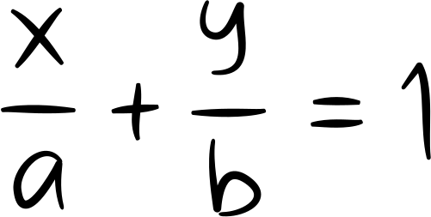

GOOGLE'S PAGE RANK
LINEAR ALGEBRA

Slide 2
WHAT IS PAGE RANK?
The PageRank algorithm is an algorithm used by search engines to rank web pages based on their relevance and importance

Slide 3
BEFORE PAGE RANK
Before PageRank, the web, was just a highly entangled space of information, zero classification of data that would render a worthy experience to the users in terms of time spent and content gained.
This often resulted in low-quality and irrelevant pages appearing at the top of search results.

Slide 4
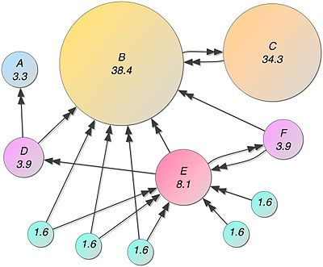
GOOGLE'S PAGE RANK
The PageRank algorithm assigns a numerical value, called the PageRank score, to each web page in Google's index.
The score is a measure of the page's importance and authority based on the links it receives from other web pages.
The underlying idea is that a page is considered more important if it is linked to by other important pages.

Slide 5


Slide 6
APPLICATIONS OF LINEAR ALGEBRA
METHOD TO FIND THE PAGE RANK:
A Markov chain can be used to model the behavior of a random web surfer navigating through web pages
We make a transition matrix which captures the probabilities of transitioning from one web page to another
The PageRank values are then determined by finding the dominant eigenvector of this matrix using the Power Method

Slide 7
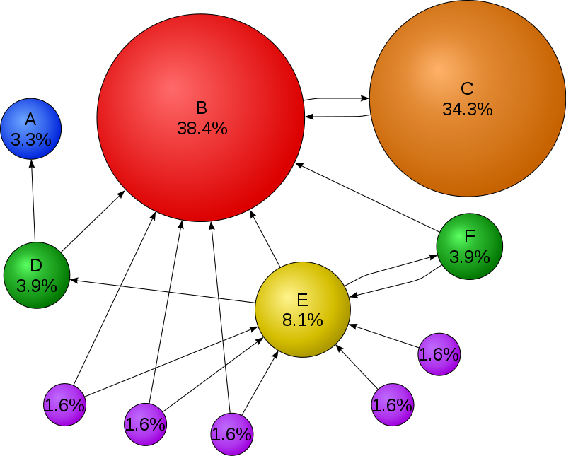
MARKOV CHAINS
Markov chains is a mathematician model
describing possible events
where the probability of each event depends only on the state
attained in the previous event
Each web page corresponds to a state in the chain, and each
hyperlink corresponds to a transition
between states with some probability.

Slide 8
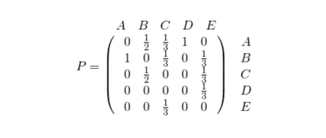
Transition Matrix
A transition matrix is a square matrix
where each element represents
the probability of transitioning
from one state to another state.
To represent the behavior of the random surfer using a Markov
chain, we construct a transition probability matrix
The rows of the transition matrix represent the probabilities of transitioning from a specific web page to all other web pages, while the columns represent the probabilities of transitioning from all web pages to a specific web page

Slide 9
Eigen Vectors
A transition matrix always has 1 as an eigenvalue and
there exists an eigenvector with eigenvalue 1 such that,
a distribution v over the states is called stationary distribution of the Markov chain with transition matrix A if
v = vA
The PageRank value is calculated using the equation:
v = (1 - d)e + dMv

Slide 10
Power Method
The eigenvector of a transition matrix M can be found using the Power Method.
The algorithm starts with an initial vector and repeatedly applies the matrix M to the vector until it converges to the dominant eigenvector. The resulting vector represents the PageRank values of all pages.

Slide 11
Graph Theory
The web pages and their relationships are represented as a directed graph in the PageRank algorithm.
Each web page is represented as a node, and the hyperlinks between pages are represented as directed edges.
This graph representation allows for the application of Linear Algebra concepts to analyze and rank the pages.
In summary, graph theory helps us model the web page network, while linear algebra provides the mathematical tools to compute the PageRank scores, which ultimately determine the ranking of web pages in search results.

Slide 12
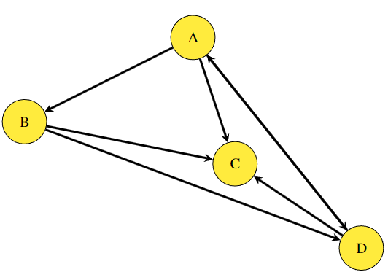
Graph Theory
The web of the World Wide Web can be efficiently represented by a network in Graph.
The basis of pagerank algorithm depends on the logic of incoming and outgoing links which information is avaliable in a graph in the form of in-degree and out-degree of a Node.

Slide 13
Python code for simulating Pagerank
import networkx as nx
import matplotlib.pyplot as plt
import math
def pagerank(graph, alpha=0.85, max_iterations=100, tol=1e-6):
G = nx.DiGraph(graph)
node_scores = {node: 1 / G.number_of_nodes() for node in G.nodes()}
iteration_scores = []
for _ in range(max_iterations):
prev_scores = node_scores.copy()
iteration_scores.append(prev_scores.copy())
for node in G.nodes():
score = sum(prev_scores[neighbor] / G.out_degree(neighbor)
for neighbor in G.predecessors(node))
node_scores[node] = alpha * score + (1 - alpha) / G.number_of_nodes()
if sum(abs(node_scores[node] - prev_scores[node]) for node in G.nodes()) < tol:
break
return node_scores, iteration_scores
graph = {
'A': ['B', 'C', 'D'],
'B': ['C', 'D'],
'C': ['A'],
'D': ['C', 'A']
}
scores, iteration_scores = pagerank(graph)
sorted_scores = sorted(scores.items(), key=lambda x: x[1], reverse=True)
for rank, (node, score) in enumerate(sorted_scores, start=1):
print(f"Rank {rank}: {node} (PageRank: {score})")
G = nx.DiGraph(graph)
node_sizes = [12000 * scores[node] for node in G.nodes()]
labels = {}
for rank, (node, score) in enumerate(sorted_scores, start=1):
score = round(score, 2)
labels[node] = f'{node}\nRank: {rank}\nPageRank: {score}'
nx.draw(
G,
with_labels=True,
labels=labels,
node_color='yellow',
node_size=node_sizes,
font_size=5,
arrowsize=16,
)
plt.title('Graph with Node Sizes Proportional to PageRank Scores and Rankings')
plt.savefig('pagerank_graph.png')
plt.show()
x = range(len(iteration_scores))
for node_idx, label in enumerate(labels):
y = [scores[label] for scores in iteration_scores]
plt.plot(x, y, label=f'{label}')
plt.xlabel('Iteration')
plt.ylabel('PageRank')
plt.title('PageRank Changes with each iteration')
plt.legend(loc='upper right')
plt.grid(True)
plt.tight_layout()
plt.savefig('pagerank_changes.png')
plt.show()

Slide 14
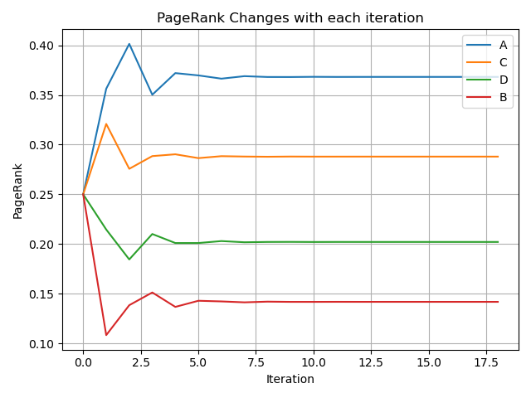
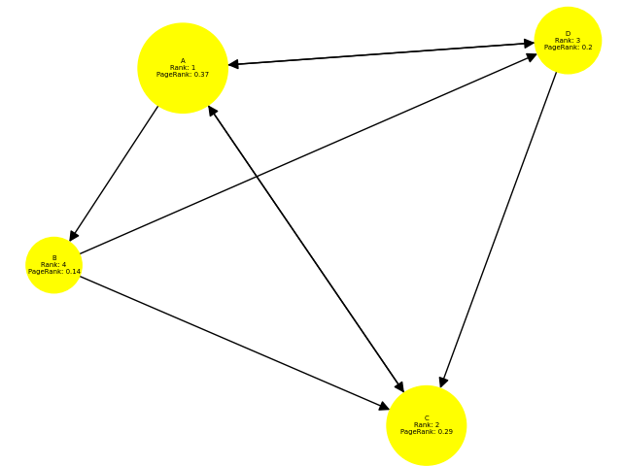
Python code for simulating Pagerank
Output:-
Rank 1: A (PageRank: 0.3681506538366117)
Rank 2: C (PageRank: 0.2879616007311895)
Rank 3: D (PageRank: 0.2020783388856028)
Rank 4: B (PageRank: 0.1418094065465959)

Slide 15
ANALYSIS OF THE PAGERANK ALGORITHM
Page rank takes into account 2 kinds of scores for each page:
Traditional content scores
Popularity scores
Popularity of a page represents its reputation
and authority in the Web.
It demonstrates how many other pages lead the user to this page more often than the other pages

Slide 16
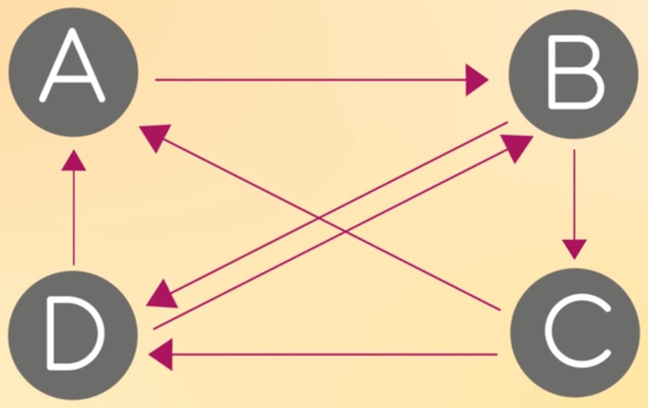
Example
A is referred to by C and D.
Which implies that given the user lands on A,
it is equally likely that it
has been redirected from either D or C.
Further the user
is absolutely likely to go to B next, from A.
B is endorsed by D and A.
Similar to A, a user is equally likely to
come from A or D given he/she is on B.
From B, there is again an 50% chance
that user next goes to either C or D
Lastly, D is being referred to
by sites B and C
and outlinks
from D lead
to A and B with equal probability
If the user is on C, the only
possibility for user to be on C currently is when it was previously on B. And from C, there’s an equal chance of
user for visiting either A or D

Slide 17
The structure of the network
The method discussed above does not always work because of the following conditions on
the hyper-link network:
• It needs to be a-periodic
• It must converge
• It must not have any dangling nodes

Slide 18
Our team- 74
Soham Vaishnav
Roll Number: 2022112002
Branch: ECD
Zainab Raza
Roll Number: 2022102013
Branch: ECE
Shailender Goyal
Roll Number: 2022111023
Branch: CSD

