Slide 1
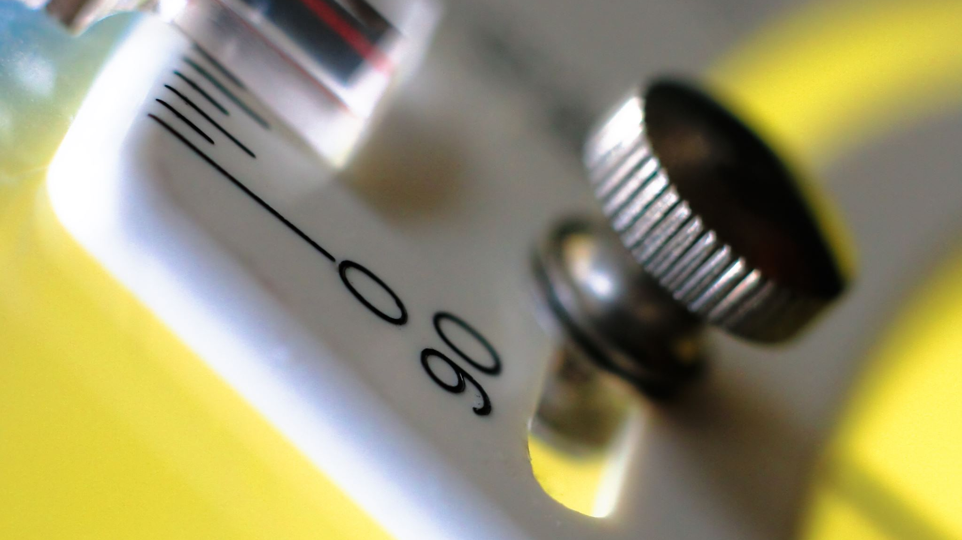
Signal Processing – EC5201
Final Course Project
Team – SRH
Team Members:
Harshvardhan Singh (2022112004)
Rupak Antani (2022102045)
Soham Vaishnav (2022112002)

Slide 2
Task 1 – Echo Creation
Echo – Reflected sound off surfaces at a certain distance add to the original signal as its delayed and attenuated versions
Principles of Echo – Minimum distance between source and reflector required for an echo to be heard by humans is about 17m considering speed of sound is 340m/s in dry air.
Less than that causes reverberations
Modelling attenuation factors - known that attenuation is “perceived” through loudness, so log scale is involved
Attenuation in echoes caused from reduction in intensity due to power dissipation when travelling a set distance that happens according to inverse square law.
Thus, power dissipation framework of signals important to model attenuation

Slide 3
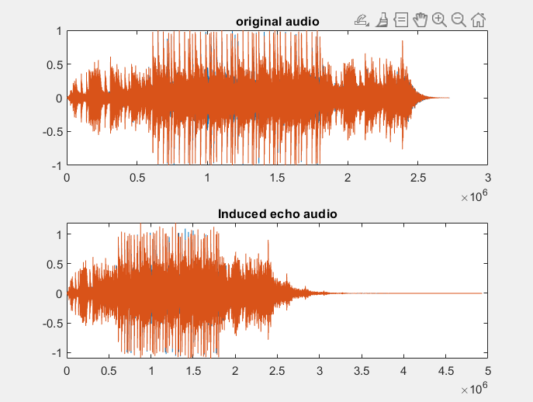
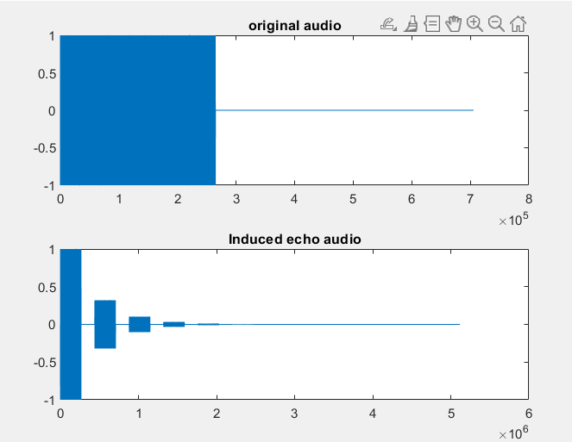
Creating Echo
First we decide the delay and number of echoes we want to induce in our signal which accordingly sets the attenuation factor too.
Next we model an impulse train zero vector of same length but with some values according to attenuation factor and the index of echo its supposed to induce
Finally we convolute the signal with these impulse trains and get the desired echo at set intervals.

Slide 4
Task 2 – Cancel the Echo
Echo cancellation one of the most challenging signal processing tasks
Involves identification and separation of overlapping signals
Previous task shows how echo is created, here we discuss few of our approaches to deal with it
Realised – difficult challenge to overcome using classical signal processing techniques.
Two most used techniques – AutoCorrelation and Adaptive Filtering

Slide 5
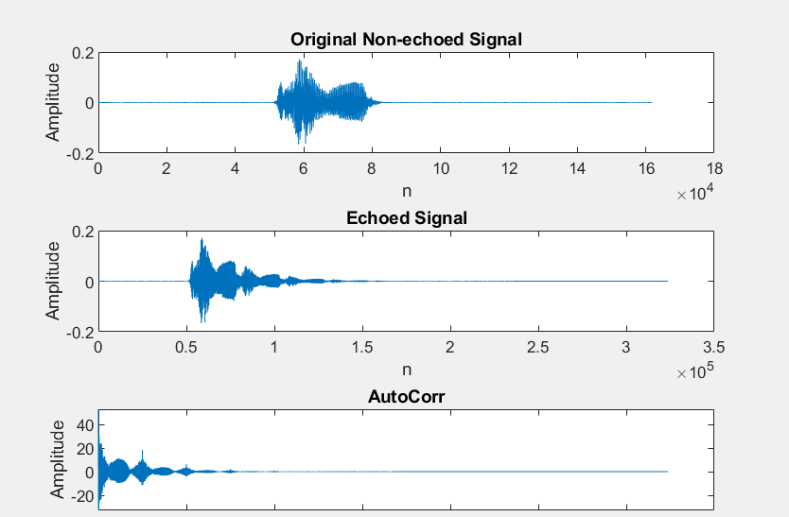
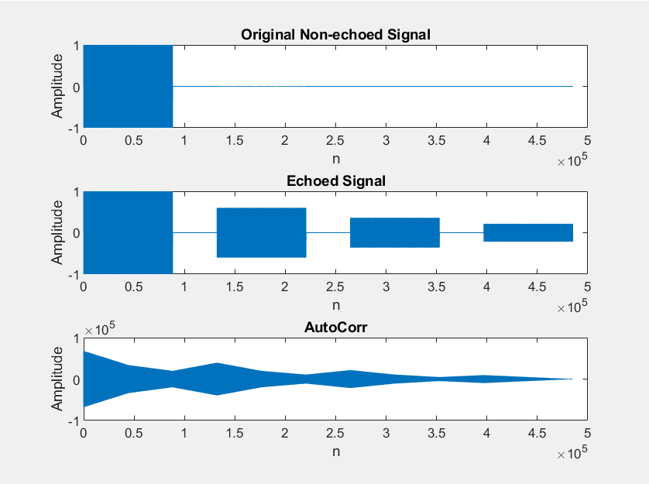
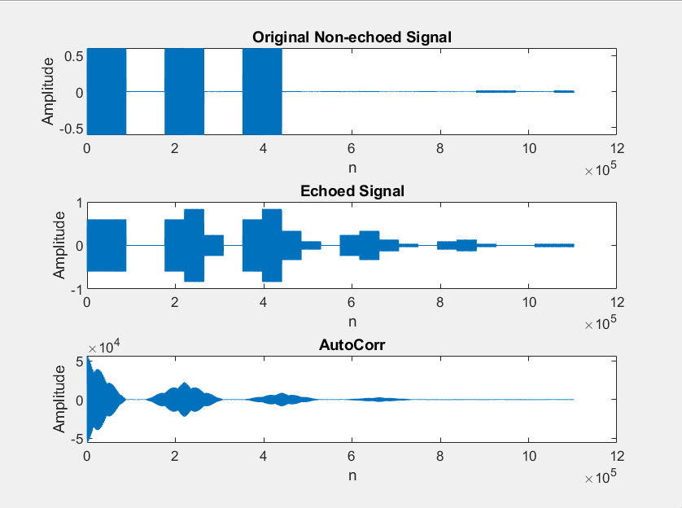
Task 2 – Approaches
AutoCorrelation – Straightforward implementation where we simply take auto-correlation of the echoed signal and check for the peaks. The peaks signify the moments in time where the signal repeats, i.e. confirms presence of echo at those spots. Following diagrams show that : (Note the peaks)

Slide 6
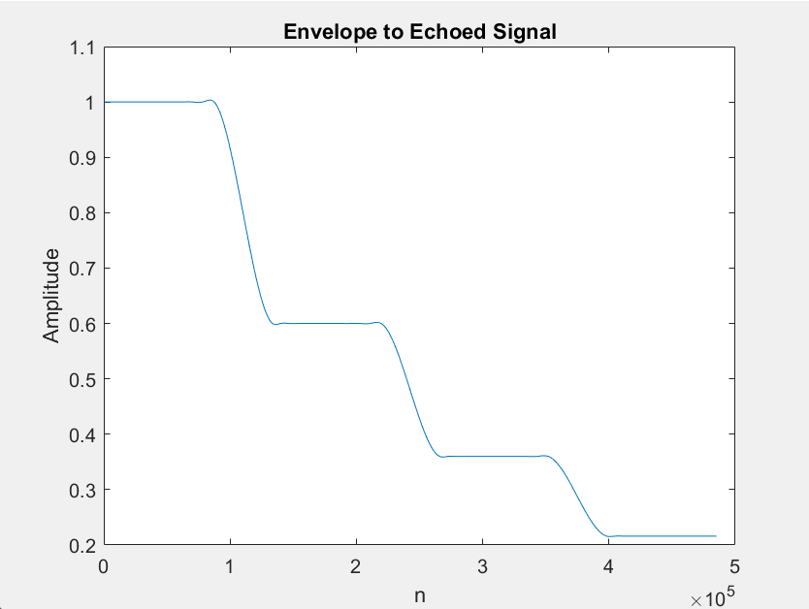
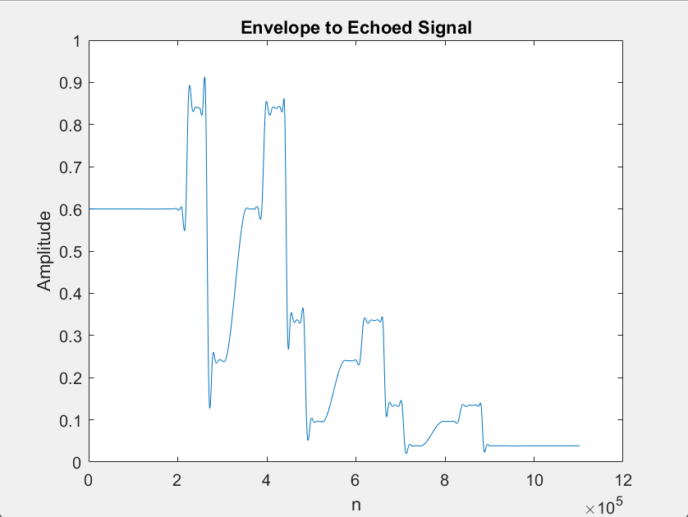
Task 2 - Approaches
AutoCorrelation - Different implementations for uniform and non-uniform delays. Both have their pros and cons.
Uniform Delayed Echo –
From the auto-correlation, we obtain the peaks by applying a special condition derived from acoustics
Find envelope to the given echoed signal – useful to identify overlaps only when we have “blocks” or signal parts which are “constant” over a sustained period of time
Use the peak locations, match them with their occurrence in the envelope, and find attenuation
Check for constant attenuation (mostly assumed) and subtract the delayed echo signal from itself to get the original non-echoed version

Slide 7
Task 2 – Approaches
AutoCorrelation –
Non-Uniform Delays –
Two Methods – Top-to-bottom and Bottom-to-top
Top-to-Bottom method involves recursively removing echoes like uniform delays by applying correlation at each step and getting attenuation from auto-correlation peaks. Issue – Convergence not guaranteed, computationally expensive
Bottom-to-Top method involves starting from the last (bottom) echo and coming to the first (top) echo by following uniform delay method but making the signal amplitude 0 starting from the instances the new echoes are introduced (due to non uniformity). Issue – Lengthy signals

Slide 8

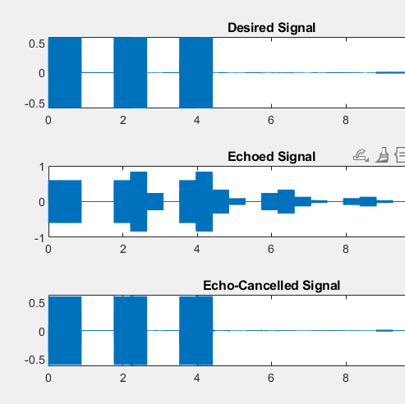
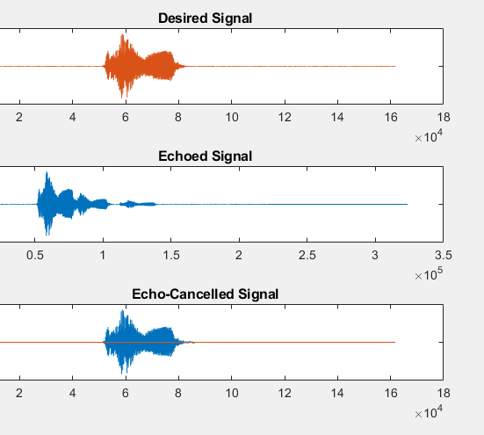
Task 2 - Approaches
Adaptive Filtering –
Many implementations like NLMS, RMS, LMS.
Widely used methods in acoustic echo cancellation
We used NLMS to model complex echo signals(non-uniform delay) the only drawback was that it needs some information about the desired signal beforehand to work, it takes a running window over the echoed signal and compares error in that signal and adjusts the output according to weighted taps and adjusts the said taps with each iteration of the window moving forward effectively adapting to whatever echo model is provided in the signal.

Slide 9

Task 3 – What is this noise?
The main aim of this task is to classify the type of background noise from a noisy music audio. The noise can be of the following types:
1.Fan
2.Traffic
3.Pressure Cooker
4.Water Pump

Slide 10

Cross - Correlation
Cross – correlation between 2 signals is used to find the extent of similarity between a signal and delayed form of the other signal.
Formula for cross – correlation between signals x[n] and y[n]:
Cross – correlation can also be applied to FFTs. It gives the similarity between 2 FFTs.
Greater the magnitude of cross - correlated signal, greater the similarity between the 2 signals.

Slide 11

Logic and its Implementation
Step 1 : Take the noisy music signal and a set of six sample noise signals made of various combinations of different types of noise.
1
Step 2 : Cross – correlate the noisy music signal with these sample noise signals.
2
Step 3 : Find peak values of these cross – correlated outputs.
3
Step 4 : Take combinations of these peak values based on the combinations taken to get the sample noise signals.
4
Step 5 : Find the maximum of these peak values.
5
Step 6 : Check that this value corresponds to which of the four peak values and based on that assign the type of noise.
6

Slide 12
Explanation of Code
First, I load the noisy music signal as well as a set of six sample noise signals using the audioread () function
Then, I cross – correlate the music signal with the noise signals using the xcorr () method.
Next, I find the peak value of each of these six cross – correlated outputs using the max() function.
Now, I form a set of four combinations based on which the sample noise signals are formed.
After this, I find the maximum of these four values using max () function.
Lastly, I check that this max value corresponds to which types of noise.

Slide 13
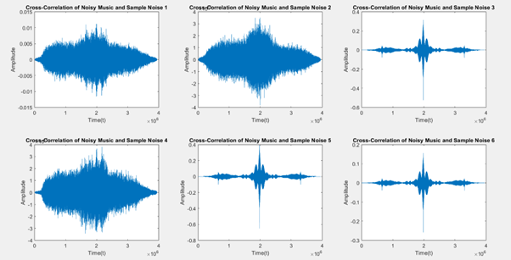
Logic and its Implementation
For example, the below image shows the cross – correlation between music signal with water pump noise and the sample audio files:

Slide 14
Thank You.

