Slide 1
Intro to Neural and Cognitive modelling Project Report
Mid Evaluation
Harshvardhan Singh (2022112004)
Soham Vaishnav (2022112002)

Slide 2
Project Aim
To understand and explore the existing literature of Striatal Beat Frequency model (SBF)
To implement a model in Python and then experimenting with the variables (and see how they affect the outputs) involved
Experiment and validate the model by performing processes related to known applications in current works.
For the novelty aspect of the project we wish to expand the experimentation of the model to non-wakeful states in hope of achieving meaningful results to explain the phenomenon.

Slide 3
Related Works:
Cortico-striatal circuits and interval timing: Coincidence detection of oscillatory processes.
- Matthew S. Matell and Warren H. Meck
Link: https://www.sciencedirect.com/science/article/abs/pii/S0926641004001697
What makes us tick? Functional and neural mechanisms of interval timing.
- Catalin V. Buhusi and Warren H. Meck
Link:
What makes us tick? Functional and neural mechanisms of interval timing | Nature Reviews Neuroscience

Slide 4
Progress
We need to note that from the papers we read, we inferred that the SBF model, at the core, is based on the set of neurons in the basal ganglia.
What makes these neurons special is the way they are connected to each other, giving rise to what is computationally known as neuron groups.
These connections enable the neurons to collectively perform two crucial tasks:
Coincide Detection
Measuring time using intervals

Slide 5
Mathematical description for SBF
We note that the SBF model deals with two kinds of neurons: cortical and striatal.
The cortical neurons form multiple neuron groups that oscillate at different frequencies
Those groups are synoptically connected to striatal neurons that detect the oscillations
When the sum of multiple oscillations crosses a certain threshold, those set of striatal neurons generate a spike.
Repeated behaviour of such neuron groups in the cortical structure strengthens the synaptic connections within and across the neurons
Similarly, the spiking activity of the striatal neurons gives rise to what we call internal clock due to the periodicity

Slide 6
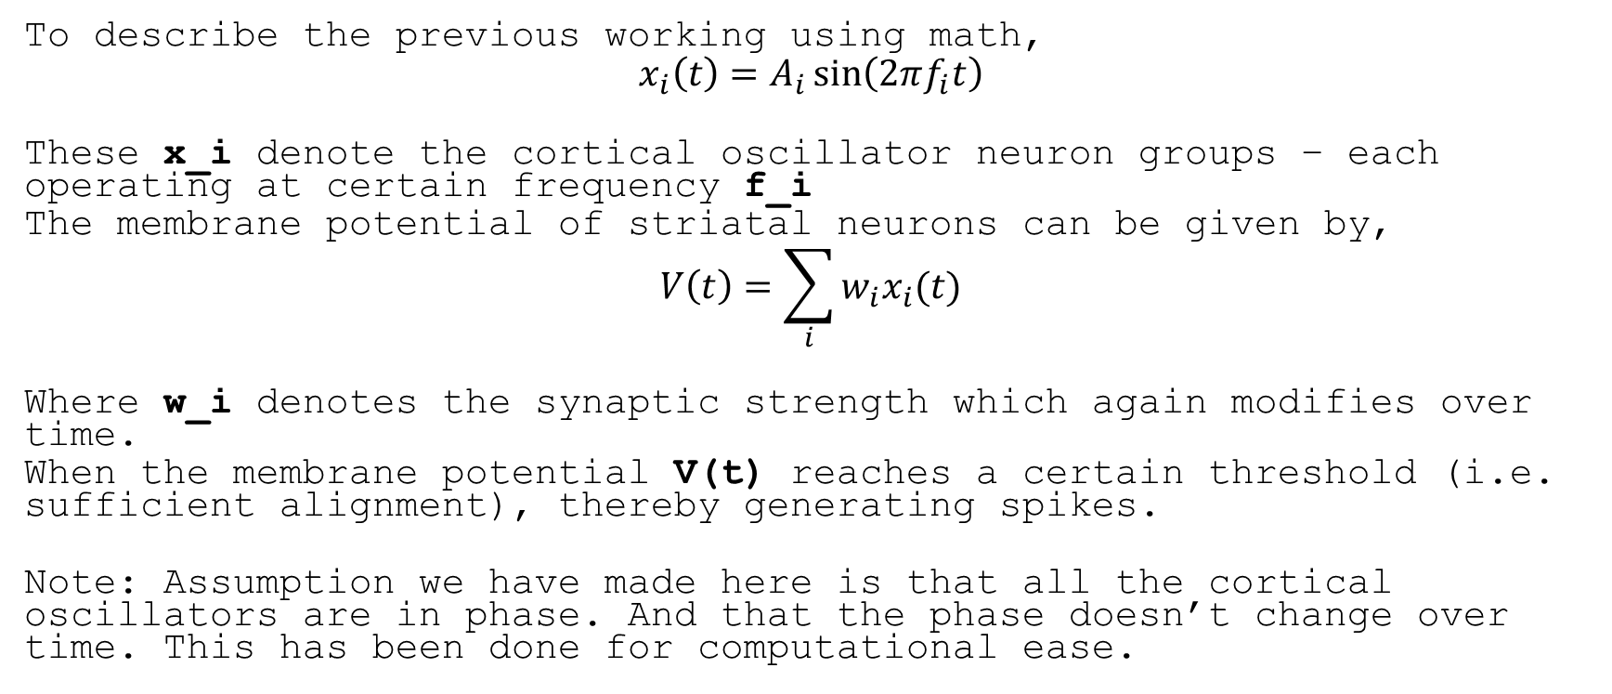
Math behind the model
To describe the previous working using math,
$$x_{i}\left(t\right)=A_{i}\sin\left(2πf_{i}t\right)$$
These x_i denote the cortical oscillator neuron groups – each operating at certain frequency f_i
The membrane potential of striatal neurons can be given by,
$$V\left(t\right)=\sum_{i}{w_{i}x_{i}(t)}$$
Where w_i denotes the synaptic strength which again modifies over time.
When the membrane potential V(t) reaches a certain threshold (i.e. sufficient alignment), thereby generating spikes.
Note: Assumption we have made here is that all the cortical oscillators are in phase. And that the phase doesn’t change over time. This has been done for computational ease.

Slide 7
Experiments
We tried to implement two very basic Neuron Groups (of 10 neurons each) using brian2
The parameters for neurons in each neuron groups are as follows:
V_rest
V_thresh
I*R
Freq
Tau (time constant)
Duration of experiment
We have currently made use of LIF model for creating neurons and the results are accordingly obtained
Of these above mentioned parameters, we played around with a few of those which will be mentioned with the results

Slide 8
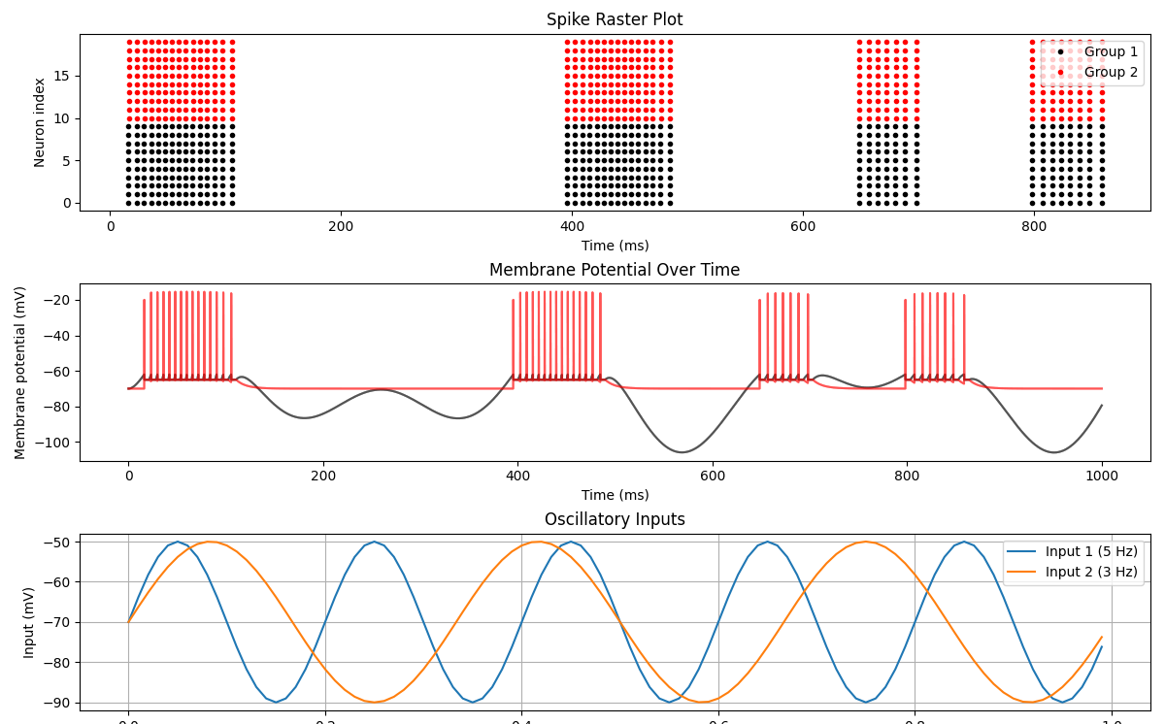
Results
Tau = 10ms
Duration = 1s
Freq1 = 5Hz
Freq2 = 3Hz
Thresh = -62mv
I*R = 20mV

Slide 9
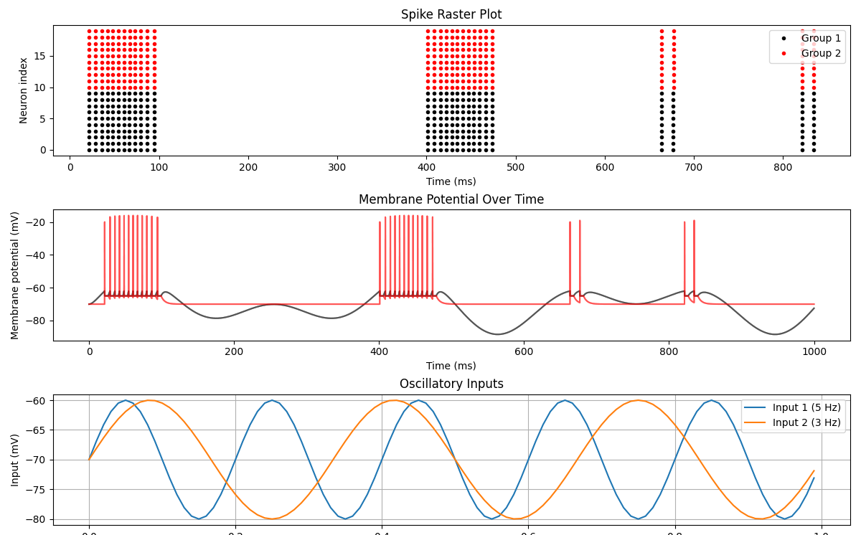
Results
Tau = 5ms
Duration = 1s
Freq1 = 5Hz
Freq2 = 3Hz
Thresh = -62mv
I*R = 10mV

Slide 10
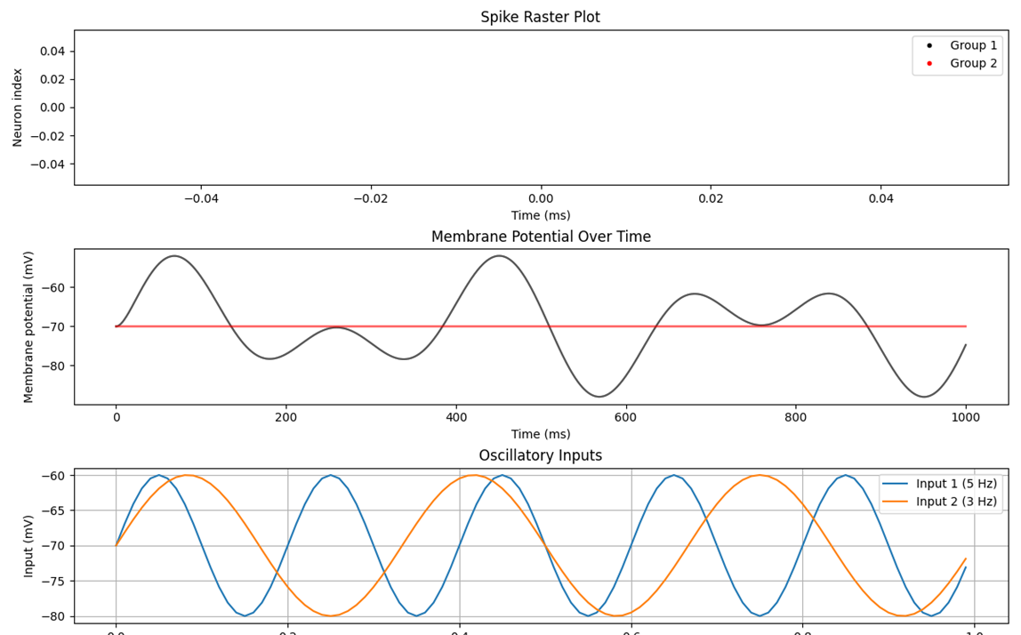
Results
Tau = 10ms
Duration = 1s
Freq1 = 5Hz
Freq2 = 3Hz
Thresh = -50mv
I*R = 10mV

Slide 11
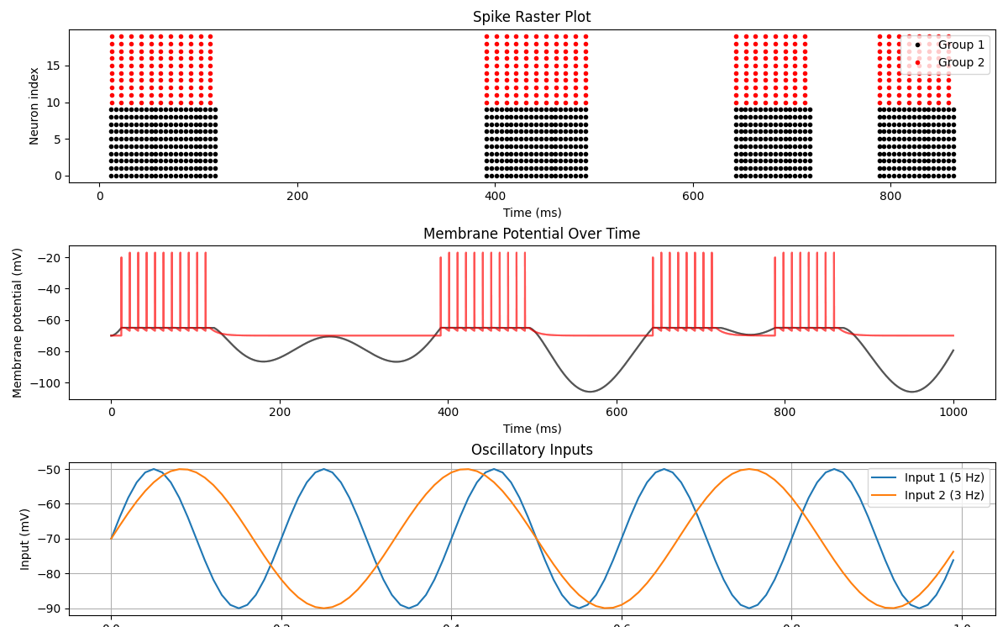
Results
Tau = 10ms
Duration = 1s
Freq1 = 5Hz
Freq2 = 3Hz
Thresh = -65mv
I*R = 20mV

Slide 12
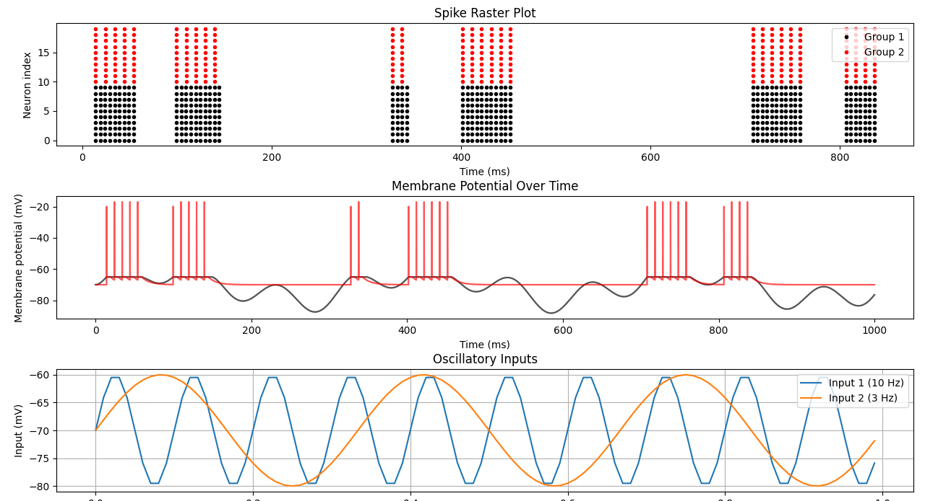
Results
Tau = 10ms
Duration = 1s
Freq1 = 10Hz
Freq2 = 3Hz
Thresh = -65mv
I*R = 10mV

Slide 13
Plan for future
For now we have modelled the SBF setup using LIF neurons, but we can try experimenting with HH-model based neurons which can give us more realistic results
Practical situations are not this smooth in their working. Therefore, we would try to look at how noise will affect the system (mainly Gaussian noise)
Our broader aim (as mentioned in the project proposal) is to explore the working of SBF in non-wakeful state. Current literature focusses on wakeful state analysis. Therefore, it will be interesting to explore the former.
Main reason for this exploration roots from the fact that perception of time is different in non-wakeful state than in wakeful state

