Slide 1
HiveMind
Cooperative warehouse robots with multi-agent reinforcement learning and emergent communication

Slide 2
Problem and goals
Warehouses run fleets of robots that share narrow aisles, compete for the same items and block each other
Hand-coded coordination needs a map and breaks when the layout changes
The question: can a team learn to coordinate purely from experience, and learn to talk?
Goal 1 · Cooperative MARL
4 robots find, pick up and deliver 12 cartons to a depot as a team. No map, randomised layout each episode, obstacles sensed only by LiDAR.
Goal 2 · Emergent communication
A 16-token message channel with no predefined meaning. Controlled ablation: no comm vs comm. Metrics: success, makespan, collisions, token entropy, mutual information.

Slide 3
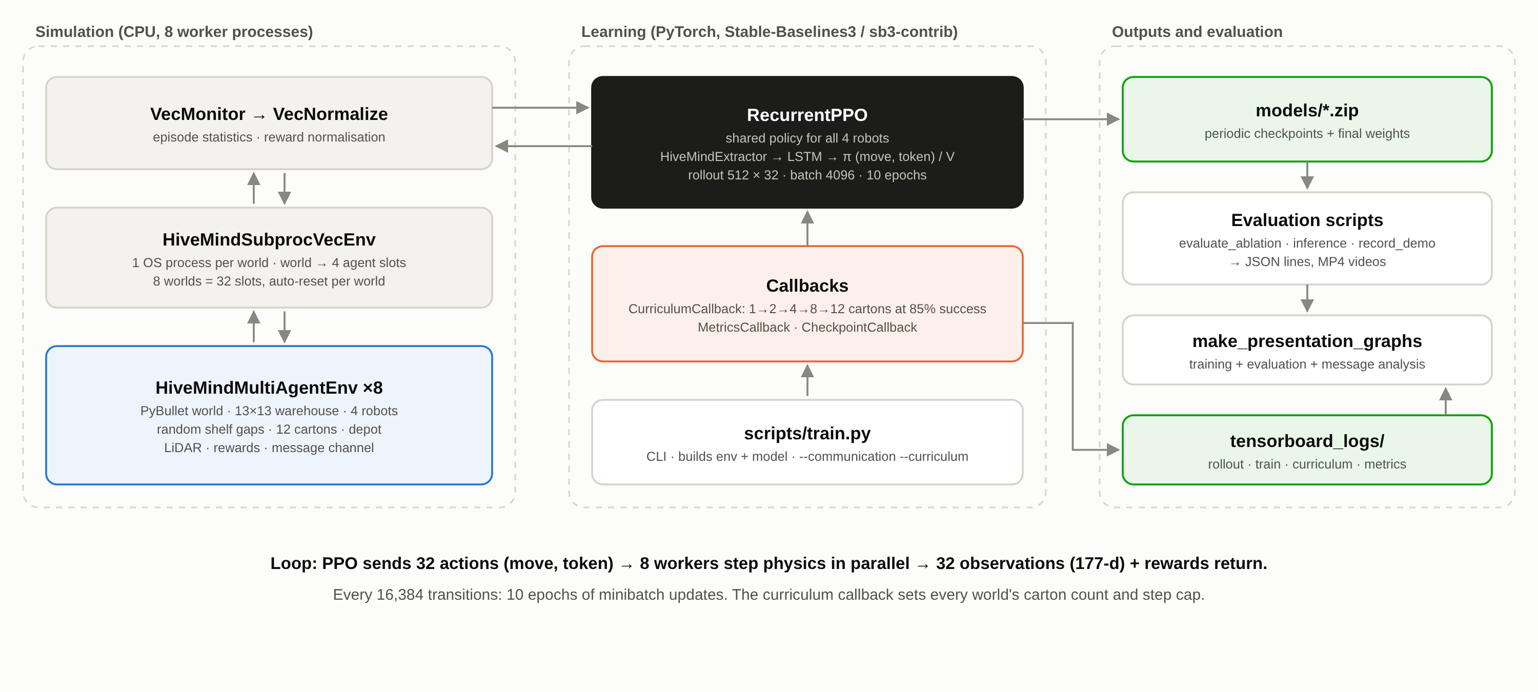
System architecture

Slide 4
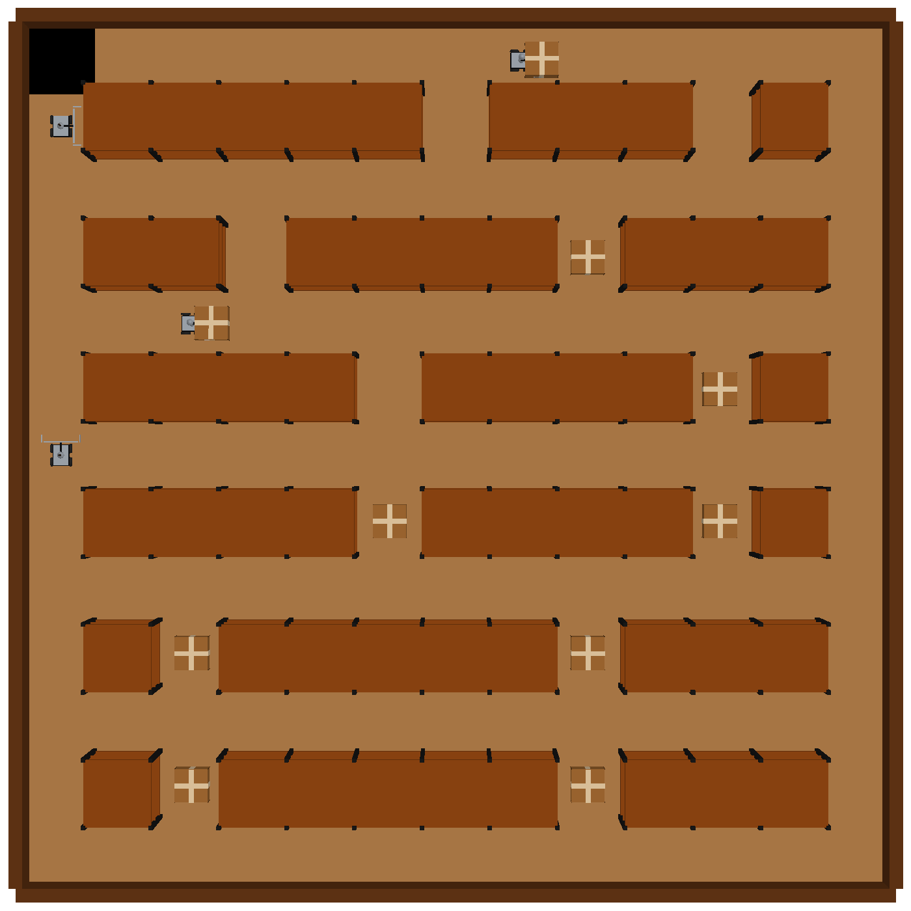
Environment: a procedural PyBullet warehouse
Simulator: PyBullet rigid-body physics wrapped as a Gymnasium environment
World: 13 × 13 grid, 6 shelf rows split by 2 random gaps each, 12 cartons in the gaps, corner depot
Robots: 4 differential-drive URDF robots with yaw arm, gripper and a mast-mounted LiDAR
LiDAR: 72 rays, 270° arc, 0.1–10 m, σ = 1 cm + 1% noise, cast at chassis height
Motion: one-cell moves and 90° turns, animated over physics sub-steps then snapped to the grid
Episode: ends when all cartons are delivered or at the step cap (60–400, scaled to task size)
Top-down view: shelves, cartons in the gaps, depot (black, top-left), robots

Slide 5
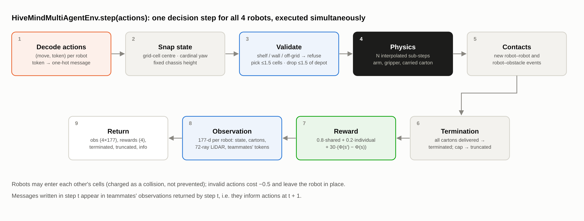
One environment step, in order

Slide 6
Observation and action spaces
Block | Size | Contents
Own state | 6 | pose (x, y, heading), velocity, carrying flag
Teammates | 12 | 3 × (pose, carrying flag)
Cartons | 36 | 12 status values + 12 (x, y) positions
Depot · time | 3 | offset to depot, fraction of episode elapsed
LiDAR | 72 | normalised ranges
Messages | 48 | 3 teammates × 16-token one-hot
Total | 177 | per robot, all values in [−1, 1]
Action: MultiDiscrete([7, 16])
7 moves (forward, backward, left, right, pick up, drop off, stay) plus one of 16 message tokens, every step.
Width pinned at 177
Checked at import, in the constructor and at runtime. Message slots exist in both ablation arms, so their networks are identical.

Slide 7
Reward design
r = 0.8 · R_shared + 0.2 · R_individual + 30 · (Φ(s′) − Φ(s))
Shared (all robots) | Reward
Carton delivered (anyone) | +10
All cartons delivered | +100
Makespan bonus | +50·(T_max − T)/T_max
Collision event | −1
Time | −0.05 / step
Individual (per robot) | Reward
Own pick-up | +1
Own delivery | +2
Collision it caused / hit obstacle | −5
Invalid action | −0.5
Idle (not turning, away from depot) | −0.02 / step
Potential shaping
Φ = −(cartons left + 0.5 if not carrying + distance / 26)
Telescopes over an episode, so it can't be farmed.
Pick-ups and deliveries always raise Φ.
Each cell of progress ≈ +1.15.
Collision blame is asymmetric: only the robot that moved takes −5. No reward exists for messaging; communication can only pay through the team reward.

Slide 8
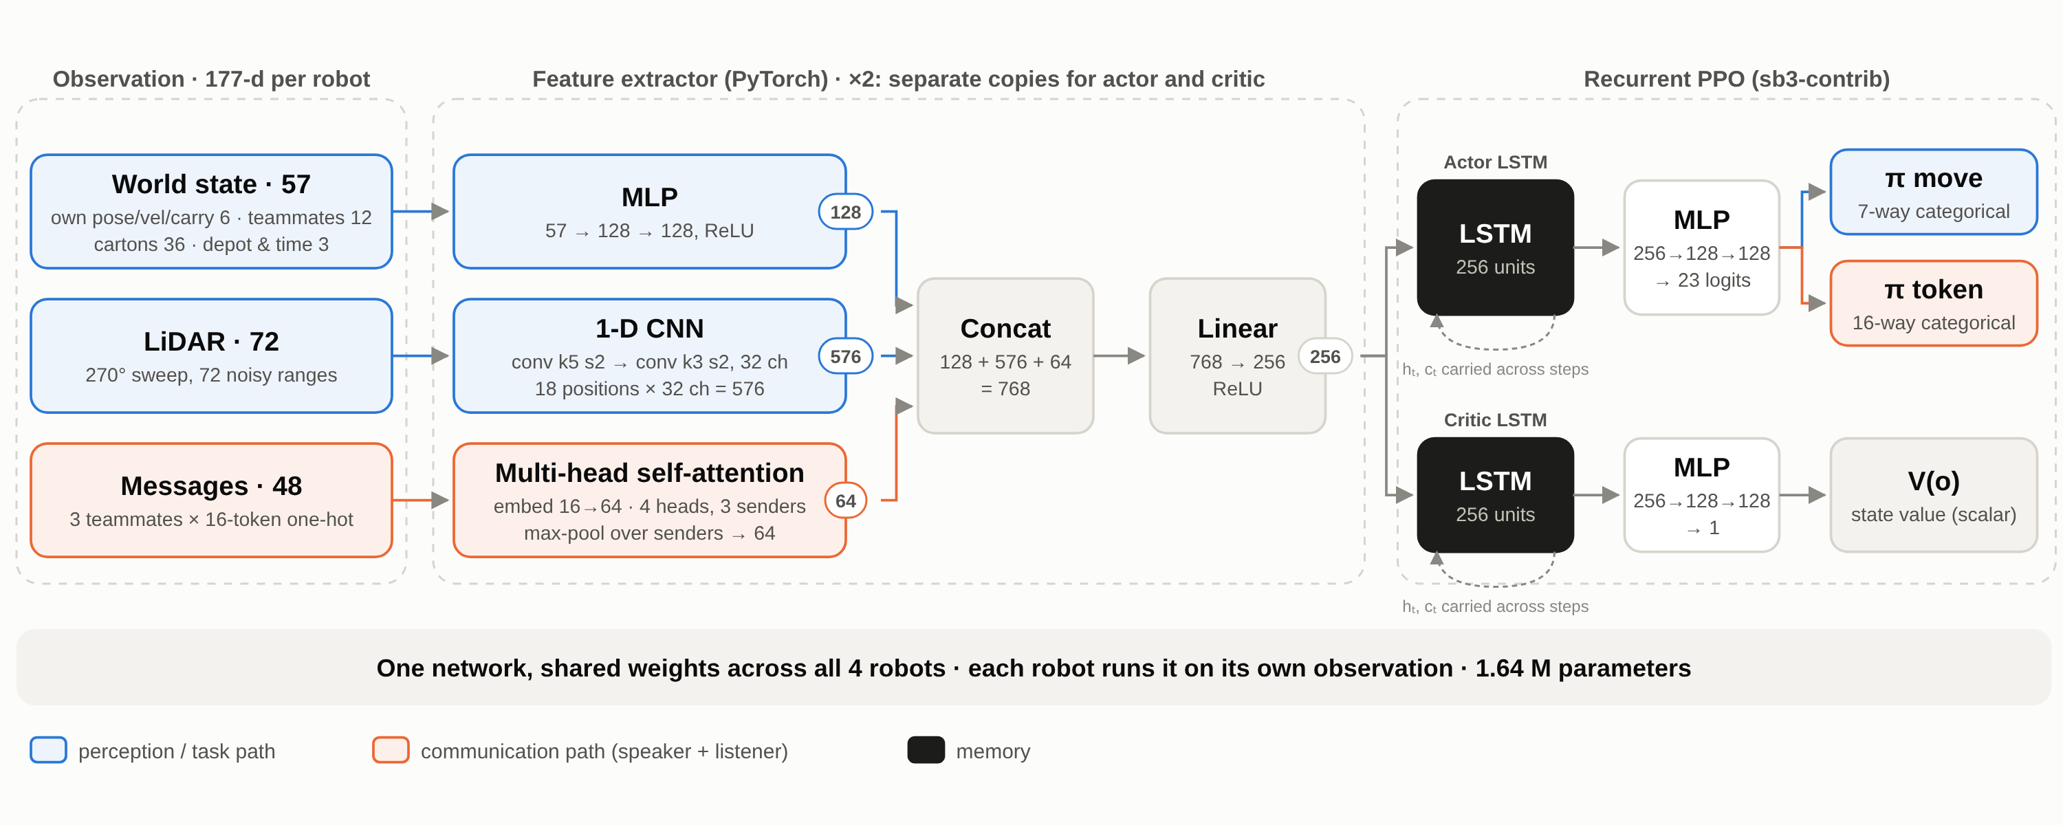
Network: Recurrent PPO with a three-branch extractor
Dimensions verified against the trained weights. Actor and critic each have their own extractor and LSTM; one set of weights drives all 4 robots.

Slide 9
Emergent communication and the ablation
Speaker: a 16-way token head; π(move, token | o) = π(move | o) · π(token | o)
Listener: embed 16→64 per sender, 4-head self-attention over 3 senders, max-pool → 64
Timing: tokens sent at step t reach teammates' observations for step t + 1
Emergent: no meaning or reward is given to tokens; any protocol must come from the team reward
 | No comm | Comm
Tokens produced | yes | yes
Tokens delivered | no (slots held at 0) | yes
Network · action space | same | same
Reward · curriculum | same | same
Hyperparameters · seed | same | same
One variable changed: whether messages reach teammates.

Slide 10
Training pipeline
Hyperparameter | Value
Algorithm | RecurrentPPO (sb3-contrib)
Parallel worlds | 8 processes → 32 agent slots
Rollout / mini-batch | 512 per slot (16,384) / 4,096
Epochs per update | 10
Learning rate | 3e-4, linear decay
γ / GAE λ | 0.999 / 0.95
Clip / entropy / value coef. | 0.2 / 0.02 / 0.5
Reward normalisation | VecNormalize
Curriculum: 1 → 2 → 4 → 8 → 12 cartons
Starting at 1 carton lets a random team finish episodes, so the critic sees the completion bonus. Promotion at 85% rolling success.
Parameter sharing
A custom SB3 VecEnv presents each 4-robot world as 4 slots of one shared policy. Physics is ~95% of the cost, so one process per world gives ~4.3× throughput.

Slide 11
Training: both arms learn the full task
Same step range for both runs. Comm reached the 12-carton stage at 2.16 M vs 2.56 M steps and finished shorter episodes (187 vs 208) at the same point. One run per arm.

Slide 12
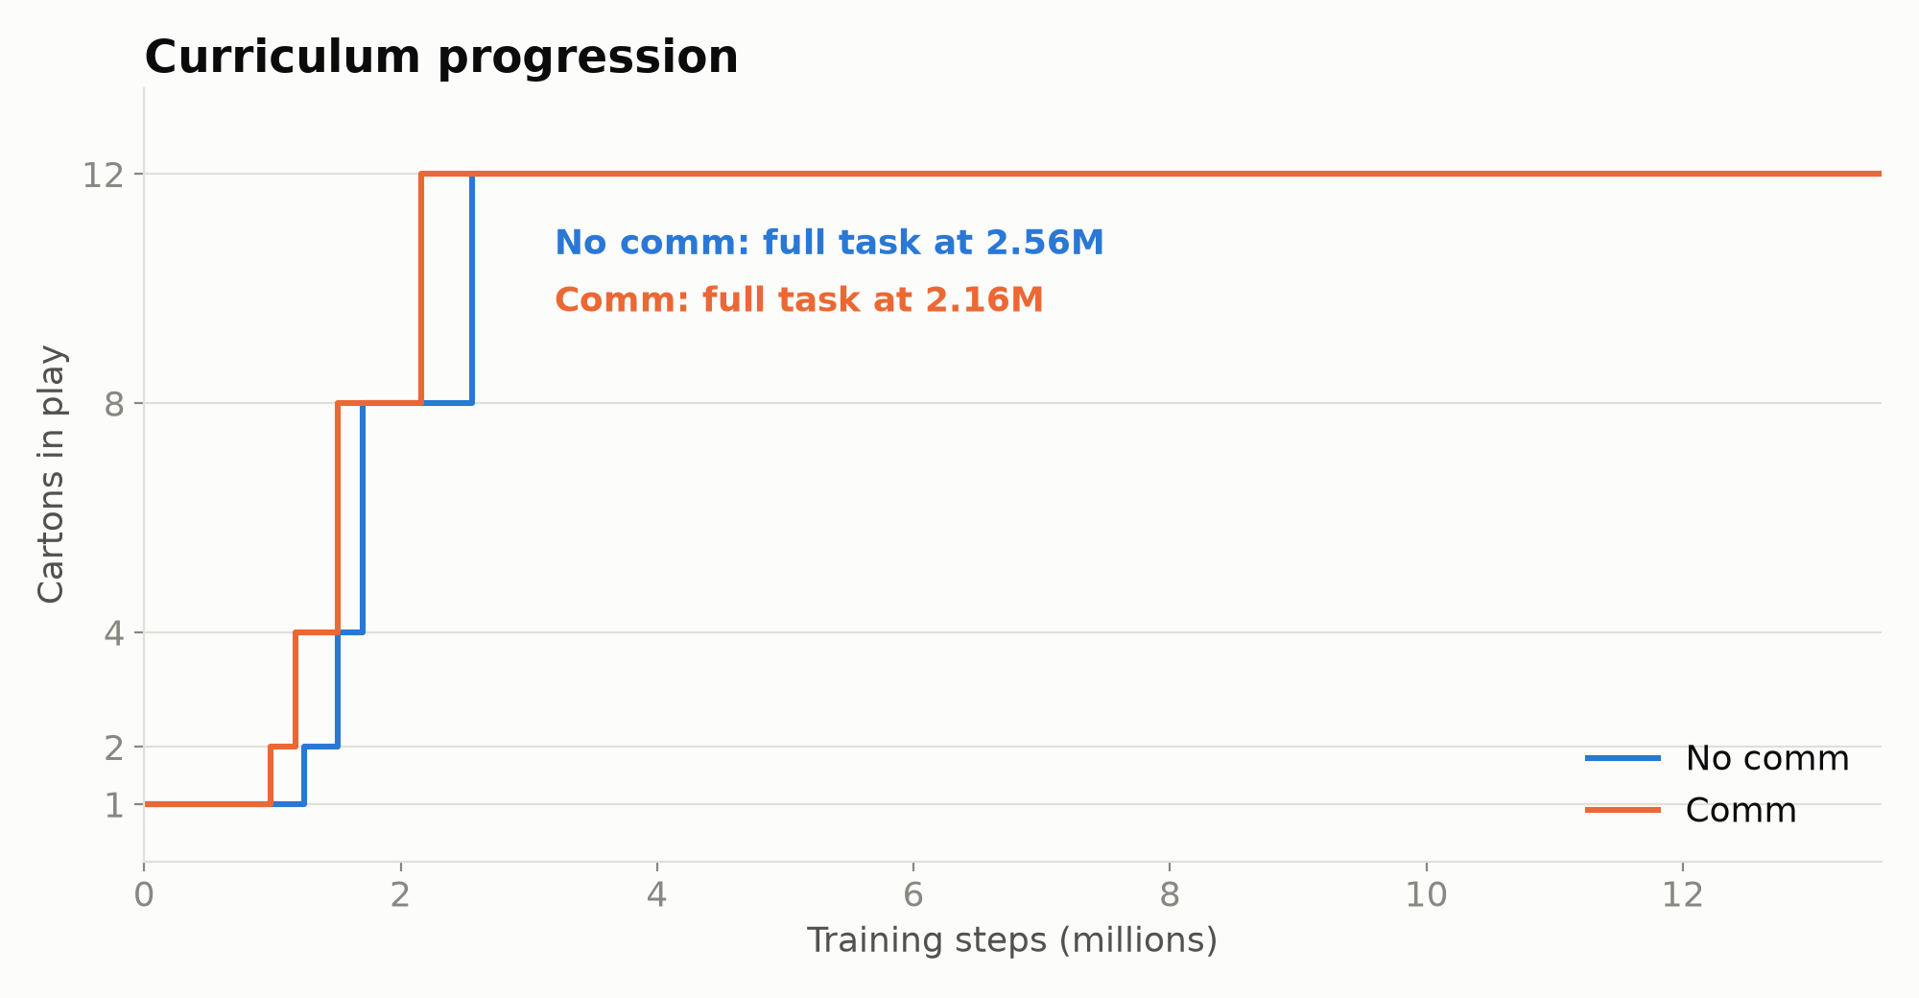
Optimisation: critic loss and curriculum
Value loss falls ~3 orders of magnitude; explained variance → 0.999 in both arms
Total and clipped-surrogate losses drop in the first ~2–3 M steps, then plateau

Slide 13
Evaluation: 100 headless episodes per setting
100%
100%
no comm · 12-carton success
comm · 12-carton success
Deterministic policy, identical warehouse layouts (fixed seeds) for every model
Both arms solve the full task every time
Smaller tasks are weaker for both: the policies specialise on 12 cartons, and step caps are tighter

Slide 14
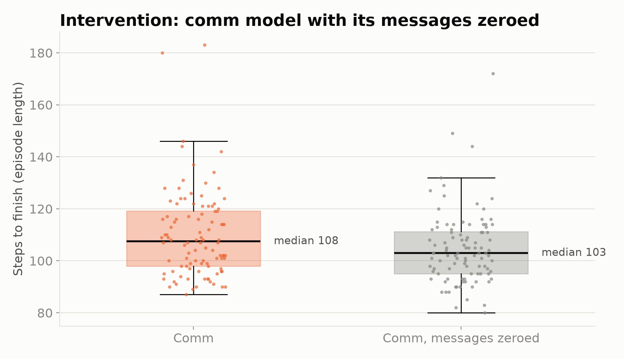
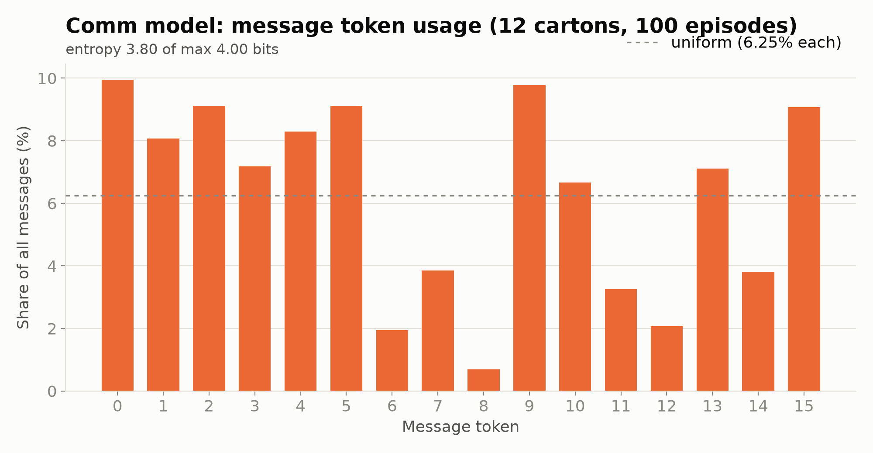
Did communication emerge?
Intervention: zeroing the comm model's incoming messages keeps 100% success with no slowdown (median 103 vs 108 steps)
Token statistics: entropy 3.80 of 4 bits (near uniform); I(token; carrying) = 0.013 bits
Conclusion: the channel is open, but the policy does not rely on it

Slide 15
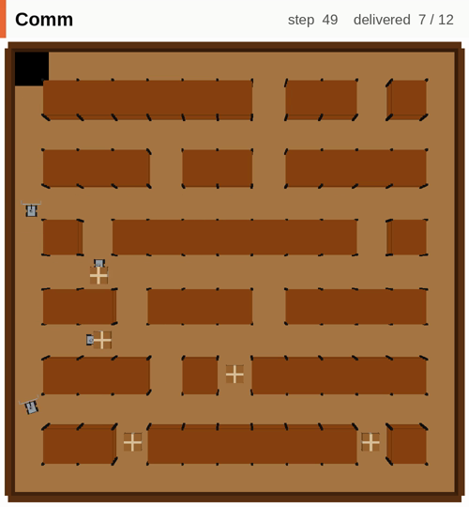
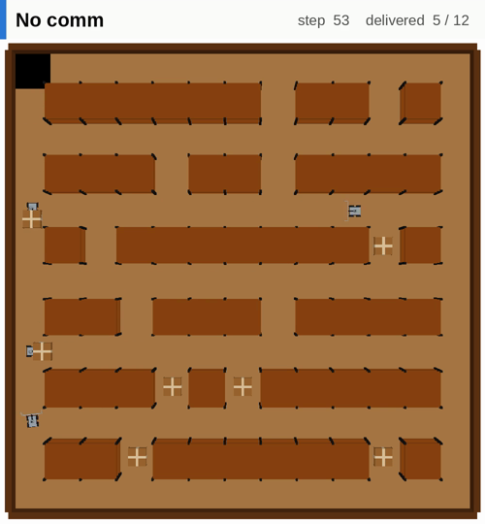
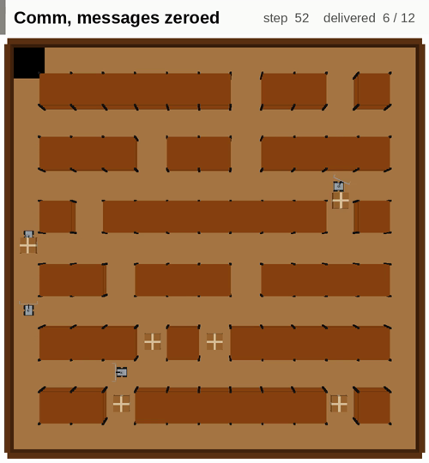
Demo videos (same warehouse, seed 1069)
Comm · 109 steps
No comm · 129 steps
Comm, messages zeroed · 108 steps
Recorded top-down with scripts/record_demo.py; each shows a full 12-carton episode.

Slide 16
Engineering challenges and fixes
Symptom | Root cause | Fix
Robots learned to stand still | Sparse reward; moving risked collisions before any payoff | Potential-based shaping (κ = 30)
Pick-ups scored negative reward | Distance potential jumped at hand-off | 0.5 hand-off + cartons-left terms in Φ
~94 shelf collisions per episode | Shelves enterable, only charged | Shelf cells blocked; −0.5 invalid action
Completion bonus never seen | Random team never finishes 4+ cartons | Curriculum from 1 carton
Terminal reward invisible | 2,000-step episodes: 0.99²⁰⁰⁰ ≈ 2·10⁻⁹ | Caps sized to task; γ = 0.999
LiDAR saw through shelves | Chassis sank under gravity | Height snapped; beam fixed at 0.17 m
Training used one core | Worlds stepped sequentially | One process per world (~4.3×)
Comm vs no comm not comparable | Adding inputs later changes the network | Message slots + token head reserved from day one

Slide 17
Limitations and next steps
Limitations
Next steps
Grid motion with kinematic interpolation, not torque control.
Teammate poses and carton positions are observed, so messages have little new to add.
Decentralised critic; one training run per arm.
Hide teammates and cartons beyond sensor range so messages must carry information.
Communication incentives: positive listening / signalling, mutual-information bonus.
Centralised MAPPO critic, multiple seeds, randomised task size.
Continuous control, then Sim2Real via ROS 2.

Slide 18
Repository, documentation and resources
final-product/: codebase, models, logs, graphs, demo videos
  README.md: setup, how to run, structure, limitations
  docs/walkthrough.md: complete technical reference
  docs/diagrams/: system → environment step → network
resource-guide/: RL, PPO, MARL, reward shaping, emergent communication, PyBullet and SB3 references
learning/iteration-phase/: archived earlier approaches, models and documents
Stack
Simulation | PyBullet · URDF
Environment API | Gymnasium
Learning | PyTorch · SB3 · sb3-contrib
Monitoring | TensorBoard
Analysis | NumPy · Matplotlib

Slide 19
Thank you
Questions?

