Slide 1


 | ZEAL EDUCATION SOCIETY’S ZEAL COLLEGE OF ENGINEERING AND RESEARCH NARHE │PUNE -41 │ INDIA COMPUTER ENGINEERING DEPARTMENT
Academic Year: 2022-2023 Semester: II
A Seminar Presentation On
“ VOICE ASSISTANT WITH ADDITIONAL FEATURES“
Group No : 20
Guided By: Prof. Arunadevi S. Khaple
Sr. No. | Name | Roll No.
1 | Sanika V. Koparde | S212021
2 | Pratik S. Kor | S212022
3 | Rahul S. Kortikar | S212023
4 | Vanshika R. Kubde | S212024
5 | Soham K. Kudale | S212025

Slide 2
Content
Abstract
Introduction
Objective
Problem Statement
Literature Review
Motivation
Architecture/Model
Methodology
Conclusion
References

Slide 3
ABSTRACT
Today technological advances are growing day by day. Previously there was a computer system where we could do only a few tasks. But now machine learning, artificial intelligence and a few more technologies have made computer systems so advanced that we can do any kind of work. Here we will explore Voice Assistant which based on new technologies.
The Voice Assistant is based on Artificial Intelligence. The program is developed by using Python programming language. Libraries like Pyttsx3, speech recognition, pywhatkit, wolfram alpha, wikipedia, mediapipe etc. are used.
Apart from that we have added a game called ‘Flappy Bird’ & ‘Virtual Mouse using openCV2’.
Project is based on OOP (Object Oriented Programming) concepts. It include abstraction, encapsulation & Inheritance.

Slide 4
INTRODUCTION
The voice assistant is an AI (Artificial Intelligence) based device, developed with the help of Python(3.10) programming language.
Voice Assistant is transforming the way we interact with technology.
It offers a more natural user experience through voice commands.
Apart from AI voice assistant we are providing Virtual Mouse as a additional feature.
The Virtual Mouse has potential to revolutionize the way we interact with technology and our daily lives.
This presentation will explore the AI Voice Assistant with its Additional Features.

Slide 5
OBJECTIVE
The objective of AI virtual assistants is to replace secretaries and personal assistants. Those who perform tasks such as reading text and dictation, finding phone numbers and making calls, emailing schedules and meeting reminders, etc.
It brings AI and Machine Learning together to recognize our voice and do what we ask for it.
The virtual mouse system's main objective is to replace the physical mouse with hand gestures for cursor control. The described system may be implemented via a webcam or built-in camera that identifies hand movements and hand tips and analyses these frames to perform specific mouse activities.
With the use of hand gestures instead of using Mouse we can reduce the use of hardware.

Slide 6
PROBLEM STATEMENT
AI Virtual Assistants are designed to aid the tasks of users in Windows, Android and iOS platforms. But to our surprise, there’s no such complete virtual assistant available for Core Windows platform consisting of 70% of the users. So, this is actually a major problem for users where there could be internet instability, server problems and places where internet is not accessible.
The proposed AI virtual mouse system can be used to overcome problems in the real world such as situations where there is no space to use a physical mouse and also for the persons who have problems in their hands and are not able to control a physical mouse.

Slide 7
LITERATURE REVIEW
Sr. No. | Title | Author | Findings
1. | Design and Development of Intelligent Voice Personal Assistant using Python | 1. Vadaboyina Appalaraju Department of Electronics & Computer Engineering, Visakhapatnam, AP, India. 2. V. Rajesh Department of Electronics & Computer Engineering, Visakhapatnam, AP, India. 3. K. Saikumar Department of Electronics & Computer Engineering, Visakhapatnam, AP, India. 4. K. Ravi Kiran Department of Electronics & Computer Engineering, Visakhapatnam, AP, India. | This Document gives clear idea about future of Artificial Intelligence also it helps to implement Voice Assistant using Python programming language. We add up Virtual Mouse using openCV (Image Processing) as an additional feature in our Project.

Slide 8
MOTIVATION
Primary motivations for using AI voice assistant are as follows:
- Life efficiency and information motives determine attitudes
- Behavioral intention.
- Only social interaction motive determines social attraction and
perceived-as- friend.
- Only life efficiency motive determines perceived-as-assistant.
For the virtual mouse, motivation was to create an object tracking application to interact with the computer and develop a virtual human computer interaction device. Webcam is a necessary component for detecting the image. Sensitivity of mouse is directly proportional to resolution of camera

Slide 9
Basic Architecture of AI Voice Assistant
Architecture/ model

Slide 10
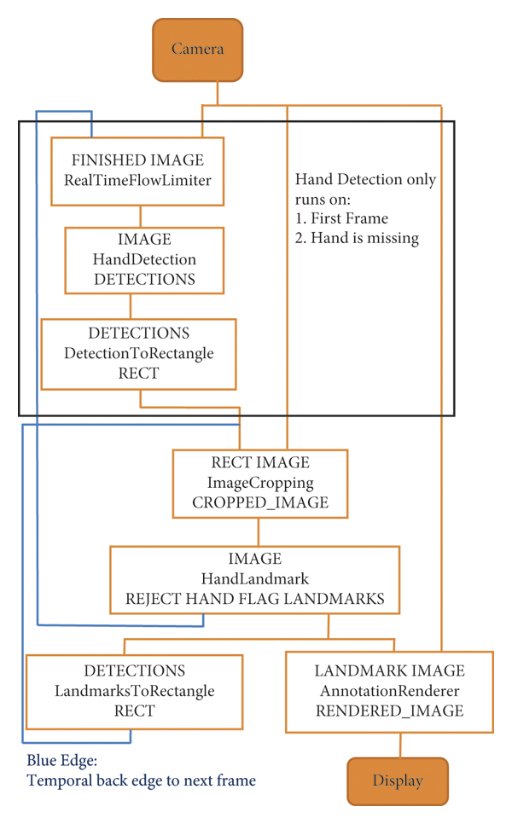
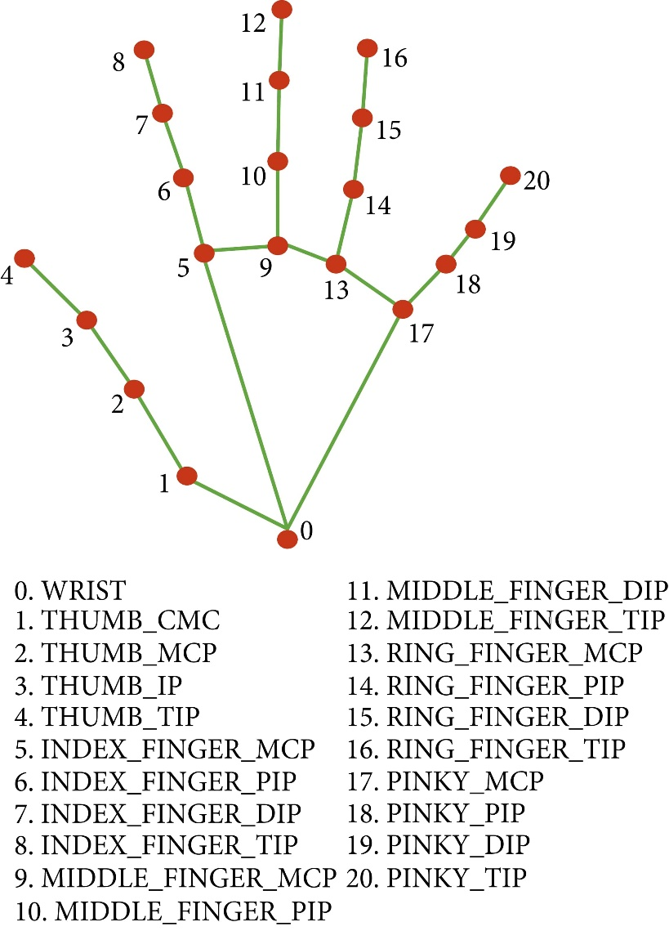
Basic Architecture of Virtual Mouse

Slide 11
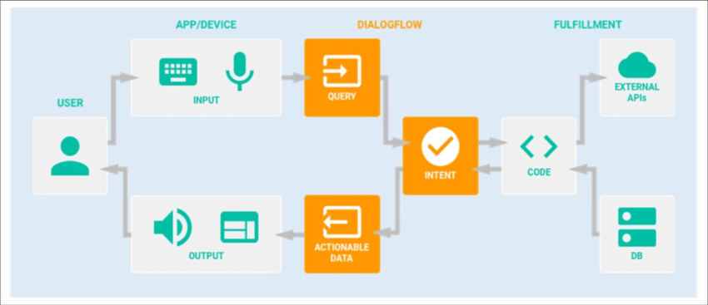
METHODOLOGY
Data Flow Diagram :-

Slide 12
Applications of AI Voice Assistant
AI voice assistants are used in many applications such as voice search, speech to text, voice commands to smart home devices, customer service, pre-sales, and voice biometrics for security. Voice assistants are easy to use and thus there are millions of devices that incorporate them in households nowadays. After upgradation,
Major Applications:
(i) Queries from the Web
(ii) Accessing Youtube Video
(iii) Weather Report
(iv) Dictionary Meaning
(v) Set Reminders
(vi) Send e-mails

Slide 13
Applications of Virtual Mouse
The AI virtual mouse system is useful for many applications; it can be used to reduce the space for using the physical mouse, and it can be used in situations where we cannot use the physical mouse. The system eliminates the usage of devices, and it improves the human-computer interaction.
Major applications:
(i) The system can be used to control robots and automation systems without the usage of devices
(ii) 2D and 3D images can be drawn using the AI virtual system using the hand gestures
(iii) AI virtual mouse can be used to play virtual reality- and augmented reality-based games without the wireless or wired mouse devices
(iv) Persons with problems in their hands can use this system to control the mouse functions in the computer
(v) In the field of robotics, the proposed system like HCI can be used for controlling robots
(vi) In designing and architecture, the proposed system can be used for designing virtually for prototyping

Slide 14
conclusion
Voice assistants do use voice recognition to convert user’s speech to audio and then back to speech again. However, it is the use of AI and more specifically machine learning that enables voice assistants to become smarter, function extremely accurately.
The main objective of the AI virtual mouse system is to control the mouse cursor functions by using the hand gestures instead of using a physical mouse. The proposed system can be achieved by using a webcam or a built-in camera which detects the hand gestures and hand tip and processes these frames to perform the particular mouse functions.
From the results of the model, we can come to a conclusion that the proposed AI virtual mouse system has performed very well and has a greater accuracy

Slide 15
References
AI Virtual Assistants for 2021Views.
https://theceoviews.com/ai-virtual-assistants-for-2021/
AI Assistant with Wolfram Alpha and Wikipedia in Python
https://medium.com/@salisuwy/build-an-ai-assistant-with-wolfram-alpha-and-wikipedia-in-python-d9bc8ac838fe
AI Virtual Mouse Using Hand Gesture Recognition - IJRASET.
https://www.ijraset.com/research-paper/ai-virtual-mouse-using-hand-gesture-recognition
Virtual Mouse using Hand Gestures | IEEE Conference Publication
https://ieeexplore.ieee.org/document/9673251/

