Slide 1
INTERACTIVE DIGITAL PORTFOLIO
CAPSTONE PROJECT
Presented By:
Soham Yashwant Surve
College Name: Loknete Shamrao Peje Government College of Engineering, Ratnagiri
Department: Artificial Intelligence and Data Science

Slide 2
OUTLINE
Problem Statement
System Development Approach
Algorithm & Deployment (Step by Step Procedure)
Result
Conclusion
Future Scope
References

Slide 3
PROBLEM STATEMENT
Many developers find it difficult to showcase their skills, achievements, and projects effectively.
Traditional resumes are static and fail to reflect creativity or technical proficiency.
There is a need for an interactive, visually appealing, and easily customizable digital portfolio.
The platform should allow smooth navigation through sections like About, Skills, Projects, and Contact with engaging animations and transitions.

Slide 4
SYSTEM APPROACH
Frontend Technologies:
HTML5: Defines the structure and layout of the webpage.
CSS3: Provides styling, color themes, and ensures responsive layouts for different screen sizes.
JavaScript: Adds dynamic interactivity such as animations, transitions, and interactive elements for a better user experience.
Design Approach:
Clean and User-Friendly Interface: Focused on simplicity, readability, and smooth navigation.
Mobile-Responsive Design: Optimized for accessibility and usability across all devices.
Modular File Structure: Clear separation of HTML, CSS, and JavaScript files for maintainability and scalability.

Slide 5
ALGORITHM & DEPLOYMENT
Portfolio Creation
Define sections and content (About, Skills, Projects, Contact, Resume link).
Add images, icons, and personal branding elements.
Include brief descriptions for each project and skill.
Frontend Design
Layout using HTML and CSS with flexbox and grid for responsive design.
Cards and section-based layout for projects and skills.
Smooth animations and transitions for interactive visual appeal.
Interactive Features
Navigation bar with smooth scrolling between sections.
Hover effects on project cards and skill icons. And Contact form for direct messages.
Testing
Cross-browser compatibility (Chrome, Firefox, Safari). And Mobile responsiveness for tablets and smartphones.
Accessibility checks for visual and interactive elements.
Deployment
Hosted on Vercel for free and easy access.
Fast loading and seamless user experience.

Slide 6
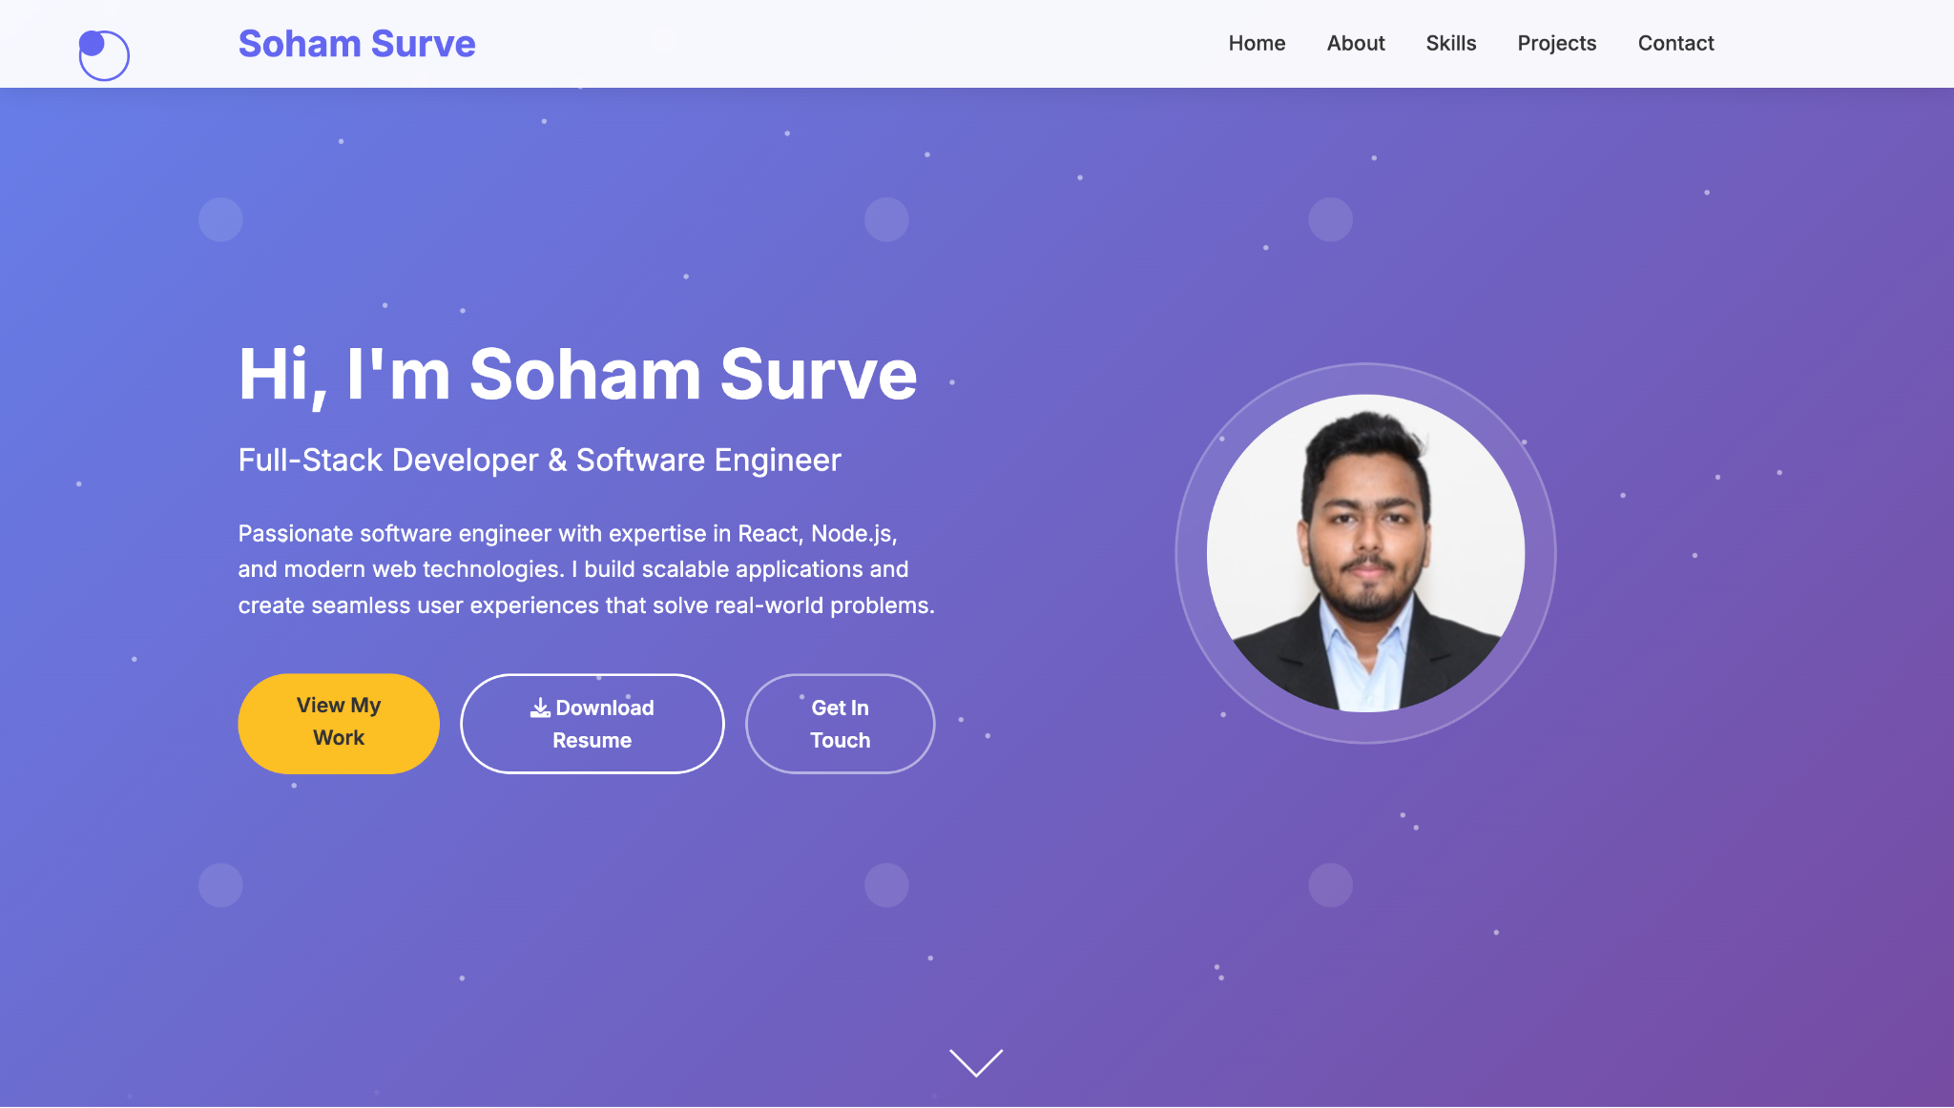
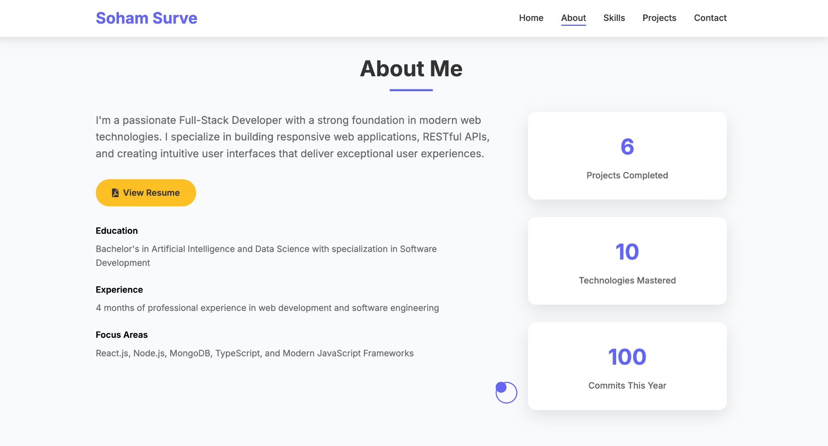
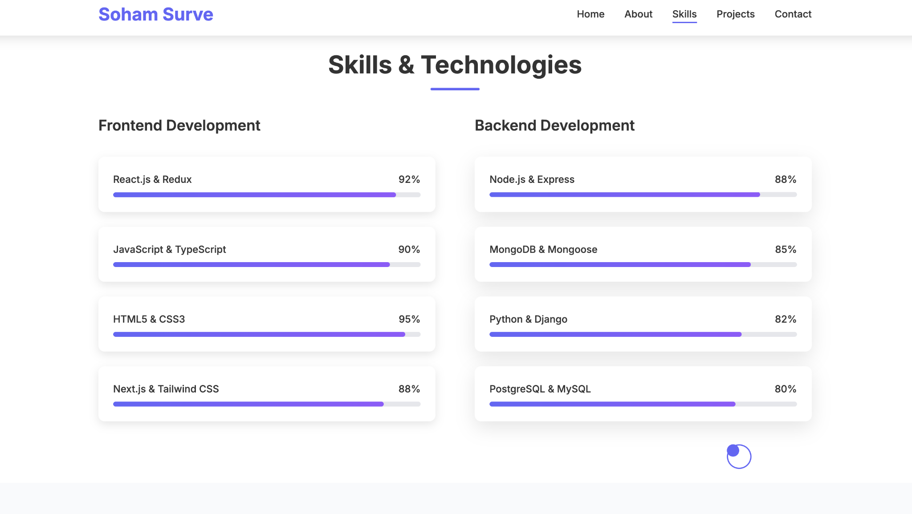
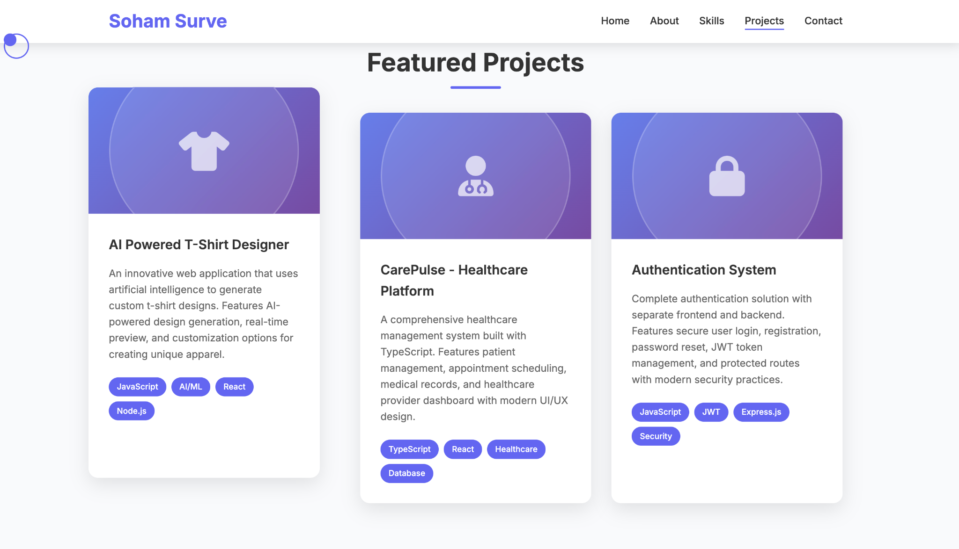
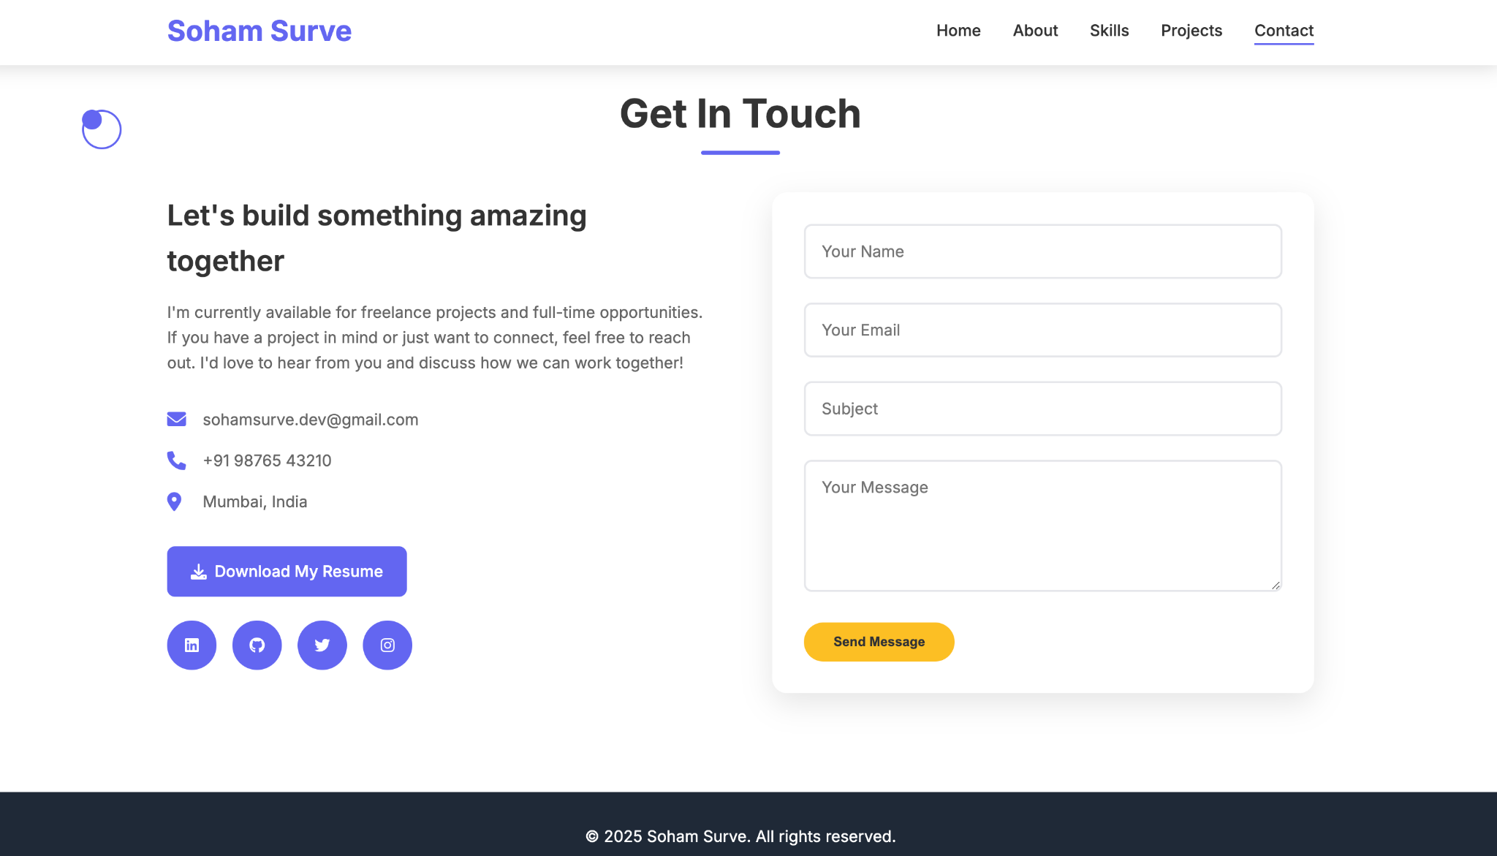
RESULT

Slide 7
GITHUB AND DEPLOYMENT LINK
Attach your Github Link : https://github.com/Sohamsurve/Soham_Portfolio/
Deployment link: https://soham-portfolio-six.vercel.app/

Slide 8
CONCLUSION
Created an interactive and visually appealing digital portfolio to showcase skills and projects.
Implemented responsive design with smooth animations for enhanced user experience.
Integrated modals, hover effects, and a contact form for interactivity.
Successfully deployed on Vercel for easy access and seamless navigation.

Slide 9
FUTURE SCOPE
Dynamic Content Management: Allow adding/updating projects and skills via a backend or CMS.
User Analytics: Track visitor interactions and project views for insights.
Personal Branding Enhancements: Integrate blog or testimonial sections to showcase thought leadership.
Advanced Interactivity: Add animations, dark/light mode toggle, and AI-powered recommendations for projects.
Multi-language Support: Make the portfolio accessible to a wider audience.

Slide 10
REFERENCES
NanthiniMoha/TNSDC-FWD-DIGITAL_PORTFOLIO
Get started with Bootstrap · Bootstrap v5.3

Slide 11
THANK YOU

