Slide 1
Improving Instruction-Following in Small Language Models Using LoRA-Based Parameter Efficient Fine-Tuning
~*~
Soham Banerjee (Senior Analyst, Accenture)
sohambanerjee2k@gmail.com RAFET 2026

Slide 2
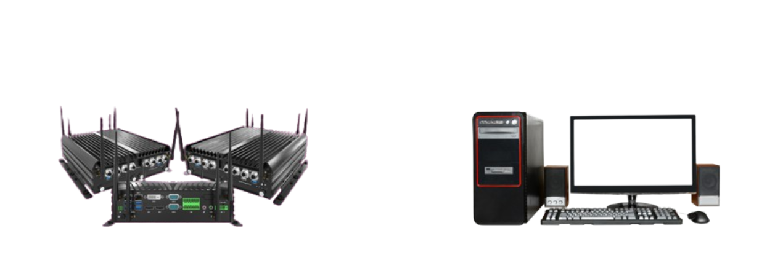
Motivation
Large Language Models require high computational resources
Full fine-tuning of LLMs is expensive and impractical
We need lightweight customisation methods
Goal: Enable local experimentation with limited hardware
vs

Slide 3
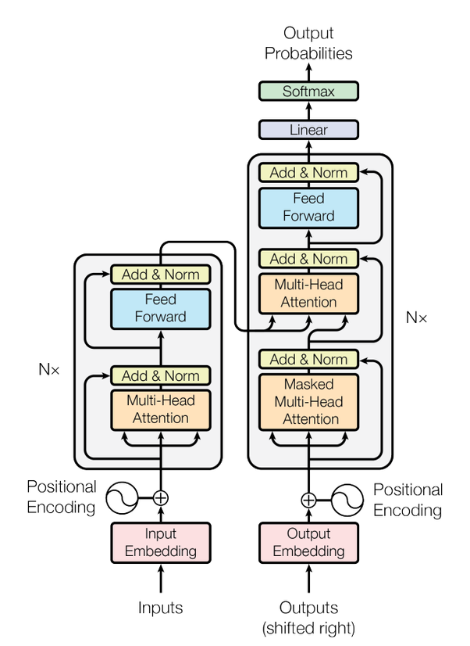
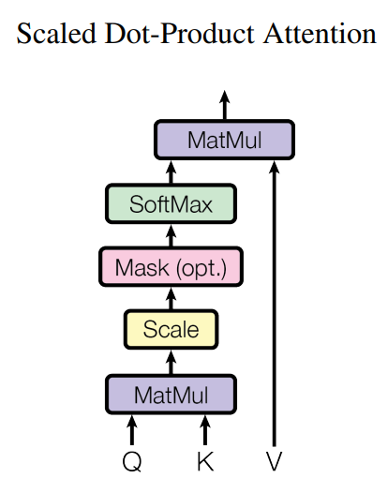
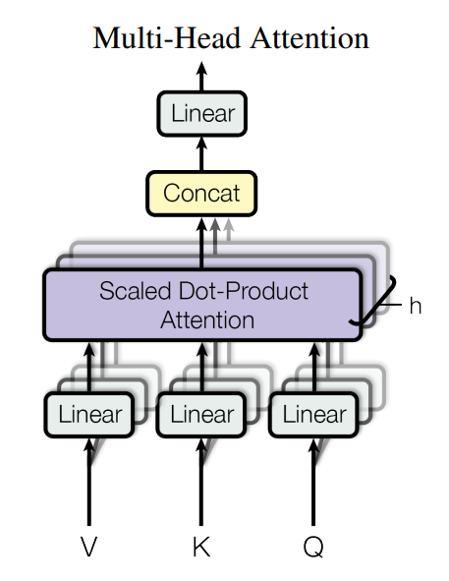
Background

Slide 4
Objective
Build lightweight local fine-tuning pipeline
Test behavioural adaptation
Use minimal datasets
Evaluate practicality

Slide 5
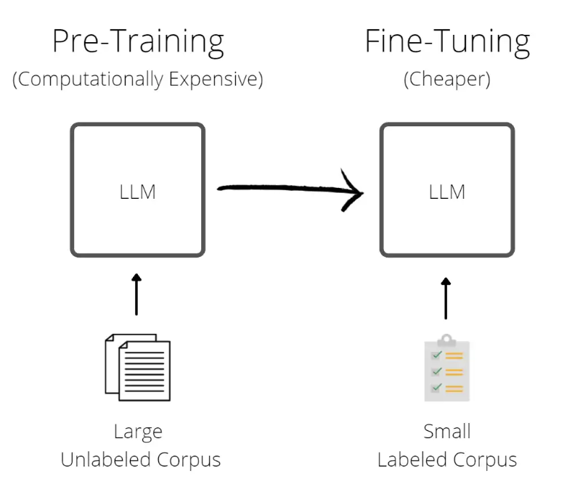
Methodology
Small pretrained model
Instruction dataset
LoRA adapters
Local execution

Slide 6
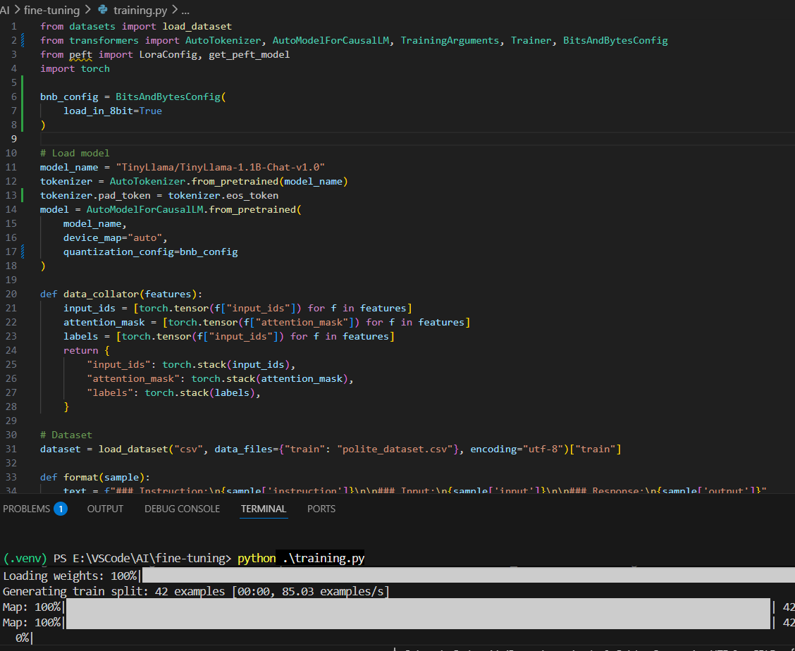
Implementation
Tools Used:
PyTorch
Hugging Face Transformers
PEFT (LoRA)
Local Training Environment

Slide 7
Dataset Design
instruction | input | output
Rewrite the sentence politely | shut up | please be quiet for a moment
Rewrite the sentence politely | give me that book | may I kindly request that book
Rewrite the sentence politely | your idea is wrong | I respectfully disagree with your idea
Rewrite the sentence politely | move out of my way | could you please let me pass
Rewrite the sentence politely | that's a stupid question | I'm not sure I understand your question fully
Rewrite the sentence politely | stop bothering me | I would appreciate some space right now
Rewrite the sentence politely | hurry up | could you please speed things along

Slide 8
Results
 | Before Fine-Tuning | After Fine-Tuning
Input | That’s a horrible idea | That’s a horrible idea
Output | That’s a bad idea | I have some reservations about that idea
 | Before Fine-Tuning | After Fine-Tuning
Input | stop being so negative | stop being so negative
Output | You’re so negative | I would appreciate a more positive outlook
 | Before Fine-Tuning | After Fine-Tuning
Input | Leave now | Leave now
Output | Get out | I'm gonna have to ask you to leave

Slide 9
Discussions & Insights
Processor | AMD Ryzen 5 5600H with Radeon Graphics, 3.30 GHz
Installed RAM | 16 GB
Storage | 500 GB SSD, 1 TB HDD
Graphics Card | NVIDIA GeForce GTX 1650 (4 GB), AMD Radeon(TM) Graphics (500 MB)
System Type | 64-bit operating system, x64-based processor
Key Takeaways:
Low compute requirement
Fast experimentation
Accessible AI customisation
Suitable for local deployment
My PC Specs

Slide 10
Future Work
Snarky tone dataset
Medieval dialogue dataset
Quantitative evaluation metrics
Web demo (Gradio/Streamlit)

Slide 11


Slide 12
References & Bibliography
GitHub Page: https://github.com/SohamtheCodesmith/fine-tuning
LoRA: https://arxiv.org/abs/2106.09685
Attention is All You Need: https://arxiv.org/pdf/1706.03762
Understanding Transformers and LLM Architecture: https://blog.mlq.ai/llm-transformer-architecture/

