Slide 1
Introduction:
Static, This and Super are the Keywords that are fundamental to Java's object-oriented
programming paradigm and help you work with objects and classes effectively.
this is used to refer to the current instance.
super is used to reference the superclass.
static is used to create class-level members that are not tied to instances.

Slide 2
Static Keyword:
Normally, a class member must be accessed only in conjunction with an object of its class.
It is possible to create a member that can be used by itself, without reference to a specific instance.
When you want to define a class member that will be used independently of any object of that class. Declare with the keyword static.
The static keyword belongs to the class than an instance of the class.
The static keyword in Java is used for memory management mainly.
Static Variable
Static Method
Static Block
Nested static classes

Slide 3
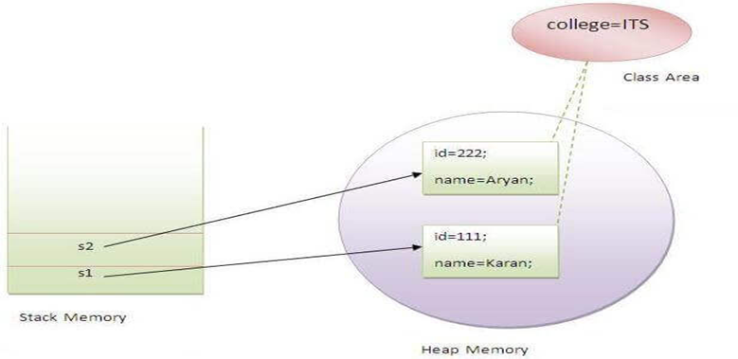
Static variable:
Static variable can be used to refer to the common property of all objects, which is not
unique for each object
example: the company name of employees, college name of students.
Static variable gets memory only once in the class area at the time of class loading.
class Student{
int rollno ; String name; ;//instance variables
static String college =“ITS”;//static variable
Student(int r, String n){ rollno = r; name = n; } //constructor
void display () { System.out.println(rollno+" "+name+" "+college);} }
//Main method
Student s1 = new Student(111,"Karan");
Student s2 = new Student(222,"Aryan");
s1.display();
s2.display();

Slide 4
Static Method:
A static method belongs to the class rather than the object of a class.
A static method can be invoked without the need for creating an instance of a class.
A static method can access static data member and can change the value of it.
There are two main restrictions for the static method. They are:
The static method can not use non static data member or call non-static method directly.
this and super cannot be used in static context.
public class StaticMethodExample {
Int value=5;
public static int square(int number) { return number * number; }
public static void main(String[] args) {
int result = StaticMethodExample.square(5); //Calling static method with className without creating instance
System.out.println("The square of 5 is: " + result); // 25
StaticMethodExample obj= new StaticMethodExample(); //creating instance to get non-static variable
System.out.println("The Value of obj is: " + obj.value); //5
} }

Slide 5
Static Block And Nested Static Classes :
Is used to initialize the static data member.
It is executed before the main method at the time of class loading.
class A2{
Static { System.out.println("static block is invoked"); }
public static void main(String args[]){
System.out.println("Hello main"); //o/p: Static block is invoked
} } Hello Main
A static nested class is a nested class that is marked as static. It does not have access to the instance-specific data of the outer class.
You can create instances of a static nested class without needing an instance of the outer class.
Static nested classes are often used for encapsulation and organization of related functionality.
class OuterClass {
static class NestedStaticClass {
// This is a static nested class
} }

Slide 6
This Keyword:
this keyword is used to refer to the current instance of a class. It is explicit reference the current object. Implicitly compiler adds this to data. It is commonly used in the following contexts:
With Variables:
this is used to differentiate between instance variables and method parameters or local variables when they have the same name.
It helps clarify which variable you are referring to.
public class MyClass {
private int value; // Instance variable
public void setValue(int value) {
this.value = value; // Use "this" to refer to the instance variable
} }
with Construtcors:
this can be used within a constructor to invoke another constructor of the same class (constructor chaining).
This is helpful when you have multiple constructors with different parameter lists, and you want to reuse code.

Slide 7
public class Person {
private String name; private int age;
public Person() {
this("Unknown"); // Calls another constructor with a default name }
public Person(String name) {
this.name = name;
this.age = 0;
}
}
With Methods:
this can be used to call other instance methods from within a method.
It is useful when you have multiple methods in a class, and you want to invoke one method from another.

Slide 8
public class Calculator {
private int result;
public Calculator() {
result = 5; }
public void add(int num) {
this.result += num;
this.display(); }
public void display() {
System.out.println(this.result) ; } //add(5)
}
this helps disambiguate the context and indicates that you are referring to an instance-level entity (variable, constructor, or method) rather than a local one.
This Keyword cannot be used in static context because, this refers to instances but static belongs to class itself
So, This Keyword resolves Naming Conflicts.

Slide 9
Super Keyword:
when a derived class and base class has the same data members. In that case, there is a possibility of ambiguity for the JVM . So super keyword is used to call superclass data members.
super keyword is a key feature of inheritance and polymorphism.
super can be used with Variables, Constructors, Methods.
Super Variables:
In a subclass, you can use the super keyword to access variables or fields from the superclass. This is
useful when you have a variable with the same name in both the superclass and the subclass.
Example:
class Animal {
String name = "Animal"; }
class Dog extends Animal {
String name = "Dog";
void printNames() {
System.out.println(super.name); // Accesses the name variable from the superclass
System.out.println(this.name); // Accesses the name variable from the subclass
} }

Slide 10
Super Constructor:
In a subclass constructor, you can use the super keyword to call a constructor from the superclass.
When calling a superclass constructor, the super() statement must be the first statement in the constructor of the subclass.
This is often used to initialize the superclass part of an object before initializing the subclass part.
class Animal {
String name;
Animal(String name) {
this.name = name;
} }
class Dog extends Animal {
String breed;
Dog(String name, String breed) {
super(name); // Call the constructor of the superclass
this.breed = breed;
} }

Slide 11
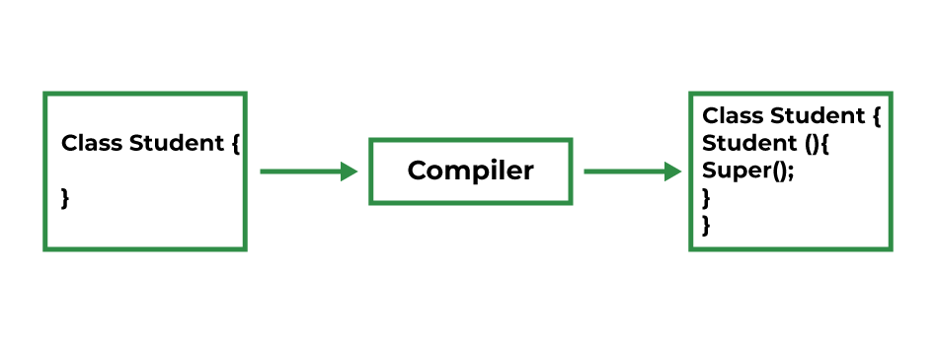
If a constructor does not explicitly invoke a superclass constructor, the Java compiler automatically
inserts a call to the no-argument constructor of the superclass.
With Methods:
You can use the super keyword to call methods from the superclass in the subclass. This is helpful when
you want to invoke the superclass's version of a method that has been overridden in the subclass.
class Animal {
void makeSound() {
System.out.println("Animal makes a sound"); } }
class Dog extends Animal {
void makeSound() {
System.out.println("Dog barks"); }
void animalSound() {
super.makeSound(); // Call the makeSound method of the superclass
} }

Slide 12
super cannot be used in a static context.
The superclass's method you want to call using super must be accessible from the subclass.
If the superclass method is private or has reduced visibility you won't be able to use super to call it from the subclass.
public class Superclass {
private void privateMethod() {
System.out.println("This is a private method in the superclass");
} }
public class Subclass extends Superclass {
public void attemptToCallPrivateMethod() {
super.privateMethod(); // This will result in a compilation error
} }
The super keyword in object-oriented programming languages is used to access or call elements from the superclass (parent class) of a derived (child) class.

Slide 13
Conclusion:
So, this keyword used to refer current class data members which removes ambiguity between global and local data.
Super keyword used to refer parent class over-ridden data members when it is inherited by any other classes. So super removes ambiguity.
Static keyword is used for memory efficiency.

