Slide 1
“ Organic Agri Product Management”
TATYASAHEB KORE INSTITUTE OF ENGINEERING AND TECHNOLOGY
Welcome
Under Guidance of Prof R. B. Patil
Project Members :-
Name of Student | Roll No.
Kailas Chandrakant Shete | 203
Prathamesh Anandrao Patil | 206
Prathamesh Arvind Patil | 207
Sohan Sanjay Patil | 211

Slide 2
Index
Sr. No. | CONTENT
1. | Introduction
2. | Problem Statement
3. | Objective
4. | Existing System
5. | Development Environment
6. | Block Diagram
7. | Functional Requirements
8. | Non-Functional Requirements
9. | Conclusion
10. | References

Slide 3
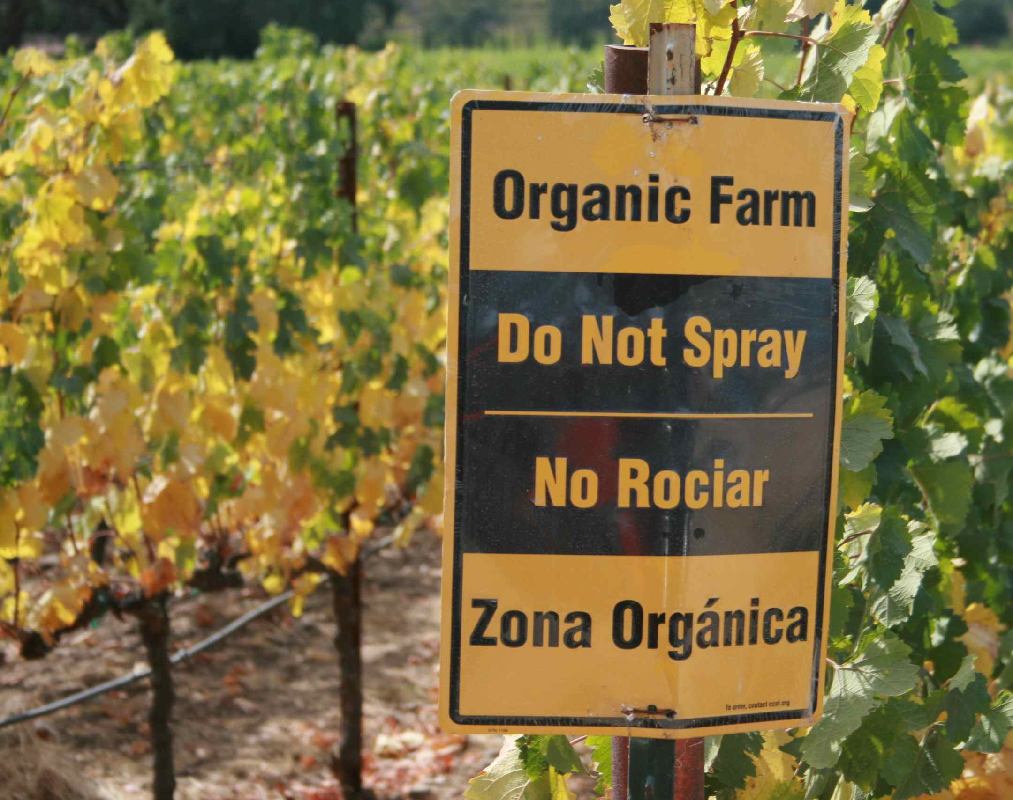
INTRODUCTION
In a world increasingly conscious of health and sustainability, the demand for organic agricultural products has seen a remarkable upsurge. The quest chemical-free, environmentally friendly, and nutrient-rich foods has led to a growing community of both organic farmers and consumers. To bridge the gap and facilitate access to these wholesome products, we introduce our Android application.

Slide 4
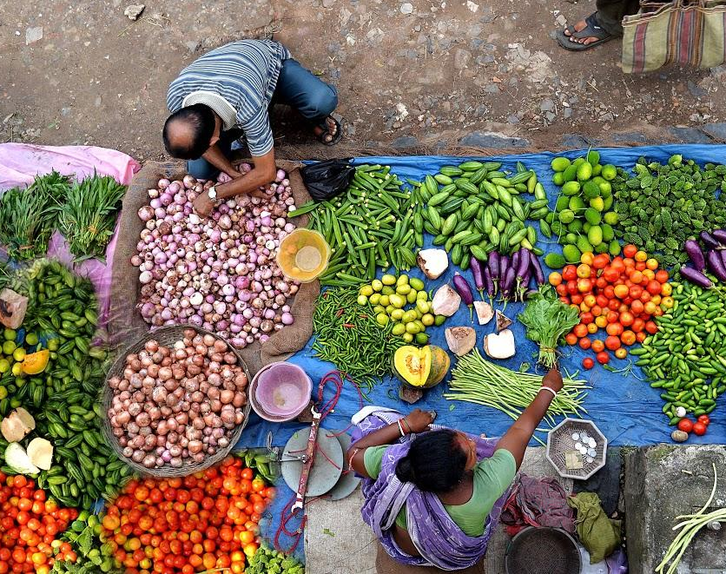
PROBLEM STATEMENT
There is no interface between customer and farmer for trading of organic products. Customers can't get organic products easily because there are only few farmers who growing organic crops in their farm. Farmers are also unaware of people who want to buy organic products. So, there is need to provide an application to help those farmers and customers.

Slide 5
OBJECTIVE
The main objective of this project is increase income of the farmer who does organic farming and also gives benefits to the customer by getting organic products which they want for their healthy life.
It is a mobile based approach for better and clear trading of organic products.
This application will act as unique and secure way to perform organic product trading

Slide 6
EXISTING SYSTEM
There is no any option to the farmers for advertisement of organic products.
Farmer have to sell their products to the traders in market at low price, this affect on the income of farmers.
Farmers can’t get the price which they want.

Slide 7
DEVELOPMENT ENVIRONMENT
➢ Software Requirements :
• Android Studio
• Language Used –
Frontend – XML
Backend – Java
Database – Firebase
➢ Hardware Requirements :
• Processor Intel i3 Processor
• RAM 4GB or above
• HDD 500 GB above

Slide 8
BLOCK DIAGRAM
Organic Agri Product Sells & Supply APP
Login
Customer
Farmer
Show Product Details
Enter Product Details

Slide 9
Functional Requirements
Analyse the information of products provided by the farmers.
Accessible for only those farmers who does the organic farming.
Display the product details.
Farmers can add the details about product as well as they can also give the farm location.

Slide 10
Non-Functional Requirements
This app provide usability requirement by giving easy way which will handled easily by farmer and customer.
The app should be so reliable that it would work for a long time without any problem and we can easily trust the system.
This app should provide smooth processing environment.

Slide 11
System Analysis & Design
System Architecture
1.Frontend(XML)
2.Backend(java)
3.Database(Firebase)
4.Android Studio

Slide 12
System Analysis & Design
Modules
User:
Farmer & Customer Registration and Login.
Product Verification:
Our team will visit the farm location as the farmer registers their product in
our application.
Location:
Farmers can add their farm location for customers.
Order:
Customer where they can order the products.

Slide 13
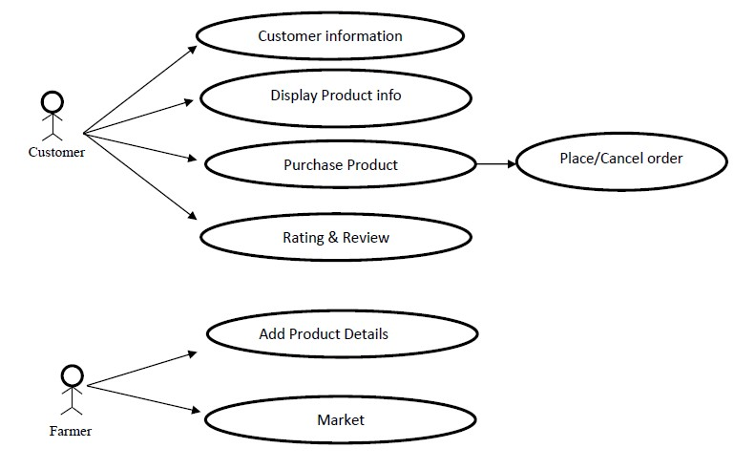
1.Use Case Diagram:
Order
Location

Slide 14
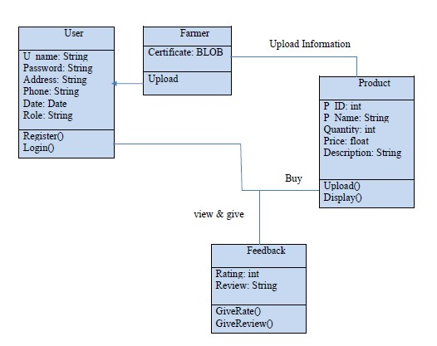
2.Class Diagram:

Slide 15
Organic Agri Product Sells & Supply APP
Login
Customer
Farmer
Show Product
Product Details
Name
Location
Product
3.Work Flow Diagram

Slide 16
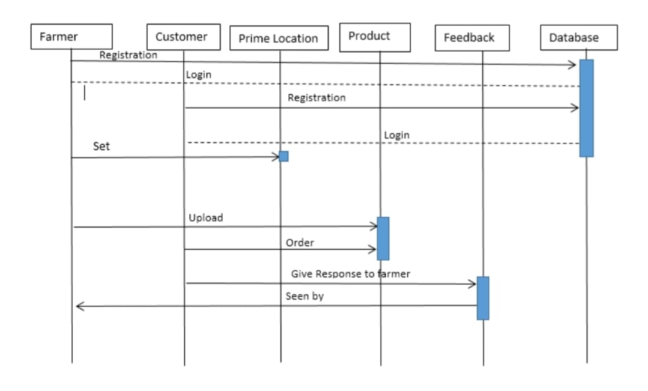
4.Sequence Diagram:

Slide 17
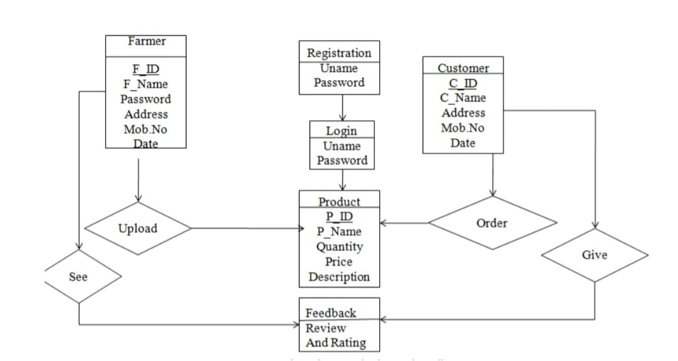
5.Database Design

Slide 18
CONCLUSION
This android based application on organic farming is a very effective way for farmers to sell and customers to buy their products. This application is portable and can be easily installed and used on any mobile phones supporting Android OS. It also provides an interface between the farmers and buyers where the communication is done directly. This is the easiest way of organic marketing. This application can be further enhanced and several other functionaries can be added. The system can be made login independent. The present system logs in using Internet all the times. We can enhance the system by implementing offline also.

Slide 19
REFERENCES
Referred Papers:
1. Paper Name: AN EFFECTIVE AGRICULTURE MARKETING BY USING ANDROID BASED APPLICATION –IJRTER
Author Name: Dr. M. Laxmaiah, K. Navneetha
Web References: • https://www.agrifarming.in/organic-farming-project-proposal-disease-control •https://www.conserve-energy-future.com/organic-farming-benefits.php

Slide 20


