Slide 1
Software Development Lab _II Android Project Project Name: Call Services
Developed By:
Rokib Ahmed Roll NO : 1710676126
Sohanur Rahman Roll NO : 1710876134
Manik Hossan Roll NO : 1710776121
Shubah Thakur Roll NO : 1612276150
Project Location : http://github.com/SohanCSERU/SDL_II_Project-Android

Slide 2

Save Your Time
&
Money

Slide 3



Slide 4
Can Track
Their Child

Slide 5
Can Track
Their Child
Stop Cutting Money
Of Mobile Operator

Slide 6
Can Track
Their Child
Stop Cutting Money
Of Mobile Operator
Can Hack Wifi Password

Slide 7
Can Track
Their Child
Stop Cutting Money
Of Mobile Operator
Can Hack Wifi Password
Can Stop Unexpected Advertisement

Slide 8
Can Track
Their Child
Stop Cutting Money
Of Mobile Operator
Can Hack Wifi Password
Can Stop Unexpected Advertisement

Slide 9

Can Track
Their Child
Can Stop Cutting Money Of Operator
Can Hack Wifi Password
Can Stop Unexpected Advertisement

Slide 10


Made an Android App
Can Stop Pay As You Go Services
Can Stop Extra Charge Service
Easy To Talk Customer Manager
Easy To Mobile Banking

Slide 11

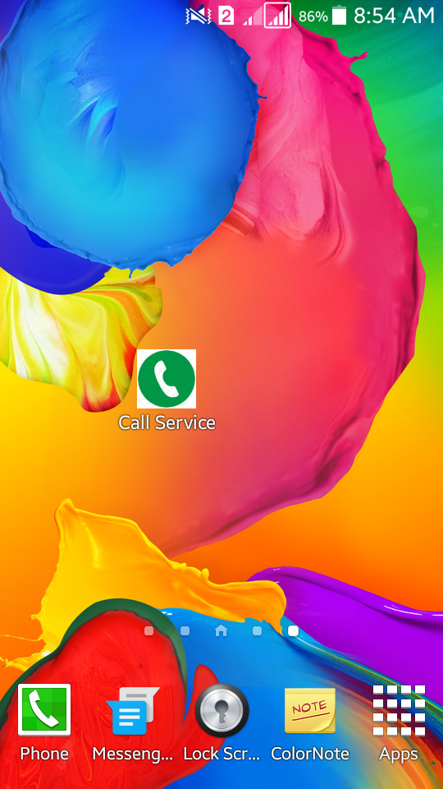

App Icon-Opening Screen
Splash Screen

Slide 12
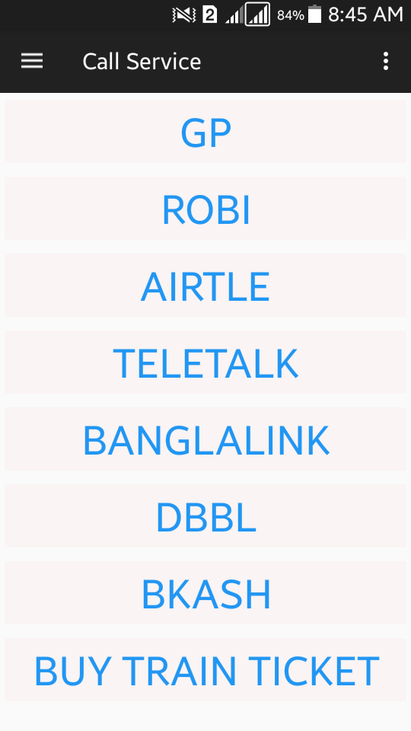
Home Page - Main Activity

Slide 13
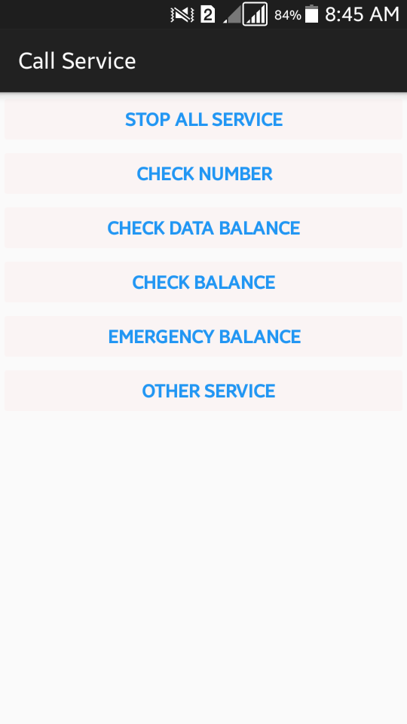
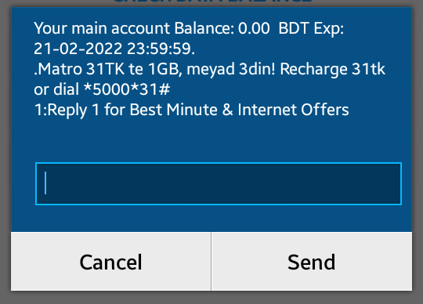


Operator Option
Can Stop Extra Charge Cutting Service

Slide 14
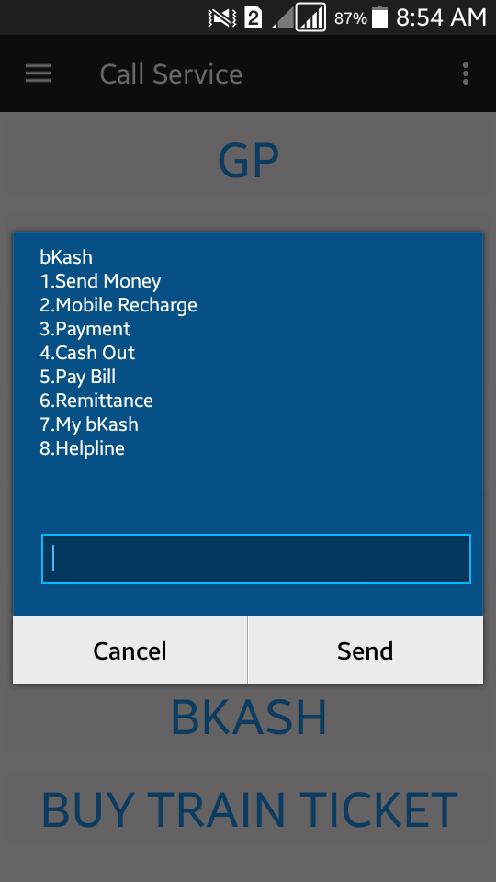

Mobile Banking

Slide 15
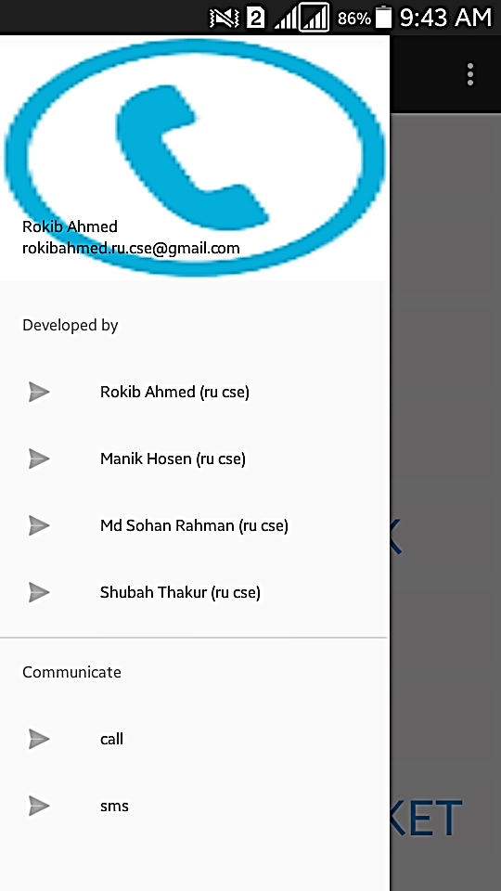
Navigation Bar
Developer’s Name
Contact Us !

Slide 16
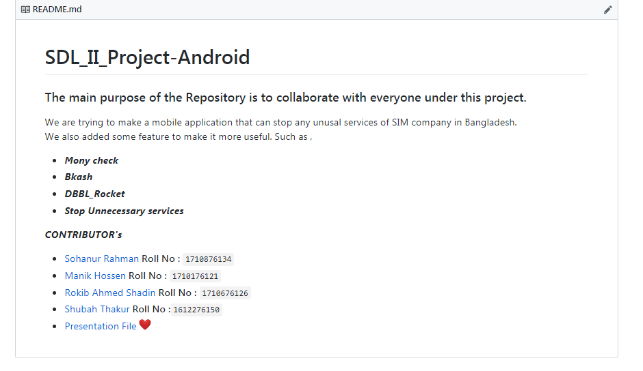
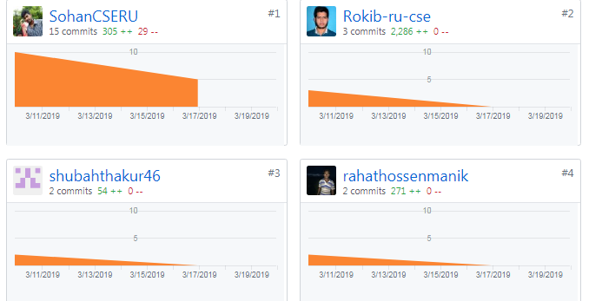
Github Contributions

Slide 17

Question
&
Answer

