Slide 1
Cryptic Splice Site identifier (CSSi)
A Python 3 Program by Sohan Choudhury

Slide 2
Context

Slide 3
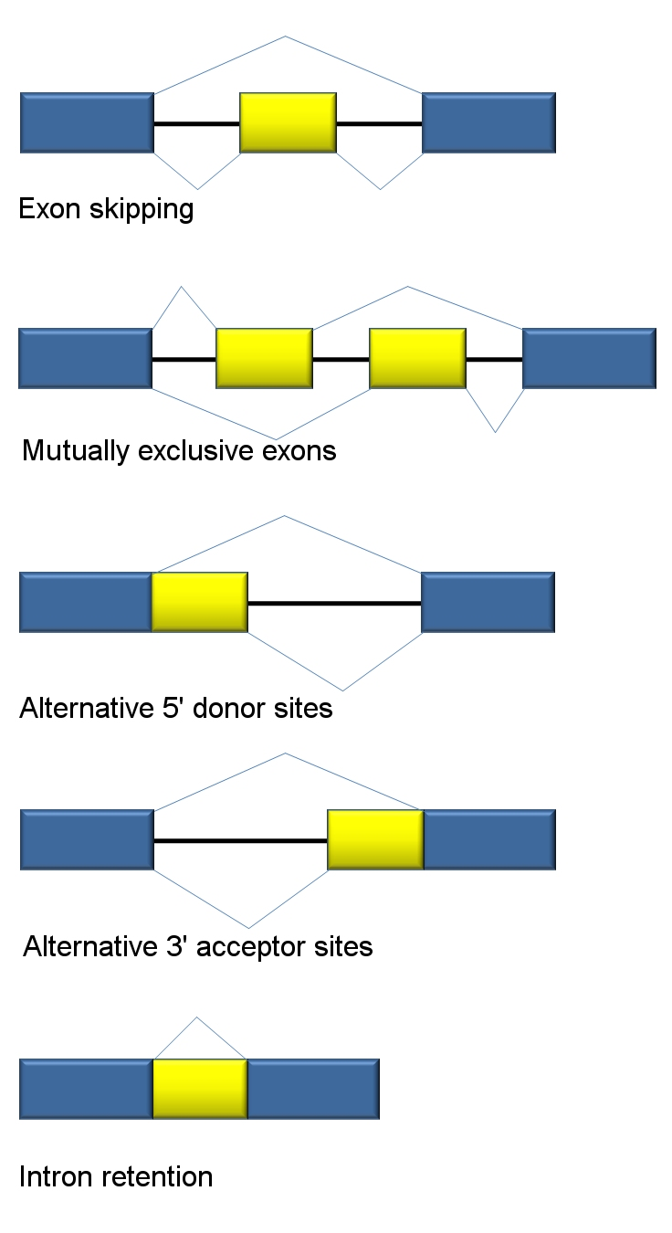
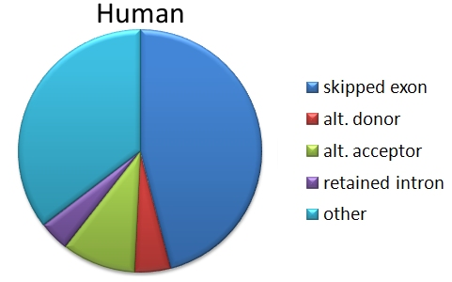
Alternative Splicing

Slide 4
Alternative Splicing

Slide 5
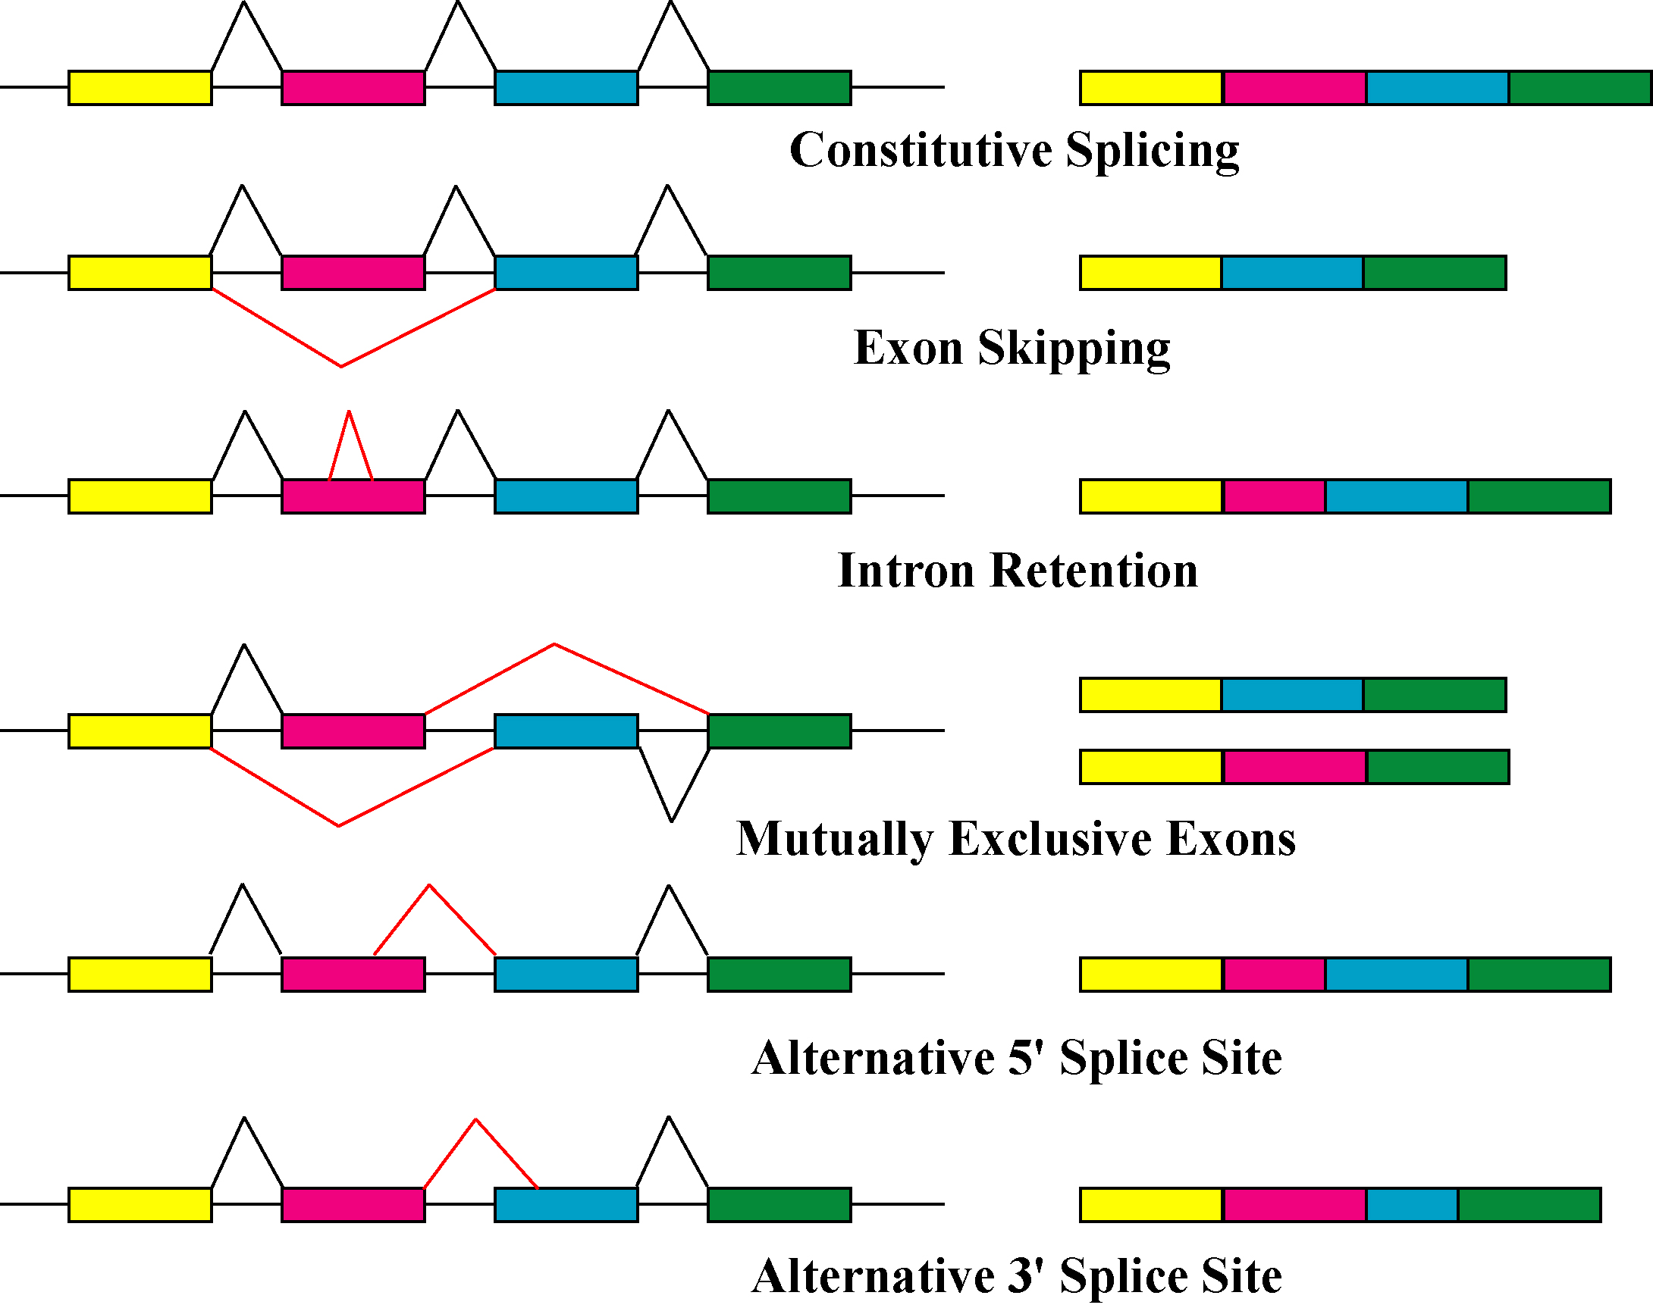
3 Cases

Slide 6
Data

Slide 7
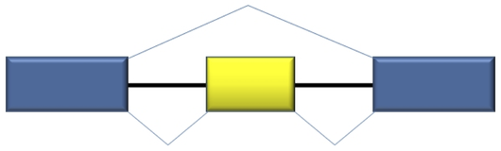
GTF / GFF3 Files
Tab-delimited
Annotation file
Sequence Name | Source of feature | Type of Feature | Start of Feature | End of Feature | Misc. | Direction (+, -) | Misc. | All other descriptions
chr1 | HAVANA | gene | 21300 | 23459 | . | + | . | gene_ID “gn1”; gene_name “X2”
chr2 | Ensembl | exon | 67393 | 70122 | . | - | . | exon_number=1; gene_ID=type08

Slide 8
STAR .tab Output
Tab-delimited
Splice Junction Notation file
Chromosome Name | Junction Start | Junction End | Direction (1 = +; 2 = -) | Misc. | Misc. | Uniquely Mapped Reads | Misc. | Misc.
chr1 | 23002 | 26477 | 1 | . | . | 0 | . | .
chr22 | 948015 | 951739 | 2 | . | . | 17 | . | .

Slide 9
CSSi

Slide 10
Overview
Goal is to identify cryptic splice sites
Cryptic / non canonical splice sites: splice junctions that are not in the annotation file
CSSi analyzes .tab file and compares to GTF / GFF3 file
.tab file is generated and provided by user
GTF / GFF3 files are standard and can be found on GENCODE
Output is both printed & saved

Slide 11
Input
Single .tab file
OR
Text file containing list of locations of multiple .tab files
AND
Annotation file (GTF or GFF3)

Slide 12
Output
Works for all 3 cases
Tab-delimited
Contains only novel splice junctions
Gene | Direction | Cryptic Case | Annotated Case | Difference | Directionality | Uniquely Mapped Reads
Gene name; gene ID | / - | chrN: A - B | chrN: X - Y | # | up/downstream | #
WASH7P; ENSG000123 | - | chr1: 1827 - 1926 | Chr1: 1827 - 2028 | 102 | downstream | 17

