Slide 1


JusLab – AI-Powered PGDIT Assistant
Developed by Md. Zahidul Islam Sohan and Waliullah for PGDIT Summer 2024,
Jahangirnagar University, supervised by Dr. Shamim Al Mamun.

Slide 2
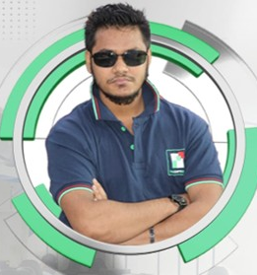
BIOGRAPHY OF MD. ZAHIDUL ISLAM SOHAN
Full Name | Md. Zahidul Islam Sohan
Academic Background | PGDIT (Information Technology), Jahangirnagar University (IIT), Ongoing (2025) MBA (Accounting), Government Titumir College, 2023 BBA (Accounting), Government Titumir College, 2018 Web Programming (PHP/MySQL), Dhaka University (IIT), 2019
Present Position | Software Engineer (PHP Laravel) Experienced in PHP (Laravel), JavaScript, jQuery, MySQL, React.js, Next.js, Django, web scraping, browser extensions, and WordPress plugin development — with hands-on work across various CMS and frameworks Thesoftking Limited.
Experience | Software Engineer (PHP Laravel) Thesoftking Limited (Oct, 2020 - Present) Software Developer (Java - Spring Boot) MerinaSoft (July, 2020 - Sept, 2020) Former Accounting Teacher (Accounting, Finance, Management) Various Coaching Centers, Mirpur, Dhaka (2016 – 2018)

Slide 3
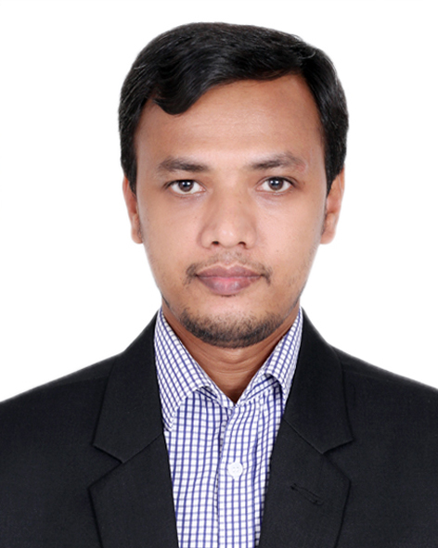
BIOGRAPHY OF Waliullah
Full Name | Waliullah
Academic Background | PGDIT (Information Technology), Jahangirnagar University (IIT), Ongoing (2025) M.A, Humanities (2014-15). Govt. Madrasah-E-Alia, Dhaka, Bangladesh. under Islamic University, Kushtia Diploma in Enterprise Systems Analysis and Design – C#.NET (ESAD-CS) under IsDB-BISEW IT Scholarship (2016), Dhaka, Bangladesh
Present Position | Manager, Software Business Leadership & Strategy: Lead and mentor a high-performing software development team while driving architecture planning and technical decision-making. Full-Stack Development: Design, develop, and maintain modern applications using ASP.NET Core MVC/API, HTML5, CSS3, JavaScript, Bootstrap, jQuery, Angular. Cloud Solutions: Architect and implement Azure IaaS & PaaS solutions, optimizing performance, security, and cost efficiency. Microsoft Ecosystem Integration: Develop and integrate solutions with SharePoint, Power BI, and Power Platform at Corporate Projukti Ltd
Experience | Asst. Manager, Software [July-2024, Feb-2025] Software Engineer [Jan-2021, Dec-2021] Jr. Software Engineer [Jan-2018, Dec-2020] Trainee Software Engineer [Feb-17, Dec-17] at the same company, I have been working since 2017.

Slide 4
JusLab - AI-Powered PGDIT Assistant (Custom chatbot for PGDIT program)
Objective:
To develop an interactive AI chatbot tailored for the PGDIT program, providing instant, accurate responses to program-related queries (curriculum, admissions, schedules, faculty) and guiding users through multi-step processes.
Purpose:
Enhance user engagement by offering quick, streamlined access to PGDIT information.
Reduce administrative workload by automating common queries.
Provide 24/7 instant responses to user questions.

Slide 5
Background & Problem Statement
Background
Digital transformation in education demands instant, automated support.
Traditional methods are slow and inefficient.
JusLab: An AI chatbot for Jahangirnagar University’s PGDIT program, enhancing information access and student support.
Problem Statement
Students struggle to get timely, accurate program info (admissions, curriculum, faculty).
High admin workload due to repetitive queries.
No 24/7 support available.
Solution: JusLab automates responses, reduces delays, and improves student satisfaction.

Slide 6
Scope & Limitations
Scope
Target: PGDIT students at JU.
Info: Admissions, curriculum, faculty, FAQs.
Platform: Web-based chatbot using |API.
Limitations
No real-time database integration.
Limited to English.
Cannot execute complex transactions.
Knowledge restricted to PGDIT domain.

Slide 7
Importance of Study
For Students: 24/7 instant support, better experience.
For Admin: Reduces workload, improves efficiency.
For JU: Modernizes education support, attracts students.
For Program: Helps to improve program quality.

Slide 8
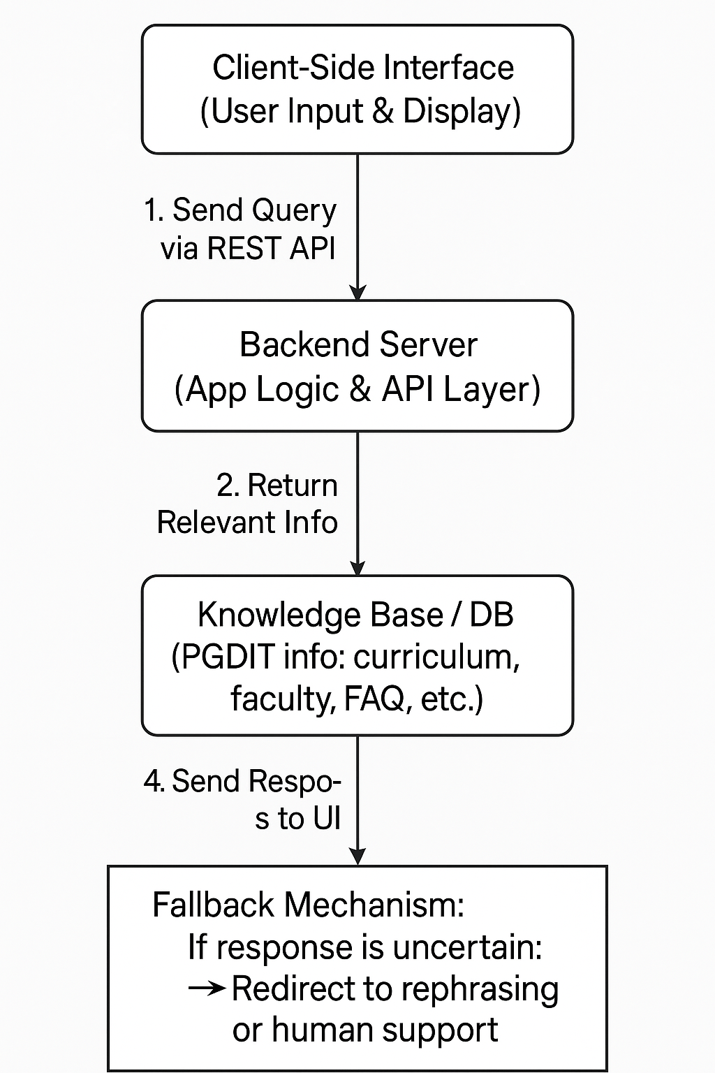
Workflow Diagram

Slide 9
Thank you

