Slide 1
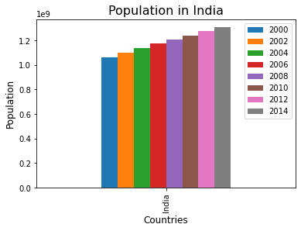
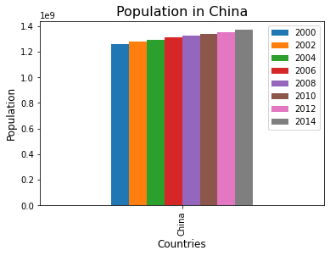
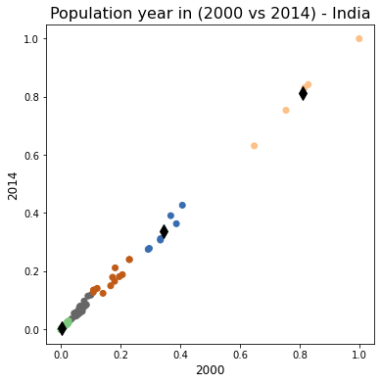
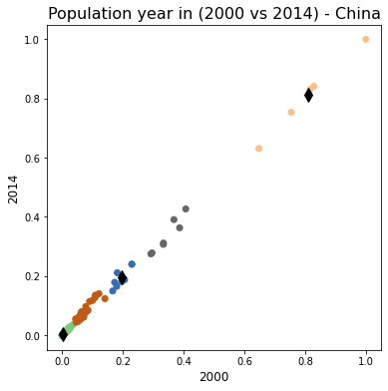
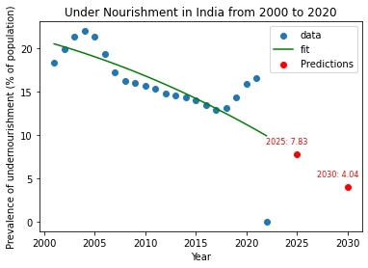
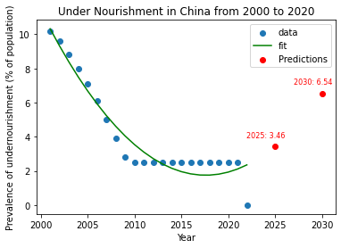
Population Dynamics and Undernourishment Trends
Name: Sohan Kumar Narayanaswamy | ID Number: 22085239
Abstract:
Understanding population dynamics and trends in undernourishment is essential to comprehending the prosperity and growth of a country. Making sense of the socioeconomic environment through the analysis of these variables aids in decision-making for scholars, policymakers, and international organizations. India and China, two large countries with different demographic and economic traits, are the subject of this study.
Introduction:
India and China collectively account for a substantial portion of the world's population. Any changes in their demographic patterns and nutritional challenges have far-reaching implications for global trends. The population dynamics of a country reflect its growth, urbanization, and economic development. Understanding these dynamics is essential for predicting future resource needs and planning sustainable development.
India's population grew steadily between 2000 and 2014, according to population assessments of both China and India. There was a notable increase between 2000 and 2010, followed by a slight decline after that year. China's growth is consistent but follows more regulated patterns; in contrast, the country's growth is rather stable.
Five clusters are produced when the population numbers for China and India from 2000 and 2014 are compared. The clusters show the variations in population increase over a 14-year period in two distinct nations. The change is indicated by the points on the chart. The graph makes it evident that population growth is linear.
The two plots depict the prevalence of undernourishment in populations in China and India whose regular food intake is insufficient to support an active and healthy lifestyle. The forecast, which denotes the value down the year in 2030, is also visible. The second plot, which depicts China in the years after 2020, shows an upward trend while the plot representing India shows a negative trend.
Conclusion:
One important measure of a country's health and well-being is undernourishment. Analysing undernourishment patterns from the plots, makes it easier to pinpoint areas that need specific interventions and shows how successful current policies are. By identifying vulnerable individuals through the study of undernourishment patterns, inclusive policies addressing socioeconomic inequalities can be developed.
The forecast plot of India, which tells us that India is working to improve the health and well-being of people. Whereas China should concentrate more about this. They can work on the areas like Policy guidance, healthcare planning etc.
GitHub Link: https://github.com/Sohankumar6/Clustering-and-fitting/tree/main

