Slide 1
Superhost churn prediction team 12

Slide 2




MEET OUR TEAM
Roshan Raj Singh
Shourya Chouhan
Shubhankar Sharma
Sohan Sahoo

Slide 3
Ideation
Revenue prediction and saturation of Superhosts in a Neighborhood
Churn Prediction
Optimization of the current dynamics
Impact on Non Superhost properties if there is an increase in Number of Superhosts

Slide 4

Problem definition
To predict whether a Superhost in the current evaluation period is going to churn in the next evaluation period, i.e. whether a Superhost is going to lose their Superhost status in the next evaluation period.

Slide 5
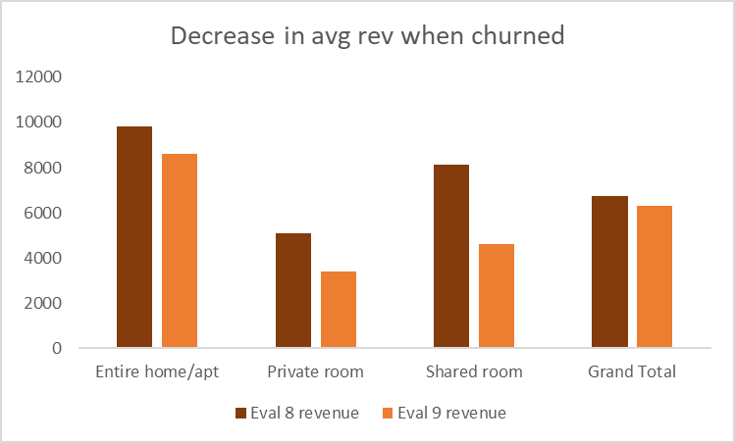
BUSINESS PROBLEM
Superhost churn business impact
Average Loss of Revenue
Average Loss of Reviews
Average Loss of Occupancy
12%
21%
18%

Slide 6
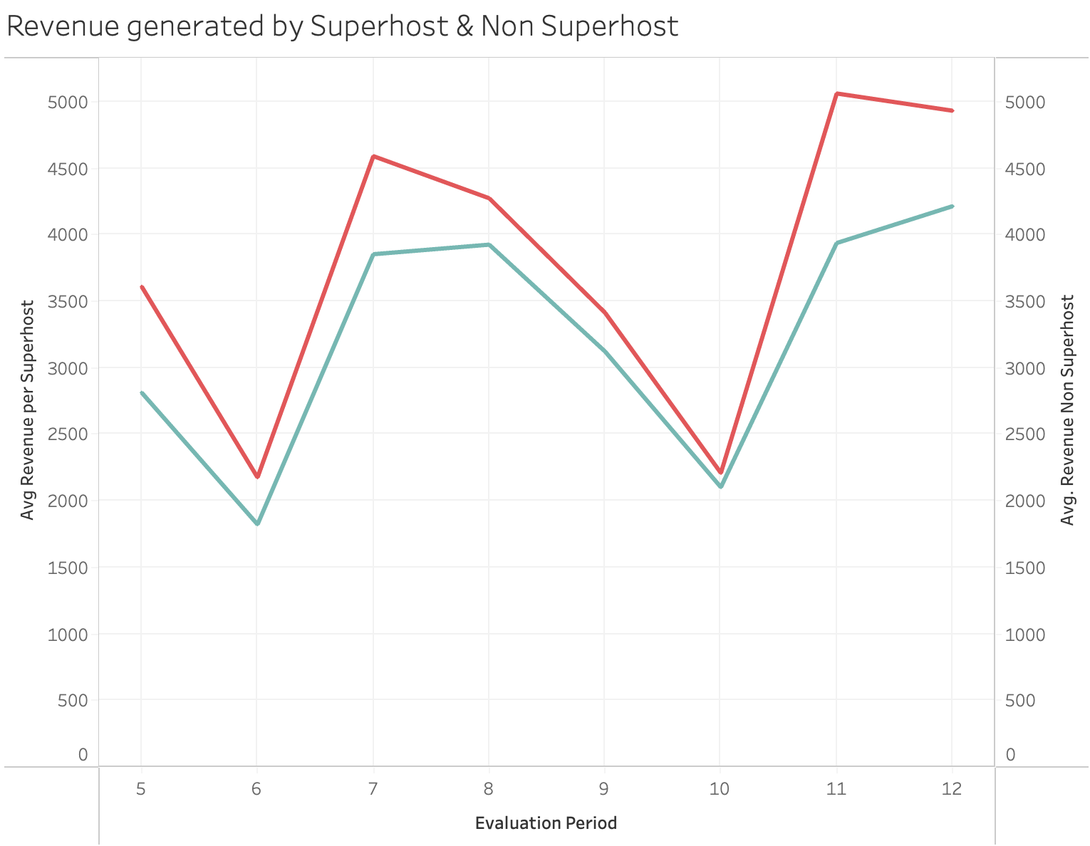

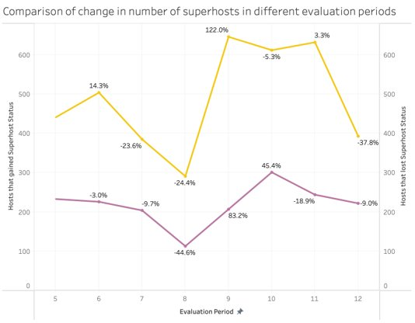

Avg revenue of Superhost properties is higher than Non Superhost properties
Rate of net change in Superhost has decreased

Slide 7
Process flow
Sample
Explore
Modify
Model
Assess
Choosing the right cities as well as evaluation period for enough and valuable datapoints
Understanding the dataset and exploring dependency of target with predictor variables
Cleaning which involved dealing with missing values and outliers, normalising the data, making it ready for the model
Ran different models and tuning parameters to figure the best fit for the dataset
Assess what factors are causing the superhosts to lose their superhost status

Slide 8
Challenges faced
Over 30% of the dataset contained missing values
During the data preprocessing phase, diverse columns required aggregation using distinct aggregation methods.
Encountering a substantial imbalance in our dataset, with Class 0 comprising 7185 instances and Class 1 only 1423 instances
To rectify this imbalance, we implemented the Synthetic Minority Over-sampling Technique (SMOTE)

Slide 9
Data Preparation process
Established the criteria for selecting Superhost IDs, mapping each ID to its churn status in the upcoming evaluation period
Determined the optimal evaluation period required for training the model to accurately predict Superhost churn in the subsequent assessment period
Procedure was executed across eight diverse cities, ensuring an ample and varied dataset for robust model training

Slide 10

Data preprocessing

Slide 11
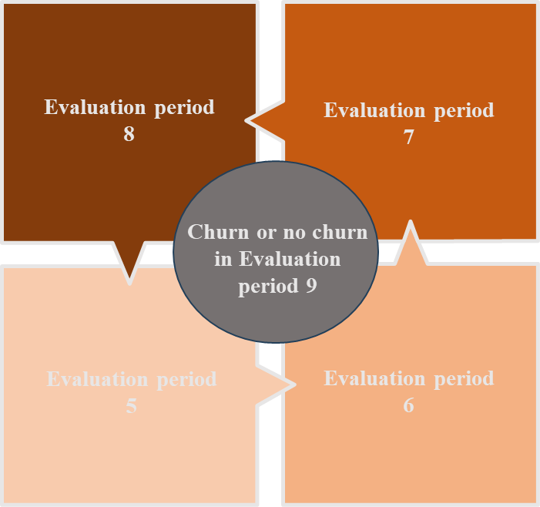
Data Aggregation
Sum
Prev_revenue
Prev_numreviews
Average
Prev_ratings
Prev_occupancy

Slide 12
Model Building Process
Data Preprocessing
Variable Selection
Dataset Partitioning
Class Imbalance Handling
Model Exploration
Hyperparameter Tuning
Threshold Optimization

Slide 13
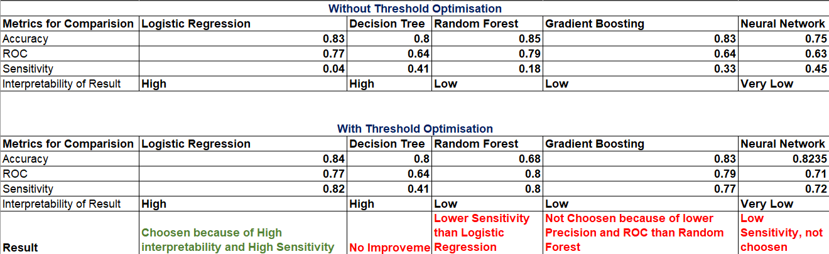
Model Comparision and selection
Logistic Regression
Decision Tree
Random Forest
Gradient Boosting
Neural Network

Slide 14
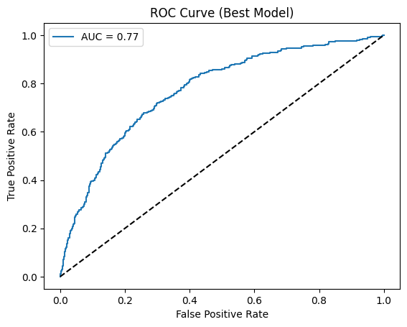
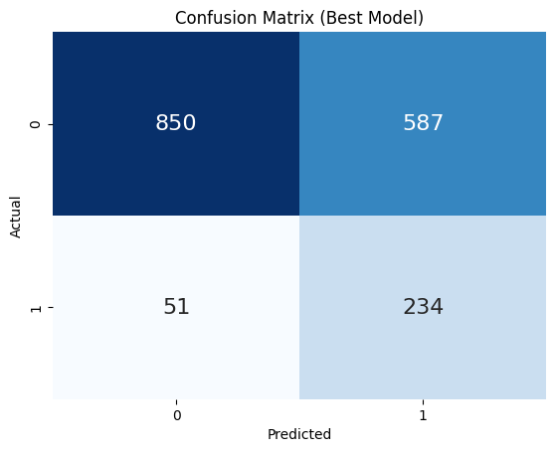
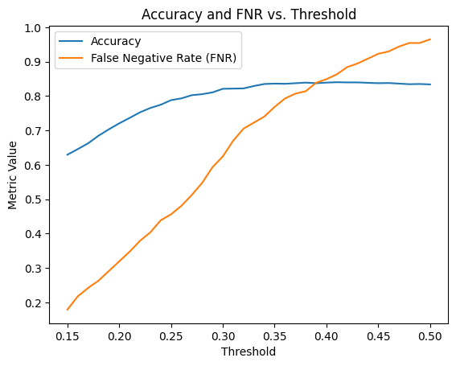
Best Model - Logistic regression
Cost vs Accuracy
234 out of 285 actual churned hosts were correctly identified
Took a hit on accuracy to decrease the false negative rate
Allows to correctly capture those hosts with a high propensity to churn than random forest
High Sensitivity, easy Interpretability

Slide 15
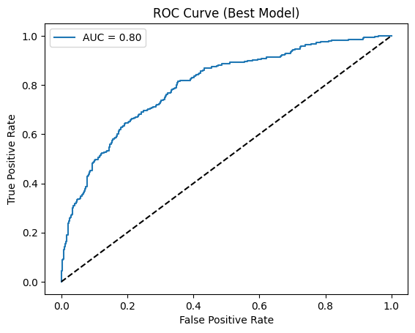
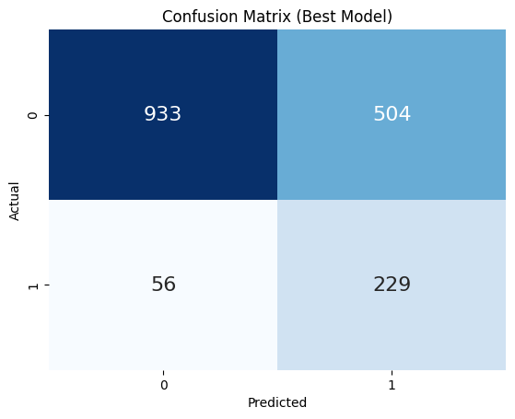
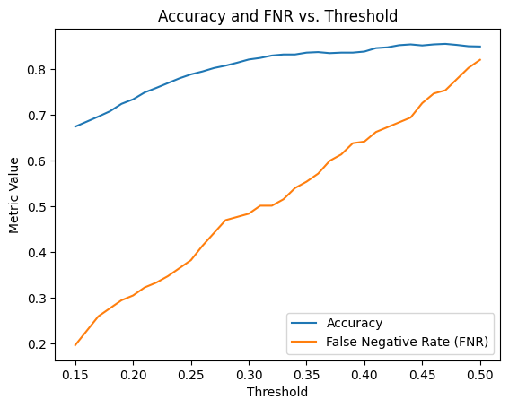
Random forest Results
Cost vs Accuracy
229 out of 285 actual churned hosts were correctly identified
Took a hit on accuracy to decrease the false negative rate
Allows to correctly capture those hosts with a high propensity to churn

Slide 16
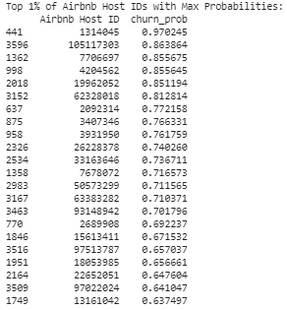
Predicted probability of Churn
Prediction
Evaluation period 10 taken into consideration
Aggregation of data for evaluation period 6, 7, 8 and 9 as suggested previously in data modeling stage
Predicted churn for different Host IDs with probabilities
Suggested actions that can be taken by Airbnb
Analyze internal and external factors contributing to churn specific to these host property's location and property type
Airbnb can proactively push the superhosts to meet the requirements
Better planning to nullify the churn by converting non-superhosts to superhosts

Slide 17
Conclusion
Provide operational auditing services to Airbnb superhosts to help them retain their superhost status
Understand which superhosts are going to lose their superhost status in the next evaluation period
Identify the factors that lead to the change in superhost status and how each factor affects the churn rate
Help superhosts by advising them on the said factors to improve on the service and retain their superhost status for the next evaluation period.

Slide 18
Extra Slides for Reference

Slide 19
Tools Used
Excel
SAS Enterprise Miner
Tableau
Jupyter And Colab

Slide 20



Data and its summary
Superhost
Non Superhost
Average Revenue
$4252.83
$3977.14
Proportion of Hosts
7185
1424
Average Number of Reviews
39.66
26.06

Slide 21
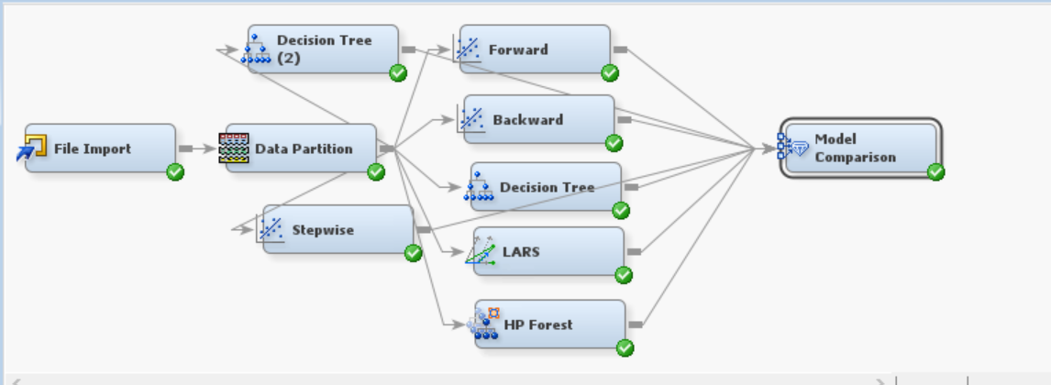
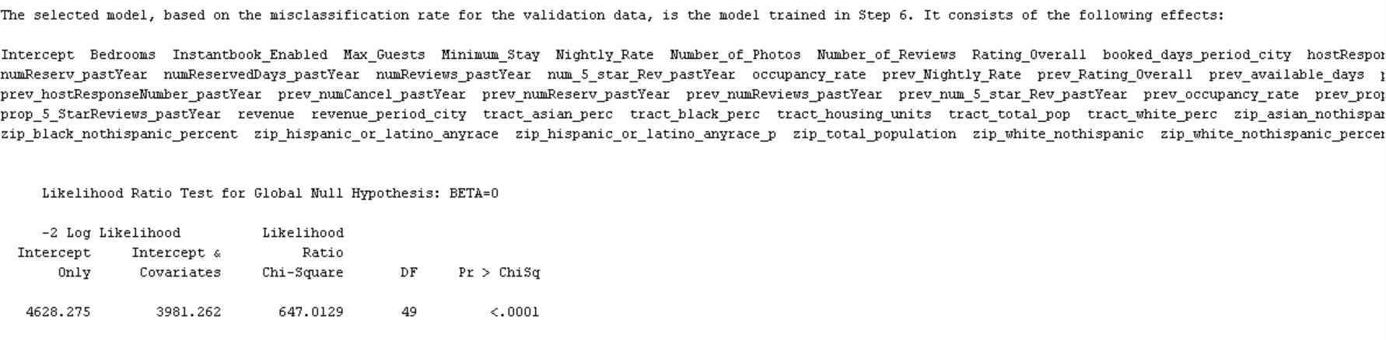
Backward Regression

Slide 22
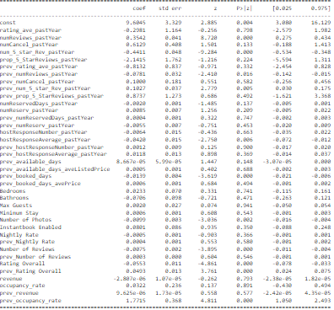
Logistic regression Results
Key variables like 'rating_avg_pastyear', 'numcancel_pastyear', 'prop_5_starreviews', 'prev_bookeddays', 'no_of_photos' were identified based on p value

Slide 23
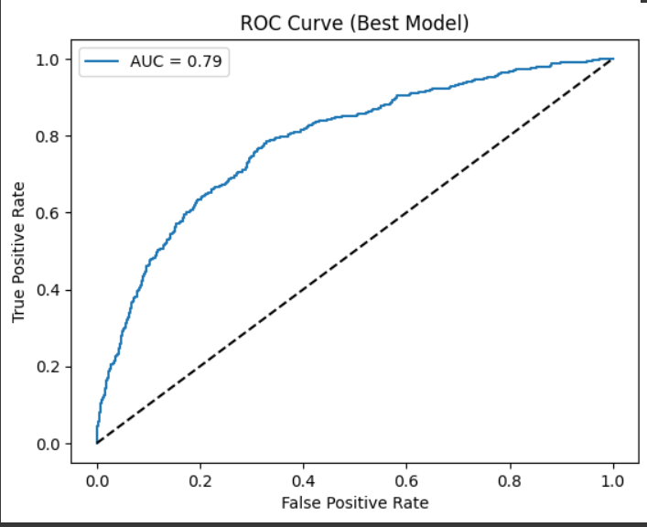
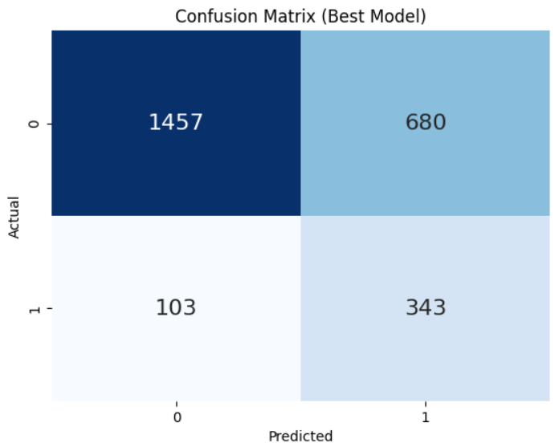
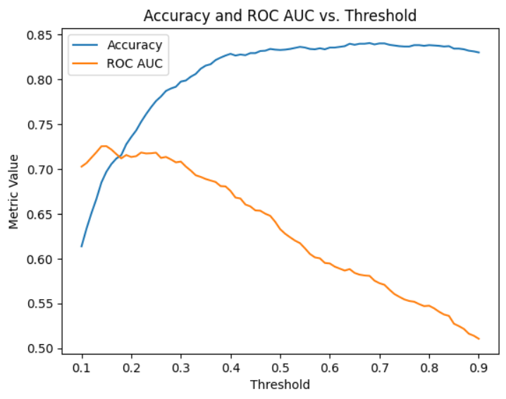
Gradient Boosting Results
Cost vs Accuracy
Train Test Split of 70:30
343 out of 441 actual churned hosts were correctly identified
Took a hit on precision to decrease the overall accuracy of predicting churned superhosts
Allows to correctly capture those hosts with a high propensity to churn

Slide 24
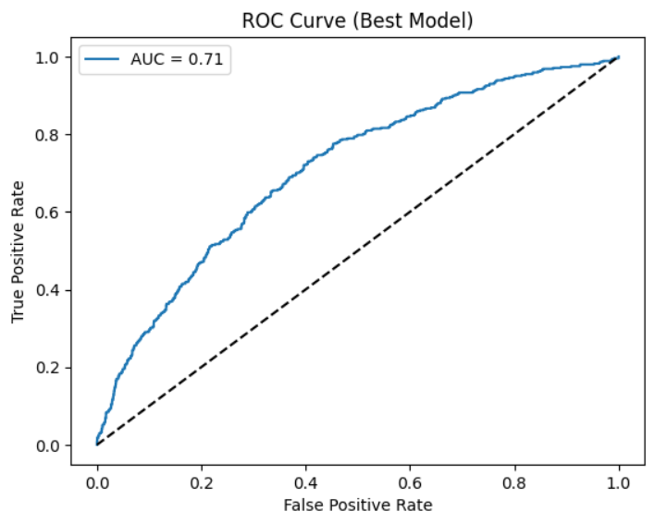
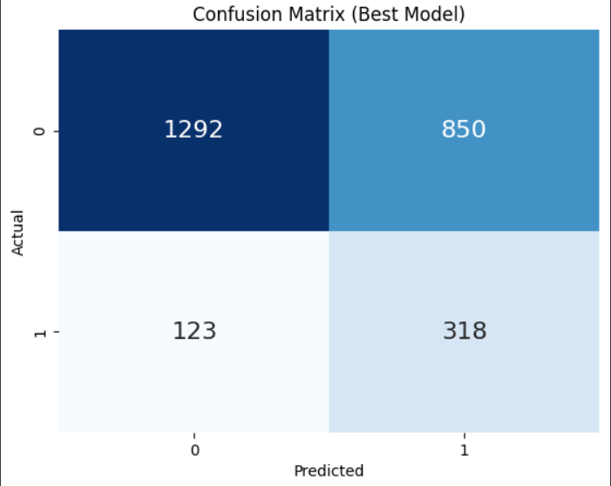
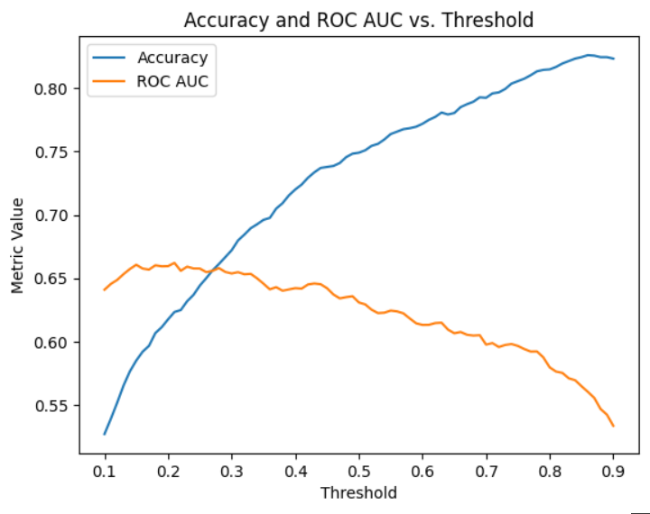
Neural Network Results
Cost vs Accuracy
Train Test Split of 70:30
318 out of 441 actual churned hosts were correctly identified
Took a hit on precision to decrease the overall accuracy of predicting churned superhosts
Allows to correctly capture those hosts with a high propensity to churn

Slide 25
THANK YOU

