Slide 1

Submitted by : Group no : 5 Rittik Halder_ 213902069 MD.Sohanur Rahman_ 213902106 Sabbir Ahammed_ 21302125 Department of Computer science and Engineering
Green University of Bangladesh
Submitted to :
Prasenjit Bhowmik
Lecture in Chemistry
Department of Textile
Section DD
Chemistry lab (CHE 102)

Slide 2
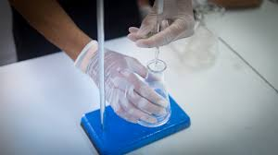
Experiment Name :
Standardization of Hydrochloric Acid(HCl) with Standard Sodium Carbonate(Na2CO3) Solution.

Slide 3
Objectives :
Theory of the experiment
Apparatus
Procedure
Calculation
Discussion
Conclusion

Slide 4
Theory
Hydrochloric acid solution may be titrated against sodium carbonate solution using methyl orange indicator. When weak base is titrated with a strong acid, solution will be slightly acidic at end point. If a weak acid is titrated with a strong base the solution is slightly basic because the salt formed will be hydrolysed to a certain extent.
The chemical reactions involved in this titration are given below.
Na₂CO₃(aq) + 2HCl(aq) → 2NaCl(aq) + CO₂(g) + H₂O(l)
CO₃²⁻(aq) + 2H⁺(aq) → CO₂(g) + H₂O(l)
In acid base titrations at the end point the amount of the acid becomes chemically equivalent to the amount of base present. In case of a strong acid and a strong base titration at the end point of solution the solution becomes neutral.

Slide 5
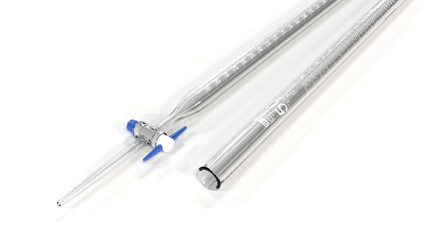
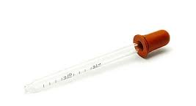
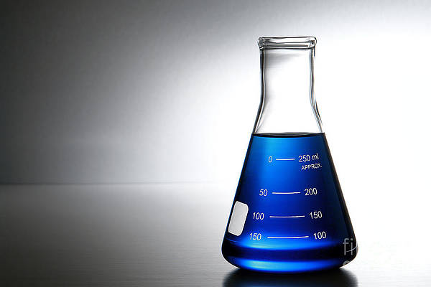
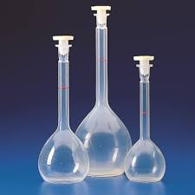

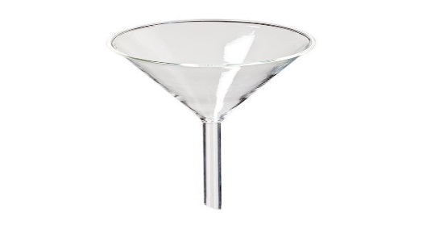
Apparatus
Burette
Pipette
Conical flask
Volumetric Flask
Burette Stand
Funnel

Slide 6
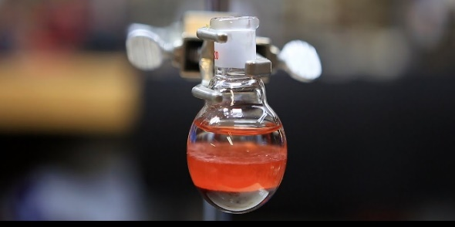
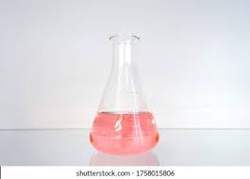
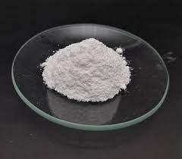
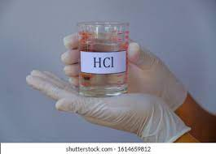

Indicator and Chemical
.
Phenolphthalein
Methyl Orange
Na₂CO₃
HCl
Distilled water

Slide 7
Procedure
Prepare Na₂CO₃ solution in 100 ml volumetric flask and take 10 ml of standard Na₂CO₃ solution in a conical flask and dilute it to about 50 ml and take one drop phenolphthalein in it.
Take HCl in a burette. Now, conical flask’s solution titrate with HCl.
When changes the color of conical flask’s solution, then stop titration and this is the first end point. Note down it.
Now, add 10 drops Methyl Orange inside the conical flask and continue titration against the same HCl acid.
The end point reached when the yellow color of the solution just change to faint pink, note down the burette reading and it is second end point.

Slide 8
Procedure
Now, difference between initial and second end point of the burette reading will be the volume of the acid required in the titration.
Repeat the whole experiment twice and these should agree within ± 0.1 ml initial to second end point.
Calculate the strength of dil.

Slide 9
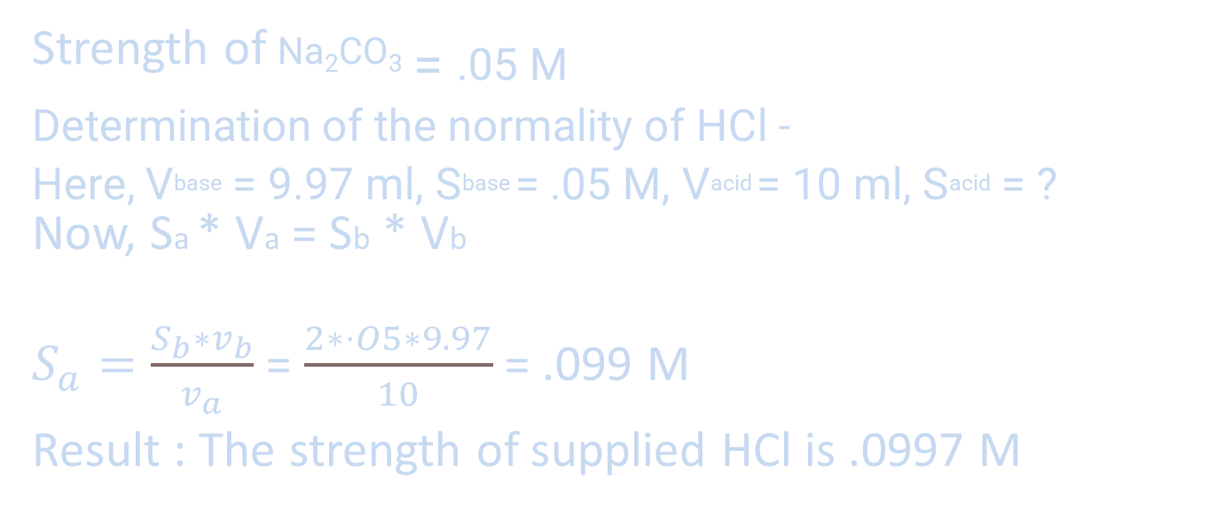
Calculation
Strength of Na₂CO_{3 = .05 M}
Determination of the normality of HCl -
Here, Vbase = 9.97 ml, Sbase = .05 M, Vacid = 10 ml, Sacid = ?
Now, Sa * Va = Sb * Vb
$S_{a}=\frac{S_{b}∗v_{b}}{v_{a}}$ = $\frac{2∗⋅O5∗9.97}{10}$ = .099 M
Result : The strength of supplied HCl is .0997 M

Slide 10
Discussion
The following causes can be assumed for the possible cause of error:
While weighing do not spill the substance on balance pan.
While the solution of Na₂CO₃ was prepared, a little amount of extra water might have added into the volumetric flask.
Wash wash the burette with water after titration is over.

Slide 11
Conclusion
The major uses of sodium chloride is as a raw martial for the production of chlorine, sodium metal and sodium hydroxide. Beside, chinese had already been using the method of staling to preserve food in the old days when refrigerator is not yet invented. The highly concentrated sodium chloride solution draw out all the water of microbes adhered become dehydrated and die in the end.

Slide 12
Do you have any
question ?

Slide 13
Thank You.

