Slide 1

Green University of Bangladesh
Department of CSE
Batch : 213
Submitted by :
Name : Md .Sohanur Rahman
Id : 213902106
Department : CSE
Submitted To:
Name : Dr. Faiz Al Faisal
Designation : Associated professor
Department of CSE

Slide 2

Topic :
Searching Algorithms
Linear Search
Binary search

Slide 3
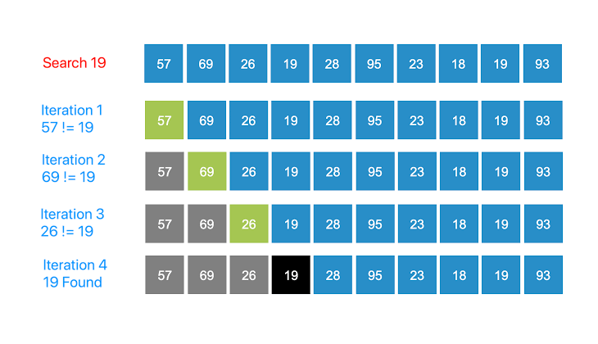
Linear Search
Definition : a linear search or
sequential search is a method
for finding an element within a list.

Slide 4
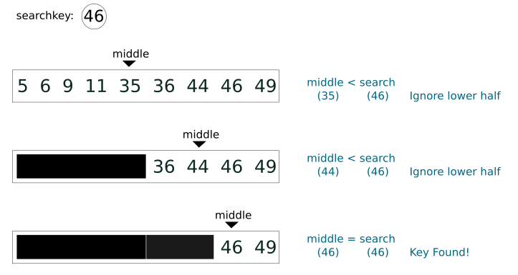
Binary Search
Definition: A binary search is a quick
and efficient method of finding
a specific target value from a set of
ordered items.

Slide 5
Thank You

