Slide 1
PROJECT PRESENTATION ON DIGITAL DICE
Presented To: Abdullah Al Farhad Lecturer, Department Of CSE Green University Of Bangladesh
Presented By:
Shariful Islam Emon (213902056)
Naimul Haque Bhuiyan Rahat (213902100)
Md Sohanur Rahman (213902106)

Slide 2
Contents
Introduction
Objectives
Digital Dice
Components
Circuit Diagram
Diagram Of 4017 & 555 Timer
Model Output
Applications
Conclusion

Slide 3
Introduction
The digital dice project aims to revolutionize the way we experience randomness in gaming, educational settings, and recreational activities. By harnessing the power of digital technology, this project introduces a convenient and reliable alternative to traditional physical dice. Through this introduction, we explore the possibilities and applications of digital dice, offering an enhanced user experience and a wide range of functionalities. By introducing digital dice, we aim to enhance the gaming experience, facilitate learning, and promote fair play in diverse scenarios.

Slide 4
Objectives
Electronic Simulation of Dice: The primary objective of a digital dice project is to create a digital or electronic version of a traditional dice used in games.
Randomness and Fairness: It should provide an equal probability for each possible outcome to maintain fairness in games or applications where chance or randomness is desired.
User Interaction: The project may focus on creating a user-friendly interface that allows users to interact with the digital dice
Portability and Accessibility: This could involve developing a mobile app, a web-based application, or a standalone device that can be used in various gaming scenarios.

Slide 5
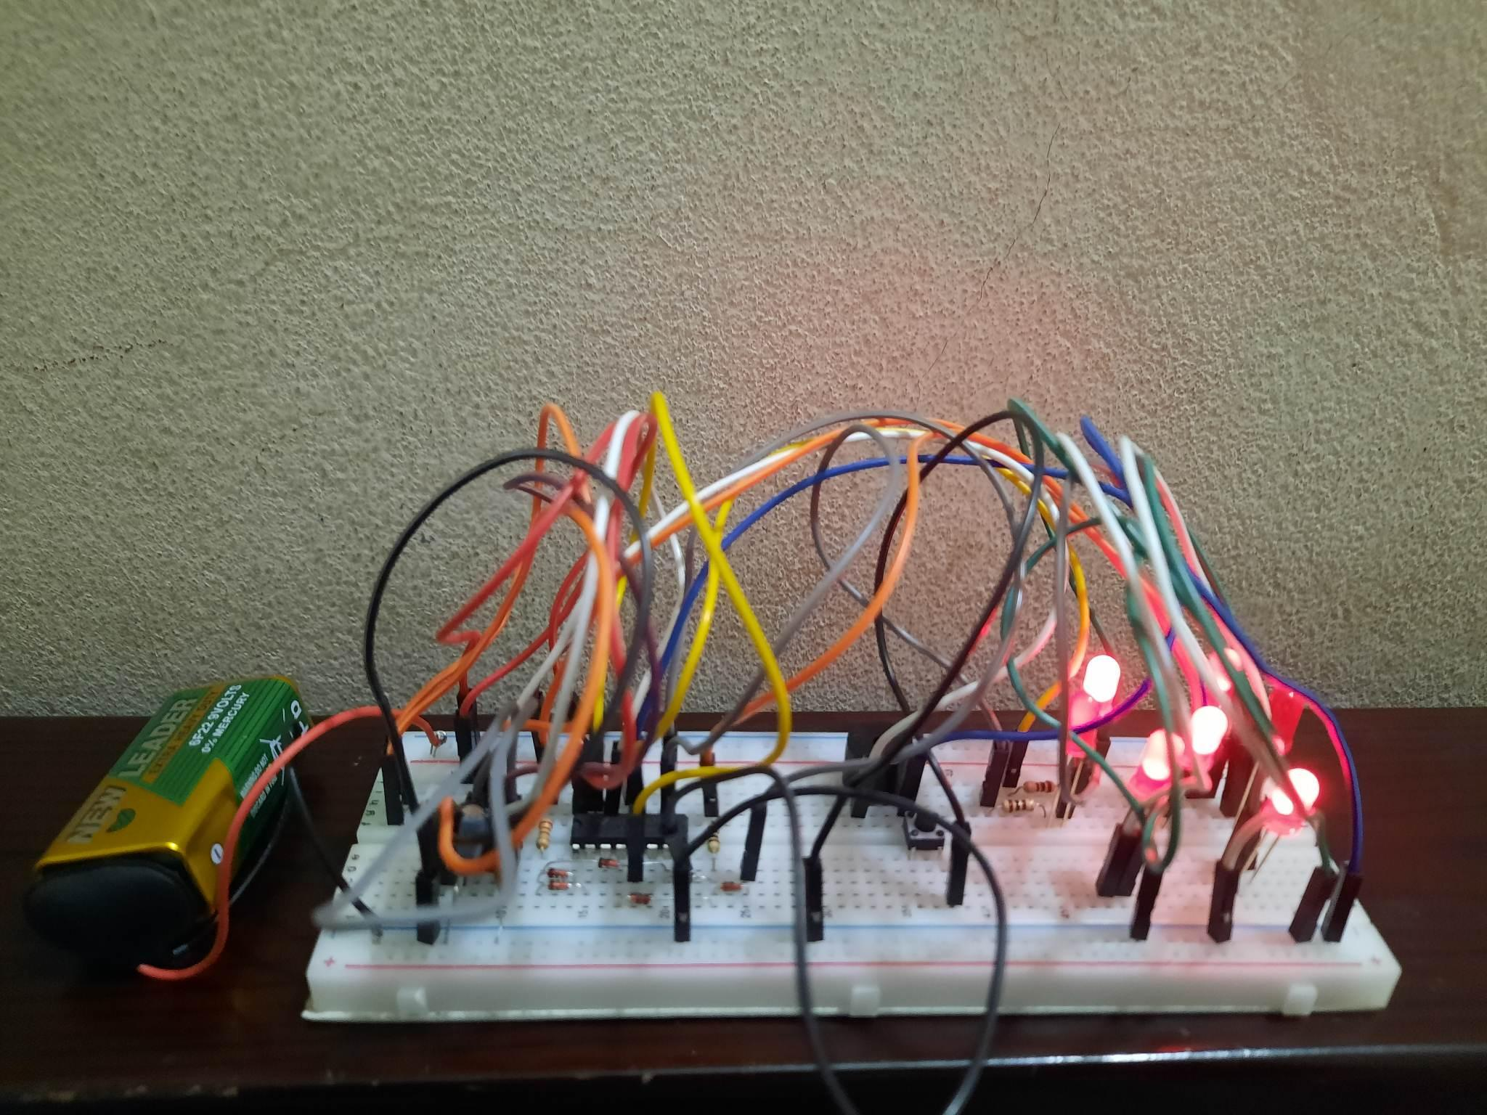
Digital Dice
A digital dice is an electronic device or application that simulates the rolling of a traditional physical dice. It uses digital technology, such as microcontrollers or integrated circuits, to generate random numbers and display them on a digital screen or LED indicators.
The working principle of a digital dice involves generating random numbers through electronic components or algorithms. This randomness is typically achieved by utilizing hardware elements like random number generators or by employing software algorithms that simulate randomness.

Slide 6
Components
1X CD4017 IC 1X 220 OHM RESISTOR
2X 10K RESISTOR 6X 1N4148 DIODES
1X BUZZER 1X 1uF CAPACITORS
3X 100 OHM RESISTOR 1X BREADBOARD
JUMPER WIRES 1X 555 TIMER IC
7X LEDS 1X PUSH BUTTON
1X 47K RESISTOR 1X 0.1uF CAPACITORS

Slide 7
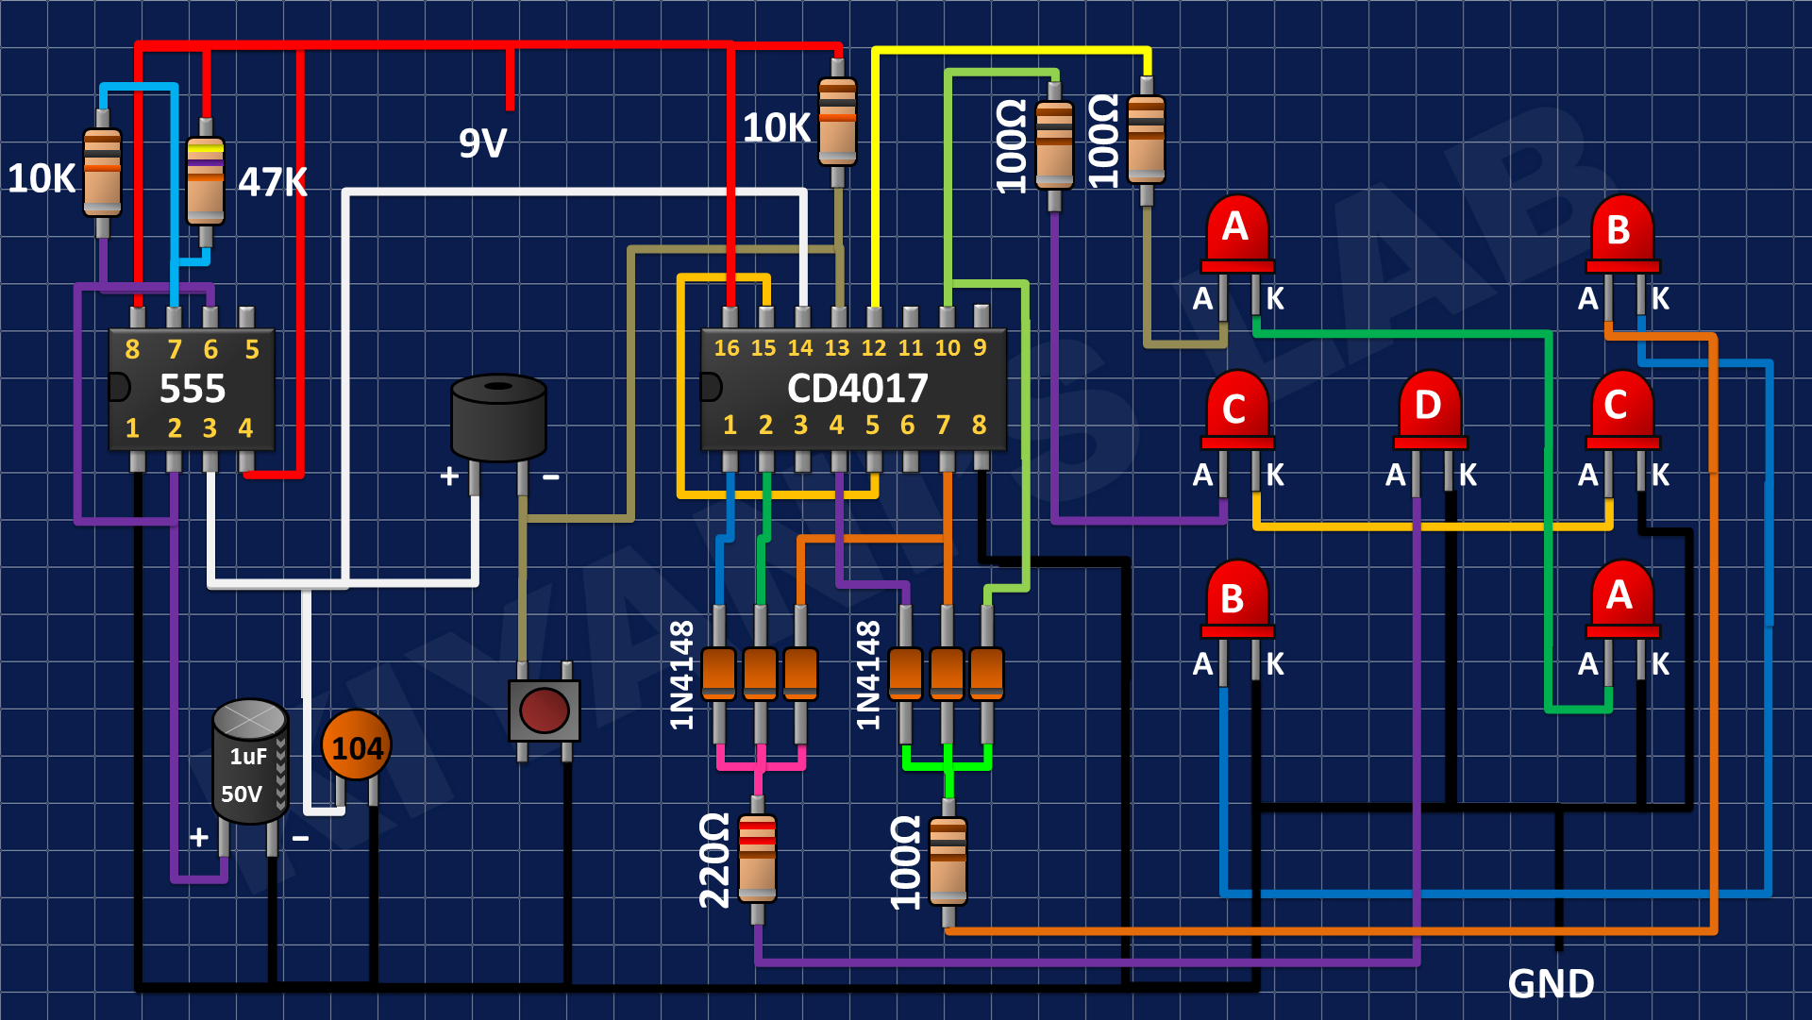
Circuit Diagram
Digital Dice Circuit Diagram

Slide 8
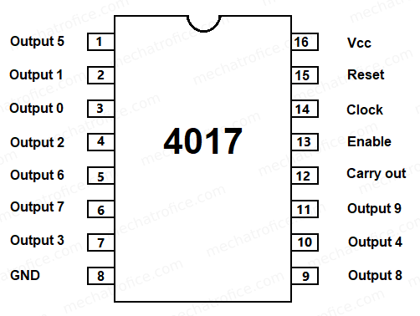
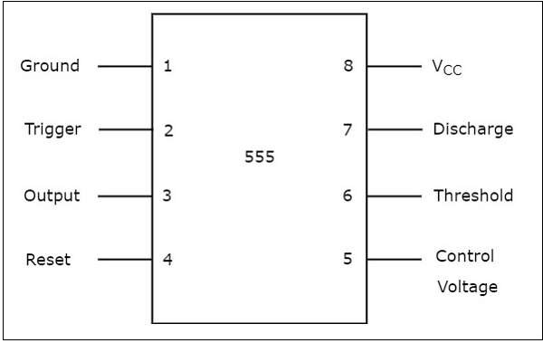
Block Diagram
CD 4017 IC
NE 555 IC

Slide 9
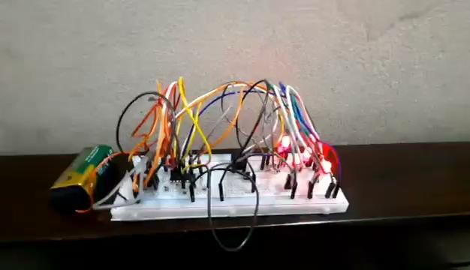
Model Output
Video Output

Slide 10
Applications
Here are some common applications:
Board Games like LUDO or SNAKE
Role-playing Games (RPGs)
Casino Games
Mobile Apps and Games
Educational Tools
Decision-Making Tools
Entertainment and Recreational Activities

Slide 11
Conclusion
In conclusion, we can say that the digital dice project utilizing the 4017 IC and 555 timer IC showcases the practical application of these components in the field of architecture. By combining the functionality of the 4017 decade counter and the 555 timer as a clock generator, we have successfully created a digital dice that simulates random outcomes.
Thank You

